Slide 1
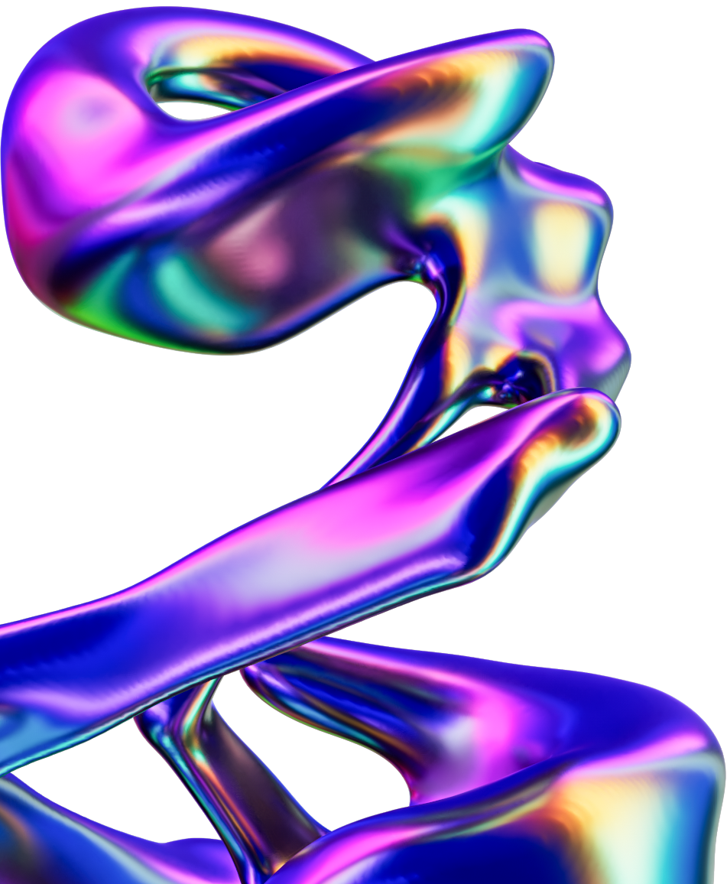




THINKFISH LLC 2026
ThinkFISH
<><
SuperMatics
Investor Outreach Proposal · October 2026
Prepared for Davis Rens & Charlie Moon

Slide 2

THINKFISH LLC 2026
Executive Summary
THE ASK, THE PLAN, THE INVESTMENT, WHAT TO EXPECT
THE ASK
THE PLAN
THE INVESTMENT
A $10M seed at a $60M post-money cap, closed by the end of Q1 2027. It builds on a $1M pre-seed led by a Korean semiconductor and superconductor manufacturer. The goal is a lead or larger allocation to anchor the round, with family offices, micro VCs and angels who understand frontier materials, quantum, fusion and AI infrastructure filling the rest.
Two LinkedIn profiles (Davis’s and Charlie’s), run end to end by ThinkFISH in your voice. We target deep-tech micro VCs, family offices and angels with a history in materials, quantum, fusion, semiconductors and data-center infrastructure. Every meeting is pre-qualified, approved by you and booked onto Davis’s calendar.
$3,000 per month, as a flat retainer. Three-month initial term, with both profiles included. No setup fee, no success fee, no commission and no involvement in the transaction. We are not a broker-dealer.
WHAT TO EXPECT
Outreach goes live within two weeks of kickoff. The first qualified investor conversations land in weeks three and four (mid-November), building to a steady 2–4 qualified meetings per week across both profiles from December. You get weekly reporting and a month-three review in January. One honest note: early-stage raises historically take 6–12 months from first outreach to capital in the bank, so a Q1 close is tight. We can have the right investors on Davis’s calendar before year-end. When checks close depends on your process and each investor’s diligence, and we’d rather you hear that from us now.

Slide 3
THINKFISH LLC 2026
Why ThinkFISH
THE TRACK RECORD, BEFORE THE PROCESS
$200M+
client-reported capital raised
10,000+
qualified investor meetings booked
500+
clients served since 2020
ISSUANCE · DARREN MARBLE, CEO
CARTHAGE CAPITAL · STEPHEN WU
“…one of the most effective investor marketing firms I’ve ever worked with when it comes to raising capital for my companies. In the last 60 days alone, FISH has arranged 25 qualified investor meetings for me.”
“ThinkFISH helped me raise $2 to $3 million across around 20 different investors over the past nine months. I basically got two to three meetings every week, consistently, and they’re already interested. I was going to cancel after a quarter if you didn’t deliver. You delivered way above my expectations.”
25 QUALIFIED INVESTOR MEETINGS IN 60 DAYS
$2–3M RAISED ACROSS ~20 INVESTORS IN 9 MONTHS
WHAT WE CONTROL, AND WHAT WE DON’T
We’re not in the room for investor meetings, so we only report what clients report back, and results vary by company, team and deal. What we control is the top of the funnel: right-sized, pre-qualified investors on your calendar every week. Full testimonials and video links are in the appendix.

Slide 4
THINKFISH LLC 2026
What’s Standing Between You and the Close
THE GAP WE’RE SOLVING
You’ve done the hard part in eight months: a focused thesis on superconducting materials, models no generalist materials platform has built, paying work with fusion and quantum hardware teams, and a signed NVIDIA contract on data-center thermal load. The gap is structural. Your pre-seed came about 90% from one strategic partner, so SuperMatics has never needed a repeatable investor pipeline. A $10M seed needs dozens of right-sized conversations, and today they depend on cold outreach from your only technical founder.
SURFACE PROBLEM
Interest from smaller VCs, family offices and HNW individuals at low-to-mid six figures, and early diligence with a couple of larger firms, but no confidence yet in a Q1 close.
BUSINESS IMPACT
Without a lead or larger allocation, the round can’t fill around $60M-post terms, and the move from internal models to an externally deployed product waits on capital.
PERSONAL IMPACT
Davis is doing the building and the investor outreach. In his words: time spent on cold outreach that “majority of the time” leads to nothing, “not the best use of time.”
Fundraising is a volume game at the right tier. The variable you control is how many qualified, right-sized investor conversations enter the top of your funnel every single week.
COST OF INACTION
Every month spent sourcing pushes the close past Q1 and leaves the round depending on what Davis called “a bit of a stroke of luck.”

Slide 5
THINKFISH LLC 2026
Your Investor ICP
TARGET SEGMENTS, IN PRIORITY ORDER
SEGMENT | WHO THEY ARE AND WHY THEY FIT
1. Deep-Tech & Frontier-Science Micro VCs | Funds with a history in advanced materials, quantum and fusion. They read novel model architectures and an NVIDIA contract as signal, and can anchor an allocation.
2. Energy, Chip & Industrial Family Offices | Family offices built on energy, chips or manufacturing. They understand superconductor supply chains and the royalty model behind manufacturing routes.
3. AI Infrastructure & Data-Center Angels | Operators and investors in compute, cooling and data-center buildouts, for whom thermal load is a known, expensive problem.
4. Quantum & Fusion Operator-Angels | Exited founders, physicists and executives from quantum hardware and fusion who know the materials bottleneck firsthand and back technical founders.
These segments are our starting point. We’ll plan a fuller outline of investor targets with you during onboarding, including check sizes, geographies (US and Korea), and exclusions such as firms already in diligence.

Slide 6
THINKFISH LLC 2026
Two Profiles, One Calendar
HOW BOTH FOUNDERS’ PROFILES FEED DAVIS’S MEETINGS
DAVIS · TECHNICAL FOUNDER
CHARLIE · CO-FOUNDER
THE REEF · RETARGETING
Davis’s profile leads with the science: a quantum-hardware background, purpose-built models for superconducting materials, and the NVIDIA, fusion and quantum work. That message lands with deep-tech funds and technical angels, and Davis takes every first meeting.
Charlie’s profile doubles the outreach volume. It has its own audience and scripts, so no investor gets messaged twice. Your account manager handles every reply and books it to Davis’s calendar, so the time difference with Korea never slows a meeting down.
Beyond outreach from your profiles, we retarget the raise to our internal database of 10k+ investors who opted in for deal flow, filtered to deep tech, energy and AI infrastructure. It’s also featured in Startup Deal Desk, our 84k-subscriber investor newsletter.
RIGHT-SIZED FOR A $60M POST
Every booking routes through a short pre-qualification form covering accreditation, check size, timeline and sectors, so you see before the call whether an investor fits a $60M-post round. Family offices, micro VCs and angels fill a seed around its lead. Any lead-capable fund or family office we find goes straight to Davis. The profile split above is our starting assumption, and we’ll confirm it with you in onboarding.

Slide 7
THINKFISH LLC 2026
How We Fill Your Calendar
SIX STEPS, ONE PAGE
1 · MULTI-SOURCE DATA
2 · SIGNAL FILTERING
3 · ICP SCORING
Sales Navigator, your own lists and past conversations, our 10k+ investor database, the 84k-subscriber Startup Deal Desk newsletter, and the events your targets attend.
Deal history and live engagement outweigh job titles. Brokers, funding agents, advisor-only contacts and “investors” who are selling services are filtered out.
Every contact scored high, medium or low fit against a scorecard built with you. High fit goes first. Scripts A/B tested against real replies.
4 · MANUAL REVIEW
5 · PRE-CALL QUALIFICATION
6 · YOUR FINAL APPROVAL
A dedicated account manager hand-checks every high-fit profile before a message goes out, and learns your story well enough to tell it in your voice.
Every booking routes through a short form: accreditation, check size, timeline, sectors. A briefing before every call; soft letdowns for the wrong fit.
Accept, vet further or decline every meeting. Shared CRM from day one, weekly reporting, monthly strategy calls. If something isn’t working, you hear it from us first.
THE FLOW
Multi-source data → signal filters → ICP scoring → manual review → pre-call qualification → your approval. Outreach only happens after the first four steps; a meeting only lands after all six. The briefing you receive before every call is on the next page.

Slide 8
THINKFISH LLC 2026
The Call Briefing
WHAT LANDS IN YOUR INBOX BEFORE EVERY MEETING · A REAL ONE, NAMES WITHHELD
CONFIRMED MEETING: New Scheduled Call – [Prospect]
From: your ThinkFISH account manager · To: you · Cc: Myra Grama, Freizle Abarrientos · Thu, Sep 17, 2026, 6:26 PM
Here is the booking summary for your upcoming call with [Prospect] on Tuesday, September 22, at 5:30pm ET. This meeting came through outbound LinkedIn outreach, and is categorized under Segment A (Hospitality-Connected Investors), with secondary alignment to Segment C (Operator-Turned-Investor / High-Income Professional). He initially pushed back hard on the original pitch, questioning whether luggage storage footprint would move a hotel’s P&L, then re-engaged and booked once the conversation was reframed around the raise and his advisory perspective rather than a property-pilot pitch.
SEGMENT FIT, STATED
Which of your ICP segments they matched and how the conversation got to a booking, so nothing is a surprise on the call.
Summary of why he’s a good fit:
15+ years of senior hospitality brand leadership: Global Brand Director for Westin Hotels & Resorts and Global Brand lead across Marriott’s premium and lifestyle portfolio, Director of Brand F&B Development (Americas) at Hilton, and a stint at a VC-backed hospitality-tech startup. He now advises private clients across the hospitality sector. His own qualifying answers reflect that: he marked himself as not accredited but also selected a $25K–$50K check size, direct investment, and a 30–90 day timeline, an inconsistency worth being aware of going in. He also selected Advisor/Consultant as his partnership interest, so the call may land better framed as an operator/advisory conversation.
WHY THEY’RE WORTH YOUR TIME
Background, their own qualifying answers and an honest read on how to frame the call, inconsistencies included.
Mutual Connections: Matthew and Cherryh. Network Highlights: 4,251 followers, active on LinkedIn engaging with colleagues’ career milestones; Cornell-affiliated.
WARM PATHS IN + TRACK RECORD
Affiliations & notable initiatives: VP, Strategy at a hospitality brand consultancy · Former Global Brand Director, Westin Hotels & Resorts (Marriott International) · Former Director, Brand F&B Development (Americas), Hilton · Led global brand strategy across Westin, Sheraton, Autograph Collection, Le Méridien, Renaissance and Delta · Part of a team that drove a 5x revenue increase with 40% margin expansion across 9 markets and 200,000+ hotel guest rooms.
Mutual connections, shared schools, roles, affiliations and initiatives that matter to you, each checked by a person.
Conversation Thread:
Prospect: “…Not sure the additional 50 sq meters a luggage storage room would change the hotel P&L much if any. I’m no longer your target audience… Let me know if helpful to chat.”
Founder: “…To be upfront, this outreach is part of a raise we’re running, not a property-pilot pitch… Given your background, I’d genuinely value your take on it from that angle.”
Prospect: “Love it. Let’s connect.” … “Perfect. Sent. Looking forward.”
THE WHOLE CONVERSATION
Every message exchanged, so you walk in knowing exactly what was said and promised.
LinkedIn Profile: full profile attached below Calendly booking: confirmed for Tue, Sep 22, 5:30pm ET
PROFILE + BOOKING
Full profile attached; the slot is already on your calendar.

Slide 9
THINKFISH LLC 2026
What To Expect
VOLUME, MEETINGS, TIMING
OUTREACH VOLUME
QUALIFIED MEETINGS
TIME TO FIRST MEETINGS
2,400+
2–4
3–4
LinkedIn touches / month, two profiles
per week at steady state (month 2 onward)
weeks from kickoff to first booked calls
We aim to send 600–800 InMails and 600–800 connection invites per profile every month, from Davis’s and Charlie’s accounts, once they’re fully warmed up. Every touch is scored and hand-reviewed before it goes out.
Conservatively 1–2 per profile per week once calibrated, and strong audiences run more. It’s not a guarantee, but it’s the range we deliver consistently. Every meeting goes to Davis.
Weeks one and two are setup: ICP, audiences, scripts and profile warm-up. Live outreach starts in week three, and the first replies and bookings follow within days.
WHAT “QUALIFIED” MEANS, AND THE HONEST TIMELINE
A qualified meeting is a high-net-worth individual, fund or family office with a verified history of similar investments, who passed scoring and human review, completed the self-qualification form on booking, and whose briefing you approved. Pre-revenue raises historically take 6–12 months from first outreach to capital in the bank. We’ll have the right investors on your calendars quickly; the close depends on your process and their diligence, and we’d rather you hear that from us now.

Slide 10
THINKFISH LLC 2026
Your First 90 Days
WHAT HAPPENS, AND WHEN
WEEKS 1-2 · LATE OCT
WEEKS 3-4 · MID NOV
MONTH 2 · DECEMBER
MONTH 3 · JANUARY
Setup & Calibration
First Live Outreach
Steady Flow
Prove-Out & Scale
Interviews: Davis, then Charlie
Investor ICP, two audiences
Profiles optimized & warmed
Scripts approved in your voice
Live on both LinkedIn profiles
First replies, first booked meetings
A/B tests on openers by segment
Steady weekly flow to Davis
Targeting tightened on real replies
Segment reporting: what converts
Review of three months of data
Pipeline mapped against the Q1 close
Continue, scale or stop
THE JANUARY CHECKPOINT
By the January review you’ll have three months of real numbers on audience quality, meeting quality and which segments convert, with the pipeline laid against your Q1 target. That’s the end of the initial term: continue, scale (add a profile, or point the same engine at manufacturing and co-development partners) or stop. The decision gets made on data, not faith.

Slide 11
THINKFISH LLC 2026
Pricing
FLAT RETAINER. NO SETUP FEES, NO SUCCESS FEES, NO SURPRISES.
THINKFISH FUNDRAISING · DONE-FOR-YOU
WHAT THAT BUYS
$3,000 / month
Davis’s weeks back: sourcing, outreach, follow-ups and qualification handled, so his time goes to investor meetings and the build
Two profiles, two audiences and one dedicated account manager, with every meeting routed to one calendar
Every investor screened on accreditation, check size and timeline before they reach Davis
No success fee and no commission, so every dollar of the $10M seed stays with SuperMatics
A January review on three months of real numbers, so the next step is decided on data, not faith
3-month initial term · Both profiles included · No success fee
Two LinkedIn profiles (Davis + Charlie), fully managed
Full investor campaign for the $10M seed, end to end
Outreach, inbox management & follow-ups
Lead qualification, pre-call briefings & scheduling
The Reef retargeting & Startup Deal Desk feature
Profile optimization, pitch & deck support
CRM, weekly reporting, A/B testing & optimization

Slide 12
THINKFISH LLC 2026
What We Are, and What We’re Not
THE COMPLIANCE QUESTION, ANSWERED UP FRONT
WHAT WE ARE
WHAT WE ARE NOT
STAYING COMPLIANT
A digital media and investor-relations firm. We build and run LinkedIn outreach in your name, qualify the responses, and put pre-vetted investor conversations on your calendar. Flat monthly fee, nothing else.
Not a broker-dealer, placement agent or finder. We don’t negotiate terms, don’t take a success fee or commission, don’t touch the transaction, and don’t raise the capital. You run the conversation and you close.
Early messages are relationship-first and high-level: no deal terms, no structure, no forecasts. Collateral only once interest is real, and you are the first to share a full deck. Every script is approved by you before it goes out.

Slide 13
THINKFISH LLC 2026
Your Team
WHO YOU WILL ACTUALLY BE WORKING WITH
FREIZLE ABARRIENTOS
SAMANTHA COWPER
MYRA GRAMA
Chief Operating Officer. Two decades across operations, business development, investor relations and client services; oversees ThinkFISH’s daily operations. Leads strategy and the ICP design, and joins your monthly strategy calls.
Onboarding Manager. Runs your first two weeks: the onboarding interviews with Davis and Charlie, profile optimization, the ICP and audiences, and script approval, so the campaign launches on time and in your voice.
Account Director. Owns the relationship from launch onward: campaign performance, the weekly report, the monthly strategy call, and the escalation point if anything needs a pivot.
YOUR DEDICATED ACCOUNT MANAGER
Assigned at kickoff and introduced by Samantha in the first onboarding session. Runs the campaign day to day under Myra: audience building, scripts, inbox, qualification, call briefings and the weekly report. One person who knows your story, reachable on Slack or WhatsApp, not a ticket queue.

Slide 14
THINKFISH LLC 2026
Next Steps
HOW WE GET STARTED
1 · REVIEW
2 · SIGN & KICK OFF
3 · FIRST MEETINGS
Davis, take this to Charlie on Monday. Matt will walk through anything that comes back on our Wednesday call (11:30am PT / 2:30pm ET). If Charlie wants to hear it directly, Freizle or Ben will join a 20-minute call at a Korea-friendly hour.
We send the services agreement the same day you say yes. Onboarding interviews with Davis and Charlie start that week, and we get access to the data room and both LinkedIn profiles.
Both profiles go live within two weeks of kickoff. The first qualified investor conversations land on Davis’s calendar in weeks three and four, then build to a steady weekly rhythm through December and into the January review.
WHAT WE NEED FROM YOU
Connect Davis’s and Charlie’s LinkedIn accounts to our system (no passwords or login credentials required). Share the data room and any investor lists or past conversations, including the firms already in diligence and everyone who passed. One 60-minute onboarding interview with Davis, and a shorter one with Charlie. A Calendly link for Davis, and a do-not-contact list. That’s it. We handle the rest.

Slide 15
THINKFISH LLC 2026
Deliverables
APPENDIX · THE ENGINE BEHIND THE MEETINGS
LINKEDIN OUTREACH
THE REEF
STARTUP DEAL DESK
2,400+
10k+
84k+
LinkedIn touches / month, two profiles
curated investor network
investor subscribers
600–800 InMails and 600–800 connection invites per profile every month, from Davis’s and Charlie’s accounts, in your voice, once fully warmed up. Every InMail credit in your Sales Navigator plans gets used.
Our internal network of opt-in investors actively seeking deal flow, retargeted with your raise.
Your company featured in our investor newsletter, putting your raise in front of capital allocators at scale.
FULLY MANAGED, END TO END
Strategy & onboarding · LinkedIn profile optimization · Investor targeting & list building · Outreach execution & inbox management · Lead qualification & meeting scheduling · Pitch positioning & storytelling support · CRM setup & management · Reporting & continuous optimization

Slide 16
THINKFISH LLC 2026
Founders Who’ve Run This Play
APPENDIX · RESULTS & TESTIMONIALS
$200M+
client-reported capital raised
10,000+
qualified investor meetings booked
500+
clients served since 2020
ISSUANCE · DARREN MARBLE, CEO
CARTHAGE CAPITAL · STEPHEN WU
OPTIONSMD · KYLE PIERCE, CEO
“…one of the most effective investor marketing firms I’ve ever worked with when it comes to raising capital for my companies. In the last 60 days alone, FISH has arranged 25 qualified investor meetings for me.”
“ThinkFISH helped me raise $2 to $3 million across around 20 different investors over the past nine months. Two to three meetings every week, consistently, and they’re already interested. You delivered way above my expectations.”
“We’ve had a great experience with the team. The number and relevance of investor connections have grown quickly, and each meeting has proven valuable. We’ve been pleasantly surprised by the unexpected opportunities that have come from them.”
25 QUALIFIED INVESTOR MEETINGS IN 60 DAYS
$2–3M RAISED · ~20 INVESTORS · 9 MONTHS
90 MEETINGS IN 3 MONTHS · LATER ACQUIRED
“You guys truly exceeded my expectations. Honestly, I viewed it as a $20,000 gamble—like playing blackjack. But ironically, the very first lead you introduced was a solid single, and I was totally blown away.”
“ThinkFISH has consistently provided a steady stream of leads each week—over 20 so far! … Whenever a prospect doesn’t meet our criteria, they immediately remove them, which saves us valuable time.”
TODD MCALLISTER, CEO, BIOAGE DATA
MATT SHIH, CO-FOUNDER & CHIEF DESIGN OFFICER, PAINTBOX LABS
VIDEO TESTIMONIALS youtube.com/@thinkFISHLLC/videos
HOW WE DO IT bit.ly/thinkfish_method WHO WE ARE bit.ly/thinkfish_VSL

