Slide 1
Counterpart Health
The contracting team your day hospital never had.
AI-assisted HPPA negotiation and contract intelligence for Australian day hospitals and independent private hospitals.
Briefing for prospective pilot sites · All product imagery from a working demonstration on synthetic data
Counterpart Health — pilot briefing · demonstration uses synthetic data · not legal or financial advice
01

Slide 2
THE PROBLEM, FROM YOUR CHAIR
The negotiation you dread arrives every three years
The letter lands in June. Your HPPA expires in November. The fund invites "proposals", attaches nothing, and suggests your rates are already generous.
You negotiate between theatre lists. No benchmarks, no contracting team, no time — against a national fund team that does this every day, with data on every comparable facility.
The contract reads politely and bites quietly. "CPI indexation" with a discretionary carve-out. Re-banding "alignments" that cut rates without a negotiation. A holdover clause that makes every month of delay free — for them.
So you sign. And the gap compounds for three more years, on a facility already running at a 4–5% margin.
Sound familiar?
“Our last renewal, the fund paid 1.9% indexation in a 3.4% CPI year — the contract let them. Then two ‘classification alignments’ moved our four best ophthalmic groups down a band. We found out what it cost us at year end.”
— Composite scenario. The figures are from our synthetic demonstration facility; the mechanics are from real, common HPPA clauses.
Counterpart Health — pilot briefing · demonstration uses synthetic data · not legal or financial advice
02

Slide 3
THE INFORMATION ASYMMETRY
What the fund knows that you don’t
Public data alone shows how uneven this table is — and the funds also hold their private benchmarks of every comparable facility’s rates.
THE COUNTERPARTY
THEIR POSITION
SOURCE
Health insurers, Dec 2025 quarter
$8.6bn quarterly revenue · $417m net profit after tax · $13.1bn net assets
APRA quarterly PHI statistics
Market concentration
Top five funds hold ~80% of policies; Medibank + Bupa alone ~52%; buying groups negotiate for dozens more insurers
APRA / ACCC
Private hospitals, 2023–24
Sector profit margins fell from 5.1% (2020–21) to −0.1% — below break-even in aggregate
Private Hospital Sector Financial Health Check (2024)
Your fallback if talks fail
Second-tier default: ~85% of the average contracted rate — a floor the fund can compute precisely, and you probably can’t
PHI (Benefit Requirements) Rules
Every figure above is real, public, and current — and almost none of it reaches a day hospital CEO’s negotiation file today.
Counterpart Health — pilot briefing · demonstration uses synthetic data · not legal or financial advice
03

Slide 4
WHAT IT COSTS · SYNTHETIC WORKED EXAMPLE
A “standard terms” agreement quietly takes 5–8% a year
Bayview Day Surgery — our fictional but carefully realistic 4-theatre Melbourne facility ($14.2m revenue, 4.9% EBITDA). One fund, one agreement, three planted clauses of the kind we see in real HPPAs:
cl. 12.3 · Discretionary indexation
1.9% paid in a 3.4% CPI year — "portfolio affordability"
≈ $45k / yr, compounding
cl. 8.4 · Unilateral re-banding
4 ophthalmic item groups moved down a band on 30 days’ notice
≈ $95–120k / yr
cl. 2.2 · Frozen holdover
Talks drift past expiry; rates freeze — delay is free for the fund
≈ $8–11k / month
cl. 14.5 · 24-month set-off
Fund can claw back "overpayments" for 2 years; you get 30 days to lodge a claim
audit-risk exposure
On the demo facility this one agreement leaks ≈ $175k/yr in rates alone — most of a year’s EBITDA. A 1% improvement across a facility’s fund revenue is worth ~$100k+ a year, every year.
Counterpart Health — pilot briefing · demonstration uses synthetic data · not legal or financial advice
04

Slide 5
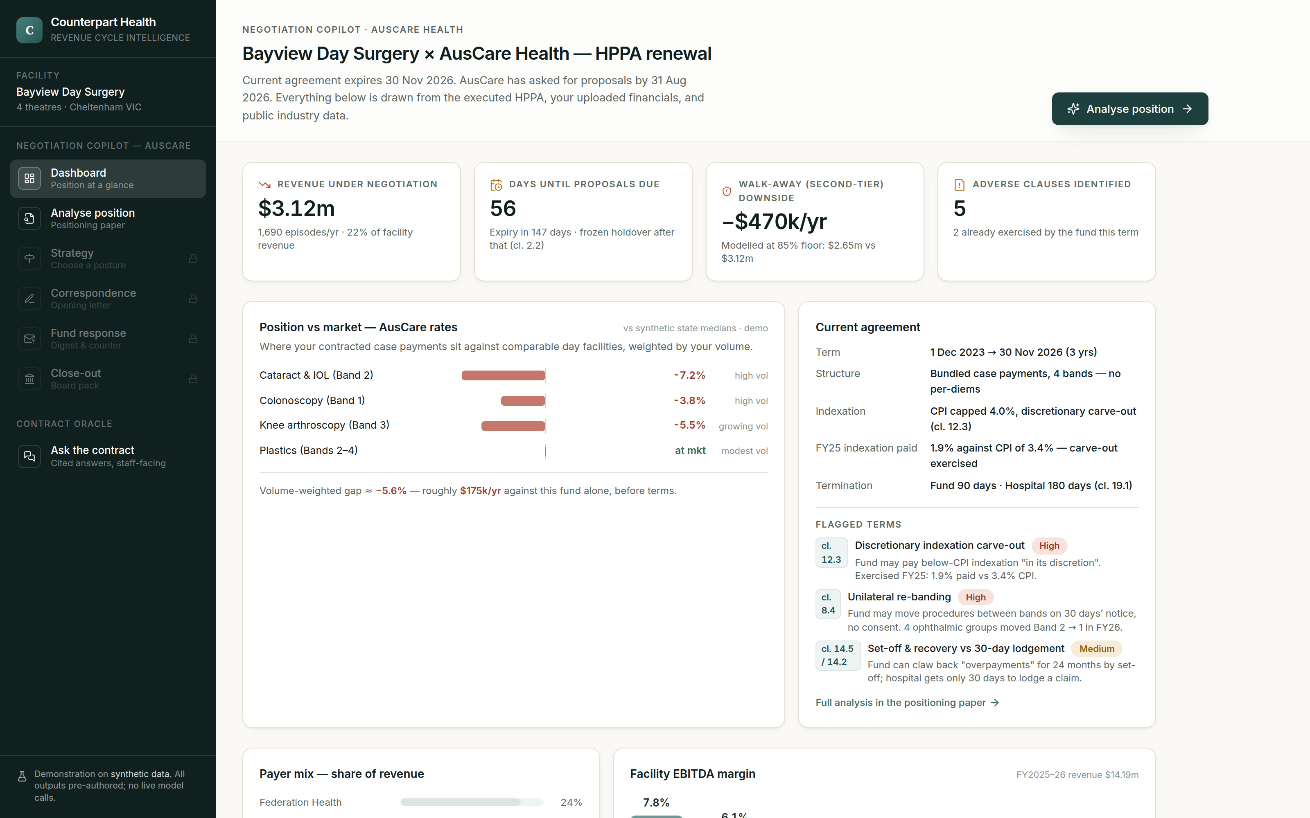
PRODUCT 1 · THE NEGOTIATION COPILOT
Walk in with a contracting team behind you
Reads your contract like opposing counsel. Every adverse clause found, priced, and explained.
Benchmarks your position. Public industry data (APRA, Ombudsman, AIHW) + your own case mix and financials.
Prices your walk-away. The second-tier default scenario modelled in dollars, not vibes.
Then runs the negotiation with you. Options at every decision point — you choose, it drafts, you send.
The renewal, at a glance — live demo, synthetic data
Counterpart Health — pilot briefing · demonstration uses synthetic data · not legal or financial advice
05

Slide 6
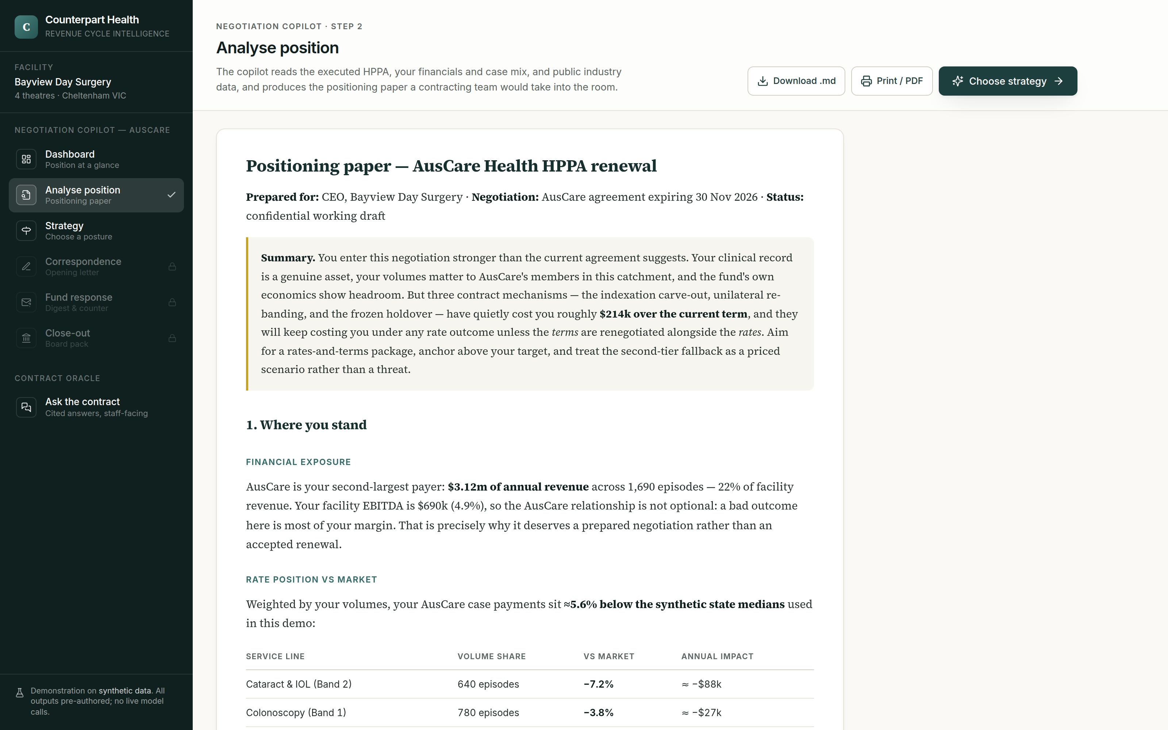
STEP 1 · ANALYSE POSITION
A positioning paper a major group would recognise
Where you stand. Rate position by service line, volume-weighted, with the dollar impact.
What the terms have cost. The carve-out, the re-bandings, the holdover — quantified over the current term.
Your BATNA, priced. Second-tier default modelled against your actual case mix.
Targets set. Target / anchor / walk-away for every element — rates and terms.
Streamed, exportable, board-ready — demo output
Counterpart Health — pilot briefing · demonstration uses synthetic data · not legal or financial advice
06

Slide 7
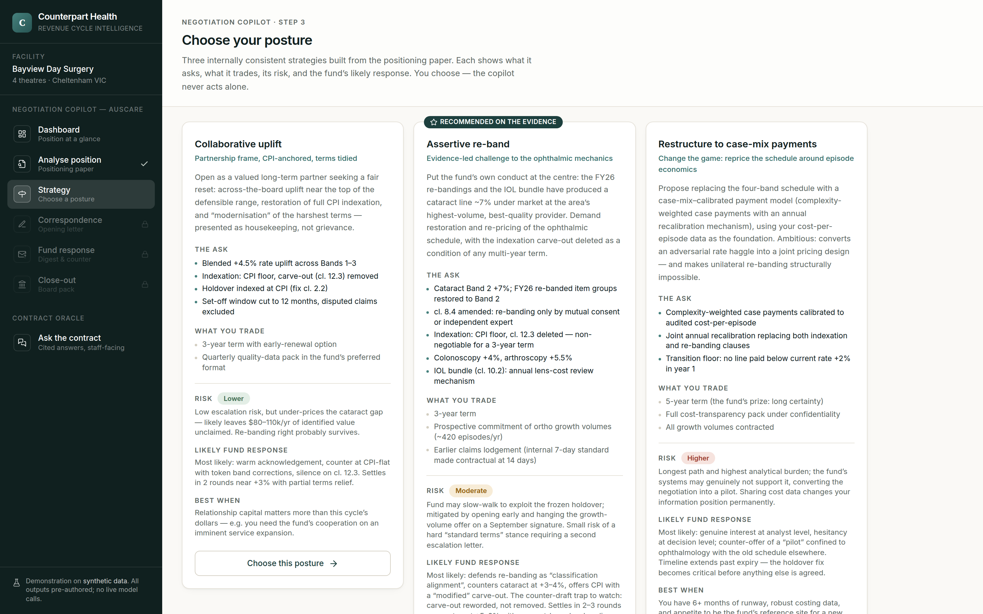
STEP 2 · CHOOSE YOUR POSTURE
Choose your own adventure — you stay in command
Options, not orders.
Risks stated up front.
Fund’s likely response predicted for each path.
Change course any time — everything re-drafts.
Three internally consistent strategies — working demo.
Counterpart Health — pilot briefing · demonstration uses synthetic data · not legal or financial advice
07

Slide 8
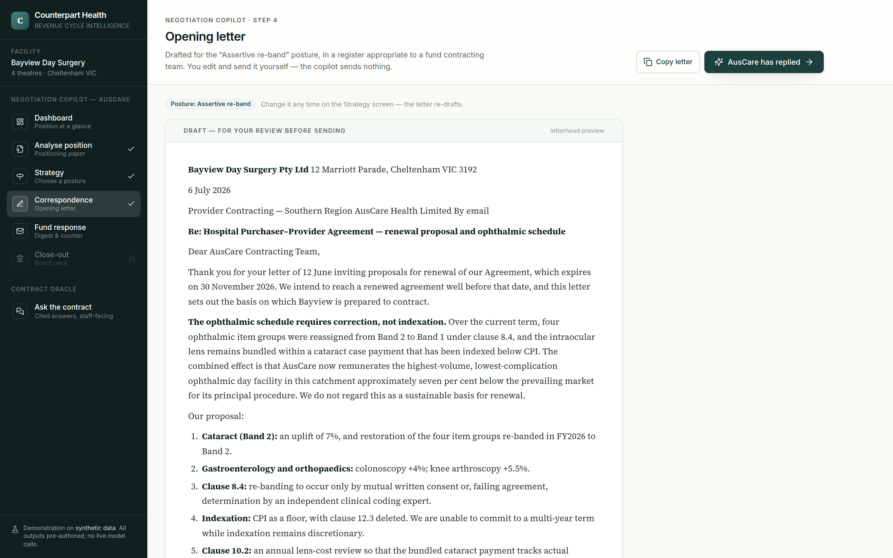
STEP 3 · CORRESPONDENCE
It drafts every letter. You edit. You send.
Fund-appropriate register. Professional, firm, precise — the letter a contracting team would write.
Your asks, structured. Rates and terms held together as one package, with deadlines attached.
Nothing sent autonomously. The copilot has no send button. Ever. That is a design principle, not a disclaimer.
Opening letter for the chosen posture — demo output
Counterpart Health — pilot briefing · demonstration uses synthetic data · not legal or financial advice
08

Slide 9
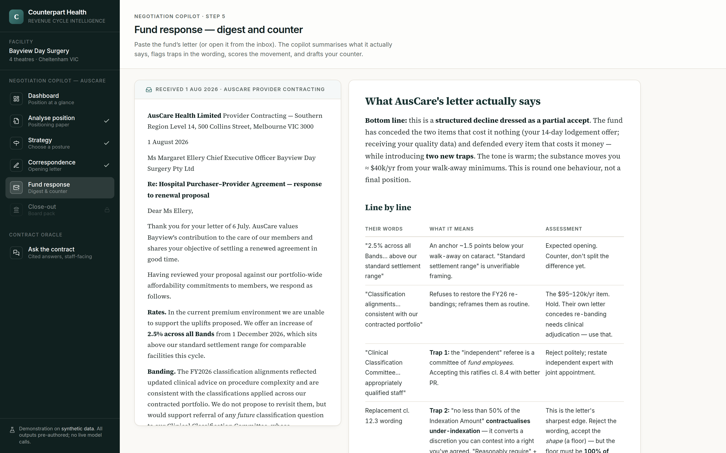
STEP 4 · THE FUND REPLIES
It reads their letter for the traps you’d miss
“Warm” ≠ movement. The digest scores real concessions.
Wording traps flagged. e.g. a “floor” that legalises 50% indexation.
Counter drafted within the strategy you chose.
Line-by-line digest and movement scorecard — working demo.
Counterpart Health — pilot briefing · demonstration uses synthetic data · not legal or financial advice
09

Slide 10
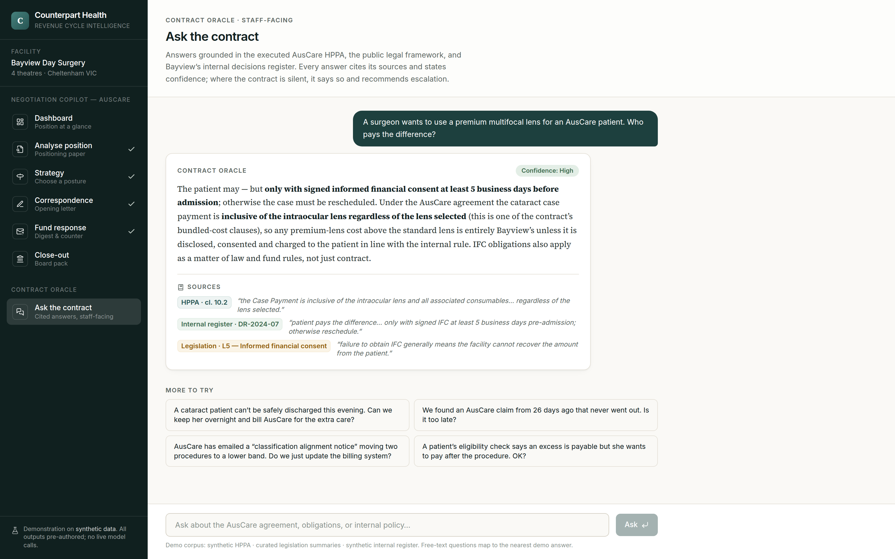
PRODUCT 2 · THE CONTRACT ORACLE
Your whole team can finally ask the contract
Grounded, cited, scored. Answers come from your executed HPPAs, the legislation, and your own policy register — with clause-level citations and a confidence rating.
Honest about silence. Where the contract doesn’t answer, it says so and recommends escalation. It never invents a clause.
Front desk to theatre. Excess collection, IFC, lens upgrades, transfer rules, audit notices — answered in seconds, consistently.
Every answer cites clause and source, and states confidence — demo
Counterpart Health — pilot briefing · demonstration uses synthetic data · not legal or financial advice
10

Slide 11
WHY YOU CAN TRUST IT
Human-in-the-loop isn’t a disclaimer. It’s the architecture.
You decide, always
Every action is proposed, never taken. The copilot cannot send, agree, or concede anything. The audit trail shows a human choice at every step.
Your data stays yours
Strict per-facility isolation. Your rates and financials are never used to benchmark, train, or inform any other customer. Benchmarks come from public data only.
Built for a regulated sector
Privacy Act / APP-aligned handling, Australian data residency, security review before any real data is touched. Decision support — not legal or financial advice, and it says so on every page.
And one bright line: the platform serves one hospital against its fund. It will never share or align rates between competing hospitals.
Counterpart Health — pilot briefing · demonstration uses synthetic data · not legal or financial advice
11

Slide 12
THE PILOT
What a pilot involves — and what you get
Your commitment
12 weeks, timed to your next HPPA renewal window.
Your documents: the expiring HPPA, 12–24 months of billing/case-mix extracts, your P&L. Under NDA, with agreed handling and deletion terms.
2–3 hours a fortnight from you or your business manager — the negotiation is still yours.
Candour: tell us what’s wrong, what’s missing, what you wouldn’t pay for.
What you get
Free pilot access to both products for the duration.
A real positioning paper for your live negotiation — clause analysis, benchmarks, priced walk-away, targets.
Drafted correspondence through your actual negotiation rounds.
First-customer pricing locked in if you continue — and a real say in the roadmap.
Counterpart Health — pilot briefing · demonstration uses synthetic data · not legal or financial advice
12

Slide 13
WHO WE ARE & WHAT WE’RE ASKING
We’re recruiting 2–3 founding pilot sites
Who we are
A venture in formation: product and AI engineering with health-sector revenue-cycle domain input, building in the open with Day Hospitals Australia and APHA networks. The prototype behind every screenshot in this deck is working today — on synthetic data, by design: no real hospital data will be touched before independent security review.
Why now
Sector margins are at break-even, contracting disputes are national news, and AI can finally read a 40-page HPPA reliably enough to matter — with a human deciding every step.
The ask
One conversation about your next renewal date and your last negotiation.
One document — your expiring HPPA — under NDA, when you’re ready.
One pilot slot — 2–3 facilities, first come, renewal-date priority.
Counterpart Health — pilot briefing · demonstration uses synthetic data · not legal or financial advice
13

Slide 14
Next step: a 30-minute demo, on your numbers-shaped problem.
We’ll walk the full negotiation flow live — dashboard to board pack — and leave you the positioning-paper sample.
Counterpart Health · pilot enquiries — [contact to be added] · This deck’s product imagery is a working demo on synthetic data; public figures cited to APRA, DoHAC, ACCC and the PHI Rules.
Counterpart Health — pilot briefing · demonstration uses synthetic data · not legal or financial advice
14

