Slide 1
Question 5: Health

Slide 2
Introduction
In this question, I aim to provide a few insights into different determinants of good health.

Slide 3
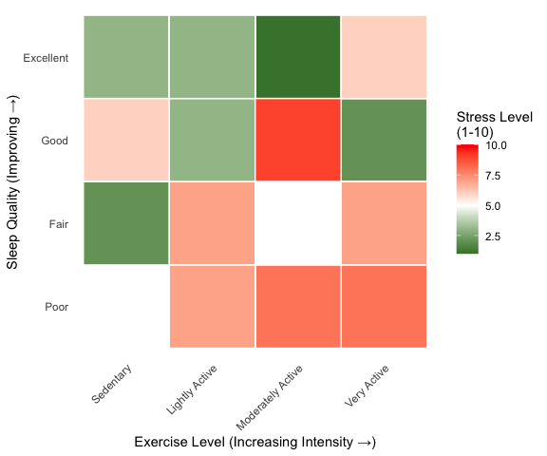
Sleep vs Exercise as determinants of health
Heatmap showing the relationship between sleep and exercise on stress

Slide 4
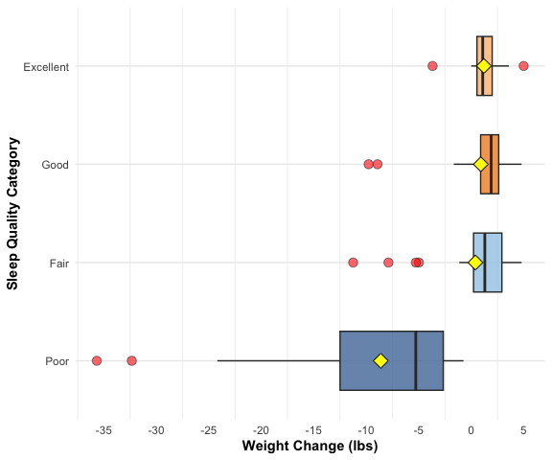
Sleep and weight change
Boxplot showing the relationship between sleep quality and weight change

Slide 5
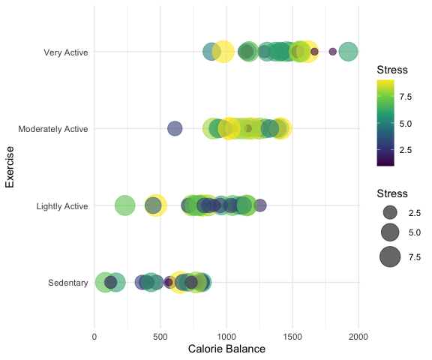
Exercise and calorie balance
Bubble plot showing the relationship between activity levels and calorie balance

Slide 6
Conclusion
Results:
Sleep is important when controlling both stress levels and weight
Exercise in moderation

