Slide 1
Question 5: Health

Slide 2
Introduction
Fama & French (1997)
In this question, I aim to provide a few insights into different determinants of good health.

Slide 3
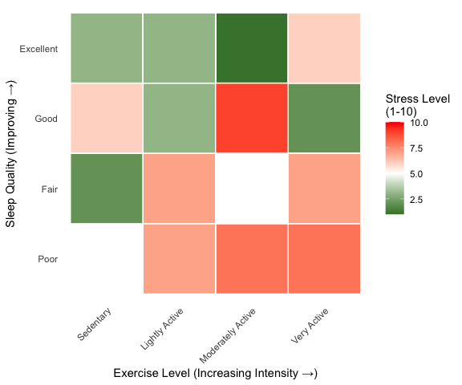
Sleep vs Exercise as determinants of health

Slide 4
References
Fama, E.F. & French, K.R. 1997. Industry costs of equity. Journal of financial economics. 43(2):153–193.

Slide 5
Appendix
Appendix A
Some appendix information here
Appendix B

