Slide 1
NHL Fantasy Guide
A Data Analytics Project by:
Raquel Alto, Rafael Cespedes, Michelle Gillis, Matt Quilay, and Jordan Usner

Slide 2

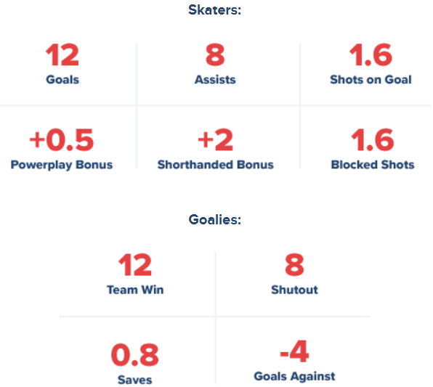
Background
In fantasy sports, fans assemble their own teams by selecting players from across the league and competing against other fans’ custom teams.
Outcomes are determined by adding up the points that those players earn in the actual games they play in. Some game statistics are considered more important than others and are therefore weighted differently.
Fantasy Sports Stats:
Football is the most common fantasy sport
56 million people play fantasy sports in North America
19% of adult men play fantasy sports, compared to 9% of women
$18 billion is spent on fantasy sports annually. By comparison, $140 billion is wagered on real sports and $70 billion is spent in lotteries.
(source: https://money.cnn.com/)

Slide 3




Dataset
Game stats from the past six NHL seasons (’14/’15 – ’19/’20)
Source: https://www.kaggle.com/martinellis/nhl-game-data
Toolset
Python Pandas
Python Matplotlib
Scikit-Learn
Xgboost

Slide 4
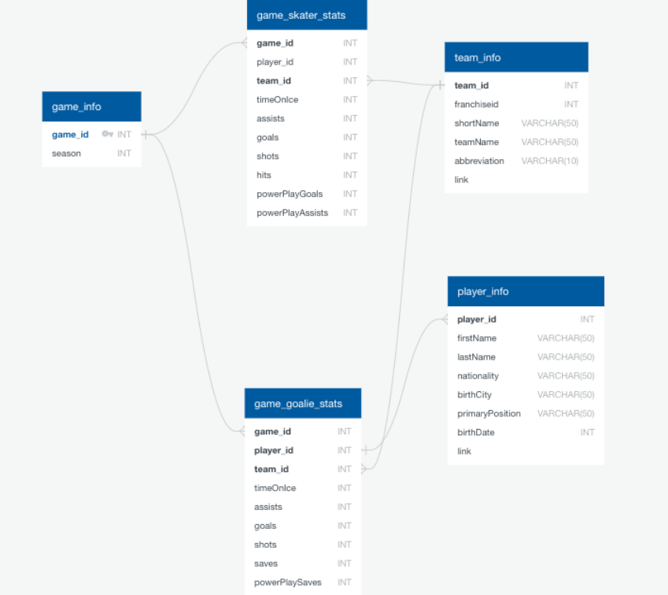
Relationships Between CSVs
joined with pandas once imported
game_skater_stats to player_info via player id
this new df joined with game_info via game id
team_info was then added via team id to produce the final dataframe used to train machine learning
game_goalie_stats was processed on it’s own

Slide 5
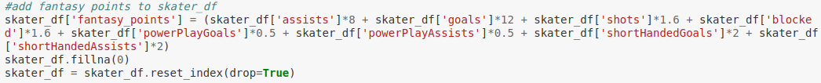

Data Clean-Up
all four csv files were imported as data frames
unnecessary columns were removed from some
a “fantasy point” column was added to quantify each players standing
dataframes were merged
this merged data frame was then filtered to show only the most recent 6 regular seasons
smaller data frames for each non-goalie position were extracted from this one

Slide 6
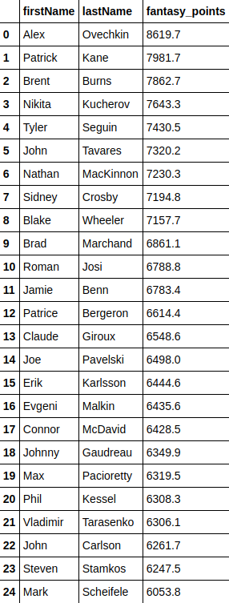
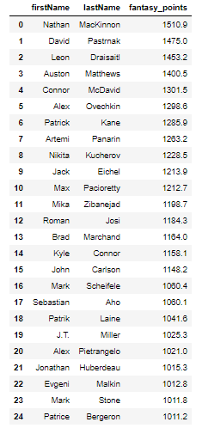
Superficial Analysis
before jumping into machine learning we used the cleaned data frames to visualize top players of the last 6 seasons and most recent 2019/20 season based on their fantasy point score
the average fantasy point score for the top players of the 19/20 season was 14.98 per game
top performers for 14/15 - 19/20
top performers for the most recent 19/20 season

Slide 7
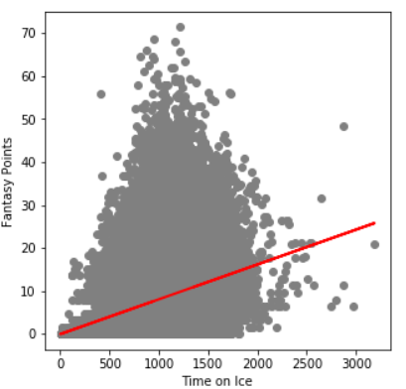
Initial ML testing
Linear Regression

Slide 8
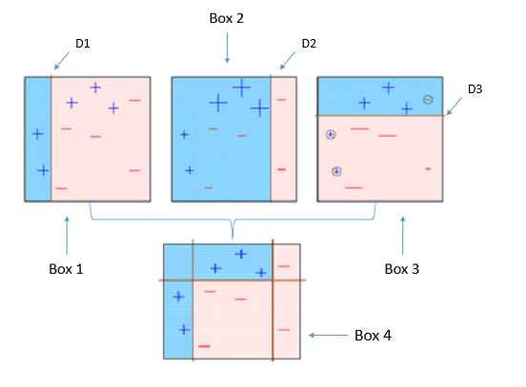
XGBoost
(Extreme Gradient Boosting)
scikit-learn package in Python
Base learning using tree ensembles
Builds a weak model then makes conclusions about various features and parameters
Uses those conclusions to build a newer and better model, utilizing the misclassification errors of the previous model.

Slide 9
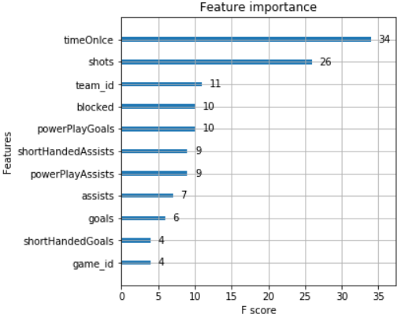
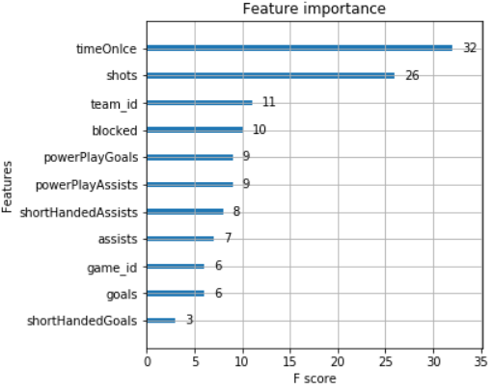
Feature Importance by Position: Centers and Wingers
Player position: Center
Player position: Wing

Slide 10
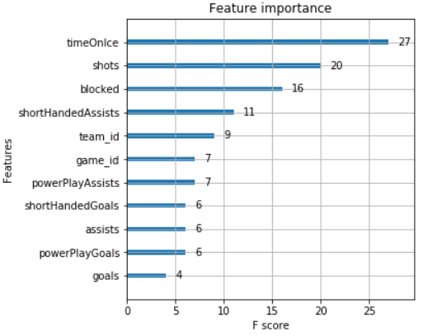
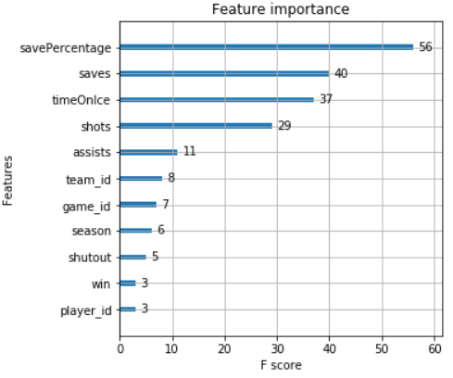
Feature Importance by Position: Defensemen and Goalies
Player position: Defense
Player position: Goalie

Slide 11
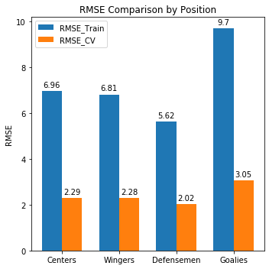
Root Mean Squared Error (RMSE) Performance Metric
Root mean squared error is the square root of the mean of the squared differences between the actual and the predicted values.
k-fold Cross Validation (CV)

