Slide 1
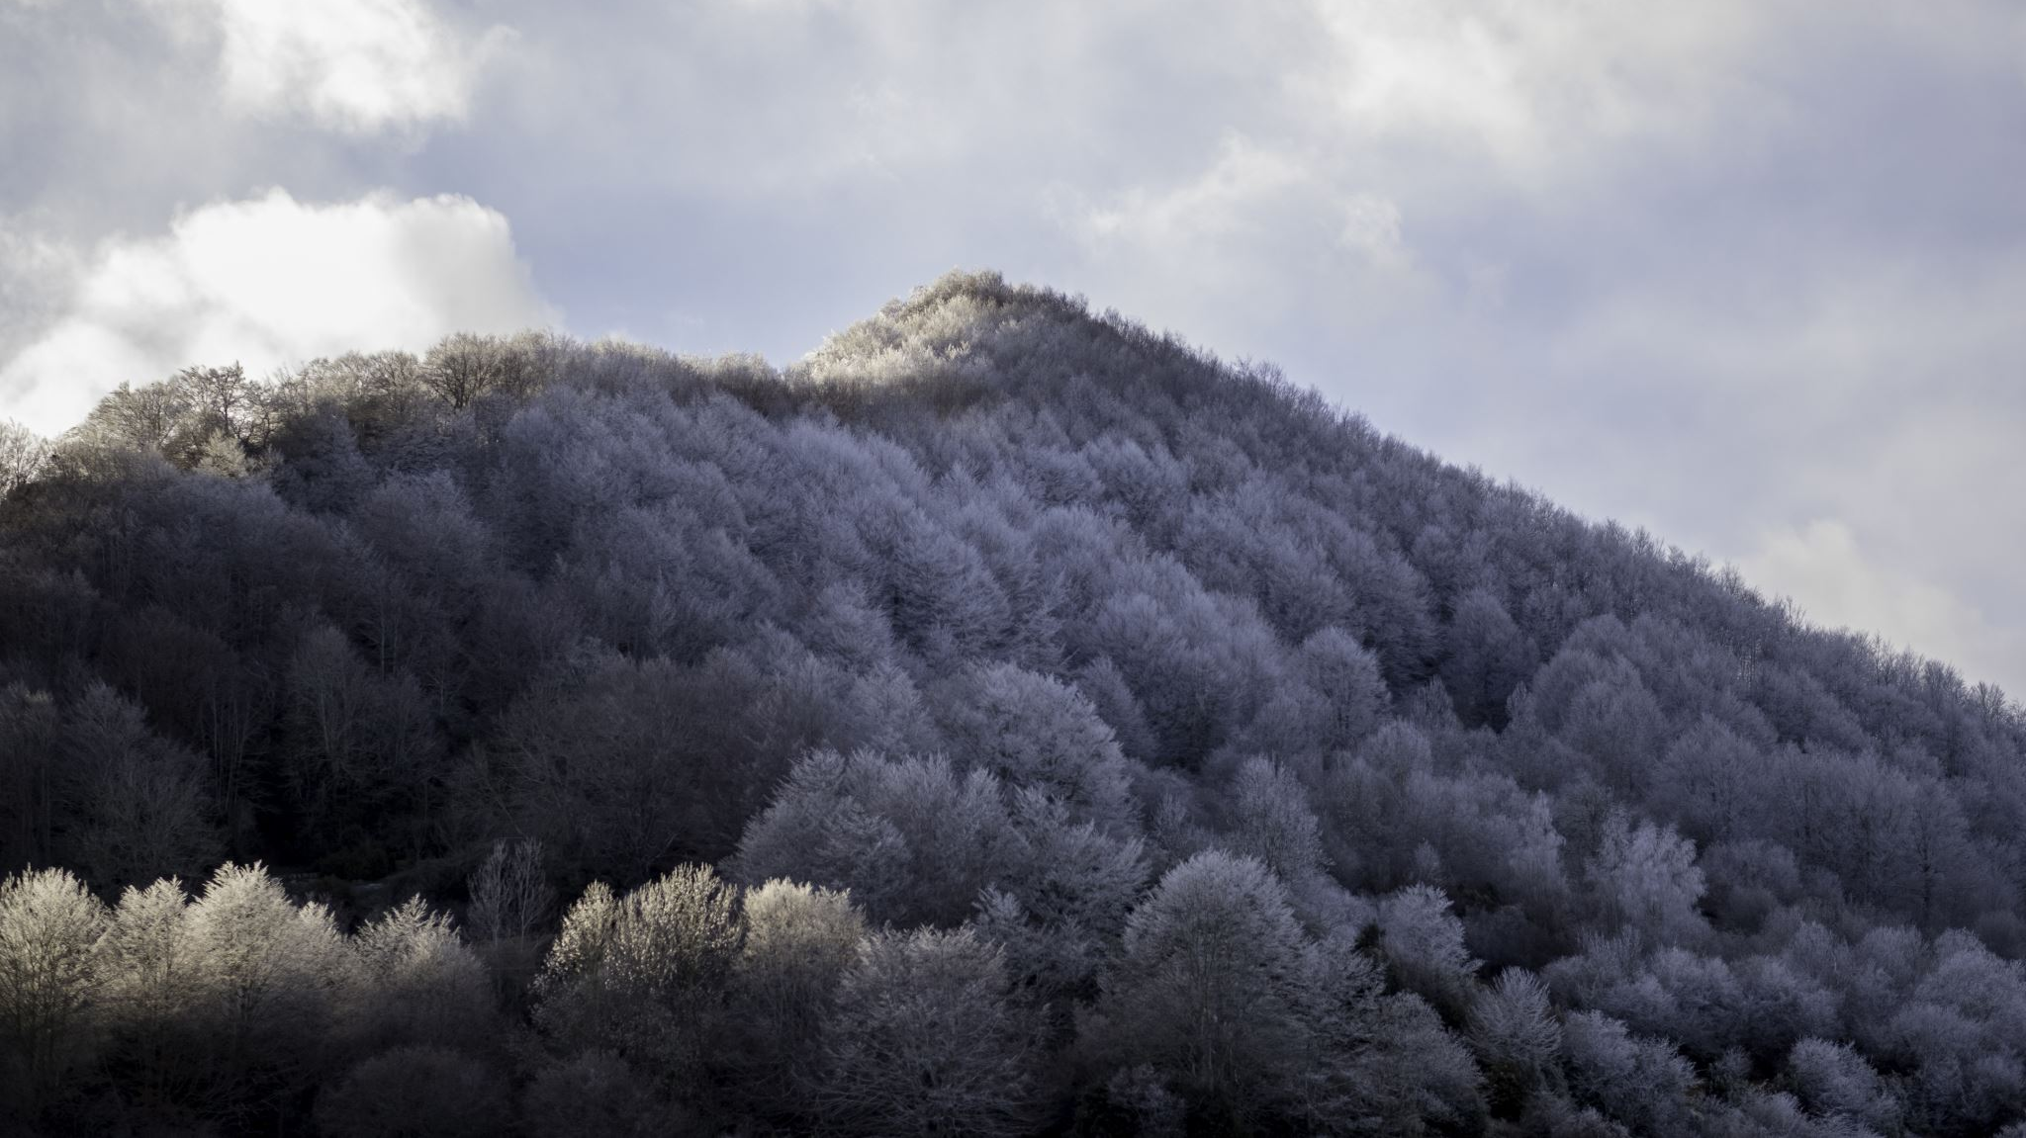
The Flight from Rural Communities: How Wildfires are Impacting Real Estate in Northern California Cities
Team Members - Nathan Ashbaugh, Gary Grisham, Prashant Kapadia, & Matthew Quilay

Slide 2
Data Sets
Zillow:
Single Family Homes by City
California . Gov
Rural Areas by County
Kaggle:
California Fire Incidents
Google Maps:
Latitude and Longitude for Zillow information

Slide 3
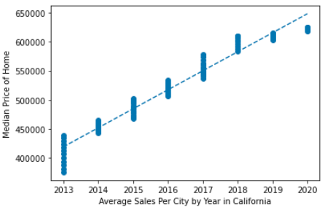
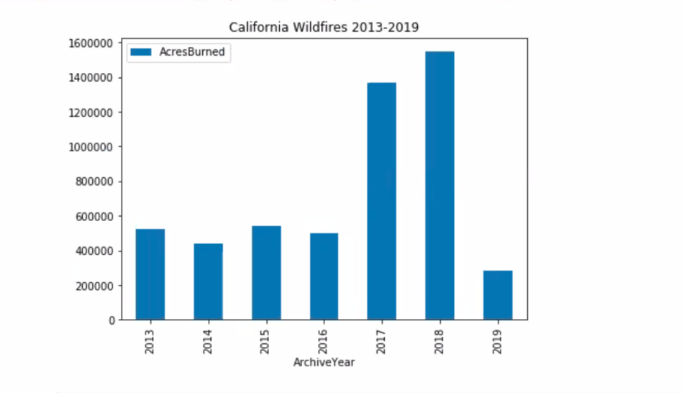
Median Home Prices vs Acres Burned
Have real estate values of cities near wildfire hotspots been significantly impacted by local rural communities? Are Californians leaving small towns in favor of cities due to wildfires?
Our model showed California prices were predicted to increase. While they do increase, they start to concentrate under $650K representing a ceiling in the greater market beginning in 2018.
The linear regression predicts prices to increase in 2020
The correlation coefficient between median prices and average sales is 0.98

Slide 4
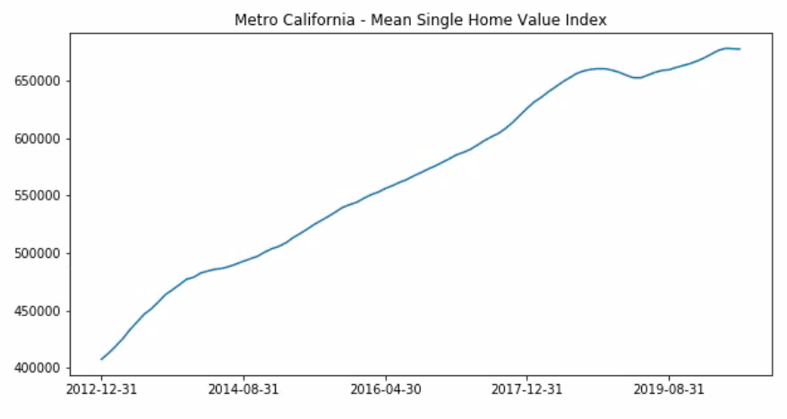
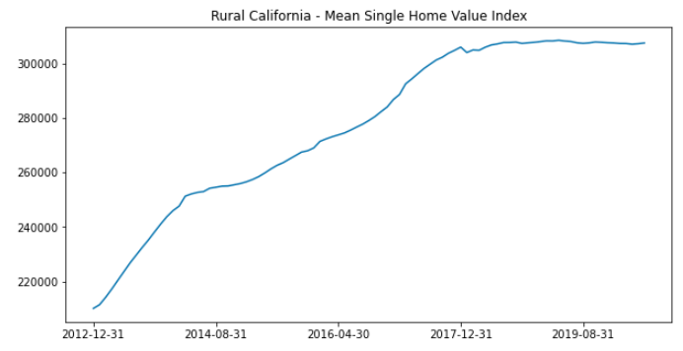
Metro vs Rural
Metro – Metro prices out pace the greater California market showing an upward trend.
Rural – Rural models start to show a ceiling at $300K as soon as 2017.

Slide 5
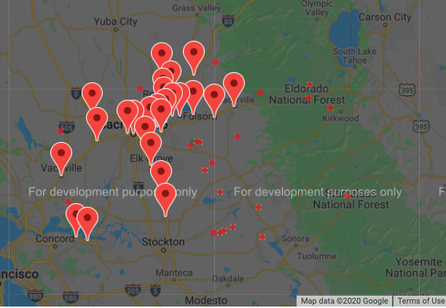
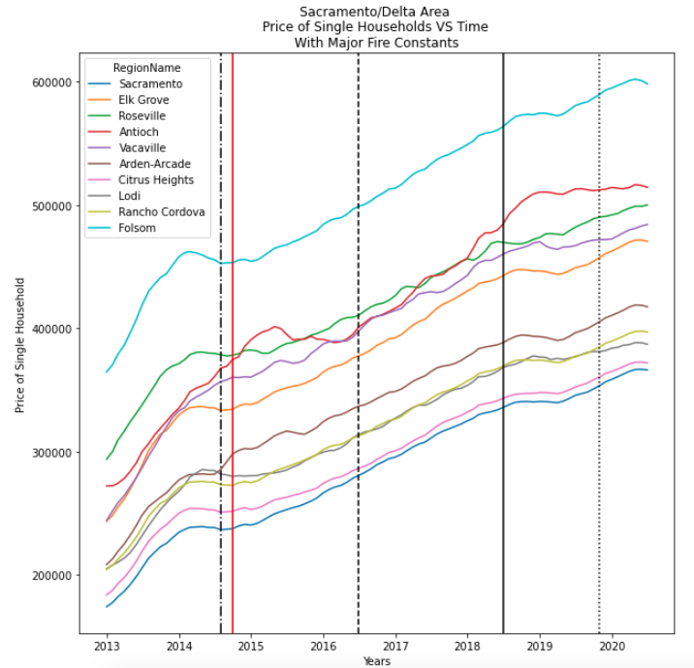
Fires in Northern California – Sacramento Area: Sand Fire - 2014-07-31 King Fire – 2014-09-30 Trailhead Fire - 2016-06-30 Waverly Fire - 2018-06-30 Caples Fire 2019-10-31
Metro Sacramento – Our model shows home prices in Sacramento are not following state trends but rising.

Slide 6
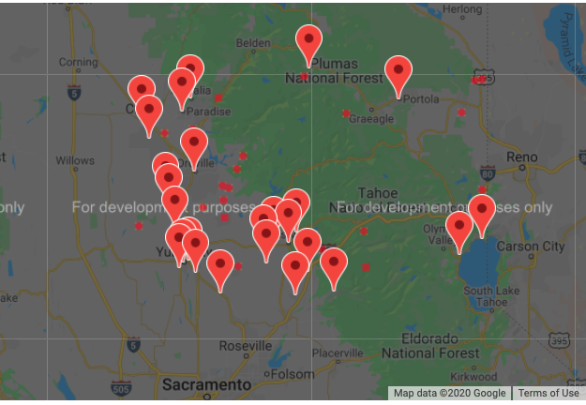
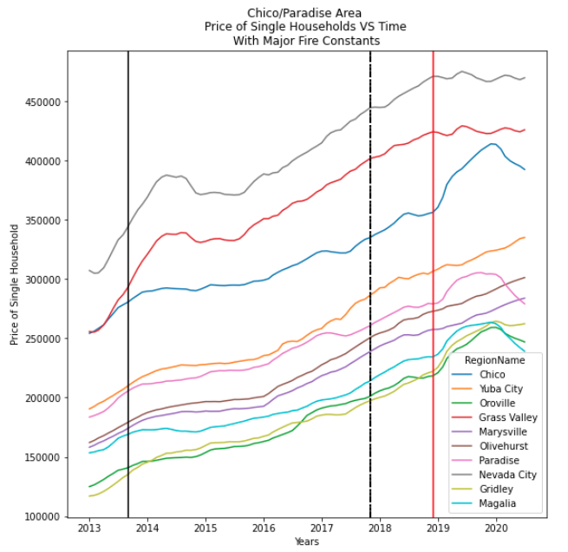
Fires in Northern California – Chico Paradise Area: American Fire 2013-08031 Cascade Fire 2017-10-31 Cherokee Fire 2017-10-31 LaPorte Fire 2017-10-31 Camp Fire 2018-11-30
Rural - Our model shows home prices in rural communities impacted by fire are dropping in some cases. This is inconsistent with the rising and flattening models previously presented. We believe this is due to wildfires and not due to price ceiling.

Slide 7
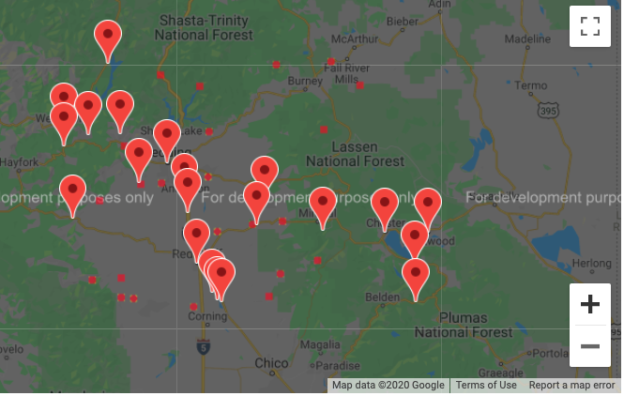
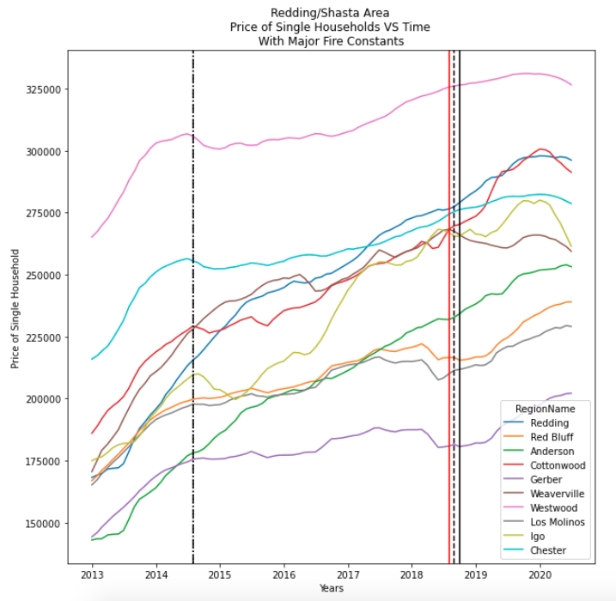
Fires in Northern California – Redding/Shasta Area: Bald Fire 2014-07-31 Eiler Fire 2014-07-31 Carr Fire 2018-07-31 Hirz Fire 2018-08-31 Delta Fire 2018-09-30
Rural/Metro – The Redding/Shasta area combines all markets showing significant gains in larger cities and cities near major freeways combined with declining values in rural communities.

Slide 8
Findings:
Rural California housing markets are declining. There is a possible connection between wildfires. Our analysis indicates there is possible connection to wildfires impacting nearby cities along major freeways causing an accelerating trend in those markets which does not match the flattening market of overall California Real Estate.
Caution should be used when investing in real estate in small towns and property above the $650K ceiling.

