Slide 1

Introduction to Formal Verification Course
@matthewvenn

Slide 2
Motivation

Slide 3
Motivation

Slide 4
Course Structure
2 x 2 hour blocks. Each block consists of:
Short presentation
Group and individual work with the tools
5 minute break
Another short presentation
More group work
Final thoughts/discussion

Slide 5
What you will learn
What is Formal Verification and how can it be applied to designing and verifying with FPGAs,
Quickly generating test traces with cover,
Proving your design is safe with BMC and K-induction,
Hands on use of the Symbiotic EDA suite

Slide 6
Part 1: What is Formal Verification?

Slide 7
What you will learn
How FV works
What is liveness and how can we use it?
How to configure, run the tools and generate traces

Slide 8
Formal Verification uses SMT solvers

Slide 9
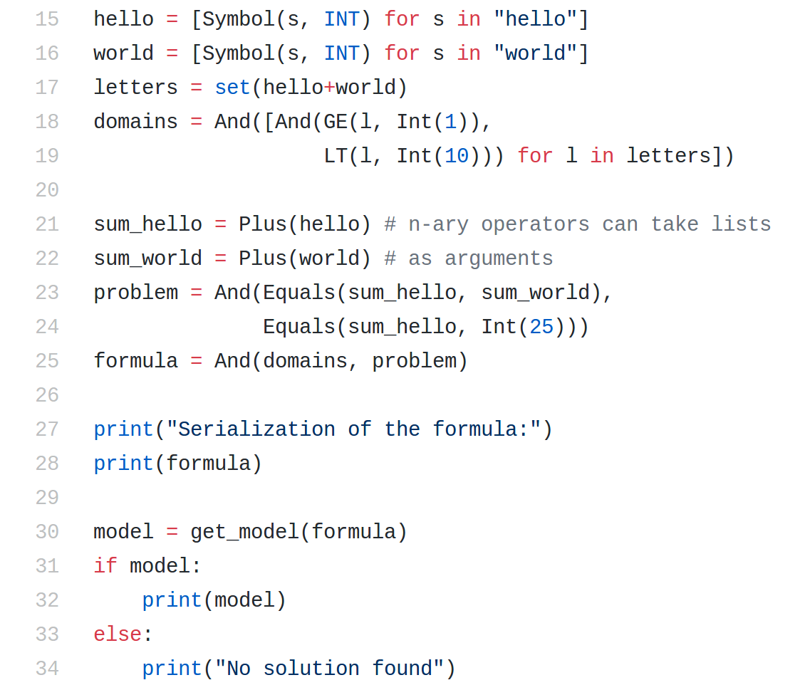
Demo: pySMT

Slide 10
For circuit analysis SAT and SMT solvers can be used to answer questions like:
  “Given a circuit, is there a state with property A that has a valid transition to another state with property B.”

Slide 11
Cover proves that something is reachable, it is a liveness property.

Slide 12
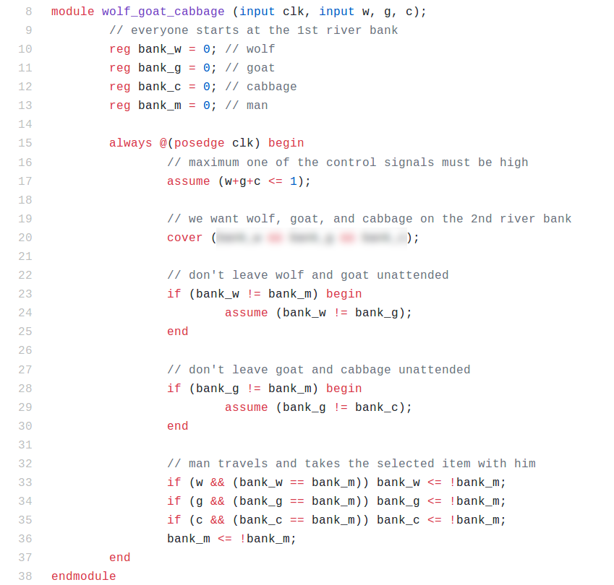
Demo: Wolf, Goat, Cabbage

Slide 13
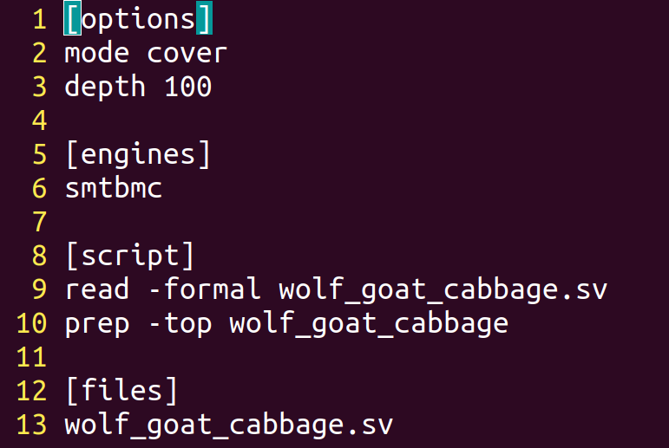
.sby configuration files

Slide 14
Demo: Cover an AXI Lite transaction
https://github.com/mattvenn/axi-lite-formal

Slide 15
Exercises part 1
https://github.com/mattvenn/formal-intro-course
Write cover statement for wolf, goat, cabbage
Use a cover statement to show LED data is set in ws2812 core
Try to cover led control pin going high in ws2812 core
Add some cover properties to the traffic light example.

Slide 16
5 minute break!

Slide 17
Part 2: BMC, Assumptions & Assertions, $past

Slide 18
What you will learn
What is a Bounded Model Check
How to constrain the search space for the solvers
Limitations

Slide 19
Bounded Model Check

Slide 20
Are the bad states reachable from the initial states ?

Slide 21
In steps 1 .. k-1:
UNSAT → next step
SAT → FAIL
Step 1:
0
Step 2:
0
1
Step 3:
0
1
2
Step 4:
0
1
2
3
In step k:
UNSAT → PASS
SAT → FAIL
Step k:
0
1
2
3
k-1
BMC proves that no bad state is reachable within k cycles.

Slide 22
BMC and induction test safety properties.
They prove that something will not happen

Slide 23
Two basic operators
1. assume()
An assume(X) statement will limit the state space that the formal verification engine examines.
2. assert()
An assert(X) statement indicates that X must be true, or the design will fail to prove.

Slide 24
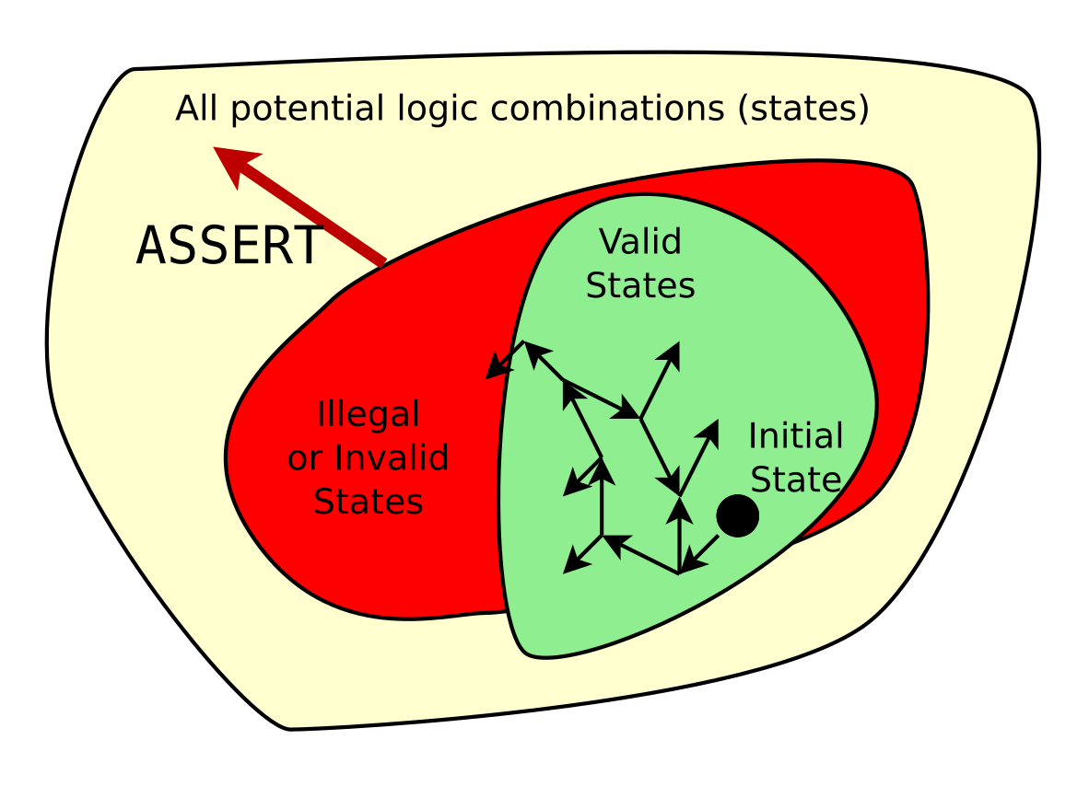
Assertions define the illegal state space.
Additional assertions will increase the size of the illegal state space.

Slide 25
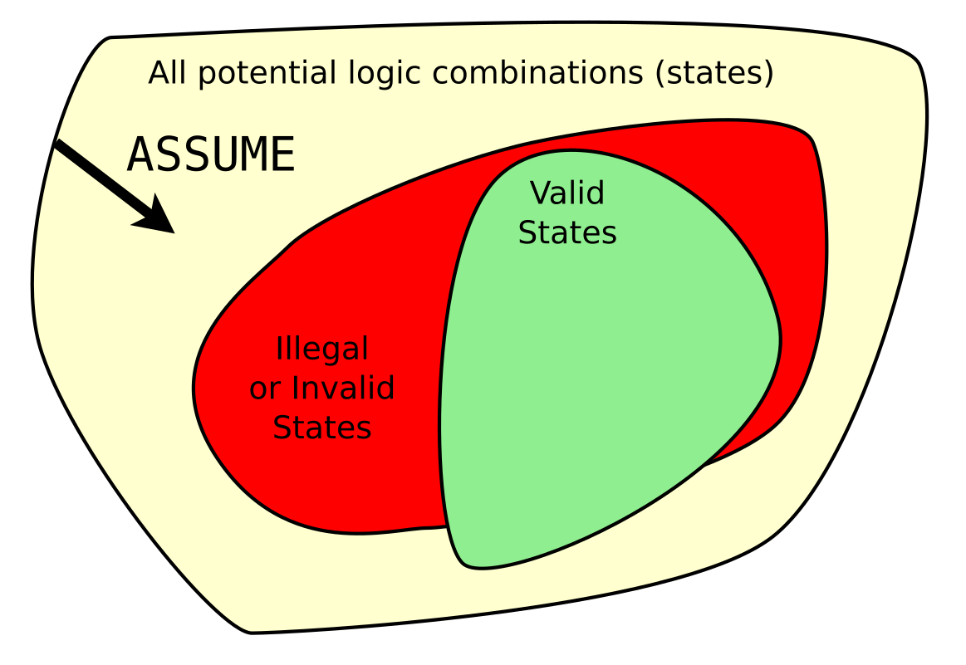
Assumptions limit the universe of all possibilities
Additional assumptions will decrease the size of the total state space
Caution: One careless assumption can void the proof.

Slide 26
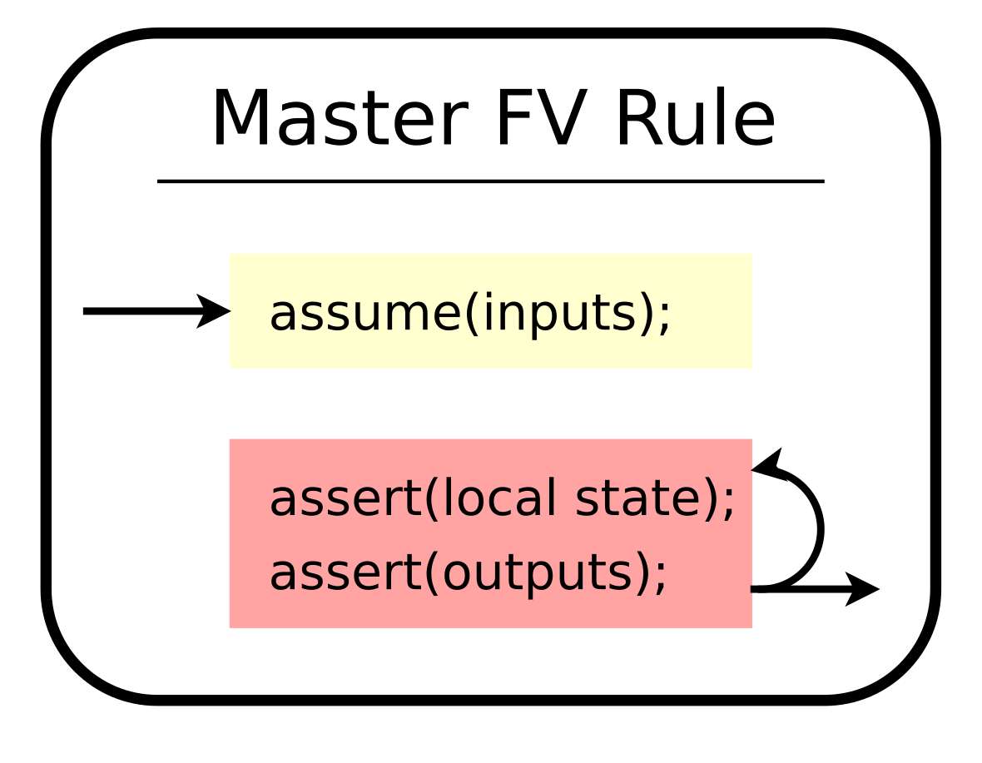

Slide 27
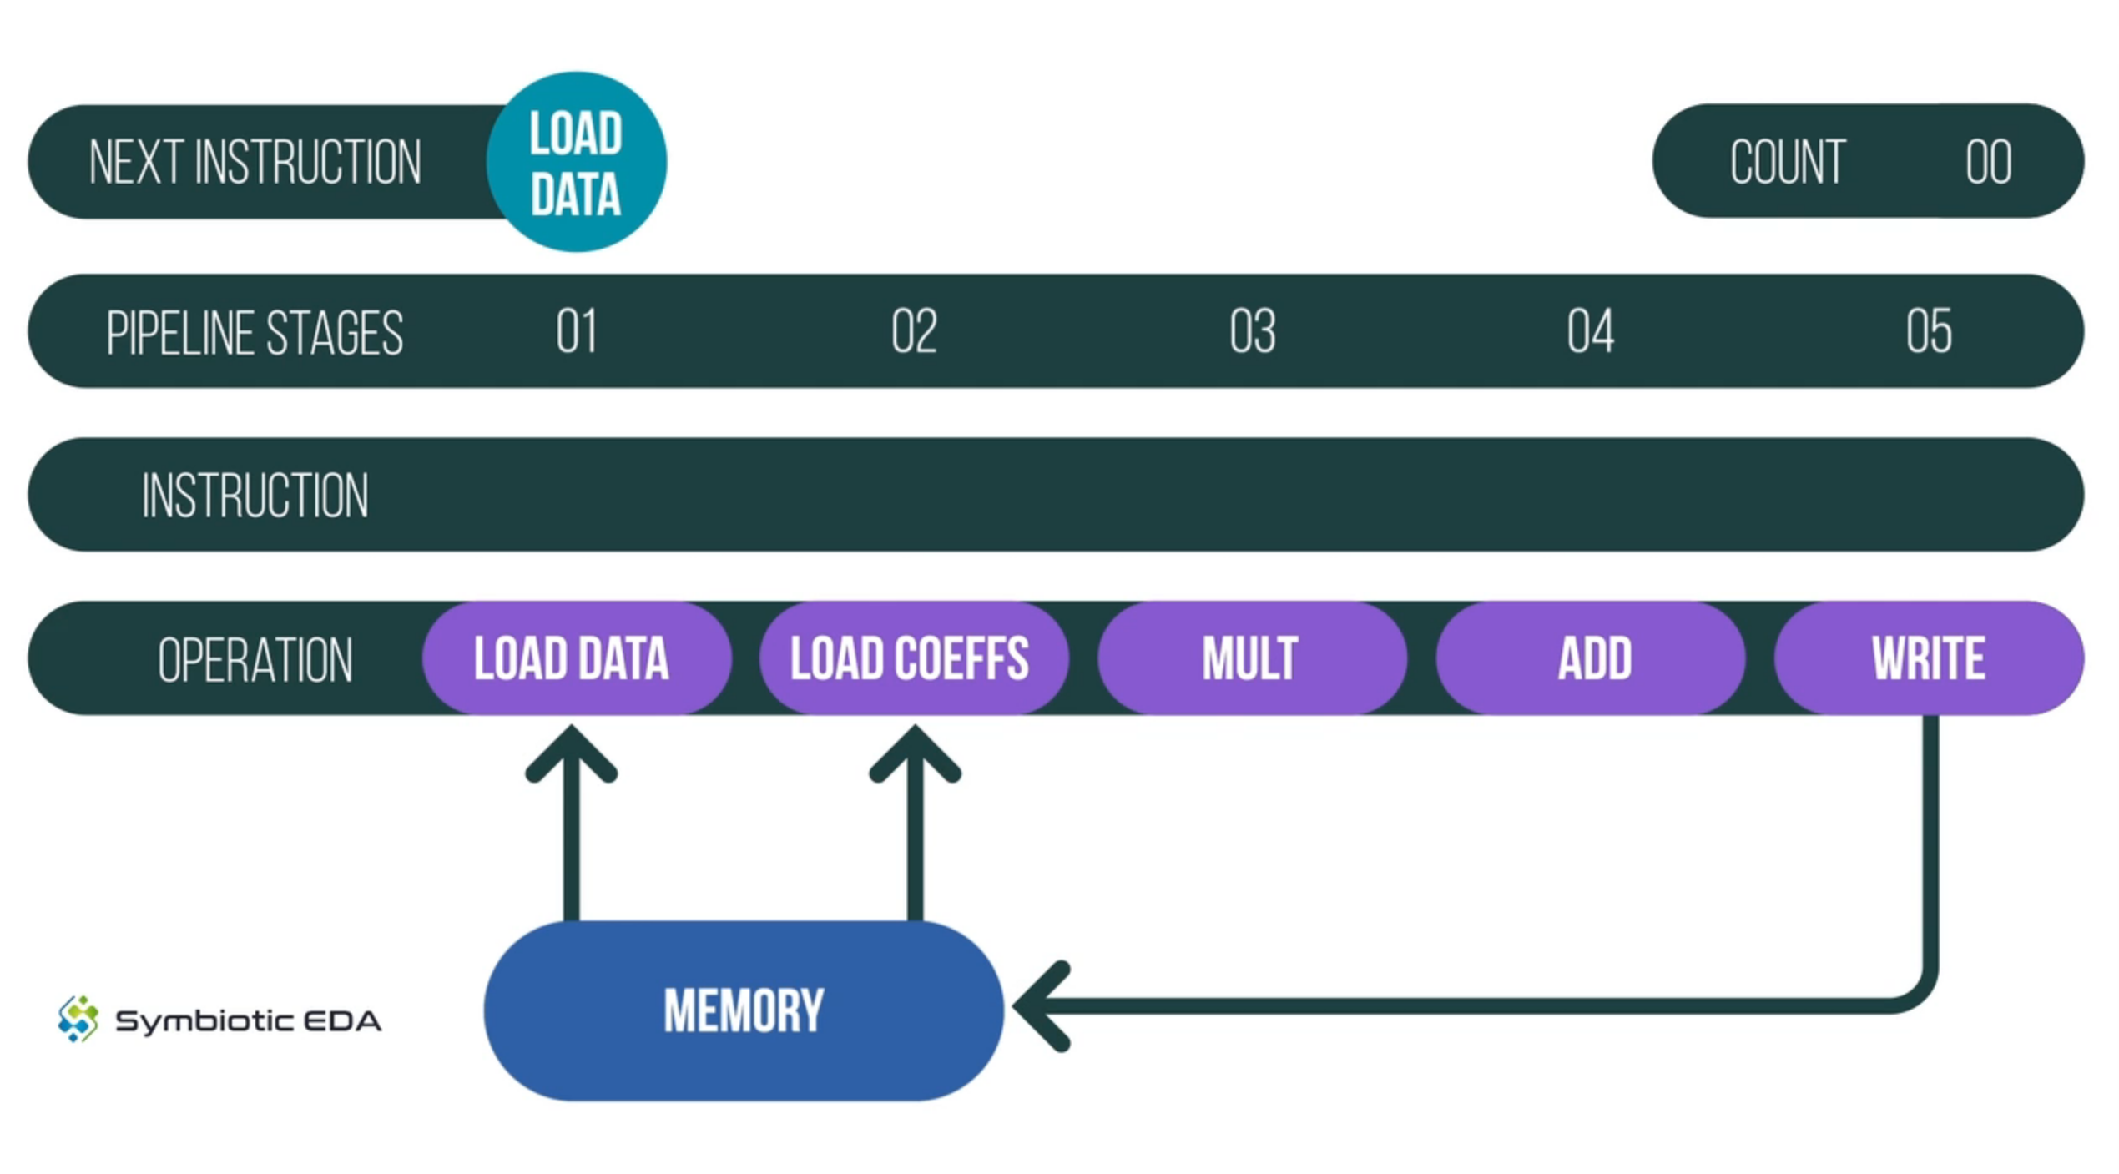
MARLANN pipeline

Slide 28
How can we prove the MARLANN pipeline is safe?
memory read enable signals:
      mem_rd0_en
      mem_rd1_en
memory write enable signals:
      mem_wr_en

Slide 29
Exercises part 2
Write an assertion to cover memory protection on MARLANN pipeline.

Slide 30
$past()
$past() allows us to make assertions cross time intervals:
If x happened last clock, then y must happen now.
x must be the same as it was last clock.

Slide 31
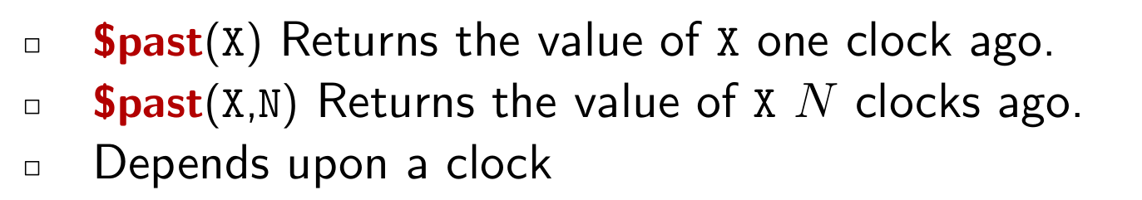
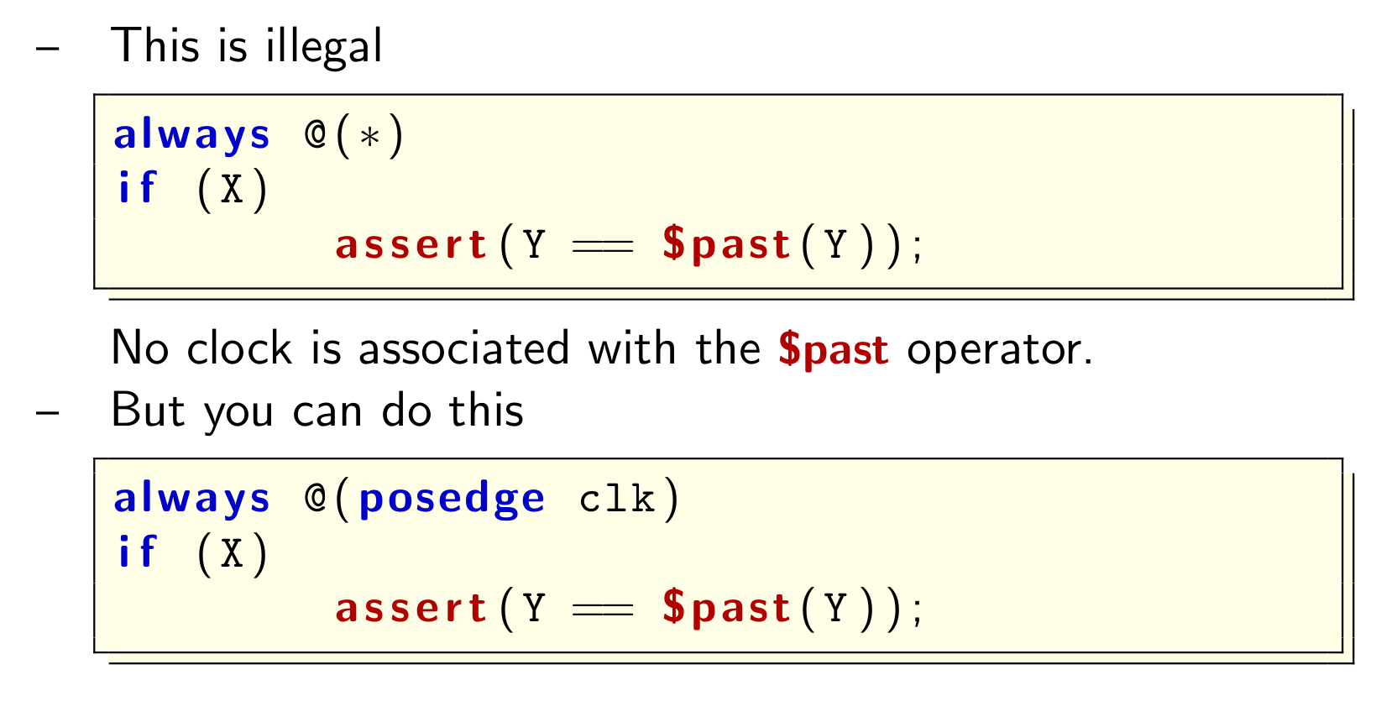

Slide 32
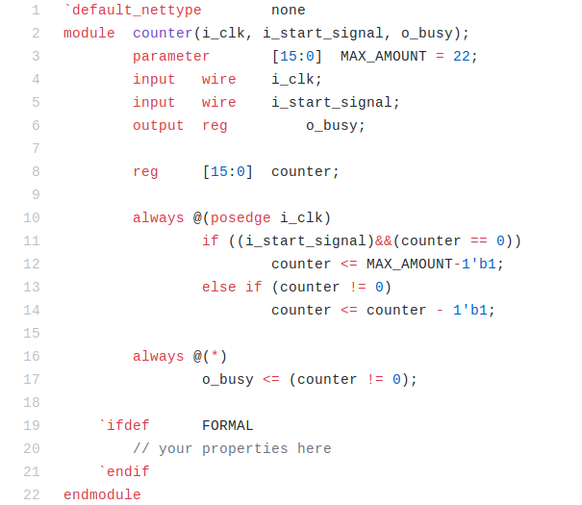
Excercise: $past() busy counter

Slide 33
Excercise: busy counter

Slide 34
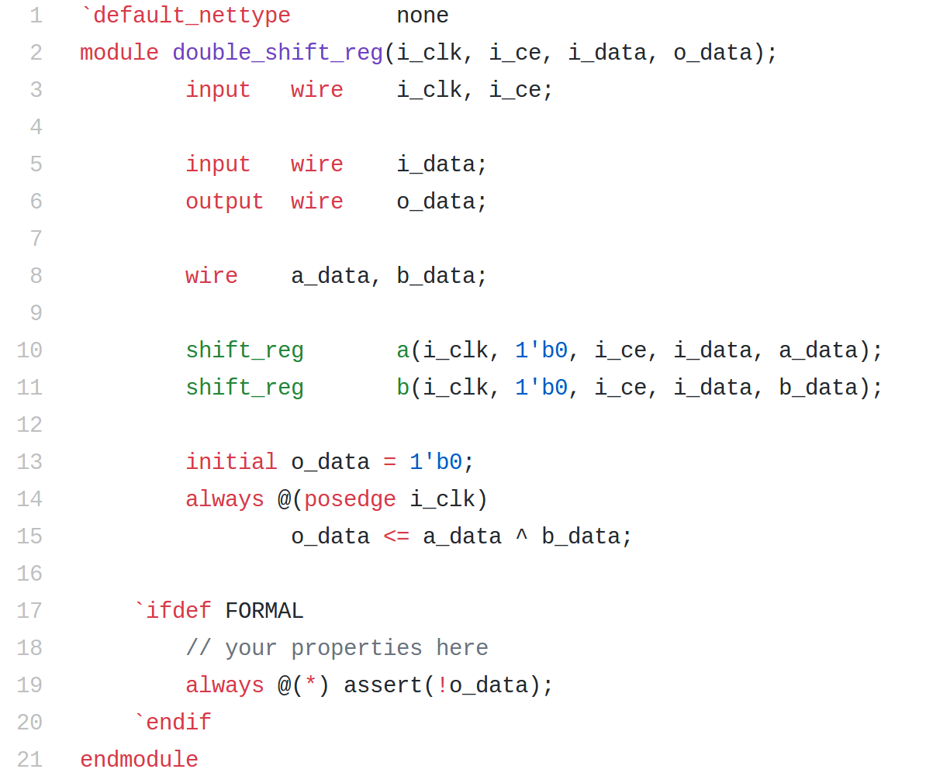
Exercise: Double shift reg

Slide 35
Exercises part 2
2) Prove that the busy counter example works as expected.
3) Write 2 assertions that prove safety properties for traffic lights
4) Write an assertion that proves a bus arbiter won’t allow 2 masters to write to bus at once.

Slide 36
Related resources
MARLANN video
Getting started with Formal videos
Verifying an AXI Lite core
Using cover as an alternative to testbenches

Slide 37
Part 3: k-Induction

Slide 38
What you will learn
What is k-Induction
Common difficulties and work-arounds

Slide 39
BMC Limitations
If you want to formally verify your design, BMC is insufficient
Bounded Model Checking (BMC) will only prove that your design is correct for the first N clocks.
It cannot prove that the design won’t fail on the next clock, clock N + 1
This is the purpose of the induction step: proving correctness for all time

Slide 40
Formal verification uses k-induction
Base case
Assume we start in initial state
Assume the first N steps do not violate any assumptions,
Prove that the first N steps do not violate any assertions.
Inductive Step
Assume N steps exist that neither violate any assumptions or assertions, and
Assume the N + 1 step violates no assumptions,
Prove that the N + 1 step does not violate any assertions.

Slide 41
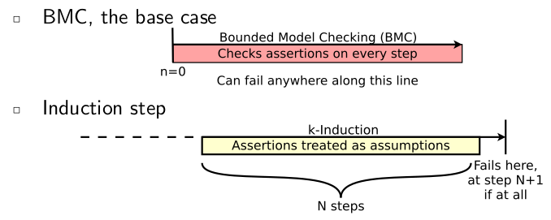
Register values at the beginning of the inductive step can be anything allowed by your assertions and assumptions

Slide 42
In steps 1 .. k:
SAT → next step
UNSAT → PASS
Step 1:
k
Step 2:
k-1
k
Step 3:
k-2
k-1
k
Step 4:
k-3
k-2
k-1
k
In step k+1:
SAT → UNKNOWN
UNSAT → PASS
Step k+1:
0
k-3
k-2
k-1
k
k-induction proves that a sequence of k non-bad states is always followed by another non-bad state. The k used for induction must be ≤ the k used in BMC
for a valid complete proof.

Slide 43
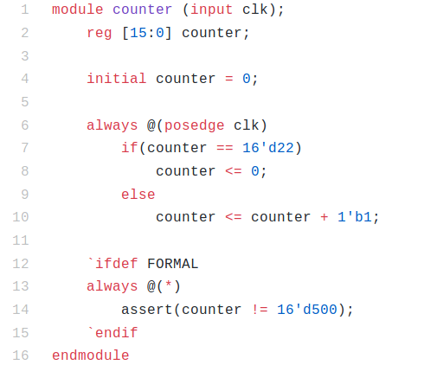
Exercise: Simple counter

Slide 44
Question: busy counter

Slide 45
Exercise: Double shift reg

Slide 46
Exercises part 3
Make a full proof for the simple counter with overflow set to 10000.
Find 2 ways to make a full proof of the double shift register.
Make a full safety proof of the traffic lights.

Slide 47
Part 4: Abstraction, Workflow

Slide 48
Demo: Bus Properties
Is Vivado generated AXI Lite IP bug free?
http://zipcpu.com/formal/2018/12/28/axilite.html
https://github.com/mattvenn/axi-lite-formal

Slide 49
Abstraction

Slide 50
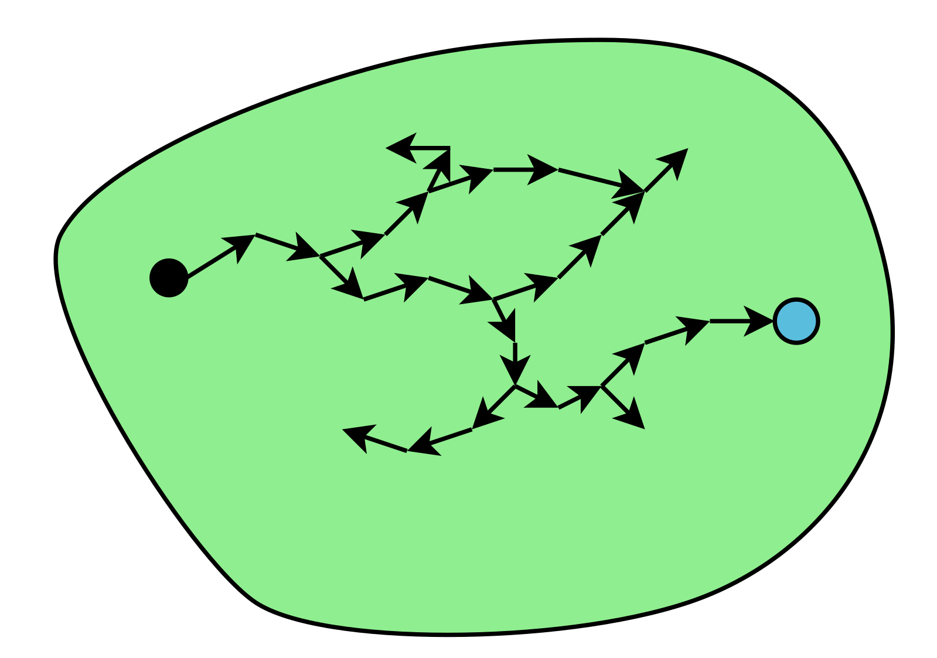
It takes too many transitions required to get to interesting states
Suppose we added to this design some additional states and transitions

Slide 51
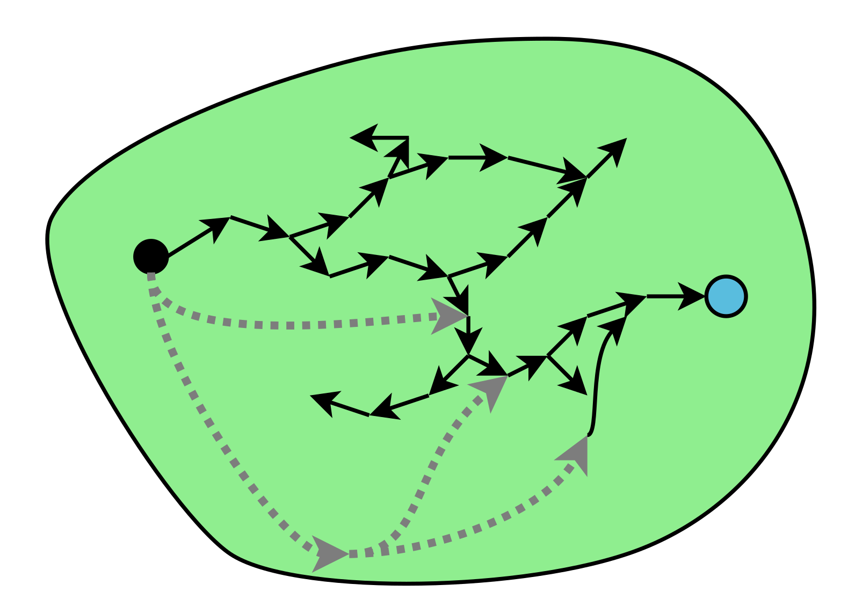
The real states and transitions must still remain
If this new design still passes, then since the original design is a subset, the original design must also still pass

Slide 52
Free variables
(* anyconst *) wire [7:0] any_const;
Can be anything, defined at start and then stays static.
(* anyseq *) wire [7:0] any_seq;
Can be anything, can change on each clock.

Slide 53
Formal Verification Typical Workflow
Step 1: Run Bounded Check
  FAIL → Fix design, add assumptions, or loosen asserts
  PASS → So far so good. Proceed to step 2
Step 2: Run Induction Proof
  FAIL → Investigate counterexample: Is it reachable? *
    REACHABLE → Fix design, add assumptions, or loosen asserts
    UNREACHABLE → Add restrictions, strengthen asserts,
    or increase induction length
  PASS → Do you want more asserts in your design?
    YES → Reduce induction length or remove restrictions.
    NO → You are done.
* Counterexample is always unreachable when induction succeeds with a larger induction length.

Slide 54
Workflow example:
Step 1: BMC (k=5, PASS)
1
2
0
1
0
3
3
1
4

Slide 55
Step 2: k-Induction (k=5, FAIL)
2
3
0,4
5
1

Slide 56
Solution: Add new assertion to break the loop
intended target
for the new assert, breaks loop
0
1
2
3
4
5
assertion also made this state a bad state, creating
a new k-induction counter example. Note that 1-2-3 and
2-3-4 are also possible loops. Increasing k would not help.

Slide 57
Solution: Add one more assertion
Now k-induction is UNSAT (PASS)

Slide 58
Exercises part 4
Cover busy_ctr busy going low with a MAX count set to 10000
Cover data pin going high on ws2812 core.

Slide 59
Thank you!
Feedback form
Follow us @symbiotic_eda
Subscribe at youtube.com/c/symbioticeda

