Slide 1
Where to open a bar in the Bay Area
Matt Vestal
IBM data science capstone

Slide 2
Rationale
The Bay Area is experiencing population growth due to the tech boom
More people coming in means more demand for local businesses
One profitable business is a bar, but where is the best place to open one with minimal competition?

Slide 3
Problem
How do we determine which places have the least amount of bars in their top 50 venues?
Location data through web scraping and Foursquare API calls

Slide 4
Data required
Location data
Coordinates
Venue data
Data will be sourced from Wikipedia and Foursquare API

Slide 5
Methodology
Use web scraping to obtain list of cities and population of cities in the Bay Area
This is done with beautifulsoup
Use Foursquare API call to obtain venue data for top 50 venues
Foursquare limit is 50
Apply K-means clustering to determine best place to open a bar

Slide 6
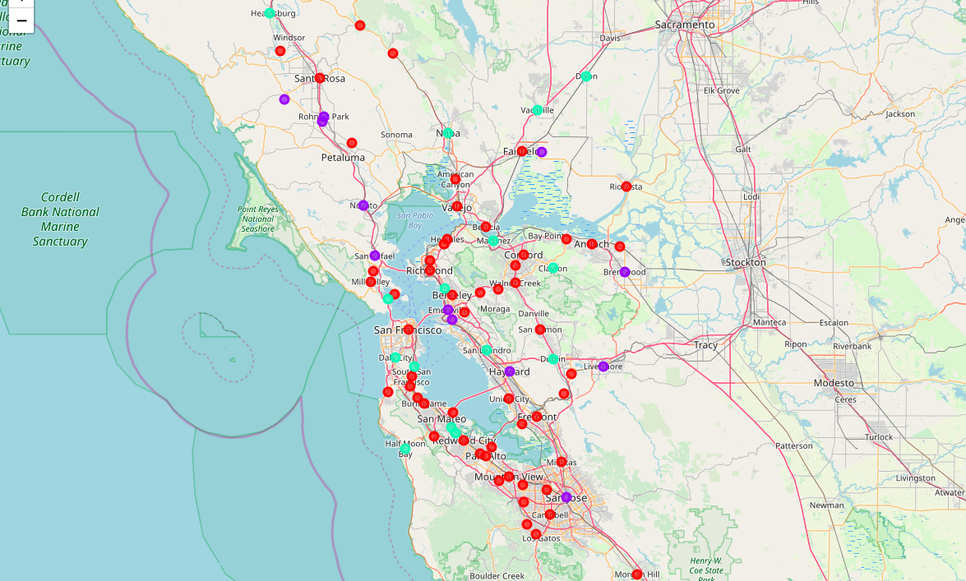
Results

Slide 7
Results
The clusters were grouped as such:
Cluster 0: the cluster with the least bars (red)
Cluster 1: the cluster with the most bars (purple)
Cluster 2: the cluster with a moderate amount of bars (green)
The mean populations in clusters 0, 1, and 2 were 67501, 151,393, and 38,215 respectively.
Cluster 0 had 11 major cities, cluster 1 had three major cities, and cluster 2 had just one major city.

Slide 8
Discussion
It appears that cluster 0 is the best place to open a bar due to the low frequency. However there is a large number of major cities here
Probably due to the low limit of the API call for venues
Despite this, its probably okay to open a bar in a cluster 0 city as long as it isn’t a major city
Cluster 2 has a moderate amount of bars but has a very low mean population. This suggests a high bar to person ratio, and it is not advisable to open a bar here

Slide 9
Conclusion
Cluster 0 cities are the best cities to open a bar, provided they are not major cities (population < 100,000).
It is not recommended to open a bar in cluster 1 cities due to the high number of bars and cluster 2 cities due to a high bar to person ratio

