Slide 1
Session nn: GraphX
  Why GraphX?
  Constructing simple graphs
  Operations on graphs
  Optimizations on graphs
  Building larger graphs
  Advanced graph algorithms
Notes:
Session nn: GraphX

Slide 2
Lesson Objectives
Understand when we need graphs in software development
Understand what GraphX does and how it simplifies working with real-life graphs
Learn how to construct simple graphs and do operations on them
Recognize use cases for optimization on graphs
Practice loading larger graphs
Apply advanced graph operations
Session nn: GraphX
Notes:
Session nn: GraphX

Slide 3
Our goals in learning GraphX
Introduce you to graph programming in general
Outline the benefits of using graphs
Learn to recognize graph use cases
Get a solid understanding of how GraphX makes graph programming realistic
Session nn: GraphX
Notes:
Session nn: GraphX

Slide 4
Section1: Why graphs?
  Section1
  Section2
  Section3
Notes:
Session nn: GraphX

Slide 5
Why graphs?
Before we ask “why GraphX?” we need to ask about “Why graphs” in general
Graphs are featured prominently today
  Social networks (Facebook)
  Influencers (Twitter)
  Search (Google PageRank)
However, graphs are useful in many other areas
  Organizational chart
  Machine assembly
  Resource scheduling
  Etc.
Session nn: GraphX
Notes:
Can students think of graphs that could use at work?
Session nn: GraphX

Slide 6
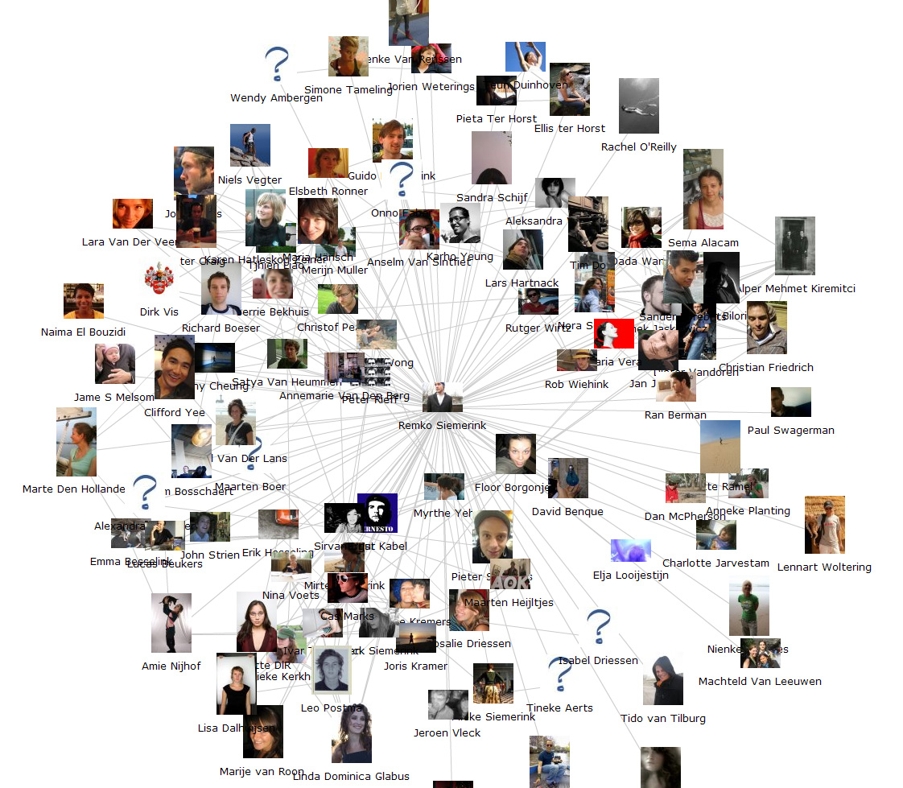
Graphs in social networks
Benefits of graph representation of friends on Facebook
  Fun
  Friends suggest help Facebook grow
  Graph machine learning helps targeted advertisement
Session nn: GraphX
Notes:
Targeted advertising is based on the analysis of your friends network, their proximity, and their likes and dislikes
Session nn: GraphX

Slide 7
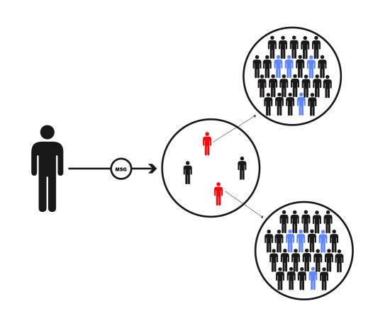
Finding influencers
Benefits of finding influencers
  Providing valuable information to the users
  Helpful for marketing
  Not obvious, and therefore useful information
  Similar to PageRank (next slide)
Source: Linkbuildr
Session nn: GraphX
Notes:
Services like Klout are based on this
Session nn: GraphX

Slide 8
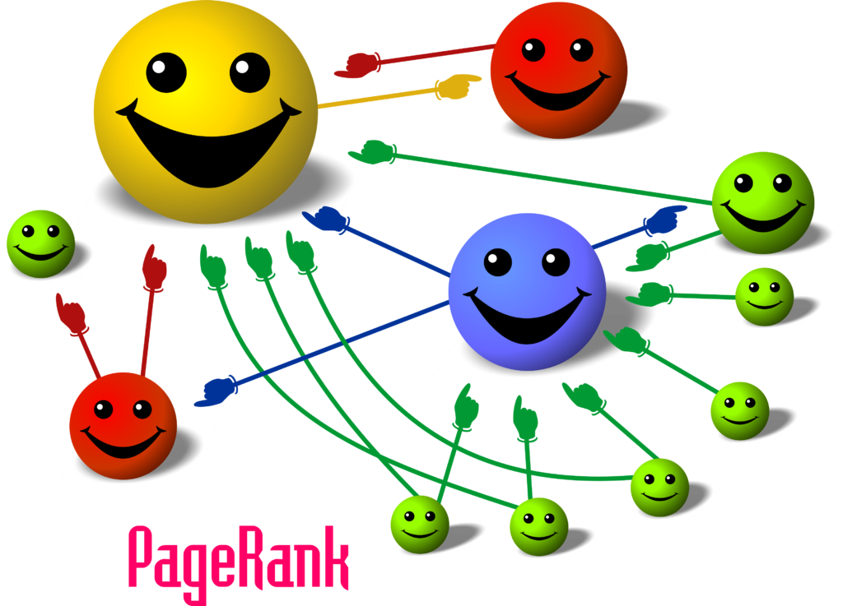
PageRank
Original algorithm that made Google succeed by returning relevant information
Useful in many other areas
Implemented by GraphX
  “Tell me who your friends,
  and I will tell who you are”
  Solved by iterations on a graph
Source: Wikimedia
Session nn: GraphX
Notes:
The same name as Larry Page, the inventor, but Google claims it is a coincidence
Session nn: GraphX

Slide 9
// Code Block Sample
Session nn: GraphX
Notes:
Session nn: GraphX

Slide 10
Section2
  Section1
  Section2
  Section3
Notes:
Session nn: GraphX

Slide 11
Session nn: GraphX
Notes:
Session nn: GraphX

Slide 12
Section3
  Section1
  Section2
  Section3
Notes:
Session nn: GraphX

Slide 13
Session nn: GraphX
Notes:
Session nn: GraphX

Slide 14
Lab nn.1: XX
Lab
Overview:
Builds on previous labs:
Approximate Time:
Session nn: GraphX
Notes:
To read the file use either
less README.txt
nano README.txt
Session nn: GraphX

Slide 15
Review Questions
Session nn: GraphX
Notes:
Session nn: GraphX

Slide 16
Lesson Summary
Session nn: GraphX
Notes:
Session nn: GraphX

