Slide 1
Session 05 : Spark API / Applications
  Section1
  Section2
  Section3
Notes:
Session nn: GraphX

Slide 2
Lesson Objectives
Learn to develop Spark applications
Learn Spark API
Session nn: GraphX
Notes:
Session nn: GraphX

Slide 3
Spark Application
  Section1
  Section2
  Section3
Notes:
Session nn: GraphX

Slide 4
Spark Applications
So far we have been using Spark Shell
  Stand-alone
  Or connecting to cluster
Shell is great for
  Ad-hoc / interactive
  Developing apps / Debugging
Once ready, we will submit the code as application
Can be in Scala / Python / Java
Session nn: GraphX
Notes:
Session nn: GraphX

Slide 5
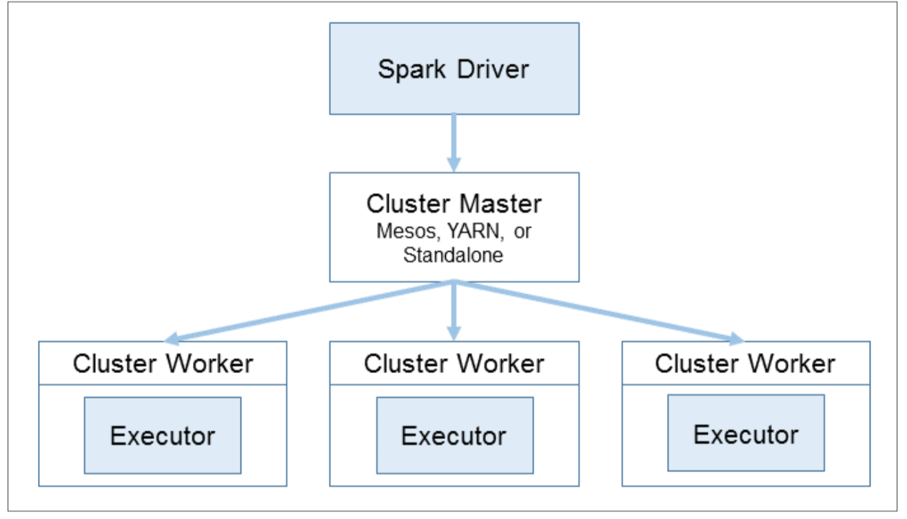
Spark Application Architecture
TODO : re-draw diagram

Slide 6
Driver
‘main’ method of application
Creates Spark context
Establishes connection to the cluster
Creates a DAG (Direct Acyclic Graph) of operations
DAG → Stages
Stages have multiple tasks
Schedules tasks on executors on cluster
Session nn: GraphX
Notes:
Session nn: GraphX

Slide 7
Executors / Tasks
Executors
  Launched at start of application.. Run for the duration of app
  Not shared across applications
  JVM containers
  Execute tasks (in threads)
  Provide memory for cache storage
Tasks
  ‘smallest’ execution units
  Process data in partitions
  Takes into account ‘data locality’

Slide 8
TODO : diagram of nodes / executors / tasks

Slide 9
Driver Code
(1) Conf Object
  Stores all conf stuff
(2) ‘SparkContext’ is the driver
(3) Operations follow
// scala
object TestApp{
def main(args: Array[String]) {
val conf = new SparkConf().setAppName(”TestApp")
val sc = new SparkContext(conf)
val rdd = sc.textFile(“file”)
val count = rdd.count()
println (“# lines : “ + count)
}
}
Session nn: GraphX
Notes:
Session nn: GraphX

Slide 10
Configuration Properties
API | Description | Example
conf.setAppName() | Sets the application name (shows up in UI) | conf.setAppName(“TestApp”)
conf.setSparkHome() | Spark install location | conf.setSparkHome(“/opt/spark”)
conf.setJars() | Additional Jars for the applications | conf.setJars(Array(” jar1.jar”, “jar2.jar”))
conf.set() | Set a property for the app | conf.set(“cassandra.host” “host1”)

Slide 11
Configuration Properties Contd
Conf.setMaster(“master”)
Master key | Description | Example
Local
local | Localhost with a single CPU core | “local”
local[N] | Run on localhost with N CPU cores | “local[4]”
local[*] | Run on localhost with all CPU cores | “local[*]”
Distributed
spark://host:port | Spark master (running stand alone) | spark://host1:7077
mesos:// host:port | Spark master (running on Mesos) | mesos://host1:5050
Yarn | Running on YAR | “yarn”

Slide 12
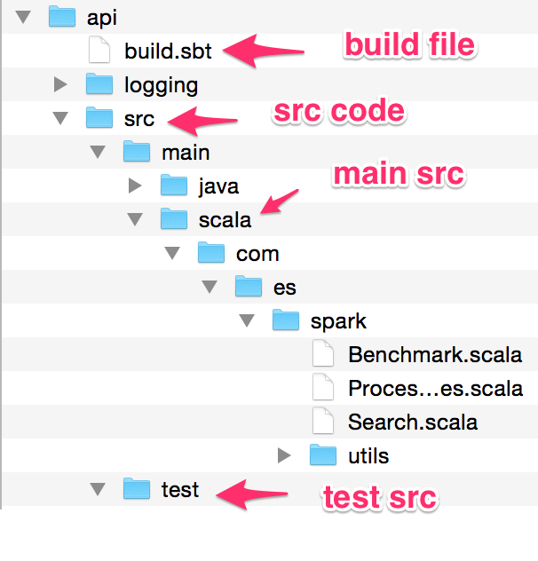
Scala Application Layout

Slide 13
Build.sbt
name := "TestApp"
version := "1.0"
scalaVersion := "2.10.4"
libraryDependencies ++= Seq(
"org.apache.spark" %% "spark-core" % "1.2.0” % “provided”
)
// need this to access files on S3 or HDFS
libraryDependencies += "org.apache.hadoop" % "hadoop-client" % "2.4.0" exclude("com.google.guava", "guava")
Session nn: GraphX
Notes:
Explain each values
Session nn: GraphX

Slide 14
Compiling Code
We use SBT – Simple Building Tool
Build tool of choice for Scala applications
build.sbt in project root dir (just like pom.xml for Maven)
Automatically downloads dependencies
sbt commands
  sbt compile
  sbt package – builds a jar
  sbt assembly – builds a ‘fat’ jar with all the dependencies
  sbt clean
To build:
sbt clean package
(first run takes a few minutes to download all deps... go get some coffee ☺ )
Notes:
TODO : add screen shots of jar location

Slide 15
Submitting The Application
bin/spark-submit
Example:
$ spark-submit --master master_url [any arguments] --class<class name> <jar file> [arguments to application]
$ spark-submit --master spark://localhost:7077 --executor-memory 4G --class com.es.spark. ProcessFiles target/scala-2.10/testapp.jar 1G.data

Slide 16
Spark-submit
Flag | Description | Example
--master <master url> | Master url | --master Spark://host1:7077
--name <app name> | Application Name | --name TestAPp
--class <main class> | Main class | --class my.TestApp
--driver-memory <val> | Memory for app driver (default 512M) | --driver-memory 1g
--executor-memory <val> | Memory for executors (more important!) | --executor-memory 4g
For more 'spark-submit' | Will print out all usage options

Slide 17
Checking Application UI
TODO : insert screen shot

Slide 18
Tools of Trade
IntelliJ
  Excellent support for Scala
  Fast / incremental compiles
  Code completion ..etc
  TODO : IntelliJ screenshot
Sublime
  TODO : insert screenshot

Slide 19
Driver Memory vs. Executor Memory
Driver memory is usually small
Executor memory is where data is cached..
  Can be big
Rdd.collect() will send data to driver
Large collections will cause out of memory error in driver
  Adjust size accordingly
TODO : insert diagram here

Slide 20
Lean-jar vs. fat-jar
‘Sbt package’ produces ‘learn jar’
  Just our application code only
  Good for apps with no dependencies
‘sbt assembly’ will produce a fat jar
  pull in all dependencies and
  Good if we have deps or using custom versions.

Slide 21
Dealing With Conflicts
Problem :
  system comes with version A of package X
  My application needs version B of package X
One solution
  Produce a fat jar with the required dependency
Sbt example:
  See next slide

Slide 22
Sbt assembly example
import AssemblyKeys._
name := "TestApp"
version := "1.0"
scalaVersion := "2.10.4"
libraryDependencies ++= Seq(
"org.apache.spark" %% "spark-core" % "1.2.0” % “provided”
)
// need this to access files on S3 or HDFS
libraryDependencies += "org.apache.hadoop" % "hadoop-client" % "2.4.0" exclude("com.google.guava", "guava")
assemblySettings
mergeStrategy in assembly := {
case m if m.toLowerCase.endsWith("manifest.mf") => MergeStrategy.discard
case m if m.toLowerCase.matches("meta-inf.*\\.sf$") => MergeStrategy.discard
case "log4j.properties" => MergeStrategy.discard
case m if m.toLowerCase.startsWith("meta-inf/services/") => MergeStrategy.filterDistinctLines
case "reference.conf" => MergeStrategy.concat
case _ => MergeStrategy.first
}
Session nn: GraphX
Notes:
Explain each values
Session nn: GraphX

Slide 23
Cluster Managers
  Section1
  Section2
  Section3
Notes:
Session nn: GraphX

Slide 24
Cluster Managers
Stand alone
Yarn
Mesos
Session nn: GraphX
Notes:
Session nn: GraphX

Slide 25
TODO : Yaakov
‘learning spark’ page 126 - 133

Slide 26
Which manager
TODO : yaakov
Learning spark , page 135

Slide 27
Logging & Debugging
  Section1
  Section2
  Section3
Notes:
Session nn: GraphX

Slide 28
Configuration
TODO : Yaakov
‘learning spark’ page 137

Slide 29
Logging and debugging
toDebugString
TODO : Yaakov
‘learning scala’ page 141

Slide 30
Information from UI
TODO
‘Learning Spark’ : page 145
Session nn: GraphX
Notes:
Session nn: GraphX

Slide 31
Logging
TODO
‘learning spark’ page 149

Slide 32
Turning off Logging
Create a file : logging/log4j.properties
TODO : format
# Set everything to be logged to the console
log4j.rootCategory=WARN, console
log4j.appender.console=org.apache.log4j.ConsoleAppender
log4j.appender.console.target=System.err
log4j.appender.console.layout=org.apache.log4j.PatternLayout
log4j.appender.console.layout.ConversionPattern=%d{yy/MM/dd HH:mm:ss} %p %c{1}: %m%n
# Settings to quiet third party logs that are too verbose
log4j.logger.org.eclipse.jetty=WARN
log4j.logger.org.apache.spark.repl.SparkIMain$exprTyper=INFO
log4j.logger.org.apache.spark.repl.SparkILoop$SparkILoopInterpreter=INFO

Slide 33
Turning Off Logging
TODO : format
Spark-submit --master xxxx --class xxxxx
--driver-class-path logging/ jar-file

Slide 34
Lab nn.1: XX
Lab
Overview:
Builds on previous labs:
Approximate Time:
Session nn: GraphX
Notes:
To read the file use either
less README.txt
nano README.txt
Session nn: GraphX

Slide 35
Review Questions
Session nn: GraphX
Notes:
Session nn: GraphX

Slide 36
Lesson Summary
Session nn: GraphX
Notes:
Session nn: GraphX

