Slide 1
Session 99: Spark Roundup
  Data Sources
  Section2
  Section3
Notes:
Session nn: GraphX

Slide 2
Lesson Objectives
Session nn: GraphX
Notes:
Session nn: GraphX

Slide 3
Data Sources
  Data Sources
  Section2
  Section3
Notes:
Session nn: GraphX

Slide 4
Spark and Data Stores
Spark is a compute platform
  Does NOT provide any data storage
Works with multitude of data stores
RDDs provide a nice abstraction
Scenario:
  Load data from HDFS (rdd1)
  Load data from S3 (rdd2)
  Create a join RDD (rdd3 = rdd1.join(rdd2))
  Save the result to Cassandra (rdd3.saveToCassandra())
Session nn: GraphX
Notes:
Session nn: GraphX

Slide 5
Spark RDD Abstraction
Spark
(compute engine)
RDD
Hadoop RDD
Cassandra RDD
HDFS
Amazon S3
Cassandra
???
Notes:
Spark can work with lots of storage types

Slide 6
Supported Data Stores
File Systems
  Local Files
  HDFS
  Cloud (Amazon S3)
  Network file systems (NFS ..etc)
Hive
JDBC

Slide 7
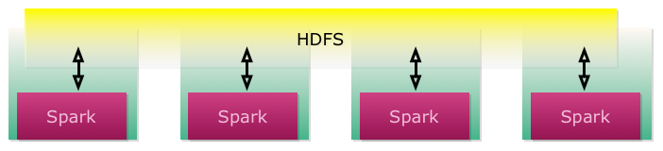
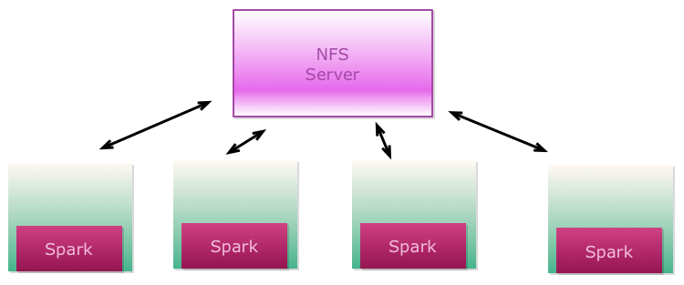
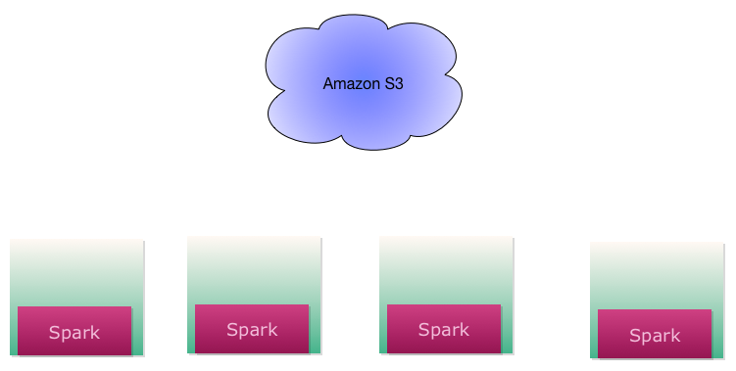
Spark File Systems

Slide 8
File Systems For Spark
 | HDFS | NFS | Amazon S3
Data locality | High (best) | Local enough | None (ok)
Throughput | High (best) | Medium (good) | Low (ok)
Latency | Low (best) | Low | High
Reliability | Very High (replicated) | Low | Very High
Cost | Varies | Varies | $30 / TB / Month

Slide 9
File System Throughput Comparison (HDFS Vs. S3)
Data : 10G + (11.3 G)
Each file : ~1+ G ( x 10)
400 million records total
Partition size : 128 M
On HDFS & S3
Cluster :
  8 Nodes on Amazon m3.xlarge (4 cpu , 15 G Mem, 40G SSD )
  Hadoop cluster , Latest Horton Works HDP v2.2
  Spark : on same 8 nodes, stand-alone, v 1.2

Slide 10
File System Throughput Comparison (HDFS Vs. S3)
val hdfs = sc.textFile("hdfs:///____/10G/")
val s3 = sc.textFile("s3n://______/10G/")
// count # records
hdfs.count()
s3.count()

Slide 11
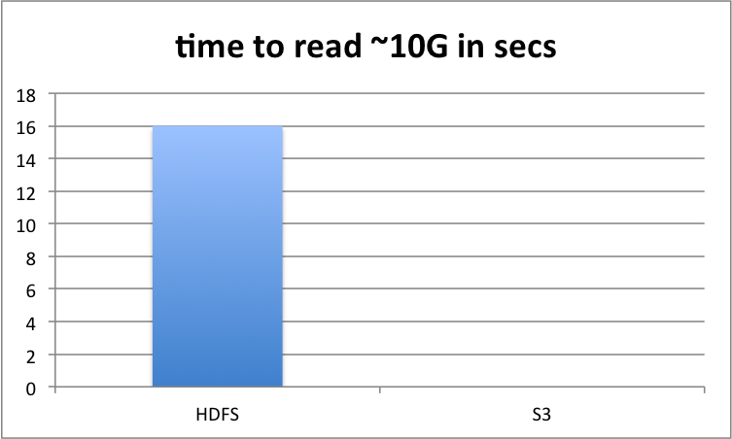
HDFS Vs. S3

Slide 12
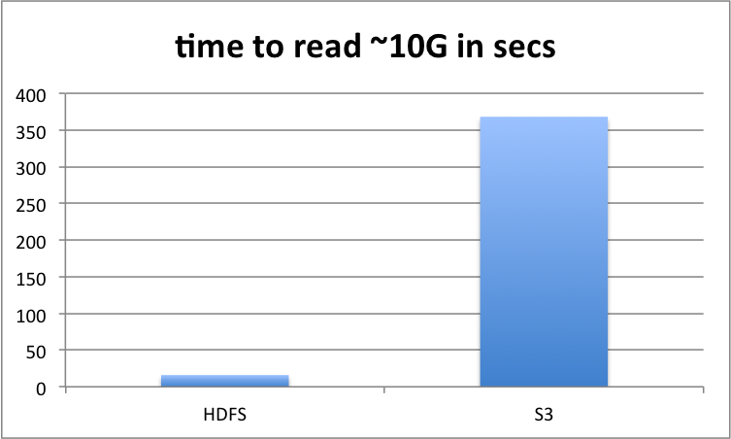
HDFS Vs. S3 (lower is better)

Slide 13
HDFS Vs. S3 Conclusions
HDFS | S3
Data locality → much higher throughput | Data is streamed → lower throughput
Need to maintain an Hadoop cluster | No Hadoop cluster to maintain → convenient
Large data sets (TB + ) | Good use case: Smallish data sets (few gigs) Load once and cache and re-use

Slide 14
// Code Block Sample
Session nn: GraphX
Notes:
Session nn: GraphX

Slide 15
Section2
  Section1
  Section2
  Section3
Notes:
Session nn: GraphX

Slide 16
Session nn: GraphX
Notes:
Session nn: GraphX

Slide 17
Section3
  Section1
  Section2
  Section3
Notes:
Session nn: GraphX

Slide 18
Session nn: GraphX
Notes:
Session nn: GraphX

Slide 19
Lab nn.1: XX
Lab
Overview:
Builds on previous labs:
Approximate Time:
Session nn: GraphX
Notes:
To read the file use either
less README.txt
nano README.txt
Session nn: GraphX

Slide 20
Review Questions
Session nn: GraphX
Notes:
Session nn: GraphX

Slide 21
Lesson Summary
Session nn: GraphX
Notes:
Session nn: GraphX

