Slide 1
Labs: Fast Track to Spring 4
(Eclipse/Tomcat)
Presentation Slides:
For INSTRUCTOR Use Only
The Java Developer Education Series
Notes:
Introduction

Slide 2
Release Level
Lab
This manual has been tested with, and contains instructions for, running the labs using the following platforms:
  Spring 4 (tested with 4.1)
  Java (tested with Java 7, requires Java 6+)
  Eclipse Java EE Edition (tested with 4.4/Luna)
  Tomcat 7 for the Spring/Web material
Recent similar versions of the software will likely work except for potentially small configuration changes
Introduction
Notes:
Any 4.x version of Spring should work
The course materials are compatible with all 4.x versions
However, we include the Spring 4.1 jars and their dependencies with the labs
If you want to use a different version, then it's up to you to make sure you have all the correct Spring jars and the correct dependency jars
All labs have been tested on Microsoft Windows using the software listed above
The labs should work on unix with little modification, except for the database setup scripts, which need to use unix shell scripts, which we also supply
Introduction

Slide 3
Lab 1.1: Setting Up the Environment
  In this lab you will set up the lab environment, bootstrap the Spring container, and test it using a unit test
Lab 1.1: Setting up Environment
Notes:
Lab 1.1: Setting Up the Environment

Slide 4
Lab Synopsis
Lab
Overview: In this lab, we will become familiar with the lab structure, set up our working environment, and test it to make sure it is running well
  We will also set up the Spring container
  The end goal is to compile and run a unit test that validates our setup
Objectives:
  Become familiar with the lab structure
  Set up our environment
  Write and run a simple smoke test that requires Spring
Builds on previous labs: None
Approximate Time: 30-45 minutes
Lab 1.1: Setting up Environment
Notes:
Lab 1.1: Setting Up the Environment

Slide 5
Information Content and Task Content
Lab
Within a lab, information only content appears the same as in the student manual pages
  Like these bullets at the top of the page
Tasks to perform are in an easily identifiable box
  An example appears below
Tasks to Perform
Look at these instructions, and notice the different look of the box as compared to that above
  Make a note of how it looks, as future labs will use this format
OK – Now locate your setup files; we're ready to start working ⁽¹⁾
Lab 1.1: Setting up Environment
Notes:
(1) Depending on your training environment, the setup files may be given to you in different ways, including:
Present on the training machines as a zip file
Already unzipped on the training machine
Given to you by the instructor
Available as a network share or web download
Your instructor will let you know how to access them
Lab 1.1: Setting Up the Environment

Slide 6
Setup Environment
Lab
You'll need the lab setup file, with a name like
  LabSetup_Spring4_Tomcat-Eclipse_20150115.zip
Our base working directory (created when we extract the setup) is:
C:\StudentWork\Spring
  Assuming you extracted the zip to C:\ - otherwise adjust accordingly
  It includes a directory structure and files needed for the labs ⁽¹⁾
Tasks to Perform
Make sure Java is installed ⁽¹⁾
Make sure Eclipse is installed ⁽²⁾
Unzip the lab setup file to C:\
  This will create the directory structure, described in the next slide, containing files that you will need for doing the labs
Lab 1.1: Setting up Environment
Notes:
(1) To make sure Java is installed, you can do one of the following
Open a command prompt, and type the below - it should execute and give version information
java -version
Look in C:\Program Files\Java for an installed JDK
If Java is not installed, then download it from one of the following, and execute the installer
https://java.com/en/download/index.jsp
https://java.com/en/download/manual.jsp
(2) To make sure Eclipse is installed, check for the install folder (usually C:\Eclipse)
If Eclipse is not installed, then first download it from http://www.eclipse.org/downloads
Under the Eclipse Packages section, click on the link for the Eclipse IDE for Java EE Developers, and save the zip file to your computer
If you need to install Eclipse, unzip the zip file (easiest location to unzip it to is C:\, but another location is fine as long as you can get to it to run the eclipse.exe executable)
Lab 1.1: Setting Up the Environment

Slide 7
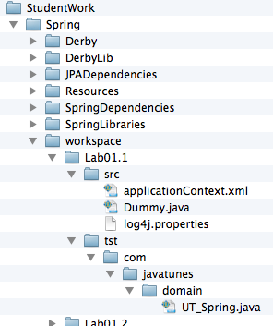
Lab Directory Structure
Lab
StudentWork\Spring contains
  Derby/DerbyLib: Database files
  JPADependencies: jars for JPA
  SpringDependencies: jars for Spring dependencies
  SpringLibraries: Spring jars
  workspace: Eclipse workspace
StudentWork\Spring\workspace will contain the following folders:
  LabNN : Folder for Lab NN
  LabNN/src : Java source
  LabNN/tst : Java unit tests
  LabNN/bin/ : compiled code (Eclipse's standard location)
Lab 1.1: Setting up Environment
Notes:
To make it easier to open command windows in the lab dirs, we've included a utility in the setup that allows you to right click on a folder to open a command prompt
Not needed for Windows 7, where you can press and hold the shift key, then right click on a folder and select "Open Command Window Here"
For earlier Windows versions, install this as follows:
Go to the Resources/CommandPromptHere folder
Right click on the .reg file there, and select Merge
Once you've done that, right clicking on a folder will show a Command Prompt Here selection in the context menu - Select that to open a command prompt in the directory
Lab 1.1: Setting Up the Environment

Slide 8
General Lab Structure
Lab
Root lab folder for this lab is:
  workspace\Lab01.1
  It already exists in your workspace
  You'll create a new Eclipse project in this folder, which contains starter files that we provide
  Lab files are in this project/folder and instructions are given relative to it
  We have existing folders for all the labs
Detailed instructions are included in this lab
  Including complete Eclipse instructions, as well as details about the lab requirements
Subsequent labs are similar to this lab, so include fewer detailed instructions
Lab 1.1: Setting up Environment
Notes:
Lab 1.1: Setting Up the Environment

Slide 9
Eclipse Overview
Lab
Eclipse: Open source platform for building integrated development environments (IDEs)
  Used mainly for Java development
  Can be flexibly extended via plugins to add capabilities
  http://www.eclipse.org is the main website
This lab includes detailed instructions on using Eclipse
  Starting it, creating and configuring projects, etc.
Other labs include fewer Eclipse details - they may just say build/run as previously
  Just use the same procedures to build/run as in this lab
  Refer back to these lab instructions as needed
Lab 1.1: Setting up Environment
Notes:
The Eclipse source base was originally developed by IBM
It was released by IBM into open source
IBM's RAD (and previously its WSAD) environment is built on top of Eclipse
Lab 1.1: Setting Up the Environment

Slide 10
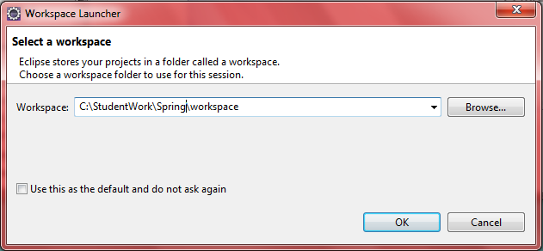
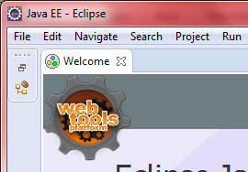
Launch Eclipse
Lab
Tasks to Perform
Launch eclipse: Go to c:\eclipse and run eclipse.exe
  A dialog box appears prompting for workbench location (below left)
  Set the workbench location to C:\StudentWork\Spring\workspace
  Click OK
  Close the Welcome screen: Click the X on its tab (below right)
Lab 1.1: Setting up Environment
Notes:
If Eclipse was installed elsewhere, adjust the paths to the Eclipse executable accordingly
You can put a shortcut to this executable on your desktop
You can also have your lab workspace in a different location
Again, just adjust the lab instructions as required
If a different default workspace location is set when you start Eclipse, then change it
Sometimes Eclipse is set up to automatically open to a different workspace location
If this is the case, you can switch workspaces after Eclipse starts by going to File | Switch Workspace
Lab 1.1: Setting Up the Environment

Slide 11
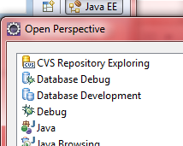
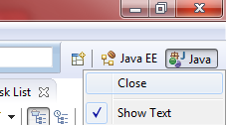
Workbench and Java Perspective
Lab
Tasks to Perform
You should be in a Java EE perspective *
Open a Java Perspective: Click the Perspective icon at the top right of the Workbench, and select Java (see below left)
  Close the Java EE perspective by right clicking its icon, and selecting close (see below right)
Unclutter the Java Perspective by closing some views
  Close the Task List and Outline views (click on the X)
  Open the Navigator View (Window | Show View | Navigator)
Lab 1.1: Setting up Environment
Notes:
The Eclipse Java EE version opens in the Java EE perspective by default
Other versions may open in a different perspective
If you're already in a Java perspective, you don't need to switch perspectives, and there is nothing for you to do
To save a our "uncluttered" perspective as the default Java perspective go to
Window | Save Perspective As | Java
You can reset the perspective to its defaults via
Window | Reset Perspective
Lab 1.1: Setting Up the Environment

Slide 12
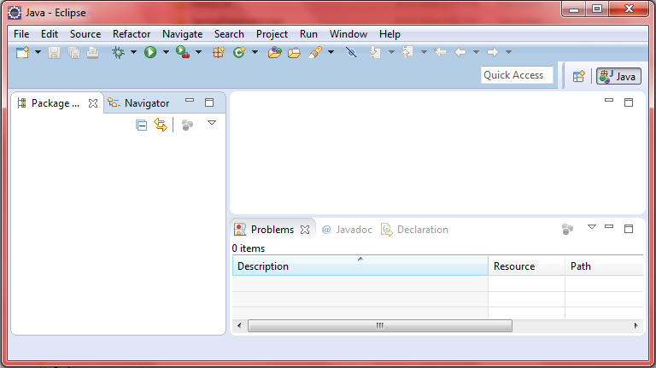
Java Perspective: Where's the Projects?
Lab
Relax! The projects will reveal themselves as we proceed
  Do not import anything
financial info
Lab 1.1: Setting up Environment
Notes:
Lab 1.1: Setting Up the Environment

Slide 13
Create User Libraries
Lab
Our projects will use a custom Spring user library, including:
  Spring jars from the Spring distribution
  Supplied external dependencies
  We'll set these up as a user library for ease of use across projects
Tasks to Perform
Go to Window | Preferences | Java | Build Path | User Libraries
  Click New… , in the dialog, call the library Spring, and press OK
  Click the Add External JARs… button, browse to
  StudentWork\Spring\SpringLibraries
  Select all the jars in that folder, Click Open
  Select the Spring library again, click Add External JARs…, browse to
  StudentWork\Spring\SpringDependencies
  Select all jars in that folder, Click Open
  Click OK to finish creating the library
Lab 1.1: Setting up Environment
Notes:
We include all the Spring jars from the Spring distribution in our setup
This is for ease of use
Otherwise you would need to download them somehow - which is no longer a trivial job since there is no archive available from the Spring project with all the jar files that make up the Spring distribution
We supply all needed dependencies in the SpringDependencies folder
These were figured out by using Maven and seeing what dependencies were added to the project
In this folder, we supply all the external dependencies for all the labs
This is quite a bit more than is needed for this lab
Lab 1.1: Setting Up the Environment

Slide 14
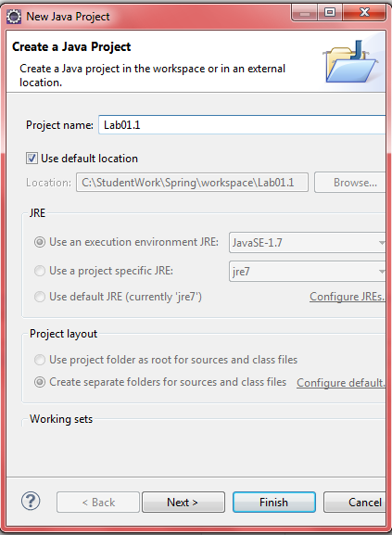
Create a Project for our Application
Lab
Tasks to Perform
Create a Java Project ⁽¹⁾
  Call the project Lab01.1
  Eclipse will then automatically set the project folder to Lab01.1
    This folder already exists in the workspace
    It contains a Java project laid out for Eclipse
  Click Next
This will bring you to the Java Settings dialog
  It should show the src and tst folders as source folders ⁽²⁾
  It will also let us add a library
Lab 1.1: Setting up Environment
Notes:
To create a Java Project, use the menu item
File| New | Java Project
There are many other ways to create a project
You can use the new icon on the left hand side of the toolbar, as shown above
You will need to create a new Java project in Eclipse each time the lab instructions tell you to use a new Lab directory - this happens several times in the course
(2) You should see the following two folders picked up automatically by Eclipse as source folders
Lab 1.1: Setting Up the Environment

Slide 15
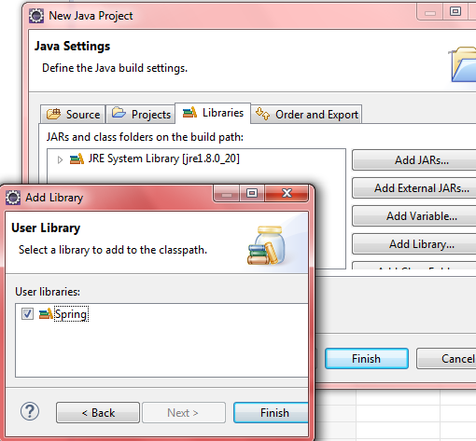
Add the Spring Library to the ClassPath
Lab
Tasks to Perform
In the Java Settings dialog, click the Libraries tab ⁽¹⁾
  Click the Add Library button, and in the dialog that comes up, select User Library then click Next
  Check off Spring, then click Finish out of all dialogs
Lab 1.1: Setting up Environment
Notes:
(1) If you forget to add the library in this step, you can always add it later as follows
Right click on the project in Package Explorer, and select Build Path | Add Libraries
That should bring you to the Libraries tab, so add in the Spring library as described above
Note that we include the JUnit library with the SpringDependencies
Eclipse also provides a JUnit library, but we prefer not to have an Eclipse dependency in the lab classpath
When the project is created, Eclipse will attempt to compile all the Java source
This may lead to warnings about unused imports, variables, etc. depending on our setup files
You can just ignore these – most of them are because the files we give you are just skeletons, and not complete.
If you want, you can shut these warnings off as follows:
Window | Preferences | Java | Compiler | Errors/Warnings
Go to the "Unnecessary Code" section, and change the settings for "Unused import", "Unused local or private member", and "Local variable is never read" to "Ignore"
Lab 1.1: Setting Up the Environment

Slide 16
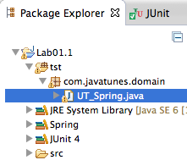

Running the Lab
Lab
Tasks to Perform
We use Eclipse to run a test case in UT_Spring.java
  No coding needed in this class
  It just bootstraps Spring to test the environment
After a clean build (error-free, not necessarily warning-free), do the following
  In Package Explorer , right click on UT_Spring.java
    It's in com.javatunes.domain package under the tst folder
  Select: Run As -> JUnit Test
  This automatically finds and runs UT_Spring's test method
Lab 1.1: Setting up Environment
Notes:
Lab 1.1: Setting Up the Environment

Slide 17
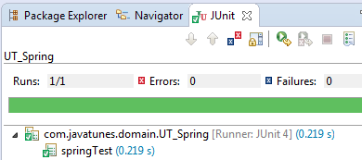
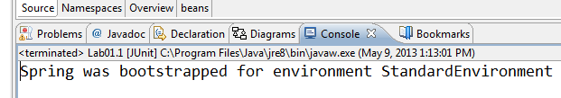
Program Output
Lab
You should see JUnit output in a JUnit view, as shown below, and output in the Eclipse Console view as shown at bottom
  These should all be error free ⁽¹⁾
Note: You'll follow similar procedures whenever you have a Java program to run in the labs ⁽²⁾
Lab 1.1: Setting up Environment
Notes:
(1) If you see any errors in the JUnit test, or exceptions in the Console output, then you've got something configured incorrectly
(2) When running programs in other labs, the only thing that may change is the program class that you'll need to right click on to run
The procedure will remain the same though
Lab 1.1: Setting Up the Environment

Slide 18
Lab 1.2: Hello Spring World
  In this lab, we will create and use a Spring context to access a bean instance
Notes:
Lab 1.2: Hello Spring World

Slide 19
Lab Synopsis
Lab
Overview: In this lab, we will create and use a Spring context to access a bean instance
Objectives:
  Become familiar with the different parts of basic Spring
  Write and run a simple Spring test
Builds on previous labs: 1.1
Approximate Time: 20-30 minutes
Lab 1.2: Hello Spring World
Notes:
The purpose of this lab is to become familiar with the different parts of a Spring application
Accordingly, the program is as simple as we can make it
It mirrors the code already shown in the manual pages
In later labs, we'll work with more complex applications
Lab 1.2: Hello Spring World

Slide 20
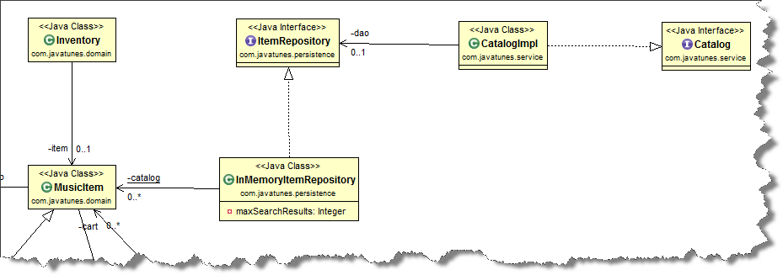
Object Model
Lab
Object Model: Our focus will be on the following types
  We'll cover more types shortly
  Note: Search methods in the catalog won't work yet
MSA-1
Lab 1.2: Hello Spring World
Notes:
Lab 1.2: Hello Spring World

Slide 21
Lab Preparation
Lab
The new lab folder where you will do all your work is:
workspace\Lab01.2
Tasks to Perform
Close all open files and projects
Create a new Java project called Lab01.2 in the workspace
  See Lab 1.1 instructions on how to do this if you need to
  Remember to add the Spring user library
Lab 1.2: Hello Spring World
Notes:
If you need to add the Spring Library after creating the project, do the following
Right Click on the project in Package Explorer, select Build Path | Add Libraries
You should be in the Libraries tab, so click the Add Library button, and in the dialog , select User Library then click Next
Check off Spring, then click Finish in all open dialogs
Lab 1.2: Hello Spring World

Slide 22
Writing and Configuring a Bean in Spring
Lab
Tasks to Perform
Open CatalogImpl.java file
  The class is in the com.javatunes.service package, under src
  Make sure CatalogImpl implements the Catalog interface
  Remember that we code to interfaces to decouple us from a specific implementation
Open up the src/applicationContext.xml file
  Click the Source tab to edit
  Finish up the declaration of the <bean> element by declaring:
    An id of musicCatalog
    A class of com.javatunes.service.CatalogImpl
Lab 1.2: Hello Spring World
Notes:
There are a number of other types in the src tree that we will use in future labs
Ignore these for now
Lab 1.2: Hello Spring World

Slide 23
Using a Bean in a Program
Lab
Tasks to Perform
Open UT_Catalog (in the tst folder) and do the following
  In catalogTest(), modify the ClassPathXmlApplicationContext constructor to specify your applicationContext.xml
  Next, look up the musicCatalog bean from the Spring context ⁽¹⁾
    Catalog catalog = ctx…
  Make sure the catalog bean is not null (use assertTrue)
  Output the catalog bean (Just use System.out.println())
  Finally, call close() on the context
  Fix any compilation errors
Run UT_Catalog as a unit test and make sure the test passes
  Right click | Run As … as in previous labs
  You should see the output from the toString() method
You've successfully configured and used a bean with Spring
  Congratulations !
Lab 1.2: Hello Spring World
Notes:
(1) Since there is only one bean that implements Catalog, we can look it up by type
Lab 1.2: Hello Spring World

Slide 24
Logging and Additional Things (Optional)
Lab
We've provided a log4j.properties file in src
  This configures some of the logging that Spring will do
  You can reduce the logging output by opening this file, and changing the INFO to WARN at the top line of the file:
  log4j.rootLogger=WARN, stdout
  You can increase the logging by using DEBUG instead
[Optional] Other things to try
  Try looking up the bean by name, – what happens? What about if you look it up by the wrong name?
  Try looking up a CatalogImpl instead of a Catalog
    Does this work? Is it a good idea? (see notes)
  Change your code back to your original solution
  before proceeding
Lab 1.2: Hello Spring World
Notes:
Spring has logging built into it
It uses commons-logging by default, which will detect the log4j jar file and use that if it is on the classpath
You can see the logging by properly configuring it, as we do in the log4j.properties file
The details of log4j are beyond the scope of this course
Looking the bean up as a CatalogImpl will work
These are POJOs, and the actual type is CatalogImpl
It's not a good idea though, because you are defeating the purpose of decoupling your code from the actual implementation type
Lab 1.2: Hello Spring World

Slide 25
Lab 1.3: Dependency Injection
  In this lab, we'll work with Spring's DI capabilities
Notes:
Lab 1.3: Dependency Injection

Slide 26
Lab Synopsis
Lab
Overview: In this lab, we'll work with Spring's DI capabilities
  We will configure Spring to inject dependencies based on the following
    CatalogImpl needs ItemRepository
  UT_Catalog does not need to change at all
    It can simply look up the catalog as it did before
    The catalog will now have complete functionality
Objectives:
  Become familiar with Spring DI, and use it in a program
Builds on previous labs: 1.2
Approximate Time: 20-30 minutes
Lab 1.3: Dependency Injection
Notes:
Lab 1.3: Dependency Injection

Slide 27
Object Model
Lab
Object Model: We'll focus on injecting an ItemRepository into the CatalogImpl
  We don't cover ItemRepository details - it's given to you in full
MSA-1
Lab 1.3: Dependency Injection
Notes:
ItemRepository and InMemoryItemRepository are given to you
You don't need to modify them at all in these early labs
Accordingly, we don't go into details on these types
They provide a simple data store and search API for items in the catalog
Lab 1.3: Dependency Injection

Slide 28
Writing and Configuring a Bean in Spring
Lab
Tasks to Perform
Continue to work in the Lab01.1 project
Open CatalogImpl for review
  Notice it has an ItemRepository property
    This is a dependency on ItemRepository
  The dependency will be “wired up” by Spring DI
Open up the src/applicationContext.xml file ⁽¹⁾
  Add a com.javatunes.persistence.InMemoryItemRepository bean definition, with an id of itemRepository
    This requires no injection or other configuration
  Modify the metadata for the musicCatalog by wiring its itemRepository property with a reference to the itemRepository bean
Lab 1.3: Dependency Injection
Notes:
(1) Look at the <bean> elements in the slides, or from previous labs to help you remember what they look like
Lab 1.3: Dependency Injection

Slide 29
Using a Bean in a Program
Lab
Run the test as before and make sure it passes
  The output should be similar to before, but now it reveals an injection of ItemRepository
Open UT_Catalog.java for editing and call the size() method on the catalog, and print it out
  It gives a result now - where did the data come from?
  Add a call to the catalog's findByKeyword(“a”)
    What is returned? Print out the returned data
In applicationContext.xml, try leaving out the metadata for the dependency wiring
Run your test again - What happens? Why?
Change your code back to your original solution before going on
Lab 1.3: Dependency Injection
Notes:
Lab 1.3: Dependency Injection

