Slide 1
Spark For Developers
Presentation Slides:
For INSTRUCTOR Use Only
Notes:
Version: 20150401
Introduction

Slide 2
Workshop Overview
An in-depth course teaching the use of Spark to efficiently process large data sets
  We also demonstrate best practices in working with Spark
The course covers the following areas
  XX
Introduction
Notes:
Introduction

Slide 3
XX Workshop Objectives
Introduction
Notes:
Introduction

Slide 4
Workshop Agenda
Session 1: Introduction to Spark
Session 2: RDDs and Spark Architecture
Introduction
Notes:
Introduction

Slide 5
Typographic Conventions
Code in the text uses a fixed-width code font, e.g.:
  Catalog catalog = new CatalogImpl()
  Code fragments are the same, e.g. catalog.speakTruth()
  We bold/color text for emphasis
  Filenames are in italics, e.g. Catalog.java
  Notes are indicated with a superscript number ⁽¹⁾ or a star *
  Longer code examples appear in a separate code box - e.g.
package com.javatunes.teach;
public class CatalogImpl implements Catalog {
public void speakTruth() {
System.out.println("BeanFactories are way cool");
}
}
Introduction
Notes:
(1) If we had additional information about a particular item in the slide, it would appear here in the notes
We might also put related information that generally pertains to the material covered in the slide
Introduction

Slide 6
Labs
Lab
The workshop has numerous hands-on lab exercises, structured as a series of brief labs
  XX
  The lab details are XX
XX Virtual machine
Introduction
Notes:
Introduction

Slide 7
Session 1: Introduction to Spark
  Introduction
  Acquiring and Using Spark
  Spark Compared
Notes:
Session 1: Introduction to Spark

Slide 8
Lesson Objectives
Understand the needs that Spark addresses
Be familiar with Spark's capabilities and advantages
Gain an understanding of a basic Spark installation
Session 1: Introduction to Spark
Notes:
Session 1: Introduction to Spark

Slide 9
Introduction
  Introduction
  Acquiring and Using Spark
  Spark Compared
Session 1: Introduction to Spark
Notes:
Session 1: Introduction to Spark

Slide 10
Current Big Data Processing Challenges
Processing needs outpacing 1st generation tools
MapReduce (MR) / Hadoop has major limitations
  MR performance bottlenecks
  Batch processing doesn't fit needs
  Programming can be difficult and verbose
  MR add-ons attempt to address these
    But many are inherent in the core architecture
Spark is a 2nd generation tool addressing these needs
  One of the premier next generation technologies
  Let's look at it
Session 1: Introduction to Spark
Notes:
MapReduce / Hadoop has become a primary tool in the big data processing arena
It does some things extremely well
It grabbed mind and market share early on, along with organizations that supported it
As a result, it plays a dominant role in the big data processing landscape
The limitations of Hadoop are becoming apparent
As big data technologies become more common, the range of tasks they need to deal with are growing
Organizations are no longer willing to live with the shortcomings of existing technology just because they brought capabilities that didn't exist before
As a result, new technologies and products are emerging to augment, and in some cases replace, existing technology
Session 1: Introduction to Spark

Slide 11
What is Spark?
Open source cluster computing engine
  Very fast: In-memory ops 100x faster than MR
    On-disk ops 10x faster than MR
  General purpose: MR, streaming, machine learning, analytics
  Compatible: Runs over Hadoop, Mesos, standalone
    Works with HDFS, Cassandra, HBase, S3 …
  Easier to code: Word count in 2 lines
Spark's roots:
  Came out of Berkeley AMP Lab
  Now top-level Apache project
  Version 1.2 just released (Dec 2014)
  “First Big Data platform to integrate batch, streaming and interactive computations in a unified framework” – stratio.com
Session 1: Introduction to Spark
Notes:
Session 1: Introduction to Spark

Slide 12
Spark Eco-System
Apache top level project
  Very active, fast growing community (1)
Databricks: supporting / developing Spark
  Founded by Spark's creators
  Employs the most active committers
Hadoop vendors (Cloudera / Horton Works)
  Support Spark in their distributions
Spark packages repository: Community index of Spark add-ons
  http://spark-packages.org/
Session 1: Introduction to Spark
Notes:
(1) Spark had over 465 contributors in 2014
This made it the most active Apache project, as well as the most active Big Data open source project
[http://en.wikipedia.org/wiki/Apache_Spark and https://www.openhub.net/p/apache-spark]
Session 1: Introduction to Spark

Slide 13
Spark Illustrated
Schema / sql
Real Time
Machine Learning
Graph processing
Spark
SQL
Spark
Streaming
ML lib
GraphX
Spark Core
Cluster
managers
Standalone
YARN
MESOS
Data Storage
S3
HDFS
Cassandra
???
Session 1: Introduction to Spark
Notes:
See the next slide for a brief explanation of each component
Session 1: Introduction to Spark

Slide 14
Spark Structure
Data Storage: Pluggable data storage systems
  Integrates with HDFS, S3, Cassandra DB and more
Cluster Manager: Manages distributed node clusters
  Provides the execution environment
  Works with Mesos, Yarn, and it's own standalone manager
Spark Core: Distributed Compute Engine
Spark Components: Modules layered on top of core
  Specialized functionality - e.g. Spark SQL for relational queries
Session 1: Introduction to Spark
Notes:
We will get into much more detail on how each of these components works and how they integrate together
Session 1: Introduction to Spark

Slide 15
Spark Core
Basic building blocks for distributed compute engine
  Task schedulers and memory management
  Fault recovery (recovers missing pieces on node failure)
  Storage system interfaces
Defines Spark API and data model
Data Model: RDD (Resilient Distributed Datasets)
  Distributed collection of items
  Can be worked on in parallel
  Easily created from many data sources (Any HDFS InputSource)
Spark API: Scala, Python, and Java
  Compact API for working with RDD and interacting with Spark
  Much easier to use than MapReduce API
Session 1: Introduction to Spark
Notes:
We will get into much more detail on how each of these components works and how they integrate together
Session 1: Introduction to Spark

Slide 16
Spark Components
Spark SQL: Structured data
  Supports SQL and HQL (Hive Query Language)
  Data sources include Hive tables, JSON, CSV, Parquet ⁽¹⁾
Spark Streaming: Live streams of data in real-time
  Low latency, high throughput (1000s events / sec)
  Log files, stock ticks, sensor data / IOT (Internet of Things) …
ML Lib: Machine Learning at scale
  Classification/regression, collaborative filtering …
  Model evaluation and data import
GraphX: Graph manipulation, graph-parallel computation
  Social network friendships, link data, …
  Graph manipulation and operations and common algorithms
Session 1: Introduction to Spark
Notes:
(1) Parquet is an on disk columnar format that is heavily compressed
Session 1: Introduction to Spark

Slide 17
Spark : 'Unified' Stack
Spark components support multiple programming models
  Map reduce style batch processing
  Streaming / real time processing
  Querying via SQL
  Machine learning
All modules are tightly integrated
  Facilitates rich applications
Spark can be the only stack you need !
  No need to run multiple clusters (Hadoop cluster, Storm cluster, etc.)
Session 1: Introduction to Spark
Notes:
Session 1: Introduction to Spark

Slide 18
Spark Use Cases
Data Scientist | Data Engineer
Ad hoc exploration Analyze data, build models Come up with ‘insights’ (recommendations, etc.) | Build data infrastructure (pipelines, processing, etc.) Productize ideas from Data Scientists (incorporate recommendation within online store)
Shells are great for ad-hoc analysis (Scala & Python) | Shells are good way to debug / test programs
Can re-use rich libraries in Scala / Java / Python | Can use already familiar languages
Interactive Development (not waiting minutes / hours for runs) | ditto
 | Unified stack (program within one stack)
Session 1: Introduction to Spark
Notes:
Session 1: Introduction to Spark

Slide 19
Spark Use Case Examples
Ooyala (video content)
  Personalized video recommendations
  Spark & Cassandra
  Open sourced Spark Job Server
    https://github.com/spark-jobserver/spark-jobserver
  http://engineering.ooyala.com/blog/fast-spark-queries-memory-datasets
TODO:
Session 1: Introduction to Spark
Notes:
Session 1: Introduction to Spark

Slide 20
  Acquiring and Using Spark
  Introduction
  Acquiring and Using Spark
  Spark Compared
Session 1: Introduction to Spark
Notes:
Session 1: Introduction to Spark

Slide 21
Apache Spark Project / Download
Spark is a top level Apache, open-source, project
  http://spark.apache.org/
Written in Scala ⁽¹⁾
  Runs on the Java Virtual Machine (JVM)
Binary tarballs available on the project website
  Containing the spark and scala libraries, interactive shells, run scripts, and one of several supported Hadoop distributions
Can be used in two mediums
  Standalone: We'll start with this first
  As part of Hadoop stack (Cloudera / Hortonworks)
Session 1: Introduction to Spark
Notes:
(1) Scala is an "object-functional" programming language
It supports both object-oriented programming and functional style programming (which is used heavily in Spark)
It was designed to get around limitations in Java - some of which have been addressed since Scala was created
For example, the addition of Lambdas and other capabilities to Java 8
Session 1: Introduction to Spark

Slide 22
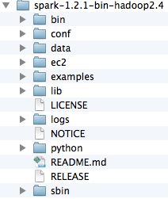
System Requirements and Installation
System requirements: Java 6+
Spark folder structure from tarball
  bin: executables (Spark/Python shells, utilities, etc.)
  conf: Configuration templates (e.g. spark-env.sh.template)
  data: Sample data files
  ec2: Scripts/files to run on EC2
  examples: Example programs (Scala, Python, Java)
  lib: Jar files
  logs: Log files
  python: Python source
  sbin: Shell scripts
Session 1: Introduction to Spark
Notes:
The example uses the Spark 1.2.1 distribution that includes Hadoop 2.4
Session 1: Introduction to Spark

Slide 23
Spark Operations
Stand-alone install is a bit 'rough around the edges'
Monitoring solutions are slim
  Sematext offerring
Need to improve:
  Manageability (restarting failed nodes / processes)
  Performance bottlenecks, etc.
Session 1: Introduction to Spark
Notes:
Session 1: Introduction to Spark

Slide 24
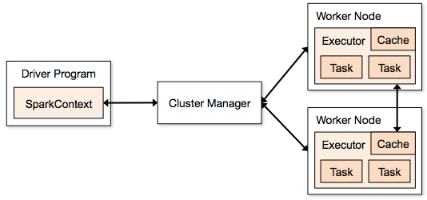
Runtime Architecture
Node
Client
Standalone
Yarn
Mesos
Session 1: Introduction to Spark
Notes:
Session 1: Introduction to Spark

Slide 25
Working with Spark
Two simple ways to start working with Spark
Use the standalone cluster manager to start a cluster
  And start all nodes on one machine
  <spark>/sbin/start-all.sh starts up a small cluster (a master and one worker) - stop-all.sh stops them
  May require a bit of setup for ssh access
Use an interactive shell
  Ships with Scala and Python shells
  Scala: <spark>/bin/spark-shell
  Python: <spark>/bin/pyspark
  These start up cluster and enable ad-hoc interaction
Session 1: Introduction to Spark
Notes:
(1) We'll go into more detail on all of this
For now, we just want to get started with Spark so we introduce them briefly
Session 1: Introduction to Spark

Slide 26
Standalone Cluster Manager
Simple standalone cluster support
  No need for other manager (e.g YARN)
  Easy setup/startup for development
Easy startup via provided launch scripts
  <spark>/sbin/start-all.sh starts a manager (master) and workers
    Default: One worker, one slave on local machine
    Or based on configuration files (next slide)
    Can log into master Web UI at hostname:8080
Other launch scripts include
  start-master.sh: Start master on this machine
  start-slaves.sh: Start workers on machines listed in conf/slaves
  stop-*.sh: Variations to stop master, slaves, or all
Session 1: Introduction to Spark
Notes:
The standalone cluster manager
Session 1: Introduction to Spark

Slide 27
Spark Configuration
conf/log4j.properties: Logging configuration
  log4j.properties.template is starter file ⁽¹⁾
conf/slaves file: List of worker hosts (default localhost)
  slaves.template is starter file
conf/spark-env.sh: Overall configuration
  IP addresses, ports, memory, cores, etc.
  spark-env.sh.template starter file has complete description
  For example, standalone configuration includes:
    SPARK_MASTER_IP / PORT / WEBUI_PORT : Master connectivity
    SPARK_WORKER_CORES / INSTANCES: Worker resources
    And many, many more
Session 1: Introduction to Spark
Notes:
(1) To use one of the starter files, copy it and rename the file without the .template suffix
e.g. copy log4j.properties.teamplate to log4j.properties
Then modify the non-template version
Session 1: Introduction to Spark

Slide 28
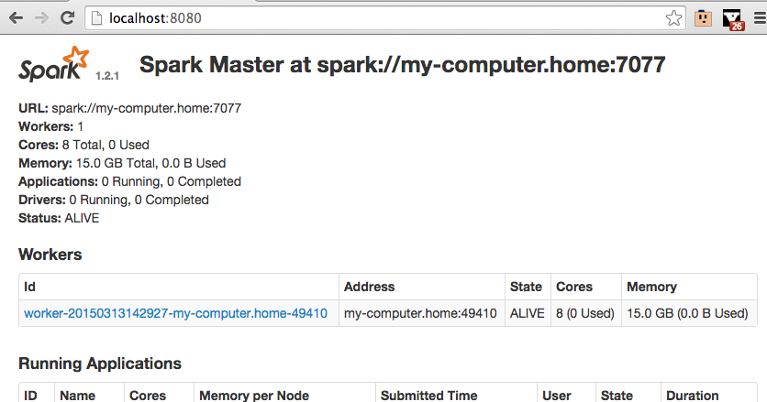
Starting Spark and viewing UI
$ ./sbin/start-all.sh
starting org.apache.spark.deploy.master.Master, logging to /Users/student/spark-1.2.1-bin-hadoop2.4/sbin/../logs/spark-student-org.apache.spark.deploy.master.Master-1-my-computer.home.out
localhost: starting org.apache.spark.deploy.worker.Worker, logging to /Users/student/spark-1.2.1-bin-hadoop2.4/sbin/../logs/spark-student-org.apache.spark.deploy.worker.Worker-1-my-computer.home.out
Session 1: Introduction to Spark
Notes:
Session 1: Introduction to Spark

Slide 29
Lab 1.1: First Look at Spark
Lab
Overview: In this lab, we will become familiar with the lab environment, set up Spark, and start a Spark cluster
Builds on previous labs: None
Approximate Time: 15-20 minutes
Login to your Spark nodes (Instructor will provide details)
Update the labs:
$ cd ~/spark-labs
$ git pull
$ cd 1.1-intro
  Follow README.txt file (use less or nano to read ⁽¹⁾)
Lab 1.1: First Look at Spark
Notes:
To read the file use either
less README.txt
nano README.txt
Lab 1.1: First Look at Spark

Slide 30
Spark Shells
Interactive shells for ad-hoc operations
  Full access to distributed compute engine
  Ad-hoc queries on large data sets can access large clusters for fast response
Scala shell: bin/spark-shell (We'll mostly use this)
Python shell: bin/pyspark
Shells run in one of:
  Local (pseudo) mode: Use embedded, in-process spark server
    NOT the same as using the standalone manger ⁽¹⁾
  Cluster mode: Connect to cluster via URL of master
Session 1: Introduction to Spark
Notes:
(1) Local mode is an un-clustered mode that runs the workers in the same process as the driver program
You can run in local mode when writing Spark programs - simply use "local" as the URL of the master to connect to (more on this to come)
Session 1: Introduction to Spark

Slide 31
Shell Execution Modes
Spark local server
shell
Spark node
Spark node
Spark master
shell
Spark node
Spark node
Session 1: Introduction to Spark
Notes:
Session 1: Introduction to Spark

Slide 32
Spark Shell Startup Examples
spark-shell: Startup using embedded server, and 1 thread
  The default
spark-shell --master local[4]: Startup using embedded server, and 4 worker threads
  Generally limit to number of cores you have
spark-shell --master spark://my-computer.home:7077
  Connect to spark cluster with master at URL above
  Assumes standalone cluster running on my-computer.home
spark-shell --help: Show help
Session 1: Introduction to Spark
Notes:
Session 1: Introduction to Spark

Slide 33
Starting Spark Shell (Local Mode)
$ bin/spark-shell
Spark assembly has been built with Hive, including Datanucleus jars on classpath
Using Spark's default log4j profile: org/apache/spark/log4j-defaults.properties
15/03/13 17:01:21 INFO SecurityManager: Changing view acls to: student
15/03/13 17:01:21 INFO SecurityManager: Changing modify acls to: student
15/03/13 17:01:21 INFO SecurityManager: SecurityManager: authentication disabled; ui acls disabled; users with view permissions: Set(student); users with modify permissions: Set(student)
15/03/13 17:01:21 INFO HttpServer: Starting HTTP Server
15/03/13 17:01:21 INFO Utils: Successfully started service 'HTTP class server' on port 49699.
Welcome to
____ __
/ __/__ ___ _____/ /__
_\ \/ _ \/ _ `/ __/ '_/
/___/ .__/\_,_/_/ /_/\_\ version 1.2.1
/_/
Using Scala version 2.10.4 (Java HotSpot(TM) 64-Bit Server VM, Java 1.7.0_75)
…
15/03/13 17:01:26 INFO SparkILoop: Created spark context..
Spark context available as sc.
scala>
Session 1: Introduction to Spark
Notes:
This shell uses, by def
Session 1: Introduction to Spark

Slide 34
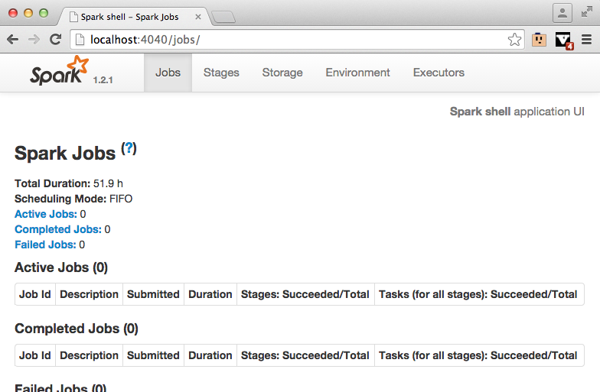
Spark Shell UI
Web-based access at http://<shell-host>:4040
  Provides information about shell program and spark jobs
Session 1: Introduction to Spark
Notes:
Session 1: Introduction to Spark

Slide 35
SparkContext - First Look
Access to Spark is via a SparkContext instance
  Represents connection to Spark cluster
  Automatically created in shell as variable sc
  Below, we illustrate some simple uses of the context
  Note the tab completion in the second example ⁽¹⁾
scala> sc
res0: org.apache.spark.SparkContext = org.apache.spark.SparkContext@2c01a0dd
scala> sc.[tab]
accumulable accumulableCollection accumulator addFile addJar
addSparkListener appName applicationId asInstanceOf binaryFiles
binaryRecords broadcast cancelAllJobs cancelJobGroup clearCallSite
clearFiles clearJars clearJobGroup defaultMinPartitions defaultMinSplits
… Remaining detail omitted
scala> sc.isLocal
res1: Boolean = true
scala> sc.master
res2: String = local[*]
Session 1: Introduction to Spark
Notes:
(1) The Spark shells provide tab completion, which is invaluable when first starting with the shell
It shows the available code completions at the point of the tab
Session 1: Introduction to Spark

Slide 36
RDD - First Look
Spark computations: Operations on distributed collections
  Called Resilient Distributed Dataset (RDD)
  The core abstraction of the programming model
  Ops on RDDs are automatically parallelized across cluster
We'll provide some simple examples now for illustration
  To see how you create an RDD via the SparkContext
  To see how the API works
We'll use these concepts and API throughout the course
  Providing detail as we go along
  Don't worry too much about it now
Session 1: Introduction to Spark
Notes:
Session 1: Introduction to Spark

Slide 37
RDD Usage Examples
Below we show some simple operations
  We read a file (guess how it's represented in Spark)
  We get some of the data in it
  We filter it (guess what the result of this is)
    We'll explain the filtering syntax later ⁽¹⁾
scala> myfile = sc.textFile("README.md") # Create an RDD
myfile: org.apache.spark.rdd.RDD[String] = README.md MappedRDD[1] at textFile at <console>:12
scala> val first = myfile.first()
first: String = # Apache Spark
scala> val all = myfile.collect()
all: Array[String] = Array(# Apache Spark, "", Spark is a fast and general cluster comp
# … Remaining detail omitted
scala> val scalaLines = myfile.filter(line => line.contains("Scala"))
scalaLines: org.apache.spark.rdd.RDD[String] = FilteredRDD[3] at filter at <console>:14
scala> scalaLines.collect()
res1: Array[String] = Array(high-level APIs in Scala, Java, and Python, and an optimized engine that, ## Interactive Scala Shell, The easiest way to start using Spark is through the Scala shell:)
Session 1: Introduction to Spark
Notes:
Reading a file in your Spark program produces an RDD that represents it
Filtering it produces another RDD
(1) The filter operation takes a function to do the filtering
We use a function that is defined inline to do the filtering (a lambda function)
When you first see these, it will likely look odd to you
However, once you use them a bit, you'll see they're just functions - even though they don't have a name, and they're defined in an odd place
Session 1: Introduction to Spark

Slide 38
Lab 1.2: First Look at Spark Shell
Lab
Overview: In this lab, we will work with the Spark Shell
  We'll start the Spark Shell in local mode
  We'll create some RDDs
  We'll perform some simple operations on them
  We'll start the Spark shell and connect to a cluster
Builds on previous labs: Lab 1.1 for general setup
Approximate Time: 25-35 minutes
Lab 1.2: First Look at Spark Shell
Notes:
To read the file use either
less README.txt
nano README.txt
Lab 1.2: First Look at Spark Shell

Slide 39
Session 1: Introduction to Spark
Notes:
Session 1: Introduction to Spark

Slide 40
  Spark Compared
  Introduction
  Acquiring and Using Spark
  Spark Compared
Session 1: Introduction to Spark
Notes:
Session 1: Introduction to Spark

Slide 41
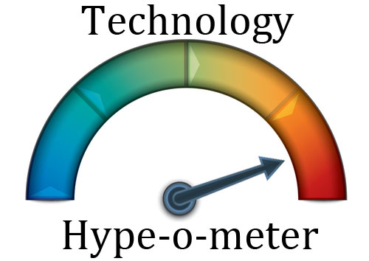
Where Does Spark Stand?
Session 1: Introduction to Spark
Notes:
Session 1: Introduction to Spark

Slide 42
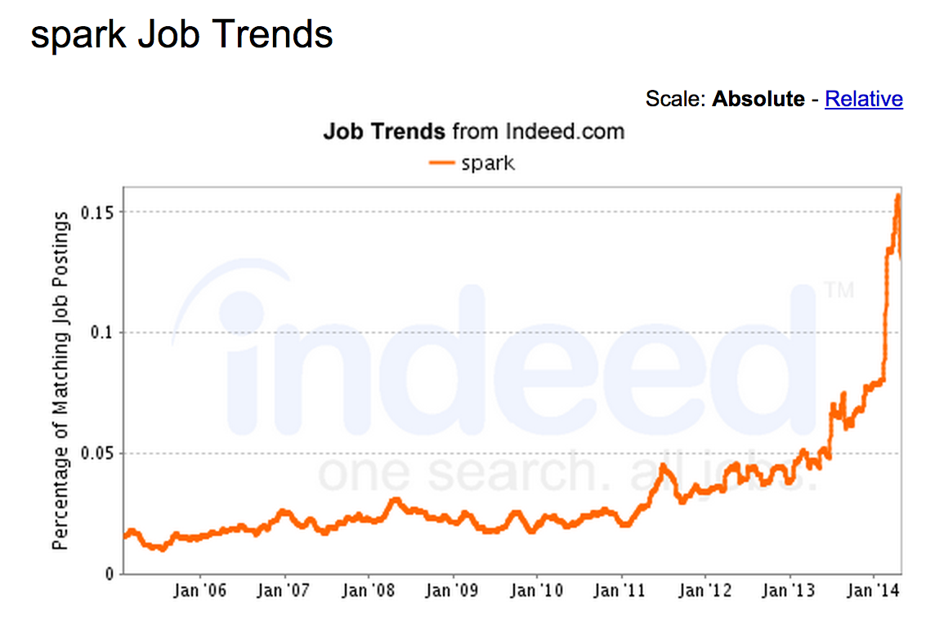
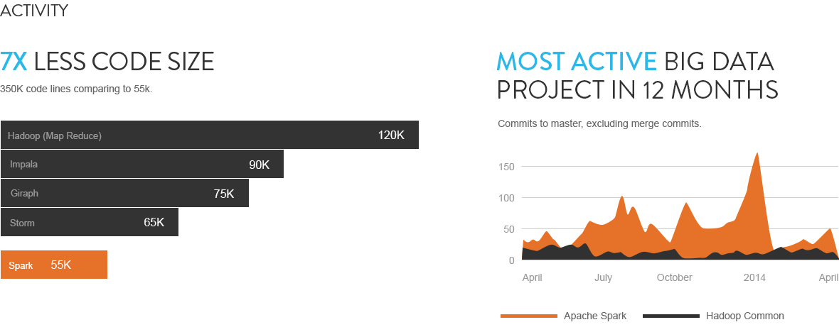
Used More and More
Source : stratio.com
Session 1: Introduction to Spark
Notes:
See https://www.openhub.net/p/apache-spark for some current usage stats
Session 1: Introduction to Spark

Slide 43
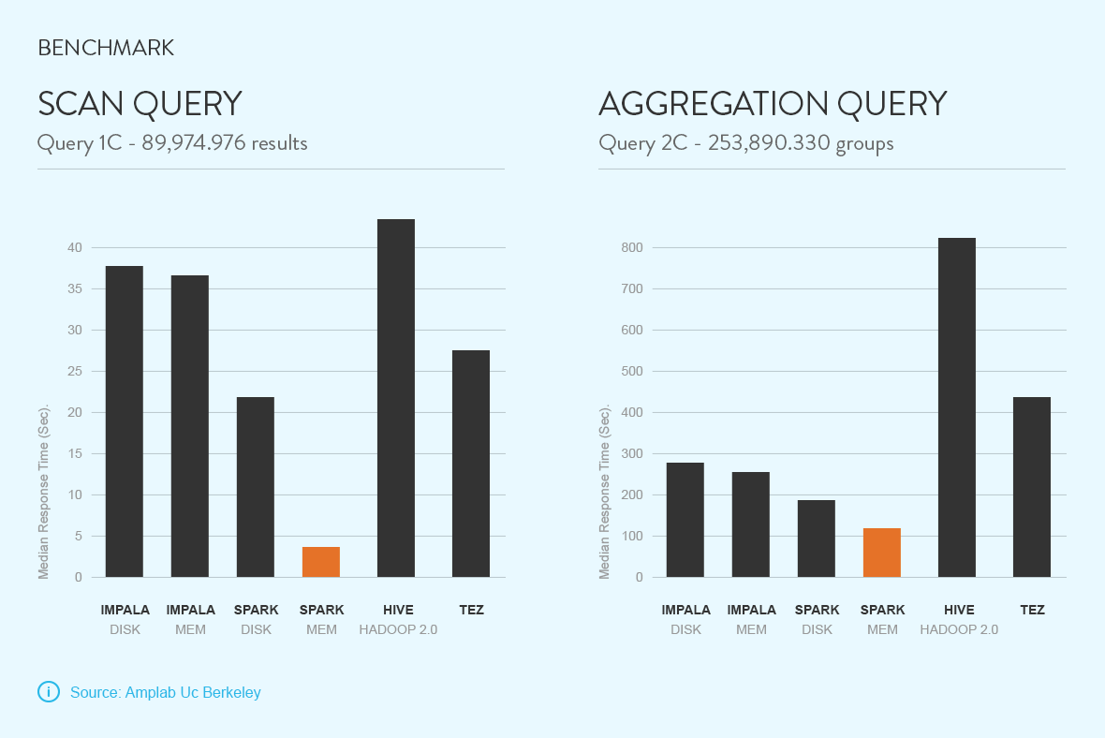
Faster Performance - Smaller Code Size
Source : stratio.com
Session 1: Introduction to Spark
Notes:
Session 1: Introduction to Spark

Slide 44

Hadoop Vs. Spark
Spark - New kid on the block
  Hadoop V1.0 in 2011, Spark V1 in 2014
  Spark is fast and leverages current knowledge and infrastructure
Spark
Hadoop
Session 1: Introduction to Spark
Notes:
Session 1: Introduction to Spark

Slide 45
Comparison With Hadoop
Hadoop | Spark
Distributed Storage + Distributed Compute | Distributed Compute Only
MapReduce framework | Generalized computation
Usually data on disk (HDFS) | On disk / in memory
Not ideal for iterative work | Great at Iterative workloads (machine learning ..etc)
Batch process | - Upto 2x - 10x faster for data on disk - Upto 100x faster for data in memory
 | Compact code Java, Python, Scala supported
 | Shell for ad-hoc exploration
Session 1: Introduction to Spark
Notes:
Session 1: Introduction to Spark

Slide 46
Spark Vs Hadoop
Spark is easier than Hadoop
  Simpler code, less code
Friendlier for data scientists / analysts
  Interactive shell
    fast development cycles
    adhoc exploration
  Specialized components (GraphX, Machine Learning, …)
API supports multiple languages
  Java, Scala, Python
Great for small (Gigs) to medium (100s of Gigs) data
Session 1: Introduction to Spark
Notes:
Session 1: Introduction to Spark

Slide 47
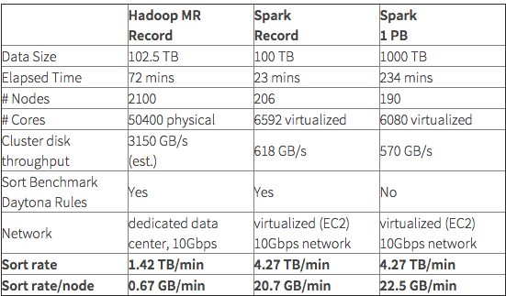
Spark - World Record Large-Scale Sort
Sorts 100TB in 23 min on 206 nodes
  Wins Daytona GraySort 2014 contest ⁽¹⁾
  Vs. Hadoop record of 72 min. on 2100 nodes
Session 1: Introduction to Spark
Notes:
(1) For more information on this contest see:
https://databricks.com/blog/2014/11/05/spark-officially-sets-a-new-record-in-large-scale-sorting.html
http://sortbenchmark.org/
Session 1: Introduction to Spark

Slide 48
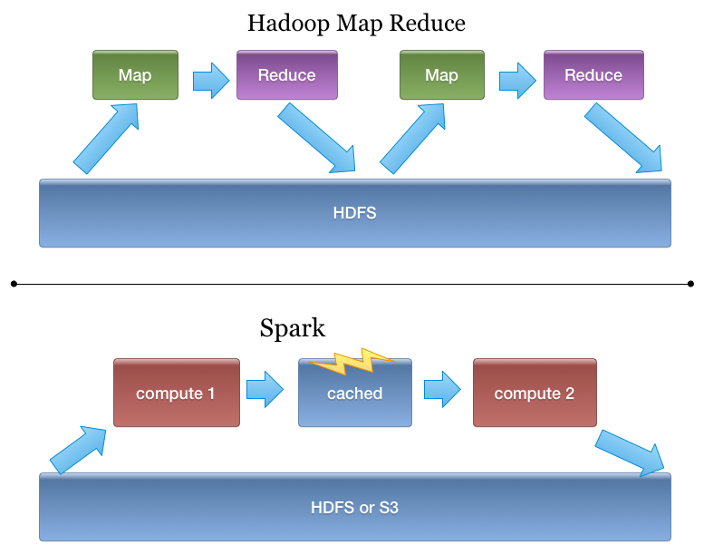
Spark Is Better Fit for Iterative Workloads
Session 1: Introduction to Spark
Notes:
Session 1: Introduction to Spark

Slide 49
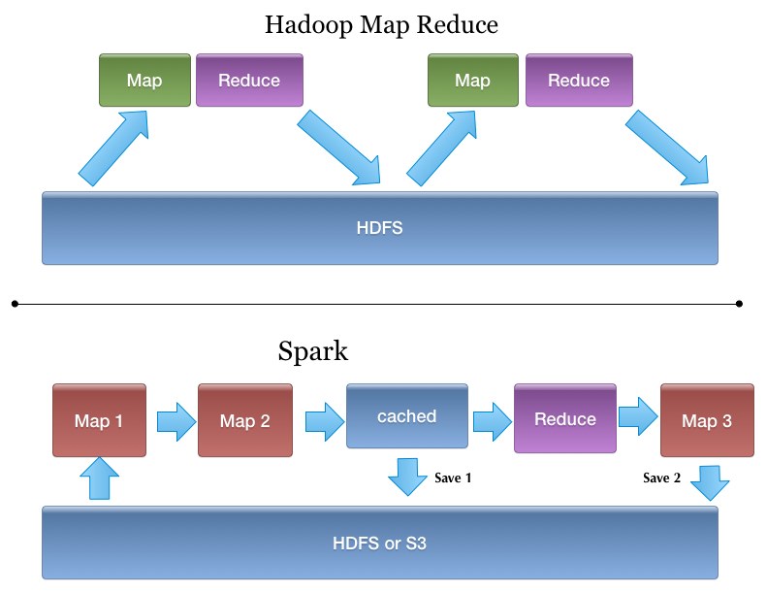
Spark - More Generic Programming Model
Session 1: Introduction to Spark
Notes:
Session 1: Introduction to Spark

Slide 50

Is Spark Replacing Hadoop?
Spark currently runs on Hadoop / YARN - Complimentary
  Can be seen as generic MapReduce
Spark is really great if data fits in memory (few hundred gigs),
Spark is 'storage agnostic'
Spark
(compute engine)
S3
HDFS
Cassandra
Session 1: Introduction to Spark
Notes:
Session 1: Introduction to Spark

Slide 51
Spark & Other Choices
Spark's unified stack can support almost all needs
Use Case | Other | Spark
Batch processing | Hadoop’s MapReduce (Java, Pig, Hive) | Spark MR
SQL querying | Hadoop : Hive | Spark SQL
Stream Processing / Real Time processing | Storm Kafka | Spark Streaming
Machine Learning | Mahout | Spark ML Lib
Real time lookups | NoSQL (Hbase, Cassandra ..etc) | No Spark component. But Spark can query data in NoSQL stores
Session 1: Introduction to Spark
Notes:
Session 1: Introduction to Spark

Slide 52
Spark for Lambda Architectures (LA)
LA: Design Pattern for data infrastructure
  Addresses needs of real-world, scalable applications ⁽¹⁾
  Came out of Twitter (Nathan Marz, et al)
  We'll see that Spark is a great fit for LA
Fault tolerant to hardware failures and human error
Layered approach incorporates batch and real-time needs
  Batch Layer: Manages master data set
    Immutable, append-only, raw data
    Also Pre-computes batch views
  Serving Layer: Indexes batch views for low-latency queries
  Speed Layer: Accommodates requests needing low latency
    Recent data only using fast and incremental algorithms
Session 1: Introduction to Spark
Notes:
(1) Nathan Marz came up with the term Lambda Architecture (LA) for a generic, scalable and fault-tolerant data processing architecture, based on his experience working on distributed data processing systems at Backtype and Twitter.
The LA aims to satisfy the needs for a robust system that is fault-tolerant, both against hardware failures and human mistakes, being able to serve a wide range of workloads and use cases, and in which low-latency reads and updates are required. The resulting system should be linearly scalable, and it should scale out rather than up.
Any incoming query can be answered by merging results from batch views and real-time views
[Michael Hausenblas: http://lambda-architecture.net/]
The key point? Many applications have need for both batch and real-time components
Architecting those can be challenging - until Spark that is !!
For more information on LA see
http://lambda-architecture.net/
http://blog.cloudera.com/blog/2014/08/building-lambda-architecture-with-spark-streaming/
Session 1: Introduction to Spark

Slide 53
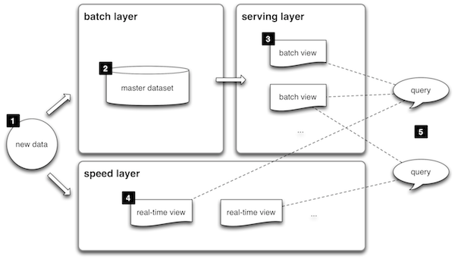
Lambda Architecture Illustrated
Session 1: Introduction to Spark
Notes:
XX
Image in slide from http://lambda-architecture.net/
[the lambda architecture] usually combines batch and real-time components. One often needs both because data arriving in real-time has inherent issues: there is no guarantee that each event will arrive exactly once, so there may be duplicates that will add noise to the data. Data that arrives late due to network or server instability also routinely causes problems. The lambda architecture handles these issues by processing the data twice — once in the real-time view, and a second time in the batch process – to give you one view that is fast, and one that is reliable.
[http://blog.cloudera.com/blog/2014/08/building-lambda-architecture-with-spark-streaming/]
Session 1: Introduction to Spark

Slide 54
Spark and LA
LA architectures require both batch and real-time components
  Challenging to architect
  Often require multiple systems
    With multiple implementations and maintenance - Not good ⁽¹⁾
  Until Spark !
Spark supports LA in a single system, e.g. mining log files ⁽²⁾
  Use core Spark functionality to process data (batch)
    e.g. Mining and storing log events with ERROR conditions
  Create/store aggregates that contain useful views (batch)
    e.g. Number of errors in a day
  Use Spark streaming for real-time views of same data (speed)
Spark is arguably the best platform for LA
  Easily supporting batch and stream in same app at scale
Session 1: Introduction to Spark
Notes:
(1) For more about the issues of building a LA-based system without good tool support see:
http://radar.oreilly.com/2014/07/questioning-the-lambda-architecture.html
(2) This example is inspired by the following article
http://blog.cloudera.com/blog/2014/08/building-lambda-architecture-with-spark-streaming/
So, why the excitement about the Lambda Architecture? I think the reason is because people increasingly need to build complex, low-latency processing systems. What they have at their disposal are two things that don’t quite solve their problem: a scalable high-latency batch system that can process historical data and a low-latency stream processing system that can’t reprocess results. By duct taping these two things together, they can actually build a working solution.
http://radar.oreilly.com/2014/07/questioning-the-lambda-architecture.html
Session 1: Introduction to Spark

Slide 55
Summary
Spark is young compared to Hadoop
Has distinct advantages
  Speed (especially when in-memory)
  Unified stack
  Ease of programming
  Adoption increasing very rapidly (which will drive evolution)
Has some issues
  Scalability is a work in progress, and is improving
  Standalone install needs improvement
  Monitoring solutions are slim - Sematext has offering ⁽¹⁾
  Management needs improvement (restarts on failure, etc)
  Performance bottlenecks still exist
Session 1: Introduction to Spark
Notes:
(1) http://blog.sematext.com/2014/10/07/apache-spark-monitoring/
Session 1: Introduction to Spark

Slide 56
XX
Session 1: Introduction to Spark
Notes:
Session 1: Introduction to Spark

Slide 57
Review Questions
What is Spark, and what are its capabilities?
How is Spark better than other solutions?
How do you work with Spark?
Session 1: Introduction to Spark
Notes:
Session 1: Introduction to Spark

Slide 58
Lesson Summary
Spark is an open source cluster computing engine
  Fast, flexible, and relatively easy to code
  Core: Distributed processing of large data sets over a cluster
  Additional Packages:
    Spark SQL: Structured data
    Spark Streaming: Live data streams
    ML Lib: Machine learning
    GraphX: Graph Processing
  Top level Apache project, supported by Databricks
Session 1: Introduction to Spark
Notes:
Session 1: Introduction to Spark

Slide 59
Lesson Summary
Spark can be installed standalone, or integrated with YARN or Mesos
  Can be installed by extracting tarball
  Included in some Hadoop distributions (Cloudera/Hortonworks)
Spark worker processes run on distributed nodes
  Running tasks as assigned by the driver
The Spark Shell supports ad-hoc, interactive operations
  Using the Scala or Python API
  A SparkContext provides access to Spark
Resilient Distributed DataSets (RDDs) represent data
  A distributed collection of items that can be worked on in parallel
Session 1: Introduction to Spark
Notes:
Session 1: Introduction to Spark

Slide 60
Lesson Summary
Spark overcomes many MapReduce/Hadoop limitations
  Faster, easier to program, with a unified stack for wide applicability
Addresses the needs of current Big Data systems (Lambda Architectures)
  In a unified stack
Growing rapidly
  Increasingly wide adoption
  Extremely active community evolving the code base
Session 1: Introduction to Spark
Notes:
Session 1: Introduction to Spark

Slide 61
Lesson Summary
Session 1: Introduction to Spark
Notes:
Session 1: Introduction to Spark

Slide 62
Lesson Summary
Session 1: Introduction to Spark
Notes:
Session 1: Introduction to Spark

Slide 63
Recap
Notes:
Recap

Slide 64
Recap of what we've done
XX
Recap
Notes:
Recap

Slide 65
What Else is There
XX
Recap
Notes:
Recap

Slide 66
Resources
XX
Recap
Notes:
Recap

