Slide 1
Session nn: Spark Streaming
  Overview
  Architecture
  Programming
  Transformations
Notes:
Session nn: Spark Streaming

Slide 2
Lesson Objectives
Session nn: Spark Streaming
Notes:
Session nn: Spark Streaming

Slide 3
Overview
  Overview
  Architecture
  Programming
  Transformations
Notes:
Session nn: Spark Streaming

Slide 4
Why Spark Streaming
Processing huge sets of data must be super quick
  Spark !
  And sometimes you must process it as it arrives
  Spark Streaming !
Spark Streaming processes live data streams
  Supports data ingestion from many sources
  Kafka, Flume, Twitter, TCP sockets, …
Completely integrated with Spark
  Providing high throughput, scaling, fault tolerance, …
  Spark transformations (map, reduce, join, …)
  Other modules (MLlib, GraphX, …)
Session nn: Spark Streaming
Notes:
Session nn: Spark Streaming

Slide 5
Spark Streaming: What is it?
Spark Streaming layered over Spark core
  Enables Big Data Stream Processing
  Raw streaming data to processed data with low latency and fault tolerance
Spark
SQL
Spark
Streaming
GraphX
MLlib
Spark
Session nn: Spark Streaming
Notes:
Session nn: Spark Streaming

Slide 6
Key Concepts
DStream: Sequence of RDDs representing input data
Transformations: Modify a DStream RDD into another RDD
  Stateless and Stateful
Output Operations: Send to external entity
  Save to storage
  Process the batch in some other way
We'll look at all of this in detail
Session nn: Spark Streaming
Notes:
Session nn: Spark Streaming

Slide 7
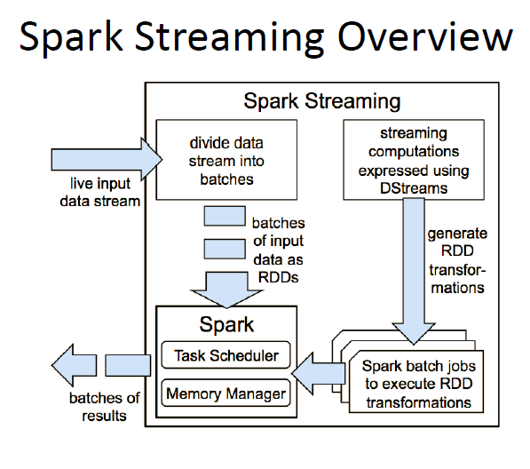
How Does it Work?
Structure streaming computation as a series of small, stateless, deterministic batch jobs (DStreams)
Session nn: Spark Streaming
Notes:
Image from "Discretized Streams: Fault-Tolerant Streaming Computation at Scale" by Matei Zaharia et. al
http://www.cs.berkeley.edu/~matei/papers/2013/sosp_spark_streaming.pdf
Session nn: Spark Streaming

Slide 8
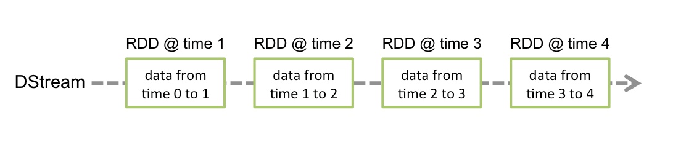
Discretized Steams (DStreams)
DStream: Sequence of RDDs representing data
  Data arrives over time (streams)
  Broken down into micro-batches
  DStreams can be created using any of the popular input sources
    Flume, Kafka, HDFS …
DStream Operations:
  Transformation – to convert to another DStream
  Output to an external device
Session nan: Spark Streaming
Notes:
Image from Spark Streaming programming guide
http://spark.apache.org/docs/latest/streaming-programming-guide.html
Session nn: Spark Streaming

Slide 9
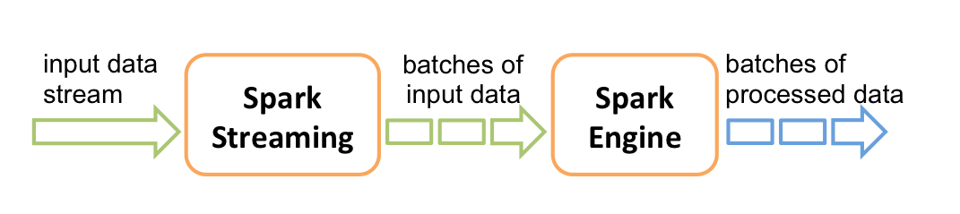
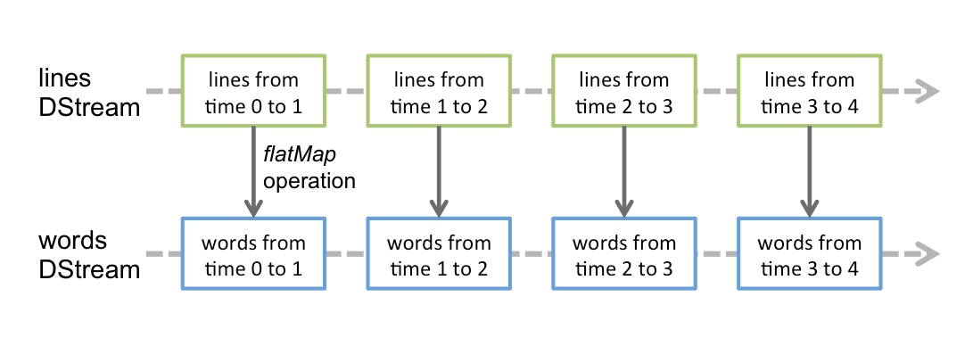
Processing - High Level
Batches are processed in Spark - with all its capabilities
  Each RDD (a batch) results in a new RDD
  For example, when doing word count from a streaming source
Session nn: Spark Streaming
Notes:
Image from Spark Streaming programming guide
http://spark.apache.org/docs/latest/streaming-programming-guide.html
Session nn: Spark Streaming

Slide 10
Typical Applications
Datacenter and DevOp Operations
Web and Mobile App Funnel Metrics
Ad Optimization and Analysis
Pattern recognition(e.g. phishing, fraud, etc.)
Mobile and IoT Applications
Session nn: Spark Streaming
Notes:
IoT: Internet of Things
Session nn: Spark Streaming

Slide 11
Architecture
  Overview
  Architecture
  Programming
  Transformations
Notes:
Session nn: Spark Streaming

Slide 12
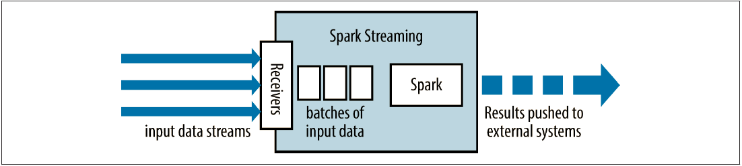
Architecture – High Level
Each input DStream is associated with a receiver
Received data is converted into batches bound by the batch interval
  Each batch becomes an RDD
Data is transformed to other RDDs and/or sent to external systems
Session nn: Spark Streaming
Notes:
Session nn: Spark Streaming

Slide 13

DStream Architecture
DStreams data from input sources is bound into batches
  Based on a batch interval
  Data within a given time interval is added to the batch
    Interval usually range from 0.5 sec. to many seconds (based on your needs)
  Batch is closed at end of time interval
  Each batch becomes a discrete RDD
Processing is distributed across machines, like normal RDDs
  Streaming can continue as batch processing occurs (done in parallel)
  Can integrate with non-DStream RDDs (e.g. via a join)
Session nn: Spark Streaming
Notes:
Image from Learning Spark by Holden Karau et. al.
Session nn: Spark Streaming

Slide 14
Receivers
Receivers are tasks running in the application’s executors.
  They collect the data and convert it into RDDs
  Which can then be transformed into new DStream-based RDDs
For fault tolerance, input data can be replicated
  Replicated across two nodes - tolerates single worker failure
  Default behavior for streams receiving data over the network (Kafka, Flume, sockets, etc)
  Other streams can be created by periodically loading data from external storage (e.g. HDFS)
Session nn: Spark Streaming
Notes:
Session nn: Spark Streaming

Slide 15
Transformation Types
Stateless: Transformation on a batch doesn’t depend on the previous batch
  Common RDD transformations such as map(), filter(), countByValue(), reduceByKey(), etc.
  e.g. filter a particular word/string from a stream of text
Stateful: Uses data/results from previous batches to compute the current batch
  Based on Sliding windows and tracking state across time
  Example operations include window() and countByValueAndWindow()
  Example use cases: Calculate % of price increase per trade for a given stock on NASDAQ
Session nn: Spark Streaming
Notes:
Session nn: Spark Streaming

Slide 16
Fault Tolerance
Raw input data is replicated in memory
  An RDD is replicated in memory – not the transformed RDDs
Sparks memory manager called Block memory keeps the replicated data as long as its required
RDDs remember the operations that created them
  The lineage
Data lost due to worker failure is recomputed using the raw input data
  So all transformed data is fault-tolerant
  Checkpointing is very critical for stateful transformations
Session nn: Spark Streaming
Notes:
Session nn: Spark Streaming

Slide 17
Checkpointing
Saves RDD state periodically to a reliable filesystem
  HDFS or S3
Why? Stateful DStream RDDs can have very large lineage ⁽¹⁾
  Recovery time could be large for data that has built up over a long time period
  Task sizes / launch time also grow larger
Solution: Checkpoint periodically
  To recover from failure, only need to go back to the last checkpoint
  Typically checkpoint interval = 5-10 times DStream sliding interval
    Tradeoff between overhead of checkpoint, vs. time saved
Session nn: Spark Streaming
Notes:
(1) A streaming application must operate 24/7 and hence must be resilient to failures unrelated to the application logic (e.g., system failures, JVM crashes, etc.). For this to be possible, Spark Streaming needs to checkpoints enough information to a fault- tolerant storage system such that it can recover from failures. There are two types of data that are checkpointed.
Metadata checkpointing - Saving of the information defining the streaming computation
Data checkpointing - Saving of the generated RDDs to reliable storage. This is necessary in some stateful transformations that combine data across multiple batches. In such transformations, the generated RDDs depends on RDDs of previous batches, which causes the length of the dependency chain to keep increasing with time. To avoid such unbounded increase in recovery time (proportional to dependency chain), intermediate RDDs of stateful transformations are periodically checkpointed to reliable storage (e.g. HDFS) to cut off the dependency chains.
To summarize, metadata checkpointing is primarily needed for recovery from driver failures, whereas data or RDD checkpointing is necessary even for basic functioning if stateful transformations are used.
Note that checkpointing of RDDs incurs the cost of saving to reliable storage. This may cause an increase in the processing time of those batches where RDDs get checkpointed. Hence, the interval of checkpointing needs to be set carefully. At small batch sizes (say 1 second), checkpointing every batch may significantly reduce operation throughput. Conversely, checkpointing too infrequently causes the lineage and task sizes to grow which may have detrimental effects. For stateful transformations that require RDD checkpointing, the default interval is a multiple of the batch interval that is at least 10 seconds. It can be set by using dstream.checkpoint(checkpointInterval). Typically, a checkpoint interval of 5 - 10 times of sliding interval of a DStream is good setting to try.
[Spark Streaming Programming Guide]
Session nn: Spark Streaming

Slide 18
24/7 Operations
Spark Streaming can be run in 24/7 mode even if a worker or drivers fail.
In order for Streaming to run 24/7, for setting up Checkpointing, one needs reliable storage system such as S3 or HDFS
  ssc.checkpoint("hdfs://...")
Lack of Checkpointing throws a warning/error even in local setup.
Session nn: Spark Streaming
Notes:
Session nn: Spark Streaming

Slide 19
Programming
  Overview
  Architecture
  Programming
  Transformations
Notes:
Session nn: Spark Streaming

Slide 20
Types and Imports
Spark streaming is in its own packages
  And is in a separate maven module
Below, we show some of the more important imports
import org.apache.spark.streaming.StreamingContext
import org.apache.spark.streaming.StreamingContext._
import org.apache.spark.streaming.dstream.DStream
import org.apache.spark.streaming.Duration
import org.apache.spark.streaming.Seconds
Session nn: Spark Streaming
Notes:
Session nn: Spark Streaming

Slide 21
Initializing Spark Streaming Application
StreamingContext: Main entry point for streaming
  Provides methods to create DStreams from various input sources
  Also sets up the SparkContext
    Driver program that connects to the Spark engine
    Once you have SparkContext, you can use it to build RDDs
SparkConf: Standard Spark config object
batchDuration: Time interval to process new data
// Code excerpt from class StreamTest
val conf = new SparkConf().setMaster("local[2]").setAppName("myApp")
val batchDuration = Seconds(1)
val ssc = new StreamingContext(conf, batchDuration)
// Now you're ready to process …
Session nn: Spark Streaming
Notes:
Session nn: Spark Streaming

Slide 22
Simple Socket Text-Stream Receiver
Assume we were receiving a text stream over the network
  We could create a DStream from this text as shown at bottom
  socketTextStream() creates a network DStream reading text
Once we have the DStream, we can transform as usual
  The example filters for lines containing "Scala"
  It then prints out the lines
val port = 7777 // Would use appropriate port for your app
val lines : ReceiverInputDStream[String] =
ssc.socketTextStream("localhost", port)
val scalaLines = lines.filter(_.contains("Scala"))
scalaLines.print()
Session nn: Spark Streaming
Notes:
Session nn: Spark Streaming

Slide 23
Lets start the Streaming
Three StreamingContext methods to control streaming:
  start(): Start the computation
    StreamingContext can only be started once
    So wait until all the wiring is done to start
  stop(): Stop the computation manually
  awaitTermination(): Wait for the computation to stop
Below, we kick off our computation
// Previous code not shown
ssc.start() // Start it up !
ssc.awaitTermination() // Run until processing terminates
Session nn: Spark Streaming
Notes:
Session nn: Spark Streaming

Slide 24
Running it all
Run this like any other Spark program
  e.g. using spark-submit, or even the shell
  ./bin/spark-submit --class com.me.StreamTest \
  --master local[4] /path/to/myapp.jar
You could emulate a networked data source with netcat
  A utility that can write data across a network ⁽¹⁾
$ netcat -lp 7777
Type sentences with the word Scala here
Or without it
Until you get tired, then kill this program
Session nn: Spark Streaming
Notes:
(1) netcat is a Unix utility that reads/writes data across a network connection
To use it with this program, just open up a terminal prompt, and type the following
netcat -lp 7777
Do this before you start the Scala program, so that the SparkContext will be able to make the connection
Once you start your Spark program, to back to the netcat terminal window, and type some lines - each time you hit return, the line will be sent over the network
And used as input for your Spark program !
Session nn: Spark Streaming

Slide 25
Previous Program Illustrated
Below, we illustrate how the input from the network is batched into DStreams, and then transformed
Server at
localhost:7777
filter
operation
scalaLines
DStream
scalaLinestime 0 to 1
scalaLinestime 1 to 2
scalaLinestime 2 to 3
scalaLinestime 3 to 4
Session nn: Spark Streaming
Notes:
Image derived from Spark Streaming programming guide
http://spark.apache.org/docs/latest/streaming-programming-guide.html
Session nn: Spark Streaming

Slide 26
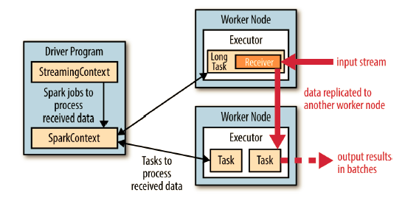
Architectural View of Application
Session nn: Spark Streaming
Notes:
Image from Learning Spark by Holden Karau et. al.
Session nn: Spark Streaming

Slide 27
Session nn: Spark Streaming
Notes:
Session nn: Spark Streaming

Slide 28
Session nn: Spark Streaming
Notes:
Session nn: Spark Streaming

Slide 29
Session nn: Spark Streaming
Notes:
Session nn: Spark Streaming

Slide 30
Session nn: Spark Streaming
Notes:
Session nn: Spark Streaming

Slide 31
Class Receiver
Base class for all receivers (e.g. Kafka, Flume, etc)
  As of Spark 1.0+
  Replaces older NetworkReceiver class
Responsible for receiving data and pushing to Spark's data management layer
Has a very simple interface
  What to do when you start the receiver
  What to do when you stop the receiver
  Other functionality
Session nn: Spark Streaming
Notes:
Session nn: Spark Streaming

Slide 32
Transformations
  Overview
  Architecture
  Programming
  Transformations
Notes:
Session nn: Spark Streaming

Slide 33
DStream Transformations
Support many normal RDD transformations including:
  Remember - These are applied to each RDD in the stream ⁽¹⁾
Transformation | Description | Example | f Signature
map(f) | Apply f to each element in DStream | ds.map(x => x*2) | f: T -> U
flatMap(f) | Like map, but can output more than one result per element | ds.flatMap( x => x.split (" ")) | f: T -> Iterable[U]
filter(f) | Filter through each element when f is true | ds.filter( x=> x % 2 == 1) | f: T -> Boolean
repartition(n) | Change number of partitions | ds.repartition(10) | NA (numerical)
reduceByKey(f) | Combine values with same key using f (for pair data) | ds.reduceByKey( (x,y) => x+y) | f: (T, T) -> T
groupByKey() | Group values with same key (for pair data) | ds.groupByKey() | NA
mapPartitions( func) | Like map, but runs on the whole partition not on each element
Session nn: Spark Streaming
Notes:
(1) Internally, a DStream is composed of the RDDs that it's broken up into
Applying a transformation to the stream actually applies it (statelessly) to each RDD making up the stream
For example, reducing by key will reduce the data within each batch separately, but not across batches (since a batch is represented by its own RDD)
Session nn: Spark Streaming

Slide 34
Data from Multiple DStreams
Stateless transformations can also combine data from multiple DStreams within each time step
  DStreams have same join-related transformation as RDDs
Example operations are similar to their RDD counterparts, e.g.
  cogroup(), join (), and leftOuterJoin()
Merge two streams using DStream's union() operator
  Similar to regular RDDs
  Use StreamingContext.union() for multiple streams
Session nn: Spark Streaming
Notes:
Session nn: Spark Streaming

Slide 35
Advanced Stateless Transformations
At bottom, we join two DStreams that are produced by map and reduce transformations
transform() is an advanced operator that lets you operate directly on the RDDs inside them
  Between two different RDDs within a DStream, e.g.
  val outlierDStream = accessLogsDStream.transform (
  rdd =>extractOutliers(rdd) )
// Assume accessLogsDStream is created elsewhere
val ipBytesDStream = accessLogsDStream.map(entry =>
(entry.getIpAddress(), entry.getContentSize()))
val ipBytesSumDStream =
ipBytesDStream.reduceByKey((x, y) => x + y)
val ipBytesRequestCountDStream =
ipBytesDStream.join(ipBytesSumDStream)
Session nn: Spark Streaming
Notes:
Session nn: Spark Streaming

Slide 36
Windowed (Stateful) Transformations
Track data across time
  Previous data used to generate or run current transformations.
Two main types of windowed operations
  Sliding window
  updateStatebyKey()
For each windowed operation, you need 2 parameters
  Window Duration: How many previous batches of data to use
  Sliding Duration: How often the new DStream computes results
    Default is batch interval
  Both are multiples of batch interval
    e.g. set Window Duration to 3 Batch Intervals
Session nn: Spark Streaming
Notes:
Session nn: Spark Streaming

Slide 37
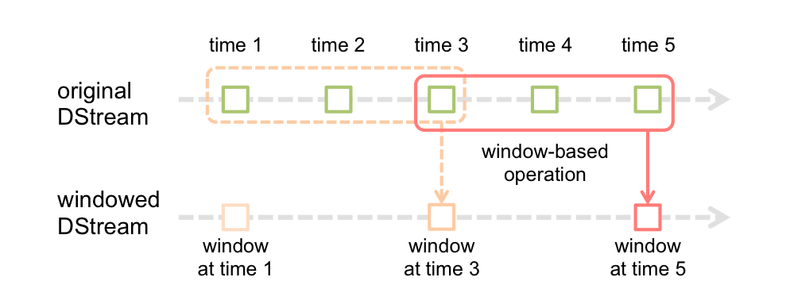
Sliding Window Illustrated
We illustrate windowing below
  Window Duration = 3 batches
  Slide Duration = 2 batches
Session nn: Spark Streaming
Notes:
Image from Spark Streaming programming guide
http://spark.apache.org/docs/latest/streaming-programming-guide.html
Session nn: Spark Streaming

Slide 38
Windowing Example
Below, we use window() to specify windowing
  def window(windowDuration: Duration,
  slideDuration: Duration)
    Both args must be multiples of the batch interval
  Defined in DStream class
  Package org.apache.spark.streaming.dstream
count() counts each RDD in the stream
  Returns a DStream made of RDDs containing the counts
// Assume accessLogsDStream is created elsewhere
val accessLogsWindow =
accessLogsDStream.window(Seconds(30), Seconds(10))
val windowCounts = accessLogsWindow.count()
Session nn: Spark Streaming
Notes:
Session nn: Spark Streaming

Slide 39
Other Windowing Operations
reduceByWindow(): Return reduced RDDs
reduceByKeyAndWindow(): Apply reduceByKey over sliding window
countByWindow(): Returns number of elements in each Window
countByValueAndWindow(): Returns counts for each value
  All of these methods return a DStream, with each RDD containing the appropriate value for its parent batch
Below, we show some examples of using these
  val ipDStream =
  accessLogsDStream.map{entry => entry.getIpAddress()}
  val ipAddressRequestCount =
  ipDStream.countByValueAndWindow(Seconds(30), Seconds(10))
  val requestCount =
  accessLogsDStream.countByWindow(Seconds(30), Seconds(10))
Session nn: Spark Streaming
Notes:
Session nn: Spark Streaming

Slide 40
Output Operations
print(num: Int): Print 1st num elements from each batch
print(): Print 1st ten elements from each batch
  DStream is materialized to accomplish this
save(): Saves elements in a Dstream in a separate directory.
  ipAddressRequestCount.saveAsTextFiles("outputDir", "txt")
saveAsHadoopFiles(): Save each RDD as Hadoop file
  Can pass prefix and suffix for filenames as arguments
  Also saveAsTextFiles(), saveAsObjectFiles()
forEachRDD(forEachFunc): Apply function to each RDD ⁽¹⁾
  ipAddressRequestCount.foreachRDD { rdd =>
  rdd.foreachPartition { partition =>
  val connection = openConnection // Connection to storage system
  partition.foreach { record => connection.send (record))
  connection.close()
  }
  }
Session nn: Spark Streaming
Notes:
(1) See the Spark streaming guide for a good explanation of this code
http://spark.apache.org/docs/latest/streaming-programming-guide.html#output-operations-on-dstreams (See the section "Design Patterns for using foreachRDD")
Session nn: Spark Streaming

Slide 41
Input Sources
Core Sources:
  Stream of Files
  Akka Actor Stream
Popular Input Sources:
  Sockets
  Apache Kafka
  HDFS
  Apache Flume (Push based receiver / Pull based receiver)
  Twitter
  To include these additional receivers add the Maven artifact spark-streaming-[projectname]_2.10,
  e.g. spark-streaming-kafka_2.10
Session nn: Spark Streaming
Notes:
Session nn: Spark Streaming

Slide 42
Session nn: Spark Streaming
Notes:
Session nn: Spark Streaming

Slide 43
Lab nn.1: XX
Lab
Overview:
Builds on previous labs:
Approximate Time:
Session nn: Spark Streaming
Notes:
To read the file use either
less README.txt
nano README.txt
Session nn: Spark Streaming

Slide 44
Review Questions
Session nn: Spark Streaming
Notes:
Session nn: Spark Streaming

Slide 45
Lesson Summary
Session nn: Spark Streaming
Notes:
Session nn: Spark Streaming

