Slide 1
Data Analysis I

Slide 2
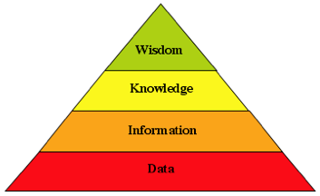
Climbing the pyramid

Slide 3
The steps
1. What do you have? (the file)
Text file, database, JSON, XML, etc.?
2. What do you have? (the data)
What do the fields mean? What type of data is it?
3. What do you want to know?
This is the first step of data analysis.
Formulate questions you need the answers to.
Perform the steps needed to answer the question.

Slide 4
The basics
Group and count
Is it text?
Text analysis, word frequencies, etc.
Is it discrete text?
Grouping, matching, counting.
It is a number?
Averages, medians, percentages, rates, ratios, correlations.

Slide 5
Formulating questions
Data analysis and the scientific method share many traits.
State hypothesis = ask a question
Get results
Compare them to the hypothesis

Slide 6
Formulating questions
A key question is always going to be this: As compared to what?
Comparing murder rates.
Am I using the right number? Average vs. median.
Dependent vs independent variables.

Slide 7
SELECT [field or *] FROM [database name] WHERE [field] =/>/</<> [condition] GROUP BY [field] ORDER BY [field] (DESC)

Slide 8
Example: Parking on campus

Slide 9
Data analysis
What questions did we ask of the parking data?
What other questions can we ask of data?
It depends on the data.

Slide 10
Assignment for Thursday
There is a SQL assignment on Canvas. You will be required to analyze some data. Answer the questions in the form. If you need help, there is a link to a tutorial.

