Slide 1
More SQL

Slide 2
New tools for the toolbox

Slide 3
New tools
UPDATE – create new fields of data based on a formula.
Joins – Connecting two datasets based on a common field. Your student ID number joins you to data on grades, bills, library books, parking tickets, etc.

Slide 4
UPDATE
UPDATE tablename SET field = “something” WHERE condition.
UPDATE contributors SET state = ' GA ' WHERE last_name = 'Cathy';
Useful for calculating formulas by step.

Slide 5
Joins
Inner join: Where both are equal.
Outer join: Everything, really.
Full outer join: Where things aren’t equal.
Left/Right join – everything from one table and only things that are equal in the second table.

Slide 6
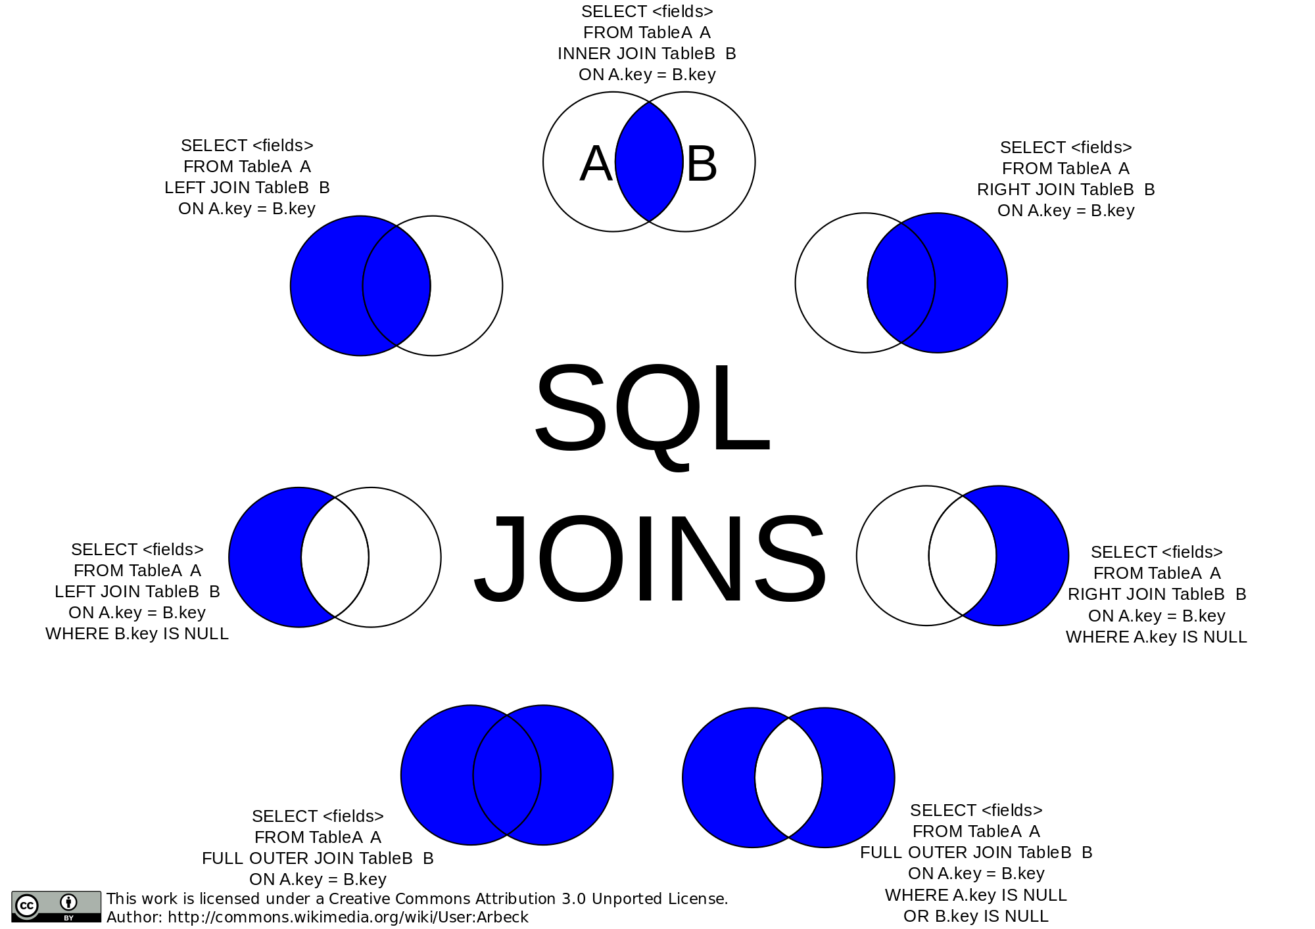
JOINS

Slide 7
The assignment for Thursday

