Slide 1
Intro to Informatics
Matt Waite
matt.waite@unl.edu
@mattwaite

Slide 2
Who am I?

Slide 3
Who are you?

Slide 4
The syllabus

Slide 5
A preview of things to come

Slide 6
Areas we will cover
1. Problem Decomposition
2. Creative Thinking
3. Programming
4. Data representation
5. Algorithms
6. Data analysis
7. Statistics and research
8. Data visualization

Slide 7
The Ashley Madison dump

Slide 8
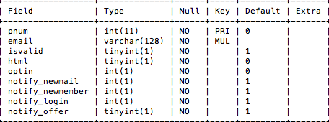
Ashley Madison

Slide 9
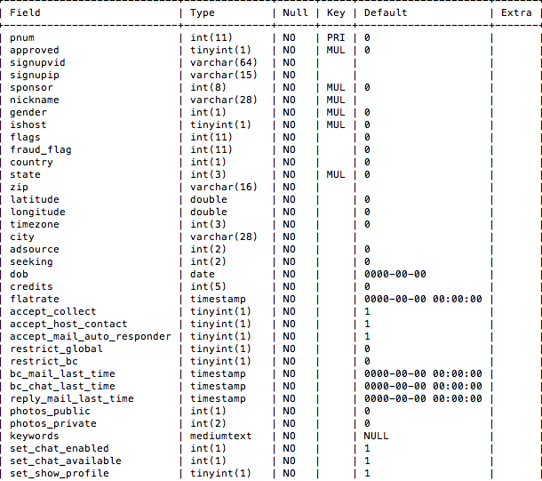
Ashley Madison

Slide 10
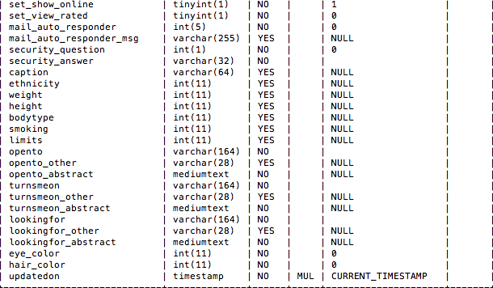
Ashley Madison

Slide 11
What could you find out?
What questions could you answer?
What limits are there?
Is this ethical?
What if you find out something that may be a serious problem?

Slide 12
Assignment
Read Part 1 and 2 of Paul Ford’s What Is Code?
Linked on Canvas
Warning: It is very long. You are expected to read it. There will be a quiz. You should budget your time accordingly.
For Thursday: Bring an internet accessible device. Laptop, tablet, phone, no matter so long as it connects to the internet.

