Slide 1
Problem decomposition

Slide 2
No problem is ever one big problem

Slide 3
Problem decomposition
Problem decomposition is the process of breaking down a project into small, trivial steps that can be accomplished easily.
Trying to do all the math homework at once is impossible. Doing one problem and moving onto the next is very doable.
Most problems in informatics are hundreds of tiny problems disguised as Big Hairy Problem.

Slide 4
Problem decomposition
Recursive decomposition: Divide the problem into smaller problems. Divide the smaller problems. And again. And again. Until you can’t anymore. Pro: Easy. Con: Often linear.
Functional decomposition: Divide the problem into functions, or groups of instructions. Bonus: Pro: functions can be executed concurrently. Con: Harder to keep track of.

Slide 5
A simple example: Basic math

Slide 6
Basic math
We’re going to build a device that detects when students are texting in class and sounds a loud alarm.
We need: A microcontroller: $15. An RF detector: $12. An alarm: $3. A power source: $10.
How much will each unit cost?
How many units will $5,000 buy me?

Slide 7
Let’s program a computer to play Go Fish

Slide 8
Charting
Sometimes the best thing is a picture to explain your steps.
The good news: There’s not really a wrong or right way to do this, so long as it’s clear what you’re up to.
Step charts and flow charts.

Slide 9
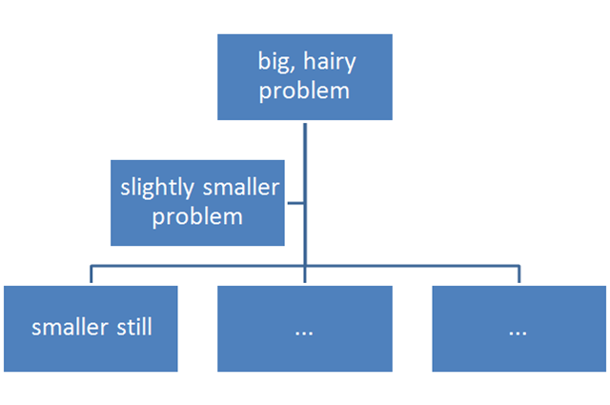
Charting

Slide 10
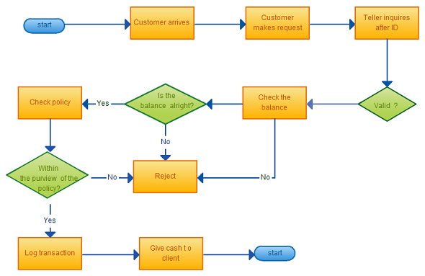
Charting

Slide 11
Your assignment
I want to create a program that goes to Rate My Professors and gets all of the ratings for each professor at the University of Nebraska-Lincoln.
Using problem decomposition, what is my program going to have to do?

Slide 12
Your assignment
You must: Choose a method of problem decomposition, describe it, and detail your steps – and I do mean detail them – using what you see in the URLs of the site, patterns, and specific data you would get.
You must: Chart your steps. Hint: Word and Powerpoint will make shapes that make a fine diagram. I don’t need art here.
Turn in your steps and chart by Thursday’s class.

