Slide 1
What is data visualization?

Slide 2
What is data visualization?
The visual representation of data.
Abstracted into a visual form – numbers made into a thing to represent those numbers.
Wait, “Abstraction”?
Computer science term meaning representing the concept while hiding away the implementation details.

Slide 3
What is data visualization?
Data visualization can be a simple representation, or a complex one.
Can represent scale, space, time, amount. It’s comparative, relies on context.
It’s meant to create a deeper understanding of a subject.
It can be silly, or deadly serious, and anywhere between.

Slide 4
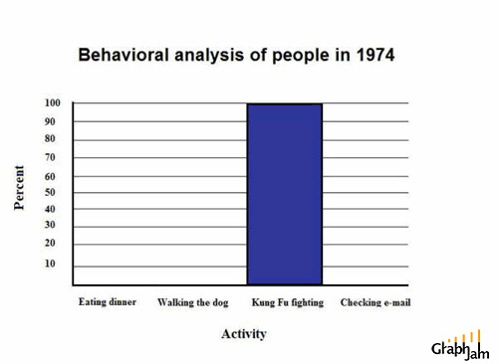
Those cats were fast as lightning.
This is funny, but in reality a terrible data visualization.

Slide 5
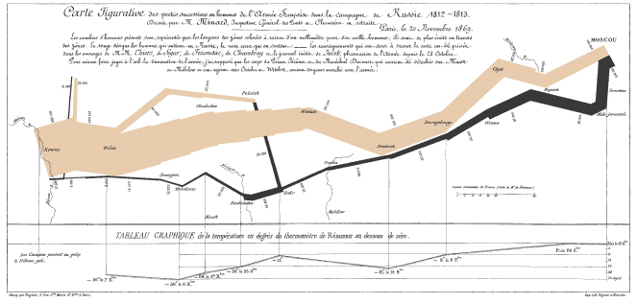
The greatest graphic ever made.
It’s rare you can describe a chart as eloquent. Aspire to it.

Slide 6
What is data visualization?
Shows the data
Induces the viewer to think about the substance rather than methodology.
Avoids distorting the data and what it says.
Presents lots of data in small space.
Makes large datasets coherent.
Encourages comparison.
Reveals several levels of detail.
Serves a clear purpose: Description, exploration, tabulation.

Slide 7
“A graphic does not distort if the visual representation of the data is consistent with the numerical representation.” -- Tufte

Slide 8
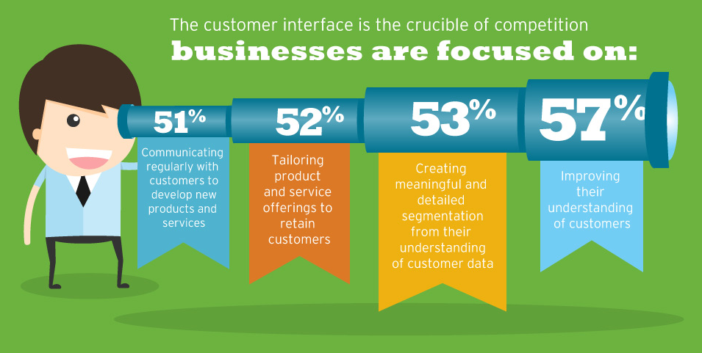
Lying with charts

Slide 9
The Lie Factor
Tufte provides a formula
Lie Factor = Size of the effect in the graphic/size of the effect in the data

Slide 10
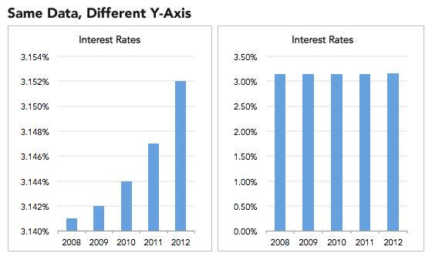
The Lie Factor

Slide 11
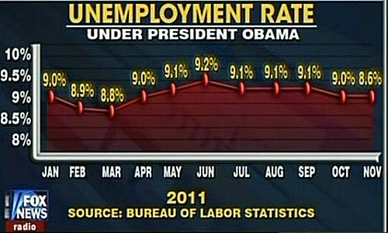
The Lie Factor

Slide 12
Real vs. Nominal numbers
Any time you are comparing growth in numbers over time, you must adjust for inflation.
A dollar in 1955 is not the same as a dollar today.
Example: How much has the cost of going to UNL gone up since 1955?

Slide 13
Visual area, numerical representation
Using shapes and sizes to represent numerical change is fraught with peril.
“Using two or three dimensions varying dimensions to show one-dimensional data is a weak and inefficient technique.” -- Tufte

Slide 14
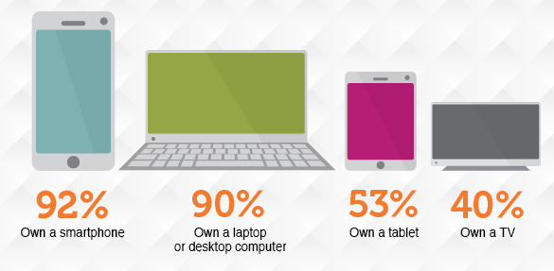
Visual area

Slide 15
Lying with charts
Context is essential for graphical integrity.
Always ask: As compared to what? What is this being compared to?

Slide 16
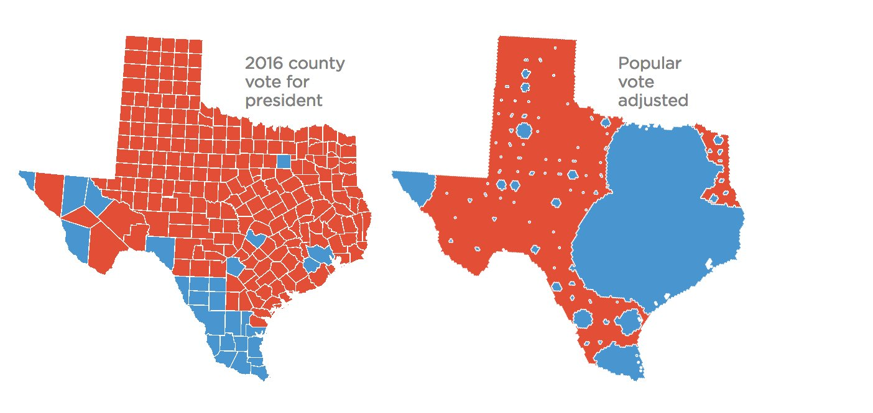
Context

Slide 17
If a chart is just wrong – numbers don’t add up to 100, etc. – is it lying?

Slide 18
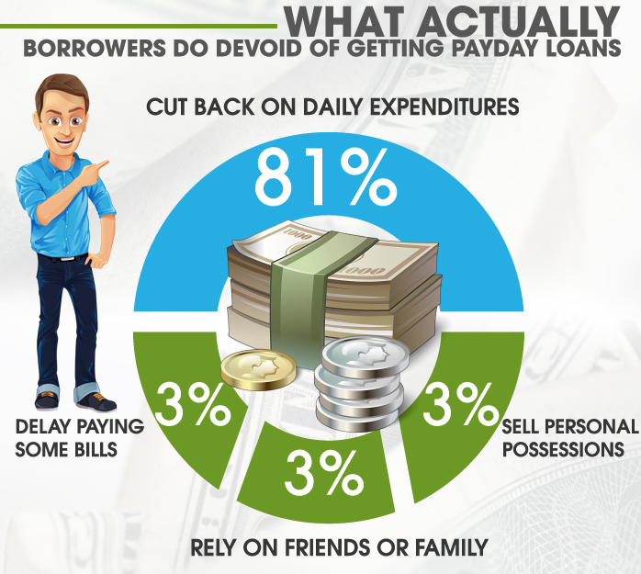
Just wrong.

Slide 19
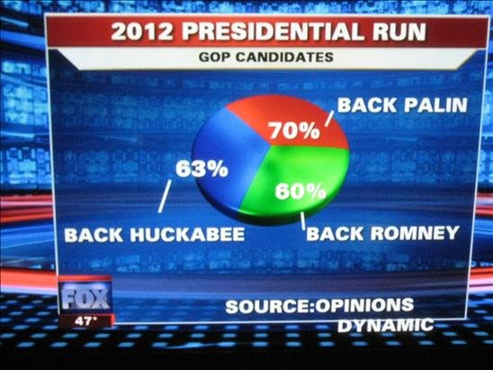
Just wrong.

Slide 20
The good news
There are a million ways to make charts now, both online and within software packages you will use.
Excel is a good one. Google has their own charting libraries. Tableau Public is used in business analytics.
Chartbuilder.

Slide 21
In class
With the time remaining, visualize an aspect of the police quality assurance survey, using the data from the last assignment.
Use Chartbuilder. At 10:30, you will email it to me and we will share them on screen.
matt.waite@unl.edu

