Slide 1
Photography
The web is a visual medium.

Slide 2
The Rules
Get closer.
Try not to use the zoom function. See rule 1.
Use the Rule of Thirds.
Lock your focus.
Light is your friend.
Light is your mortal enemy.
No Instagram. No filters. No bullshit.

Slide 3
Composition

Slide 4
Composition tips
Where is the light?
Where is the action?
Where can I see faces?
Where can I get a unique angle on this?
Are all my photos head high and horizontal?
Have I moved around?
Am I close enough?

Slide 5
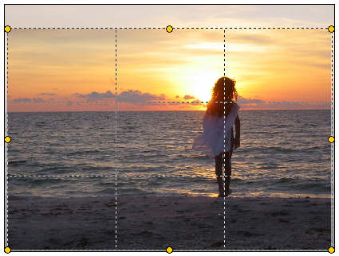
The rule of thirds

Slide 6
The Rule of Thirds

Slide 7
Light is your friend/enemy
Your phone camera isn’t as good at handling light as a regular camera.
Step one to composing a shot: Where is the light coming from?
Avoid backlighting.
Use a flash as a last resort.

Slide 8
More composing
Hold the camera steady. Your phone’s shutter isn’t as fast as an SLR. In low light, the SLR will also have a slow shutter speed.
Dig your elbows into your hips.
Fill the frame.
Focus on one thing. Lock the focus on that.
Get closer. Get closer get closer get closer get closer.

Slide 9
Mug shots.
Downstairs in the photo studio.

Slide 10
Assignments
Read Briggs Chapter 6 on photography
Watch Bruce Thorsen on YouTube BEFORE YOU DO ANYTHING ELSE.
Given what you’ve learned, shoot a feature photo. This photo should be on or around campus. It should involve a person or people.
USE THE COMPOSITION TIPS.
Bring it to class on Monday.

