Slide 1
What is data visualization?
Class #2

Slide 2
What is data visualization?
The visual representation of data.
Abstracted into a visual form – numbers made into a thing to represent those numbers.
Wait, “Abstraction”?
Computer science term meaning representing the concept while hiding away the implementation details.

Slide 3
What is data visualization?
Data visualization can be a simple representation, or a complex one.
Can represent scale, space, time, amount. It’s comparative, relies on context.
It’s meant to create a deeper understanding of a subject.
It can be silly, or deadly serious, and anywhere between.

Slide 4
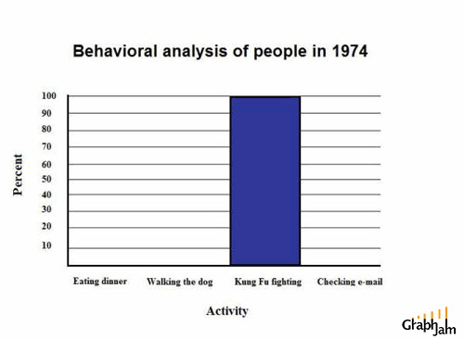
Those cats were fast as lightning.
This is funny, but in reality a terrible data visualization.

Slide 5
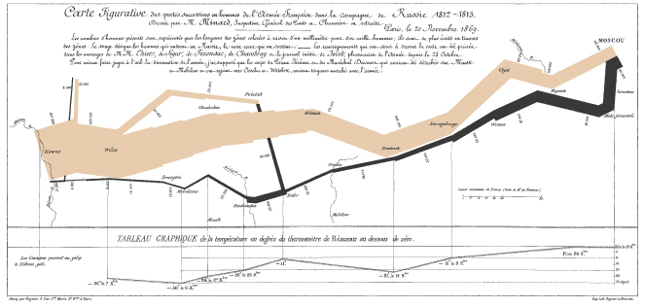
The greatest graphic ever made.
It’s rare you can describe a chart as eloquent. Aspire to it.

Slide 6
What is data visualization?
From Tufte, data visualization …
Shows the data
Induces the viewer to think about the substance rather than methodology.
Avoids distorting the data and what it says.
Presents lots of data in small space.
Makes large datasets coherent.
Encourages comparison.
Reveals several levels of detail.
Serves a clear purpose: Description, exploration, tabulation.

Slide 7
What is data visualization?
Data visualization is journalism. It’s storytelling.
It has the same structure as a story.
It has the same rules as journalism.
It just uses visual cues and the mechanics of your brain to tell that story.
Don’t believe me?

Slide 8
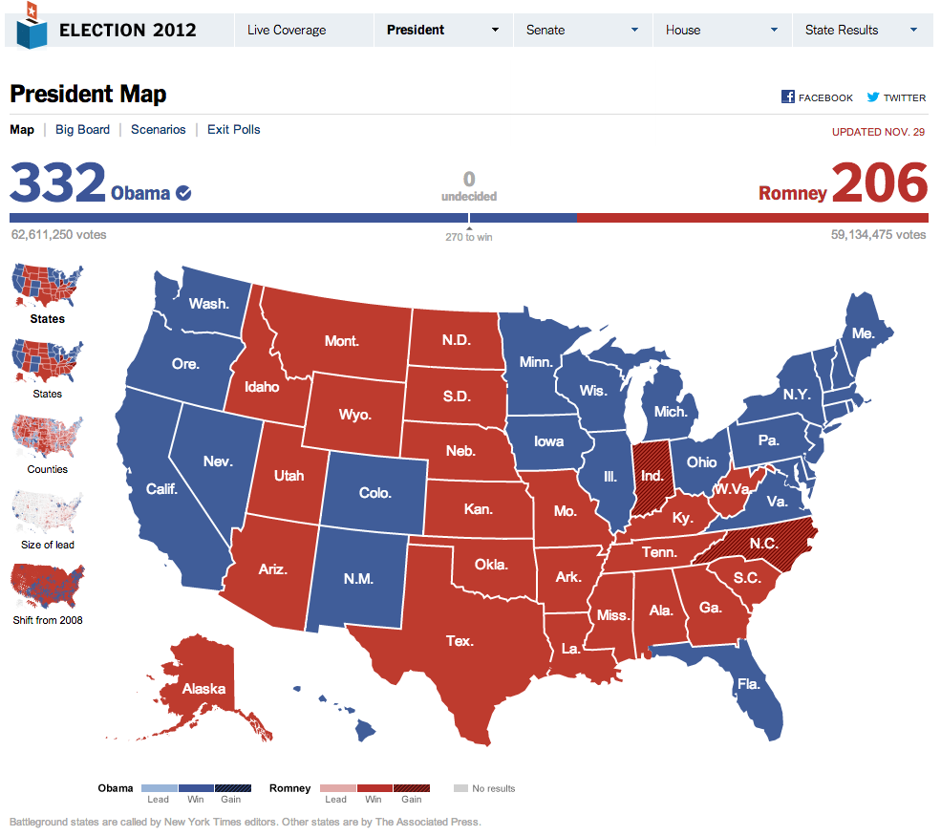

Slide 9
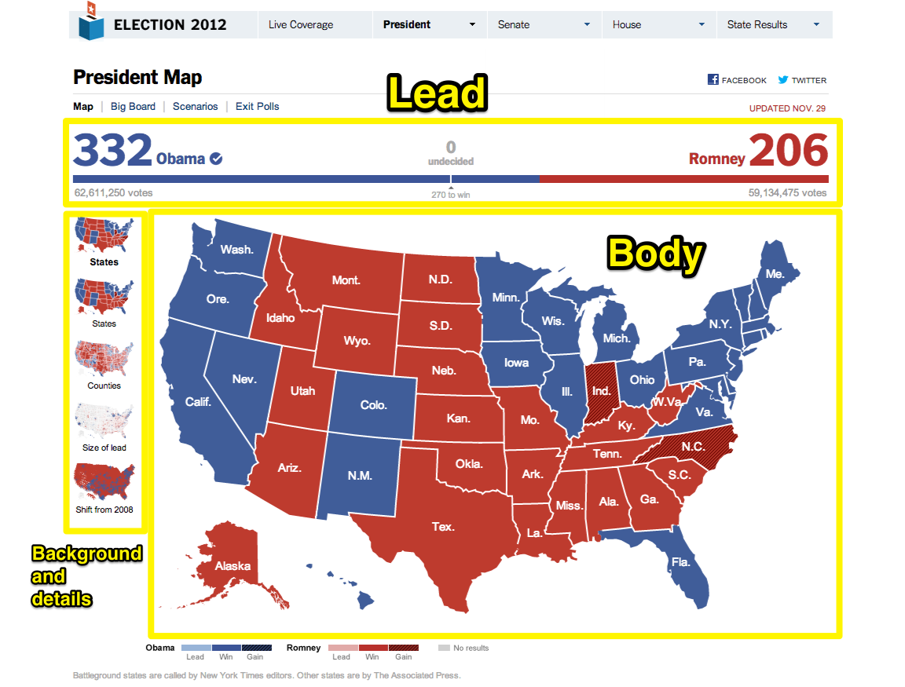

Slide 10
In class exercise
Google “Money on the Bench”
What’s the lead?
Nut graph?
Body?
Background and details?
What did you take away from this?

Slide 11
Homework
Read Tufte Chapter 1 Part 1 on Graphical Excellence (pg. 13-51).
Read Kevin Quealy’s post on chartsnthings about Money on the Bench (third link in your Google search for money on the bench). Note the process.
Update your forked course repository. Hint: Google “update forked repository”

