Slide 1
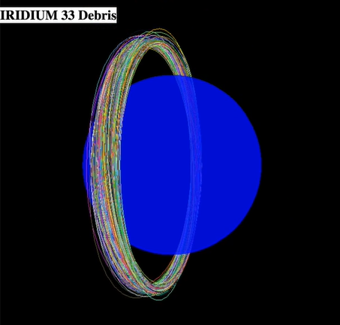
ORBINATOR
Iridium 33 Debris Orbital Elements
NASA and USAF data via CelesTrac and Space-Track.org
Preventing the “Kessler Syndrome”
Michael Patrick – HUD & Architecture
Matthew Cook – Unity and Modeling
Yinchu Xia – Orbital Data Processing
Cheng Su – 3D Modeling
NASA 2019 Space Apps Challenge
Orbital Scrap Metal - The Video Game ("To The Stars")
ThreeJS Animation
Analysis revealed debris clouds are toroidal vs. simple satellite orbits!
https://drive.google.com/file/d/1qtbrwsSGGKeWwx0lwcMet-rp7l0OXUxc/view

Slide 2
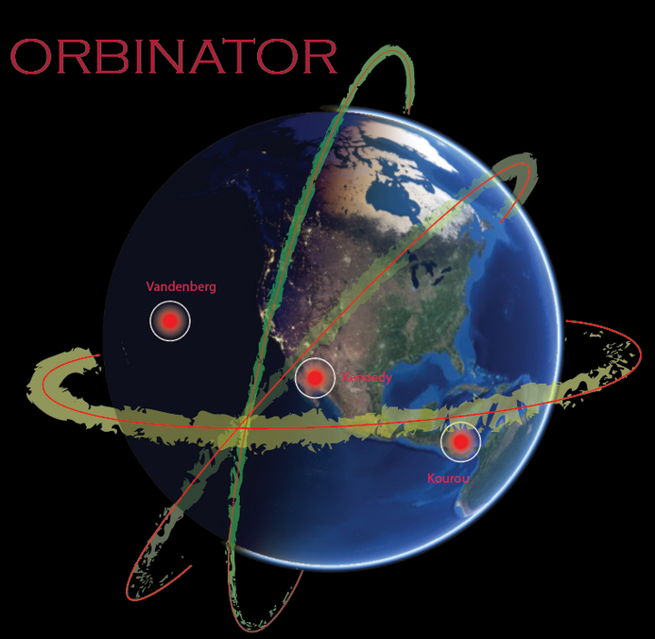
Goal:
Expose widespread general users to the complexities and key concepts of the problem
NASA WorldWind
Launch Direction
Debris Cloud Zones
Altitude Adjustment
Inclination Changes
Target Types
Disposal Techniques
Create New Strategies – Situation mutates on a daily basis, human heuristics required!
ORBINATOR Orbital Scrap Metal
NASA 2019 Space Apps Challenge

Slide 3
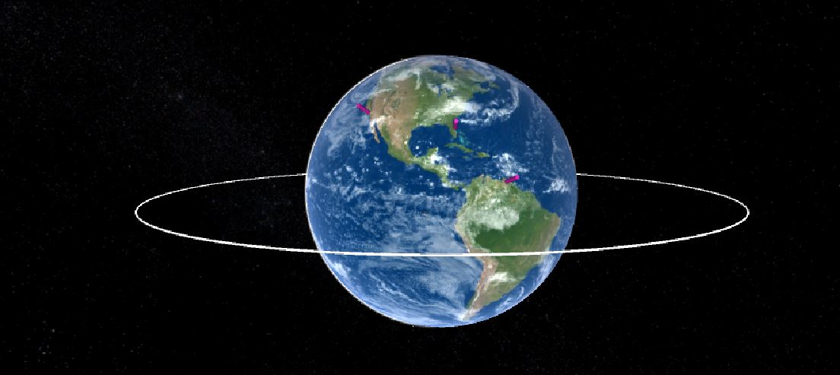
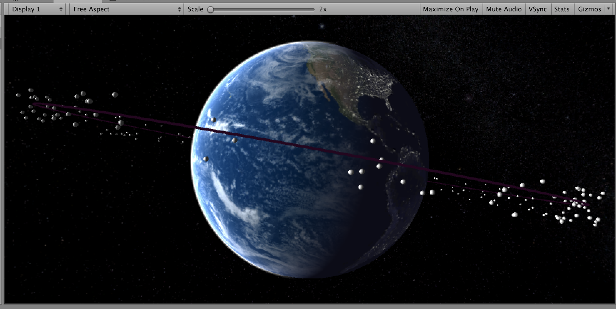
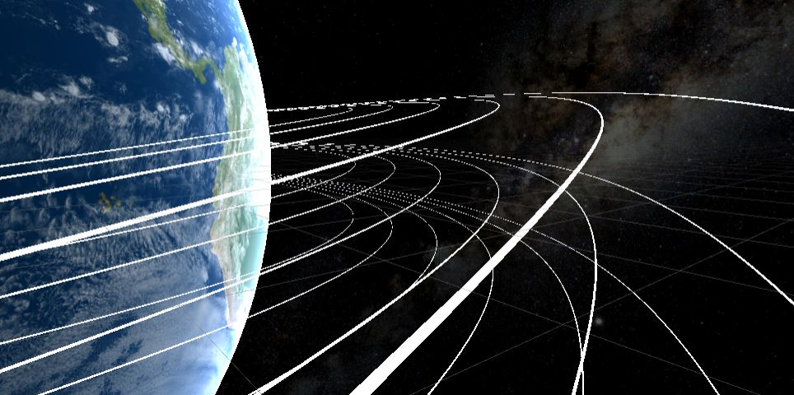
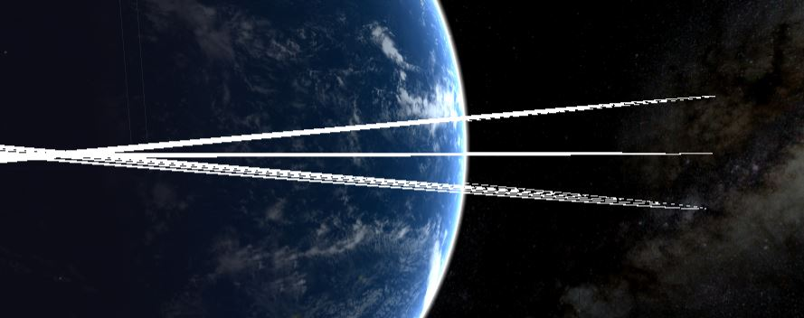
Play:
Strategy vs. First Person Shooter!
“Carrier” with specialized “Drone” vehicles
Beamers - Paint chips, wrap fragments
Collectors - Nuts and bolts – return to carrier
De-Orbiters – Boosters and entire cubesats
.
.
Chain of Decision Scenarios 3x3
User selects Launch Site and Direction for Debris Cloud Zone
Maneuvers ‘Carrier’ to an optimum central position
Using HUD, allocates ‘Drones’ by target type, size, by orbital plane and velocity change required
.
+
Unity Animation
.
+
NASA Documentation: Astromaterials Research & Exploration Science - ORBITAL DEBRIS PROGRAM OFFICE ( ORDEM and LEGEND )
ORBINATOR Orbital Scrap Metal

Slide 4
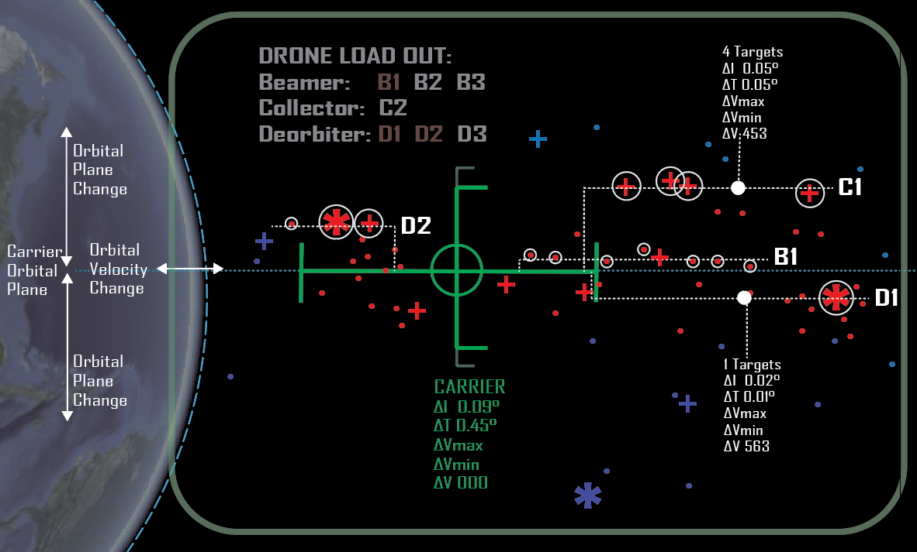
HUD:
Innovative Display!
NOT a ‘3-d Space’, display is ‘Orbital Energies Space’
Critical Elements:
Energy Budgets
Inclination Changes
Target Characteristics
Drone assignment and Dispatch
Unity Animation
Display Elements are also ‘Controls’
ORBINATOR Orbital Scrap Metal

Slide 5
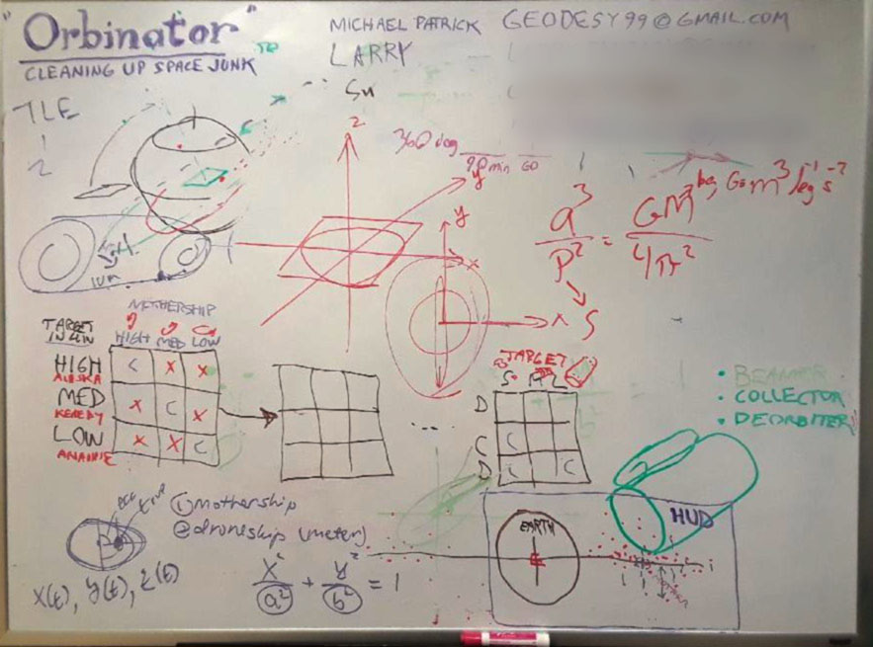
Thank You!
Future?:
Kerbal Space Program Plug-in? Real data with evolving virtual designs and reefing strategies
600 trillion ISK on the active accounts in EVE Online, which in ISK to real life money value translates to around 18 million USD
Crowd funded with institutional matching funds of real hardware for competitions
Questions?
Michael Patrick – HUD & Architecture
Matthew Cook – Unity and Modeling
Yinchu Xia – Orbital Data Processing
Cheng Su – 3D Modeling
https://github.com/mattwcook/Orbinator
https://warycat.github.io/orbinator/
ORBINATOR Orbital Scrap Metal

Slide 6
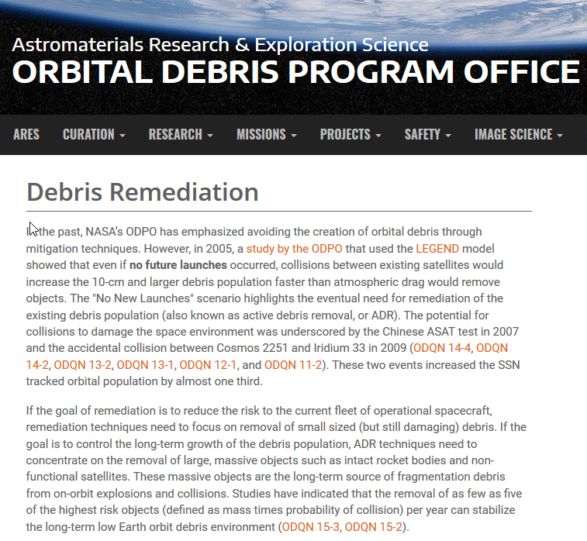
https://orbitaldebris.jsc.nasa.gov/remediation/
ORBINATOR Orbital Scrap Metal

