Slide 1
Writing Beyond the Academy
Writing & Digital Literacy Skills Courses in Local Public Libraries
Matthew Weirick Johnson, MSLS
academic.mattweirick.com

Slide 2
Community workshop series (CWS)
Partnership between UNC’s School of Information & Library Science & 3 local libraries (cws.web.unc.edu)
Durham County Library – Southwest Regional, Chapel Hill Public Library, Carrboro Cybrary (Orange County Library System)
Primary goal is to provide critical digital literacy skills to local community members (digital literacy handbook)

Slide 3
Who is the community?
Chapel Hill Public Library
Durham County Libraries Southwest Regional Branch
Carrboro Cybrary

Slide 4
Digital (Information) literacy
Information Literacy – understanding of when information is needed and ability to find, understand, evaluate, and use that information
Ability to use technological and digital tools
Ability to find and access information about technological and digital tools to learn and develop new skills
Ability to understand and evaluate digital media
& more

Slide 5
Class examples – spring 2018
Date | Class | Date | Class
January 25 | Computer & Internet Basics | March 22 | Microsoft Word Basics
February 1 | Gmail Basics | March 29 | Microsoft Excel Basics
February 8 | Social Networking | April 5 | Microsoft PowerPoint Basics
February 15 | Microsoft Word Basics | April 12 | Doing More With Word
February 22 | Job Searching & Resumes | April 19 | Doing More With Excel
March 1 | Online Shopping | April 26 | Doing More With PowerPoint
March 8 | Finding Good Health Information Online | May 3 | News & Media Literacy
Spring Break | Spring Break | May 10 | Online Security & Privacy

Slide 6
Handout examples
https://ils.unc.edu/cws/Handouts/Job%20Searching/Online-Job-Searching-And-Resume-Writing.pdf

Slide 7
Job searching & resume writing
Find employment resources online | Help employers find you | Register for employment sites
Post your resume online | Create a professional online presence | Apply through employers’ websites
Keep track of job search materials | Find more help!
Writing?
Cover letters?

Slide 8
Incorporating writing
Demonstrating resume writing
Incorporating resume examples
Providing one-on-one instruction
Conducting resume reviews
Collaborating with other librarians with expertise
Reaching out to the writing center

Slide 9
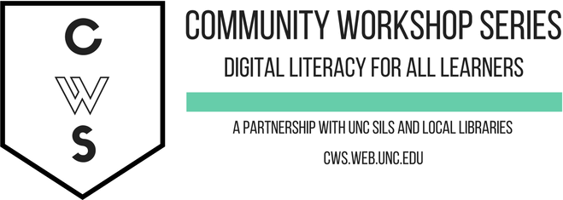
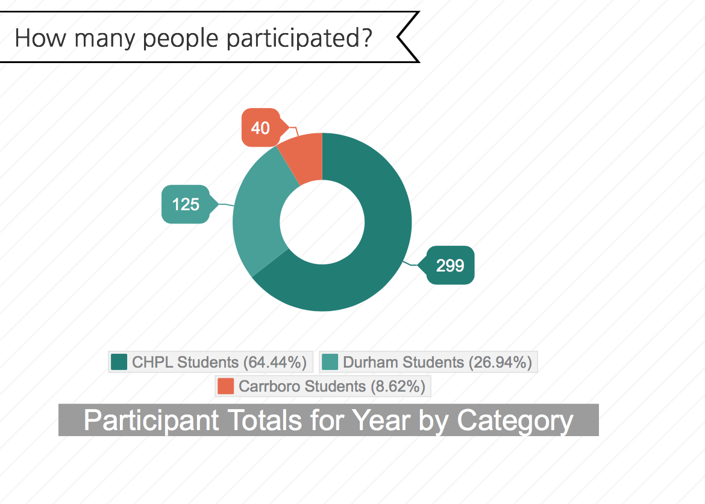
assessment
The teachers for our classes are primarily SILS students
CWS provides important opportunities for learning in our local community while also complementing the educational experience offered at SILS
Instruction skills and teaching experience are becoming more important for LIS jobs, and CWS helps prepare you
Teaching classes improves your skills in public speaking, presentation, and interpersonal communication

Slide 10





Questions?
And maybe answers.
Matthew Weirick Johnson
academic.mattweirick.com
matt@mattweirick.com
academic.mattweirick.com/files/iwca-2018.pptx
academic.mattweirick.com/talks/2018-10-11-iwca-2018

