Slide 1

Where in Los Angeles is Carmen Sandiego?
Matthew Weirick Johnson, MSLS
UCLA Library
11 January 2019
academic.mattweirick.com

Slide 2

Introduction
Bachelor of English in Literature & Language; Virginia Tech, Blacksburg, VA
Master of Science in Library Science; University of North Carolina, Chapel Hill, NC
Graduate Certificates: SILS Diversity Advocate, Interdisciplinary Health Communication, Interdisciplinary Health Disparities
Community Workshop Series Coordinator
Duke University Medical Center Library, Research & Education Intern
Miriam Braverman Memorial Prize, Progressive Librarians Guild

Slide 3
Agenda
Course Information (Considerations, Assumptions, Overview)
In-Class Activity
Assessment (Pre- & Post-)
Questions

Slide 4
Presentation Topic
A team of UCLA faculty ask you to help plan and deliver an instructional session for their undergraduate CityLAb Summer Institute. The focus of the institute is the city of Los Angeles, and it features project-based active learning, delivered through hands-on studios/workshops, seminars, guided tours, and fieldwork.
The class has 16-20 students from diverse backgrounds; many of the students are from non-UCLA institutions and have little familiarity with the resources and library services they need for their assignments. These assignments include weekly group-authored digital projects that contain:
multi-media (video, audio, images) they themselves collect, as well as historic or current online resources;
spatial and demographic data that pertain to specific events tied to locations in Los Angeles (e.g. Chinese Massacre in 1871).
How would you approach this session? What resources would you teach and why? How would you assess your students’ learning? Please explain your thought process in preparation for this class.

Slide 5
Course Objectives
Learn to use and critically assess a suite of digital tools, spatial datasets, and mapping/ visualization technologies for studying urbanism in Los Angeles.
Analyze Los Angeles’s built environment through perspectives informed by urban history, cultural studies, architecture, ethnographic fieldwork, and speculations about the future.
Understand how the history of Los Angeles is intimately and unevenly linked with the history of technologies; lean how this is manifest in built spaces and urban infrastructures.
Combine urban, architectural, digital, and humanist perspectives to understand interrelations between various racial, economic, social, and/or cultural narratives in the city.
Learn transferable skills through action-oriented, collaborative, and project-based research, while engaging in multidisciplinary inquiry.
Learn to work in research teams in order to conceptualize, design, carry out, and deliver persuasive arguments through writing, mapping, and visual media.

Slide 6
Considerations
Introduction to the course relies on students’ existing knowledge (adult learning theory)
Course heavily incorporates collaboration, group work, and inter/multidisciplinarity
No prior experience or coursework necessary (only a high school diploma is required)
Many students are likely new to UCLA

Slide 7
Assignments
Project 1.1: Basic Digital Map in Google Earth
Google My Maps, Google Earth, Social Explorer, ESRI Storymaps
Project 1.2: Thick Mapping
Fieldwork, LA spatial datasets, Google Earth, Presentation
Project 2.1: Final Project Draft
Storyboard, film segment
Project 2.2: Final Film
6-10 minute film, original scripting/acting, archival and ethnographic work, found footage
Final Cut Pro, Premiere
Project 3: Digital Online Portfolio
Illustrator, Photoshop, InDesign
Focus on finding data, maps, and scholarly sources instead of learning technological tools

Slide 8
Teaching Philosophy
Adult Learning Theory
Experiential Learning
Inquiry-Based Learning

Slide 9
Digital Humanities & Interdisciplinarity Urban Studies & Transdisciplinarity
Geography
Thinking about the humanistic study of space, place, & time (human & physical geography).
GIS
Thinking specifically about spatial data & the tools we use to analyze & present it.
History
Thinking about the overlap of the past, present, and future and how that can be mapped
Sociology &
Demography
Thinking about data about groups of people, society, social movements
Notes:
Architecture, the urban, ethnographic research

Slide 10
Digital Humanities & Interdisciplinarity Urban Studies & Transdisciplinarity
Geography
Explore maps
GIS
Explore datasets
History
Explore available literature
Sociology &
Demography
Explore demographic data

Slide 11

20 Students

Slide 12
Already in 5 Groups of 4

Slide 13
1 Student from Each Group Joins a Subject Area
The Geographers
The Sociologists
The Historians
The GIS Specialists

Slide 14
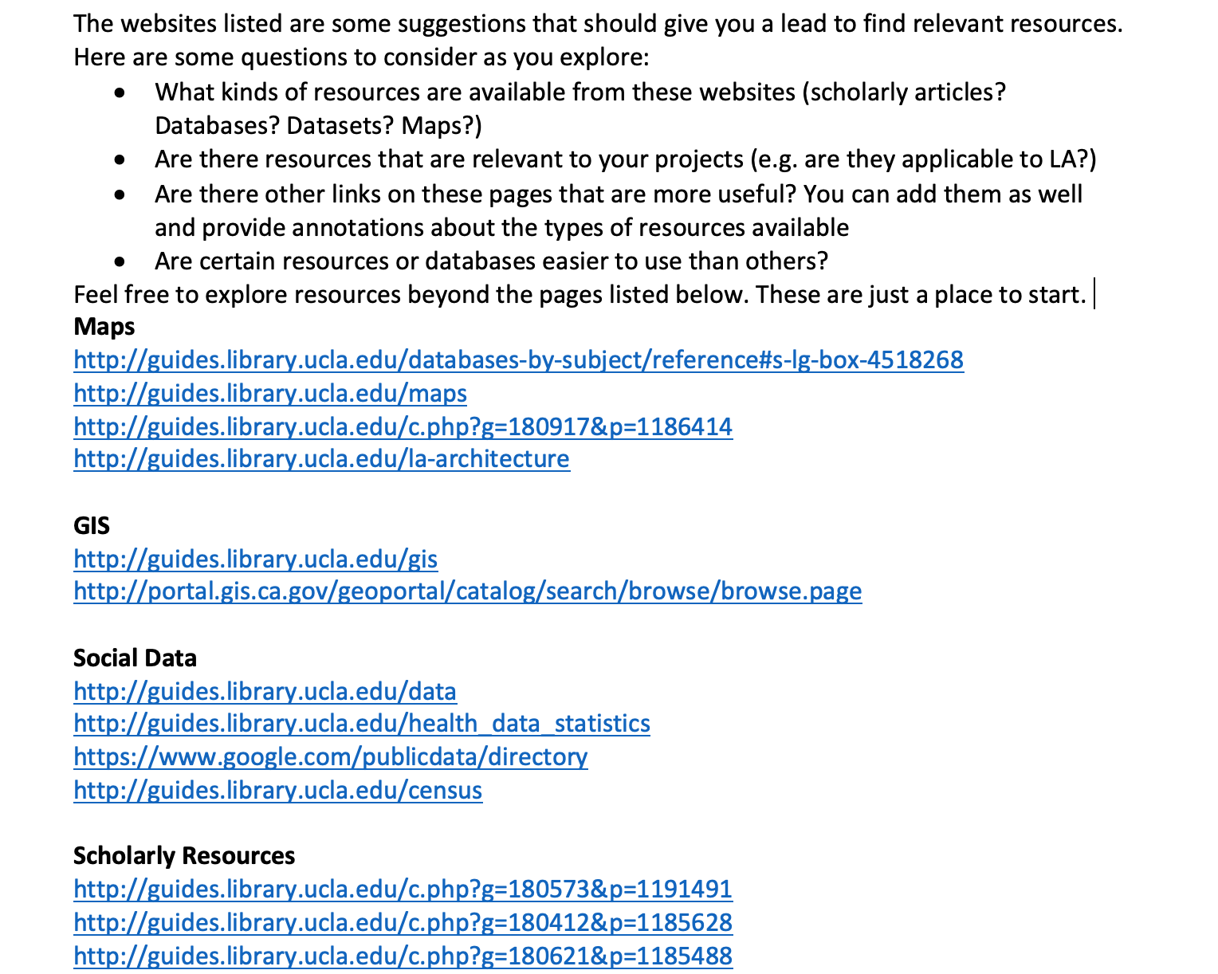
Google Doc Activity

Slide 15
Pre-Assessment
Online learning object created using Google Forms & Instructional Videos embedded in a website
The learning object will take students through the basics of searching from the library website, including required responses
Learning object will feed into the beginning of class

Slide 16
Post-Assessment
A Google Docs assignment sheet to complete
Students will identify data sets and resources that are relevant for their projects.
There should be room for variance in terms of how far along students are (i.e. some students might have data sets, topics, and articles and others might still be looking at databases and search terms)
Faculty members and instructor will provide feedback on this assignment to help direct students

Slide 17
Class Schedule Example
Before Class (30 mins.) | Pre-assessment/Online Learning Object
-00:05 – 00:05 | Note.ly activity
00:05 – 00:15 | Review Note.ly, Feedback on pre-assessment
00:15 – 00:25 | Overview of in-class activity and a(n) (few) example(s)
00:25 – 00:45 | In-class activity in groups
00:45 – 00:50 | Wrap up
After class (1 hour) | Post-assessment
15 minutes | Rotate groups once
20 minutes | Large group discussion
~ | Work in project groups

Slide 18
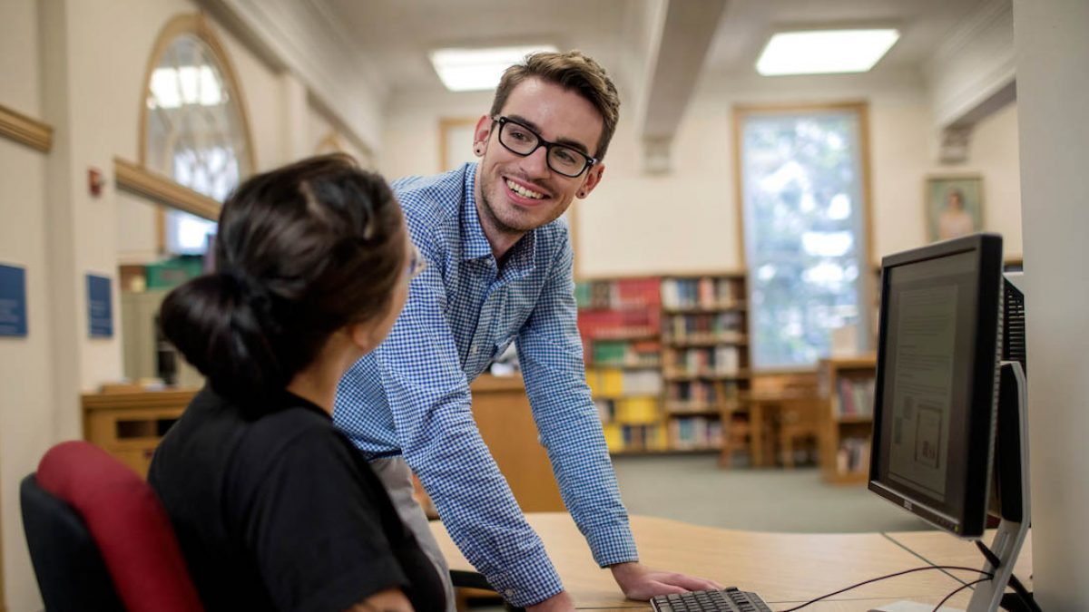




Matthew Weirick Johnson
academic.mattweirick.com
matt@mattweirick.com
academic.mattweirick.com/files/ucla-presentation-20190111.pptx
academic.mattweirick.com/talks/2019-01-11-ucla-presentation

