Slide 1
“Where we’re going, we don’t need roads”
Methodology as Infrastructure, (In)Visibility, and the Potential of Disorientation
Matthew Weirick Johnson
PhD Student, Educational Measurement & Evaluation, University of South Florida

Slide 2


Back to The Future

Slide 3
—Susan Leigh Star
People commonly envision infrastructure as a system of substrates—railroad lines, pipes and plumbing, electrical power plants, and wires. It is by definition invisible, part of the background for other kinds of work. It is ready-to-hand. This image holds up well enough for many purposes-turn on the faucet for a drink of water and you use a vast infrastructure of plumbing and water regulation without usually
thinking much about it.

Slide 4
Properties of Infrastructure
1
Embeddedness
6
Embodiment
of standards
2
Transparency
7
Built on an installed base
Reach or scope
Becomes visible
upon breakdown
3
8
4
Learned as part
of membership
9
Fixed in modular increments
Links with conventions
of practice
5

Slide 5
Infrastructure is… transparent
“in the sense that it does not have to be reinvented each time or assembled for each task but invisibly supports those tasks”

Slide 6
Infrastructure… becomes visible when it breaks down
“The image [of infrastructure] becomes more complicated when one begins. . .to examine the situations of those who are not served by a particular infrastructure. . .[f]or the person in a wheelchair, the stairs and doorjamb in front of a building are not seamless subtenders of use, but barriers” (Star, 1999)
“When British colonialists built radio networks or mobile cinemas, for instance, they did so with the intention of educating and developing Nigerians into ‘modern’ colonial citizens” (Larkin, 2008)

Slide 7
Infrastructure is… learned as part of membership
“New participants acquire a naturalized familiarity with [infrastructure’s] objects as they become members.”

Slide 8
Infrastructure is… fixed in modular increments, not all at once or globally
“Changes take time and negotiation, and adjustment with other aspects of the systems are involved.”

Slide 9
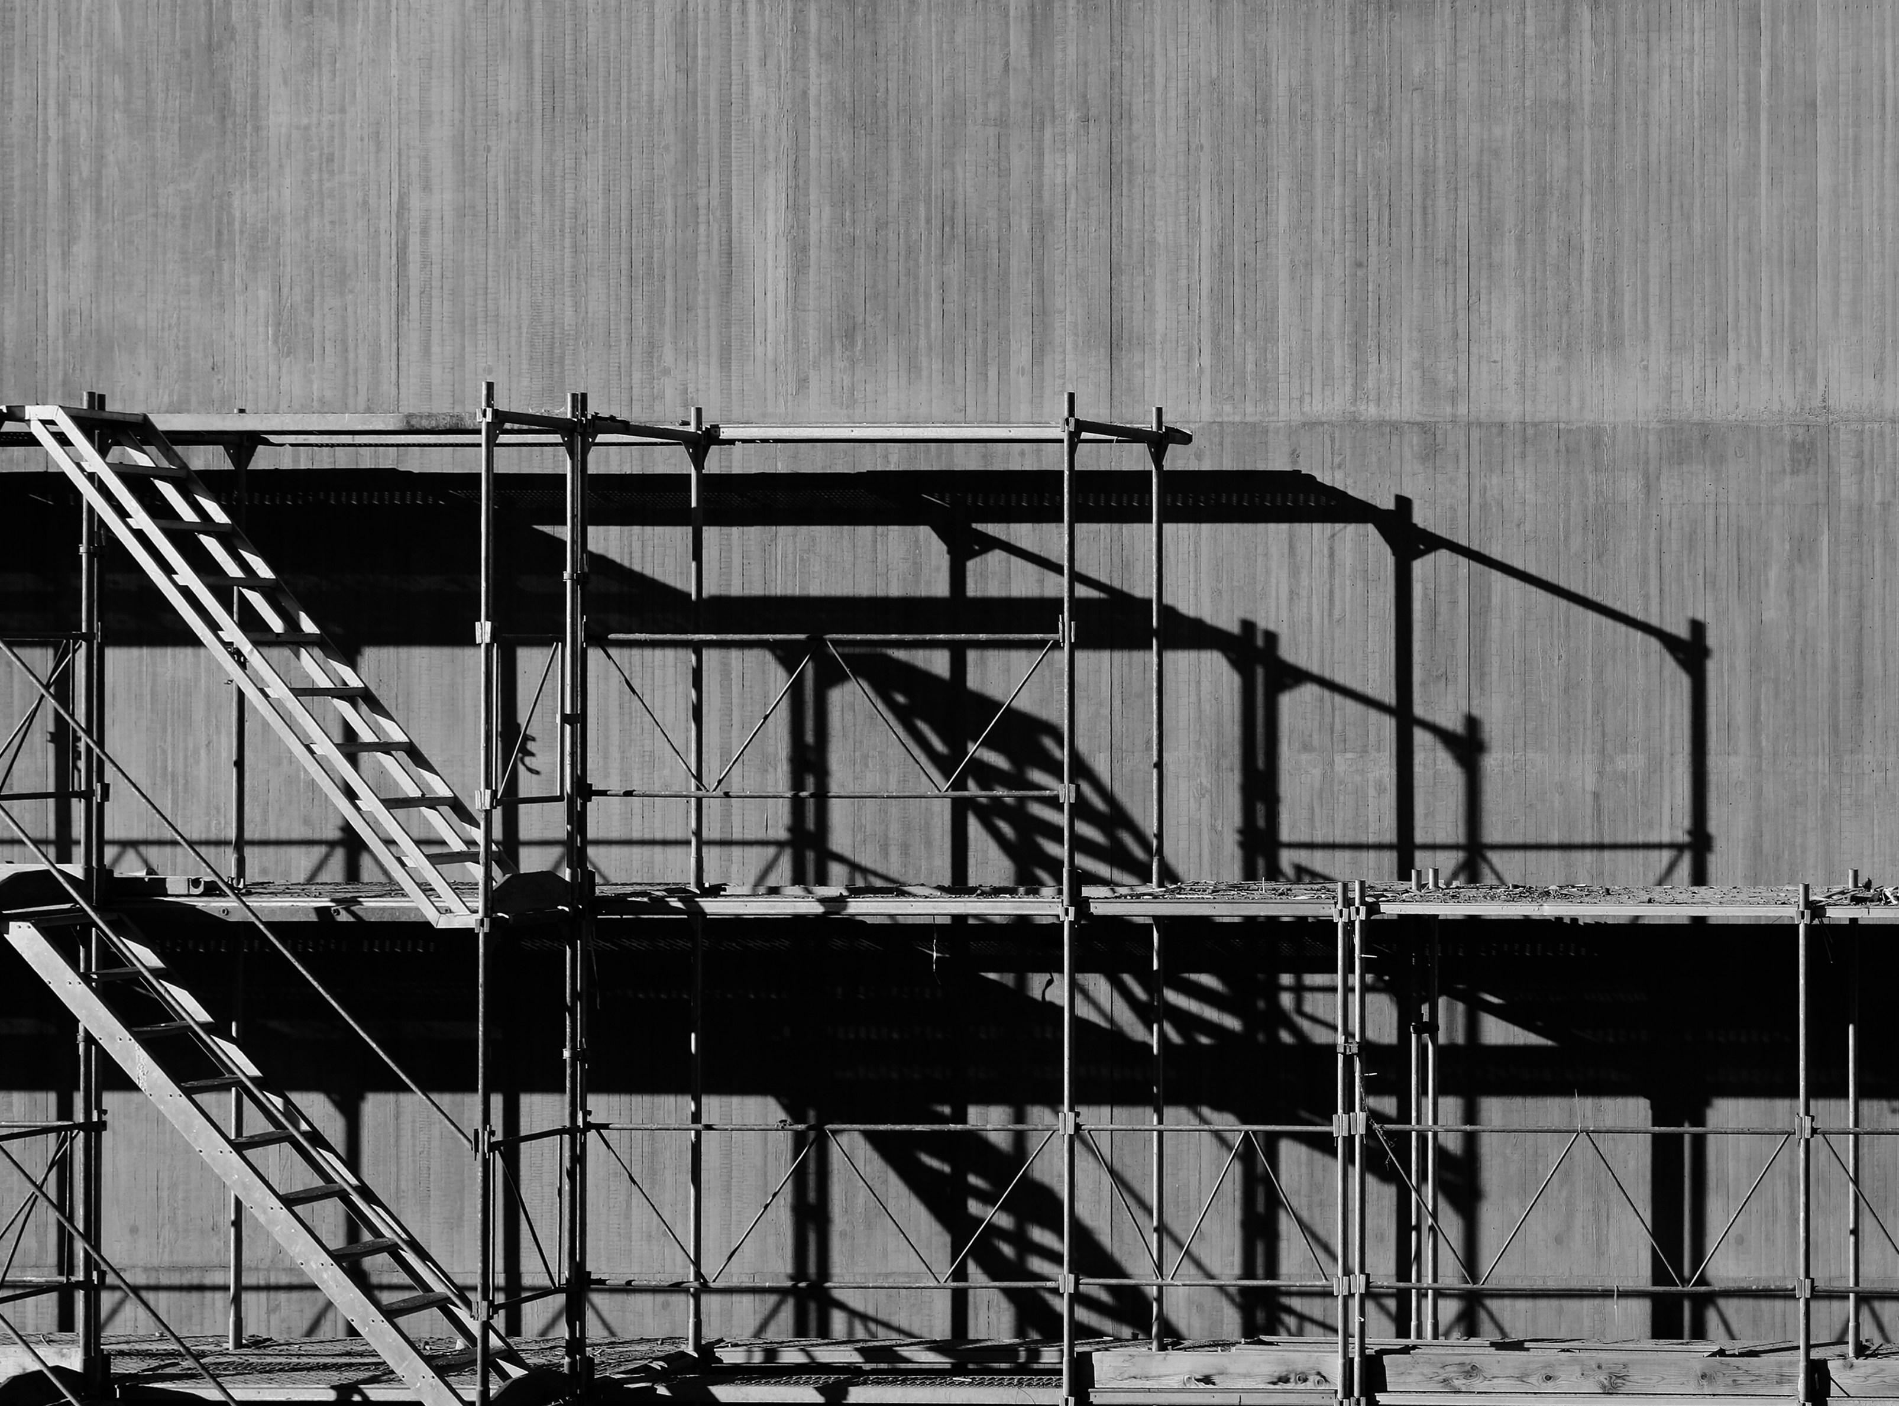
Scaffolding

Slide 10
The Road Not Taken
Robert Frost
Two roads diverged in a yellow wood,
And sorry I could not travel both
And be one traveler, long I stood
And looked down one as far as I could
To where it bent in the undergrowth;
Then took the other, as just as fair,
And having perhaps the better claim,
Because it was grassy and wanted wear;
Though as for that the passing there
Had worn them really about the same,
And both that morning equally lay
In leaves no step had trodden black.
Oh, I kept the first for another day!
Yet knowing how way leads on to way,
I doubted if I should ever come back.
I shall be telling this with a sigh
Somewhere ages and ages hence:
Two roads diverged in a wood, and I—
I took the one less traveled by,
And that has made all the difference.

Slide 11
Thanks!
Do you have any questions?
matt@mattweirick.com

