Slide 1
Linear Regression
Final Presentation
Matt | Chenxi | Wei

Slide 2
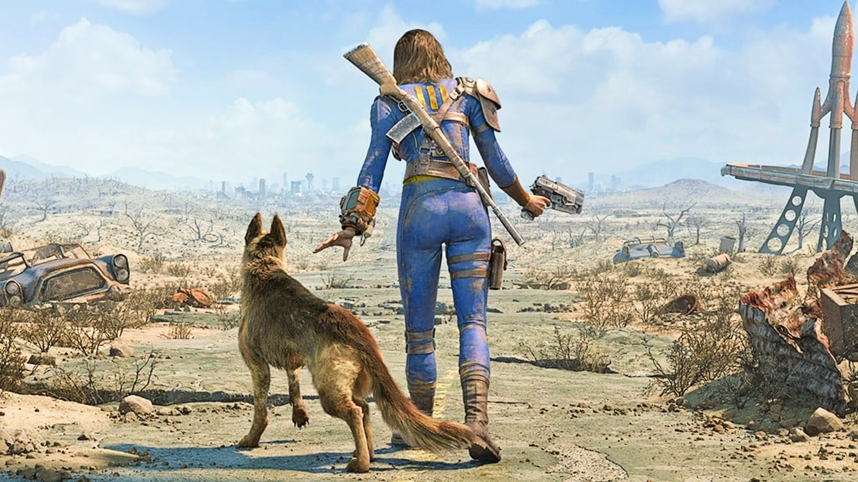


Fallout: San Francisco
2022

Slide 3
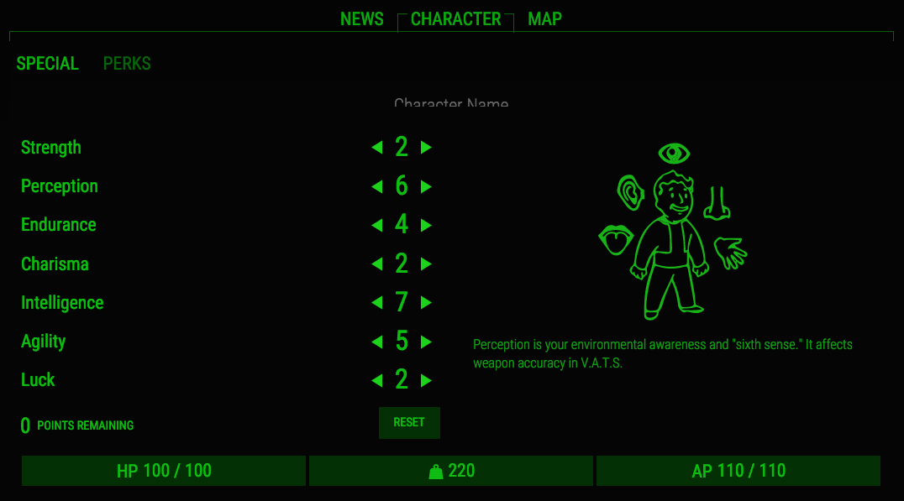
NEW CHARACTER: <NAME>
0
0
0
0
0
0
NEW Type: <TYPE>
0
50

Slide 4

NEW CHARACTER: Javier
3
7
4
9
12
11
NEW Type: ASSASSIN
4

Slide 5

NEW CHARACTER: Jinwei
17
8
13
0
1
5
NEW Type: WARRIOR
2

Slide 6
Can we predict which player set-ups will
be better?

