Slide 1
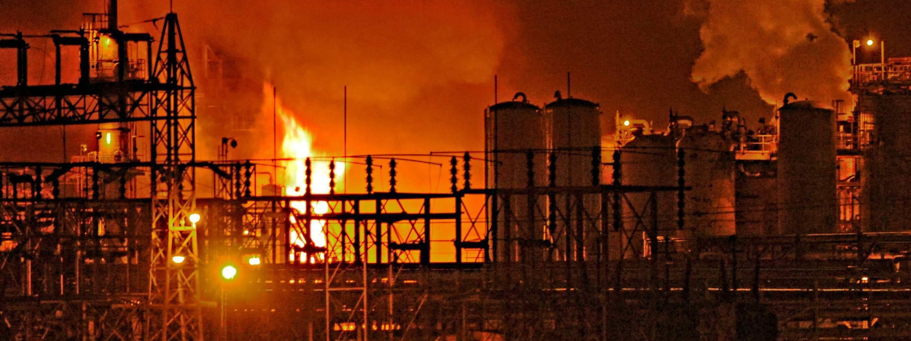
Cyber-Physical Security of A Chemical Plant
Prakash Rao Dunaka and Bruce McMillin
Department of Computer Science
Missouri University of Science and Technology
Rolla, MO 65401 USA
ff@mst.edu, +1573-341-6435

Slide 2
What is a Chemical Plant?
A chemical plant is typically an industrial process plant that manufactures or processes chemicals on a large scale.
Control Unit
Raw materials
Operations
Output

Slide 3
Why is Security Important?
Integrity (safety, product quality, financial loss)
Confidentiality (design documents, formulas and manufacturing process)

Slide 4
How to address security?
By developing effective security models.
By examining stuxnet-like attacks and their impact.
Security models will be addressing the potential and limitations of an attack.

Slide 5

Non-deducibility
Secure Domain
Non-deducibility
Good?
- Bad?
Open Domain
Open Domain
Non-deducibility is a bidirectional model.
Inside Domain

Slide 6
The Challenge
Prevent the bad guys from seeing confidential/private information.
Make sure the good guys can deduce that an attack is happening from the bad guys
In a CPS
With the same model

Slide 7
Our Approach : Multiple Security Domain Nondeducibility ( MSDND)
MSDND:
There exists some world with a pair of states where one must be true and the other false (exclusive OR), but an entity i has no valuation function for those states. In security domain SD^{i}, i simply cannot know which state is true and which is false.
Mathematically,
MSDND (ES) = ∃w ∈ W ⊢ [(s_{x} ∧ s_{y})] ∧ ~( s_{x} ∧ s_{y}) ∧ [w ⊢( ∄V_{x}^{i} (w)∧ ∄V_{y}^{i} (w) )]
An equivalent formula is
MSDND (ES) = ∃w ∈ W ⊢ [(s_{x} s_{y})] ∧ [w ⊢(∄V_{x}^{i} (w)∧ ∄V_{y}^{i} (w) )]
If a System is MSDND secure- It is BAD for the system
If a System is Not MSDND secure- It is GOOD for the system
⊕

Slide 8
It is bad for the system if it is MSDND secure with respect to integrity since by the deﬁnition of MSDND the observer does not have valuation functions for the states of the system i.e. he cannot determine which state is true and which state is false (he cannot determine if there is any change in information).
However it is good for the system with respect to conﬁdentiality because any observer will not be able to know any changes made to the system.

Slide 9
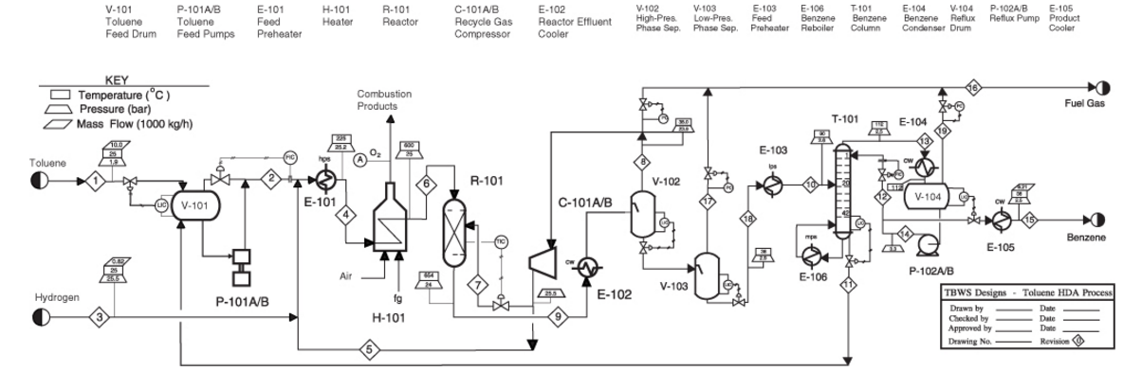
Case Study: Benzene Plant
Toluene + H₂ → Benzene + CH₄ + Energy

Slide 10
Information flow paths in the plant
Level, Pressure, Flow, and Temperature Information paths
AH
Alarm High
E
Element
T
Transmit
RC
Relay/
Compute
PLC
CV
Control Valve
AH
Alarm Low
Operator

Slide 11
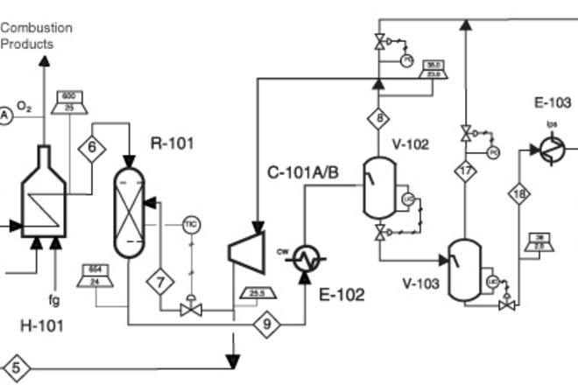
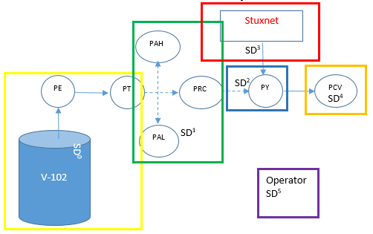
Attack Model: Stuxnet-like
Security Domains of pressure information path
Reactor(R-101) and Phase Separator (V-102)

Slide 12

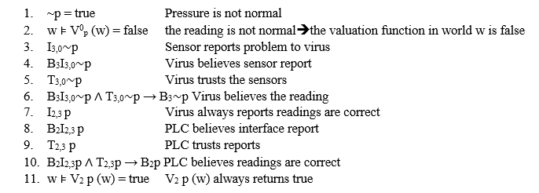


under attack (no alarms) : Pressure is not normal
Claim: Pressure information is MSDND secure.
Proof:
P
BUFFER
P
PLC
I_{2,3}P
B₂I_{2,3}P
T_{2,3}P
B₃~P
P
STUXNET-like
I_{3,0}~P
B₃I_{3,0}~P
T_{3,0}~P
Transmitter
~P
Sensor

Slide 13
Continued..
Since B₂I_{2,3}p ∧ T_{2,3}p → B₂p, the PLC believes the lie told in step 7 in all cases. Therefore, unknown to entities in SD², V²_{p} (w) and V²_{∼p} (w) cannot be evaluated. Therefore p is MSDND secure from SD^{2.}
BAD for the plant. Threat goes undetected

Slide 14
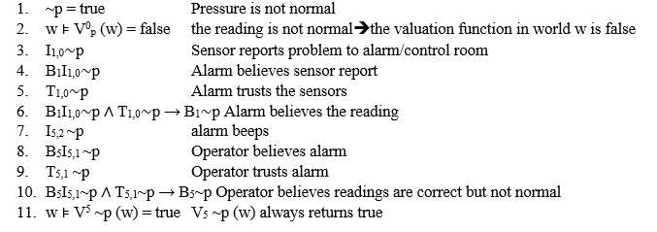

Under attack with physical alarms in place
Corollary: If the alarms are working, then pressure information beyond the threshold will make the alarm go off which will make the information not MSDND secure.
Proof:
P
BUFFER
P
PLC
B₃~P
I_{2,3}P
B₂I_{2,3}P
T_{2,3}P
P
STUXNET-like
Alert Mismatch
I_{3,0}~P
B₃I_{3,0}~P
T_{3,0}~P
Transmitter
~P
12. MSDND (ES) = ∃w ∈ W ⊢ [(S_{p} XOR S_{~p})] ∧ [w ⊢(∃ V_{~p}⁵ (w)∧ ∄V_{p}⁵ (w) )]
Sensor
I_{5,2}~P
B₅I_{5,1}~P
T_{5,1}~P
V_{~p}⁵ (w)exists: this contradicts the second part of the MSDND definition.
I_{1,0}~P
B₁I_{1,0}~P
T_{1,0}~P

Slide 15
Continued..
Since B₅I_{5,1~}p ∧ T_{5,1~}p → B_{5~}p. Therefore, in SD⁵, V⁵_{∼p} (w) can be evaluated. The Operator knows that pressure is not in desired range. Therefore p is not MSDND secure from SD⁵.
GOOD for the plant. Threat can be detected.
Conclusion:
If there is a physical alarm on the information path and an entity ’i’ looks because he or she does not trust the electronic reports, the pressure of the vessel is not MSDND secure with respect to any entity that checks the physical alarm

Slide 16
Interaction between the Reactor and Phase Separator:
Reaction being exothermic, hydrogen is compressed and recycled back to the reactor via Phase Separator (V-102) to control the temperature.
Invariant is a function, quantity, or property that remains unchanged when a speciﬁed transformation is applied.
Invariant equation:
T_{R-101} = T_{s6} + T_{reaction} – T_{s7}
T_{R-101} is out of range ➔ T_{s6} or T_{s7} is faulty or both are faulty or the sensor at T_{R-101} is faulty.
T_{R-101} | Temperature of the Reactor
T_{s6} | Temperature reduction due to pumping of H₂ (Stream 6)
T_{reaction} | Rise in temperature due to reaction
T_{s7} | Temperature of the inputs ( Stream 7)

Slide 17
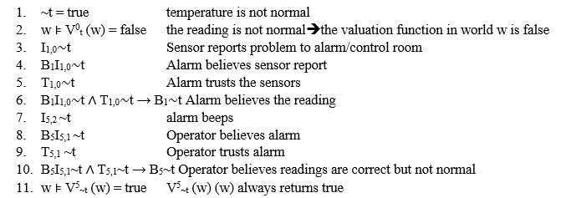
MSDND in temperature information path
Case a: Suppose T_{s7} is faulty and as result temperature is out of range (alarm beeps)
Proof:
~t
BUFFER
~t
PLC
~t
I_{3,0}~t
B₃I_{3,0}~t
T_{3,0}~t
Transmitter
~t
12. MSDND (ES) = ∃w ∈ W ⊢ [(S_{t} XOR S_{~t})] ∧ [w ⊢ (∃ V_{~t}⁵ (w) ∧ ∄V_{t}⁵ (w) )]
Sensor
I_{5,2}~t
B₅I_{5,1}~t
T_{5,1}~t
V_{~t}⁵ (w)exists: this contradicts the second part of the MSDND definition
I_{1,0}~t
B₁I_{1,0}~t
T_{1,0}~t

Slide 18
Continued..
Since B₅I_{5,1}~t ∧ T_{5,1}~t → B₅~t. Therefore, in SD⁵, V⁵_{∼t} (w) can be evaluated. The Operator knows that temperature is not in desired range. Therefore t is not MSDND secure from SD⁵.
GOOD for the plant. Threat can be detected.

Slide 19
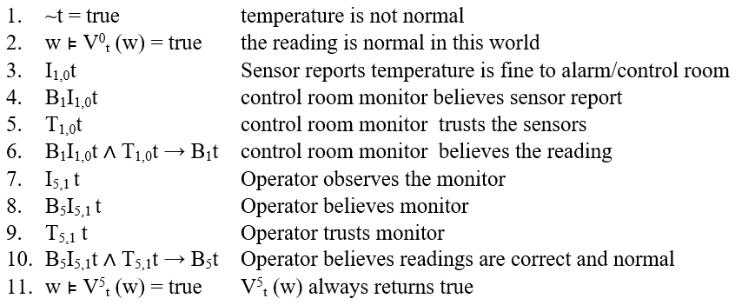
Continued..
B₁t
Case b: Suppose T_{s7} is faulty and temperature is in desired range (alarm does not beep).
Proof:
I_{1,0}t
B₁I_{1,0}t
T_{1,0}t
BUFFER
t
PLC
B₅t
t
I_{3,0}t
B₃I_{3,0}t
T_{3,0}t
~t Not desired but in range
Transmitter
t
Sensor
I_{5,2}t
B₅I_{5,1}t
T_{5,1}t
12. MSDND (ES) = ∃w ∈ W ⊢ [(S_{t} XOR S_{~t})] ∧ [w ⊢ (∄ V_{~t}⁵ (w) ∧ ∄V_{t}⁵ (w) )]
I_{1,0}t
B₁I_{1,0}t
T_{1,0}t

Slide 20


Continued..
B₁t
Unknown to entities in SD⁵ (operator), V⁵_{t} (w) and V⁵_{∼t} (w) cannot be evaluated. Therefore, t is MSDND secure from SD^{5.} The temperature is consistent with both working and non-working states of the system.
BAD for the Plant. Since a potential threat cannot be detected.
However when we take the invariant into consideration:
14. I_{5,6} t Operator observes the invariant
15. B₅I_{5,6} t Operator believes invariant
16. T_{5,6} t Operator trusts invariant
17. B₅I_{5,6}t ∧ T_{5,6}t → B₅t Operator believes readings are correct and normal
18. S_{Inv} ∧ S_{t} = S” Normal working if and only if this is true.
19. w ⊧ V⁵_{~t} (w) = true
I_{1,0}t
B₁I_{1,0}t
T_{1,0}t
BUFFER
t
PLC
TR-101 = Ts6 + Treaction –Ts7
I_{5,6}t
B₅I_{5,6}t
T_{5,6}t
t
Mismatch
~t Not desired but in range
I_{3,0}t
B₃I_{3,0}t
T_{3,0}t
MSDND (ES) = ∃w ∈ W ⊢ [(S” XOR S_{~t})] ∧ [w ⊢ (∄ V_{~t}⁵ (w) ∧ ∃ V_{t}⁵ (w) )]
Transmitter
t
V_{t}⁵ (w)exists: this contradicts the second part of the MSDND definition
Sensor
I_{5,2}t
B₅I_{5,1}t
T_{5,1}t
I_{1,0}t
B₁I_{1,0}t
T_{1,0}t

Slide 21
A Few Other invariant equations
The overall material balance for the benzene process.
Input = Output
Stream 3 + Stream 1 = Stream 15 + Stream 16.
[Toluene feed + Hydrogen feed] == [ Benzene produced + Fuel gas produced]
Conversion per pass of toluene to benzene in R-101
Toluene introduced= 144 (Stream 6) + 0.04 (Stream 7) = 144.04 kmol/h
Benzene produced= 116 (Stream 9) − 7.6 (Stream 6) − 0.37 (Stream 7) = 108.03 kmol/h
ε= 108.03/144.04 = 0.75
Alternatively, the following can be written:
Moles of benzene produced= Toluene in - Toluene out == 144.04− 36.00 = 108.04 kmol/h
ε= 108.04/144.04 = 0.75

Slide 22
conclusions:
 | Stuxnet attack on Pressure path
information path | Case | Result | Inference
Pressure path | under Attack/ No alarms | MSDND secure | BAD for the plant
Pressure path | under attack with physical alarms | Not MSDND secure | Good for the plant
Temperature path | temperature out of range | Not MSDND secure | Good for the plant
Temperature path | temperature with in range | MSDND secure | BAD for the plant
Temperature path | temperature with in range with Invariant in place. | Not MSDND secure | Good for the plant, threat can be detected
MSDND is useful to model attacks where the goal is to hide critical information from an operator rather than to steal information.
If a System is MSDND secure- It is BAD for the system
If a System is Not MSDND secure- It is GOOD for the system
A system without any MSDND secure information ﬂows between the CPS and cyber monitors has fewer weaknesses which can be exploited.

Slide 23
Future work:
can MSDND be extended and applied to the connected processing units.
effect of a single attack on all other connected processing units.
to detect the easiest information path that an attacker can disrupt to have maximum impact and how to counter such attacks.

Slide 24
Cyber-Physical Security of A Chemical Plant
Prakash Rao Dunaka and Bruce McMillin
Department of Computer Science
Missouri University of Science and Technology
Rolla, MO 65401 USA
ff@mst.edu, +1573-341-6435

