Slide 1
Lecture 10
Time Series Econometrics
April 11, 2023

Slide 2
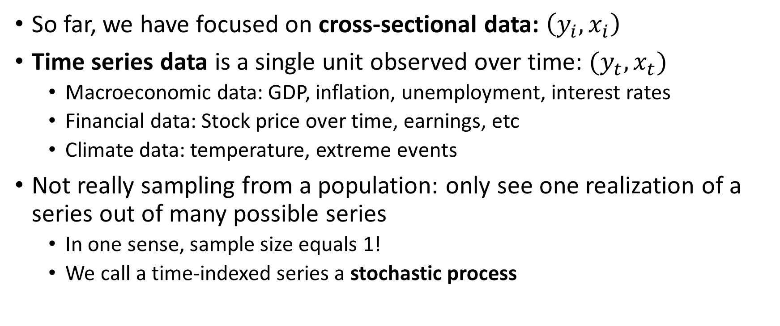
Time Series Introduction
So far, we have focused on cross-sectional data: $\left(y_{i},x_{i}\right)$
Time series data is a single unit observed over time: $(y_{t},x_{t})$
Macroeconomic data: GDP, inflation, unemployment, interest rates
Financial data: Stock price over time, earnings, etc
Climate data: temperature, extreme events
Not really sampling from a population: only see one realization of a series out of many possible series
In one sense, sample size equals 1!
We call a time-indexed series a stochastic process

Slide 3
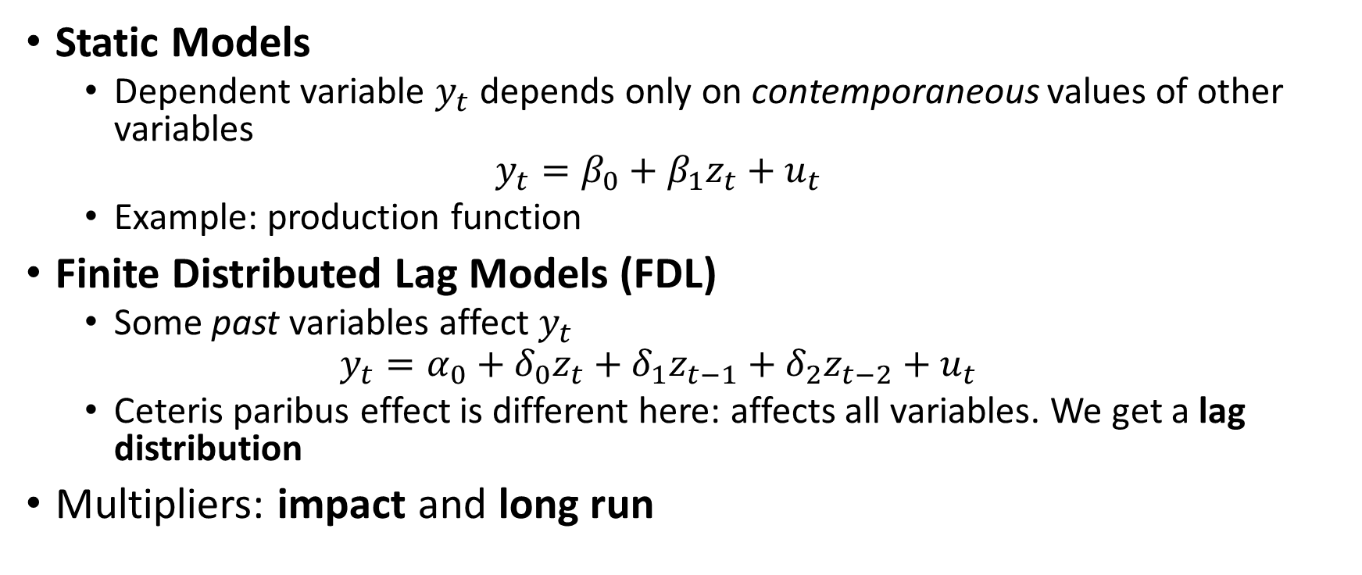
Two Examples of Time Series
Static Models
Dependent variable $y_{t}$ depends only on contemporaneous values of other variables
$$y_{t}=β_{0}+β_{1}z_{t}+u_{t}$$
Example: production function
Finite Distributed Lag Models (FDL)
Some past variables affect $y_{t}$
$$y_{t}=α_{0}+δ_{0}z_{t}+δ_{1}z_{t−1}+δ_{2}z_{t−2}+u_{t}$$
Ceteris paribus effect is different here: affects all variables. We get a lag distribution
Multipliers: impact and long run

Slide 4
Assumptions and Properties
Assumptions are similar as before, but some key differences
TS.1: Linear in parameters
TS.2: No perfect collinearity
TS.3: Strictly exogenous
TS.4: Homoskedasticity
TS.5: No serial correlation
TS.1-TS.3: unbiasedness, TS.4-TS.5: BLUE
Asymptotic assumption modifications
TS.1’: Add weak dependence (and sometimes stationarity)
TS.3’: Contemporaneously exogenous
TS.4’: Contemporaneously homoskedastic
TS.1-TS.3: consistency, TS.1-TS.5: Asymptotic normality
TS.6: Errors are independent of x, i.i.d., and normally distributed
With TS.1-TS.6, estimators are normally distributed, can use t- and F- statistics as before

Slide 5
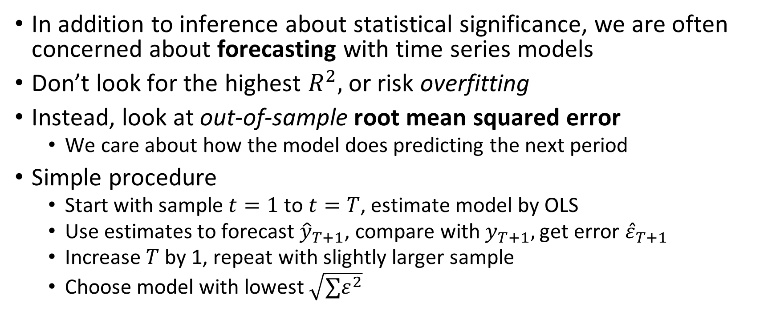
Forecasting
In addition to inference about statistical significance, we are often concerned about forecasting with time series models
Don’t look for the highest $R^{2},$ or risk overfitting
Instead, look at out-of-sample root mean squared error
We care about how the model does predicting the next period
Simple procedure
Start with sample $t=1$to $t=T$, estimate model by OLS
Use estimates to forecast ${\hat{y}}_{T+1}$, compare with $y_{T+1},$get error ${\hat{ε}}_{T+1}$
Increase $T$ by 1, repeat with slightly larger sample
Choose model with lowest $\sqrt{∑ε^{2}}$

Slide 6
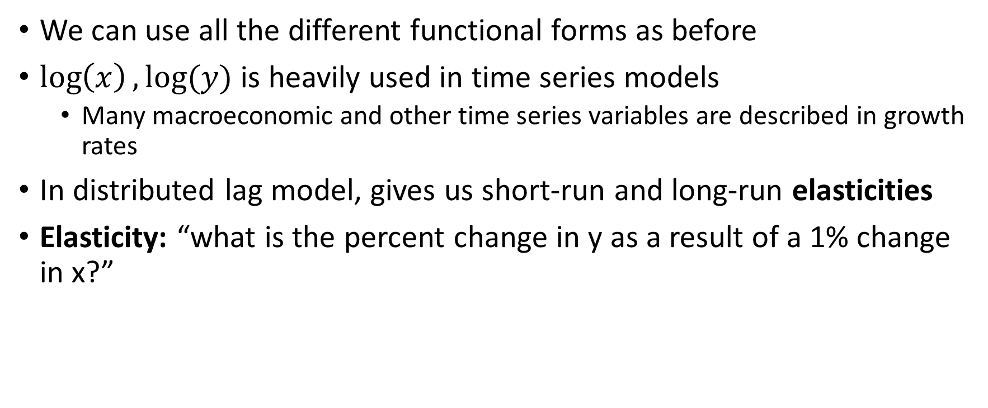
Functional Forms
We can use all the different functional forms as before
$\log\left(x\right),log⁡(y)$ is heavily used in time series models
Many macroeconomic and other time series variables are described in growth rates
In distributed lag model, gives us short-run and long-run elasticities
Elasticity: “what is the percent change in y as a result of a 1% change in x?”

Slide 7
Dummy and Index Variables
Dummy variables in time series represent whether or not a certain event has occurred, or isolate a certain period where dynamics might be different
Binary variables used for event studies: whether an event influences an outcome
Index variable:
Variable that is only defined relative to itself in a base period
Base value is a chosen value for the variable in the base period, often 1 or 100
e.g.: price level = 100 in 2012

Slide 8
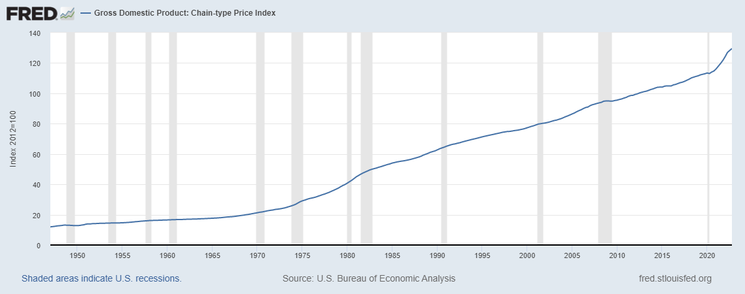

Slide 9
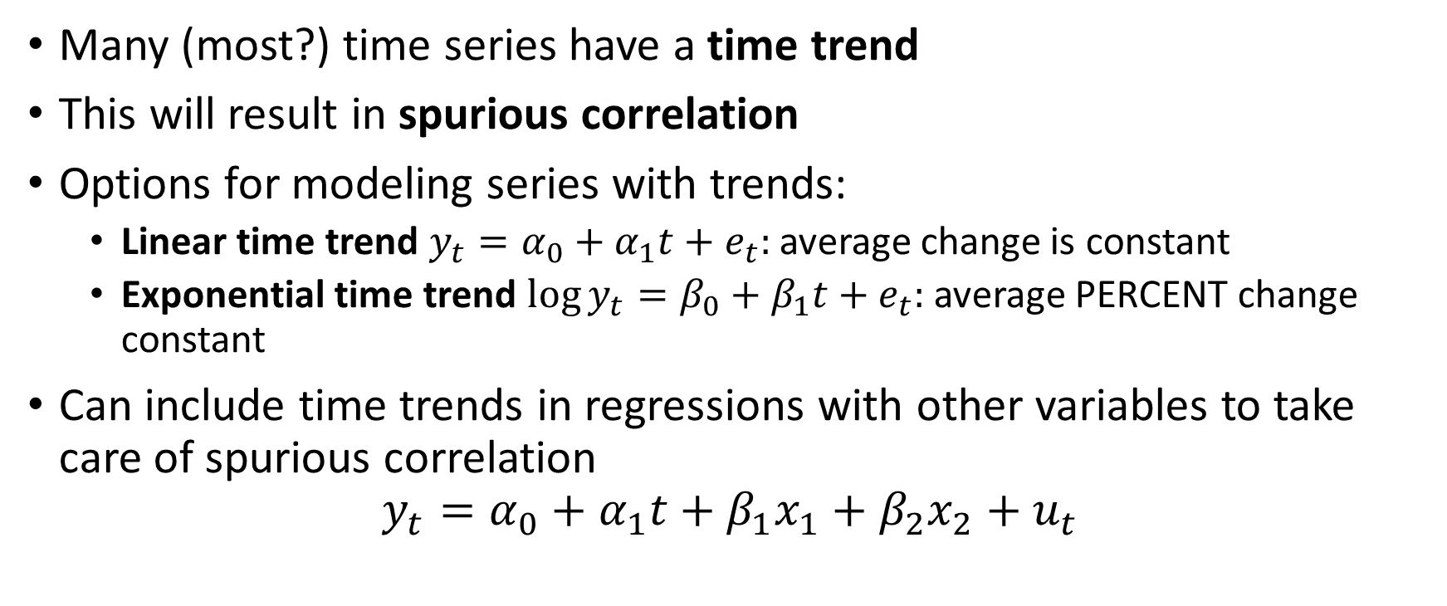
Time Trends
Many (most?) time series have a time trend
This will result in spurious correlation
Options for modeling series with trends:
Linear time trend $y_{t}=α_{0}+α_{1}t+e_{t}:$ average change is constant
Exponential time trend $\log{y_{t}}=β_{0}+β_{1}t+e_{t}:$average PERCENT change constant
Can include time trends in regressions with other variables to take care of spurious correlation
$$y_{t}=α_{0}+α_{1}t+β_{1}x_{1}+β_{2}x_{2}+u_{t}$$

Slide 10
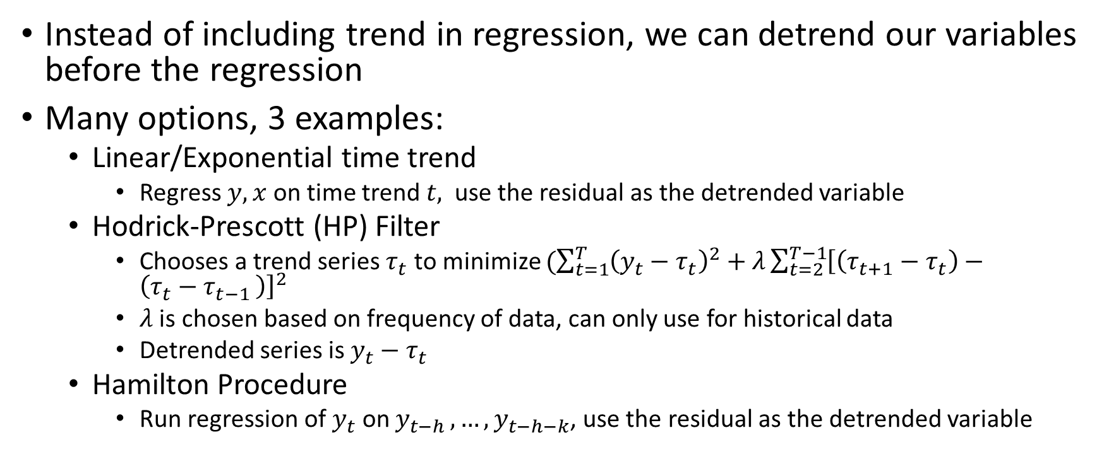
Detrending
Instead of including trend in regression, we can detrend our variables before the regression
Many options, 3 examples:
Linear/Exponential time trend
Regress $y,x$ on time trend $t,$ use the residual as the detrended variable
Hodrick-Prescott (HP) Filter
Chooses a trend series $τ_{t}$ to minimize $(\sum_{t=1}^{T}{{\left(y_{t}−τ_{t}\right)}^{2}+λ}\sum_{t=2}^{T−1}{{\left[\left(τ_{t+1}−τ_{t}\right)−\left(τ_{t}−τ_{t−1 }\right)\right]}^{2}}$
$λ$ is chosen based on frequency of data, can only use for historical data
Detrended series is $y_{t}−τ_{t}$
Hamilton Procedure
Run regression of $y_{t}$ on $y_{t−h }, …,y_{t−h−k}$, use the residual as the detrended variable

Slide 11
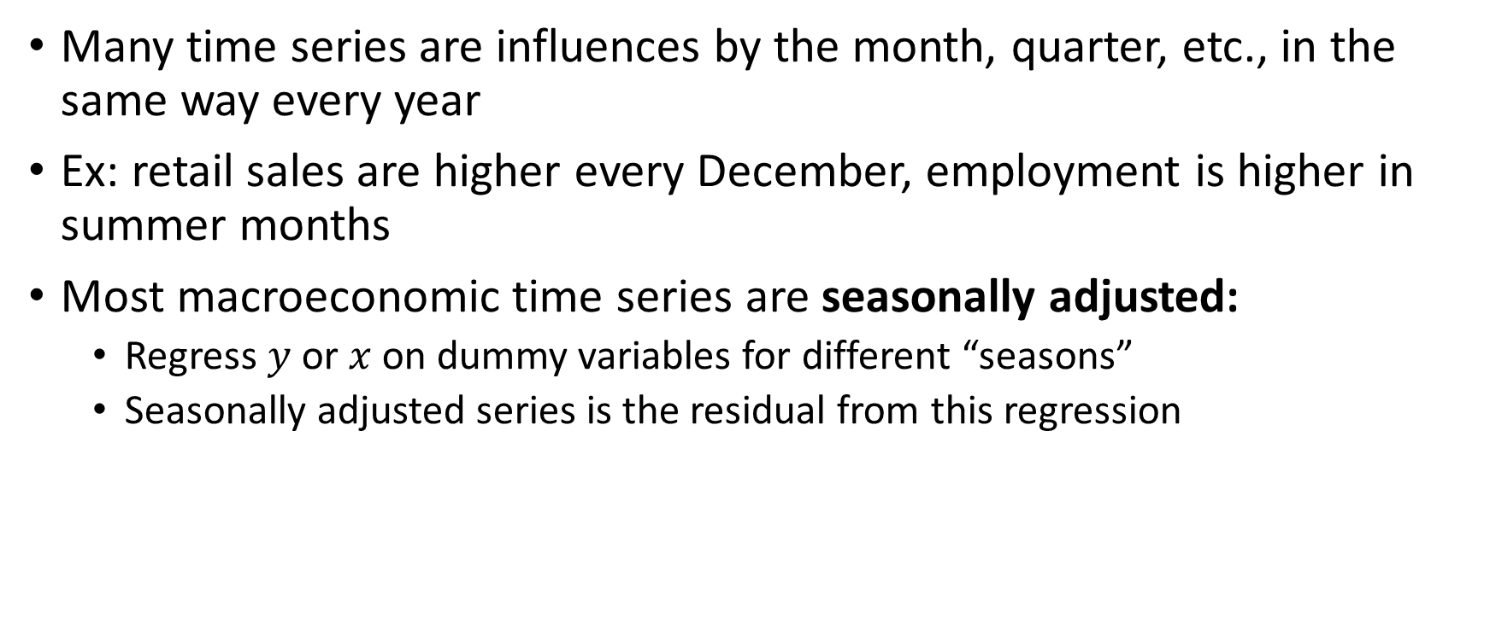
Seasonality
Many time series are influences by the month, quarter, etc., in the same way every year
Ex: retail sales are higher every December, employment is higher in summer months
Most macroeconomic time series are seasonally adjusted:
Regress $y$ or $x$ on dummy variables for different “seasons”
Seasonally adjusted series is the residual from this regression

Slide 12
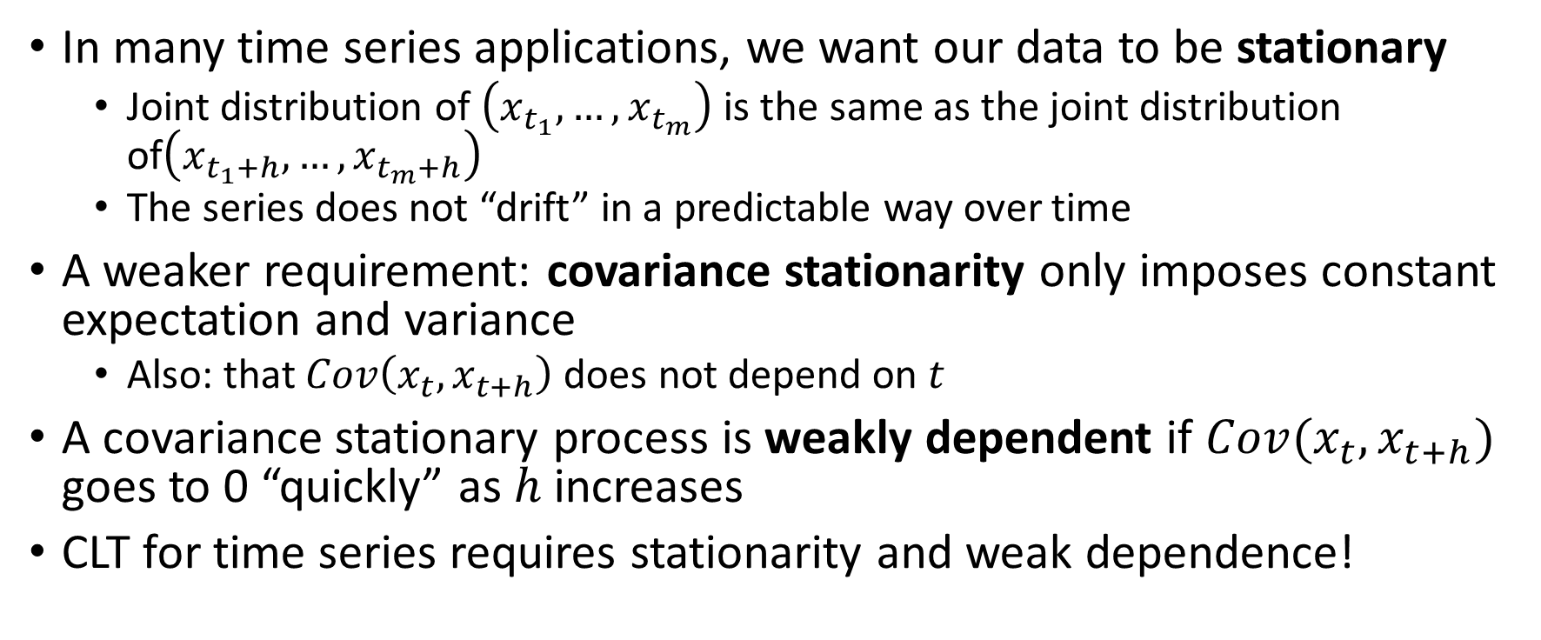
Stationarity
In many time series applications, we want our data to be stationary
Joint distribution of $\left(x_{t_{1}},…,x_{t_{m}}\right)$ is the same as the joint distribution of$\left(x_{t_{1}+h},…,x_{t_{m}+h}\right)$
The series does not “drift” in a predictable way over time
A weaker requirement: covariance stationarity only imposes constant expectation and variance
Also: that $Cov\left(x_{t},x_{t+h}\right)$ does not depend on $t$
A covariance stationary process is weakly dependent if $Cov(x_{t},x_{t+h})$ goes to 0 “quickly” as $h$ increases
CLT for time series requires stationarity and weak dependence!

Slide 13
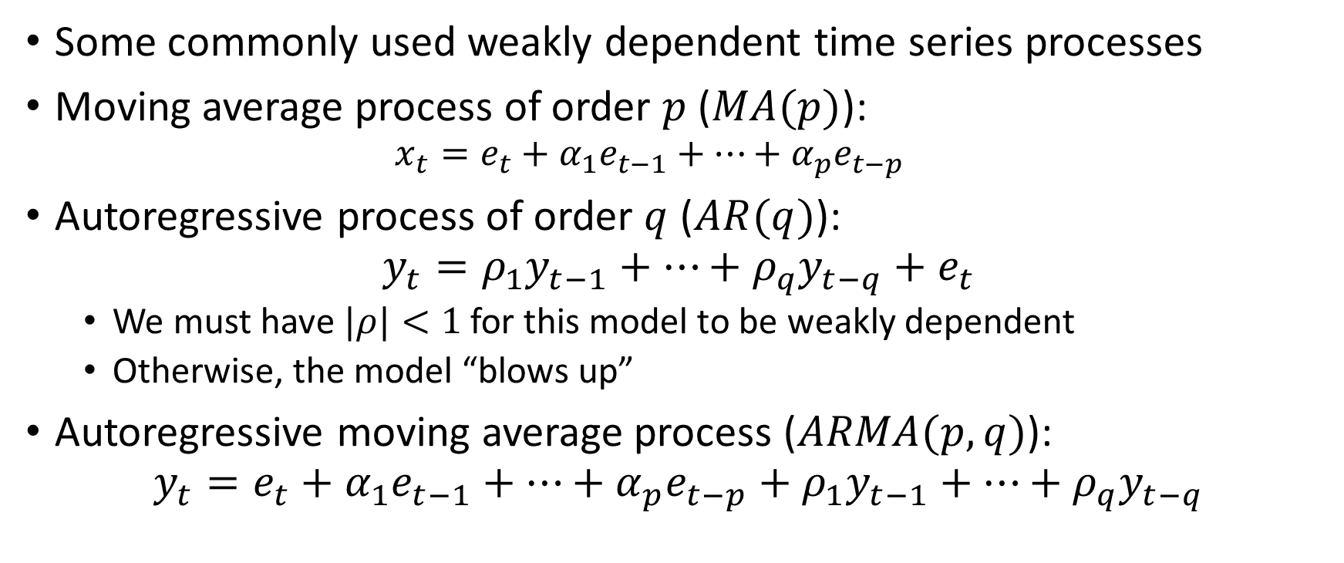
MA and AR Models
Some commonly used weakly dependent time series processes
Moving average process of order $p$ ($MA(p)$):
$$x_{t}=e_{t}+α_{1}e_{t−1}+…+α_{p}e_{t−p}$$
Autoregressive process of order $q$ ($AR(q)$):
$$y_{t}=ρ_{1}y_{t−1}+…+ρ_{q}y_{t−q}+e_{t}$$
We must have $|ρ|<1$ for this model to be weakly dependent
Otherwise, the model “blows up”
Autoregressive moving average process ($ARMA(p,q)$):
$$y_{t}=e_{t}+α_{1}e_{t−1}+…+α_{p}e_{t−p}+ρ_{1}y_{t−1}+…+ρ_{q}y_{t−q}$$

Slide 14
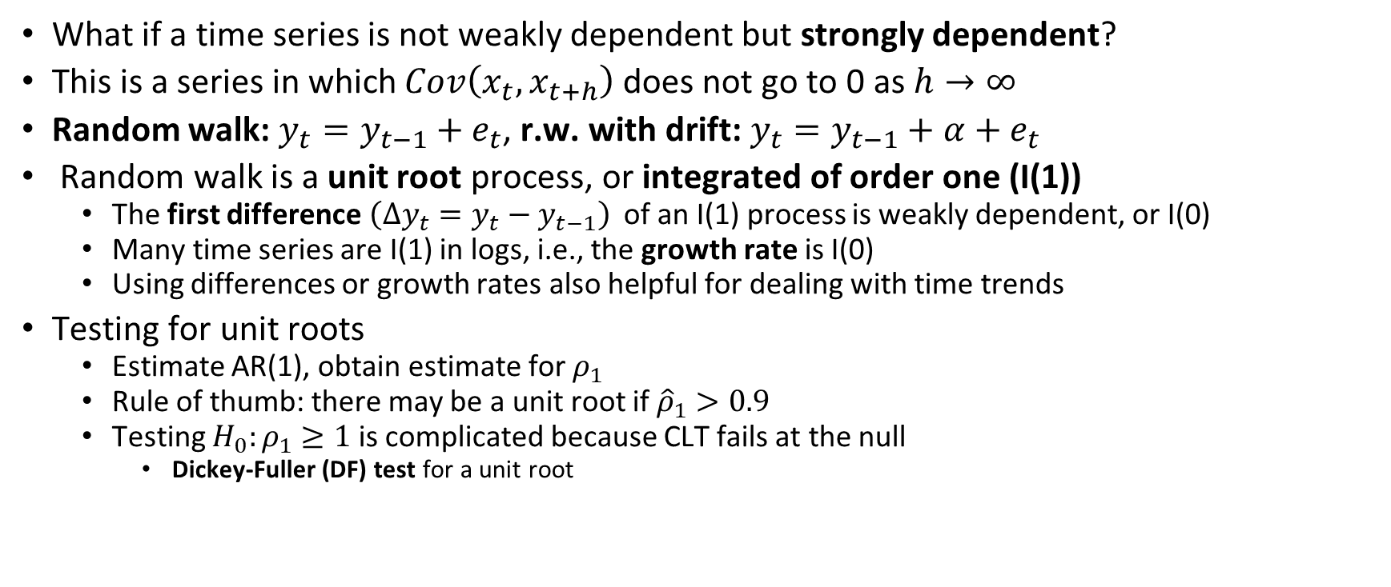
Highly Persistent Time Series
What if a time series is not weakly dependent but strongly dependent?
This is a series in which $Cov\left(x_{t},x_{t+h}\right)$ does not go to 0 as $h→∞$
Random walk: $y_{t}=y_{t−1}+e_{t}$, r.w. with drift: $y_{t}=y_{t−1}+α+e_{t}$
Random walk is a unit root process, or integrated of order one (I(1))
The first difference $\left(Δy_{t}=y_{t}−y_{t−1}\right)$ of an I(1) process is weakly dependent, or I(0)
Many time series are I(1) in logs, i.e., the growth rate is I(0)
Using differences or growth rates also helpful for dealing with time trends
Testing for unit roots
Estimate AR(1), obtain estimate for $ρ_{1}$
Rule of thumb: there may be a unit root if ${\hat{ρ}}_{1}>0.9$
Testing $H_{0}:ρ_{1}≥1$ is complicated because CLT fails at the null
Dickey-Fuller (DF) test for a unit root

Slide 15
Serial Correlation and Heteroskedasticity
If we control for the correct variables and numbers of lags, errors will be serially uncorrelated
However, sometimes we’re interested in specific applications (e.g., a static Phillips curve) which may violate this assumption
When we have serial correlation, OLS not BLUE and standard errors are invalid
Thankfully, we can compute heteroskedasticity and autocorrelation consistent (HAC) standard errors
One test for serial correlation: Durbin-Watson Test
Heteroskedasticity methods go through as before

Slide 16
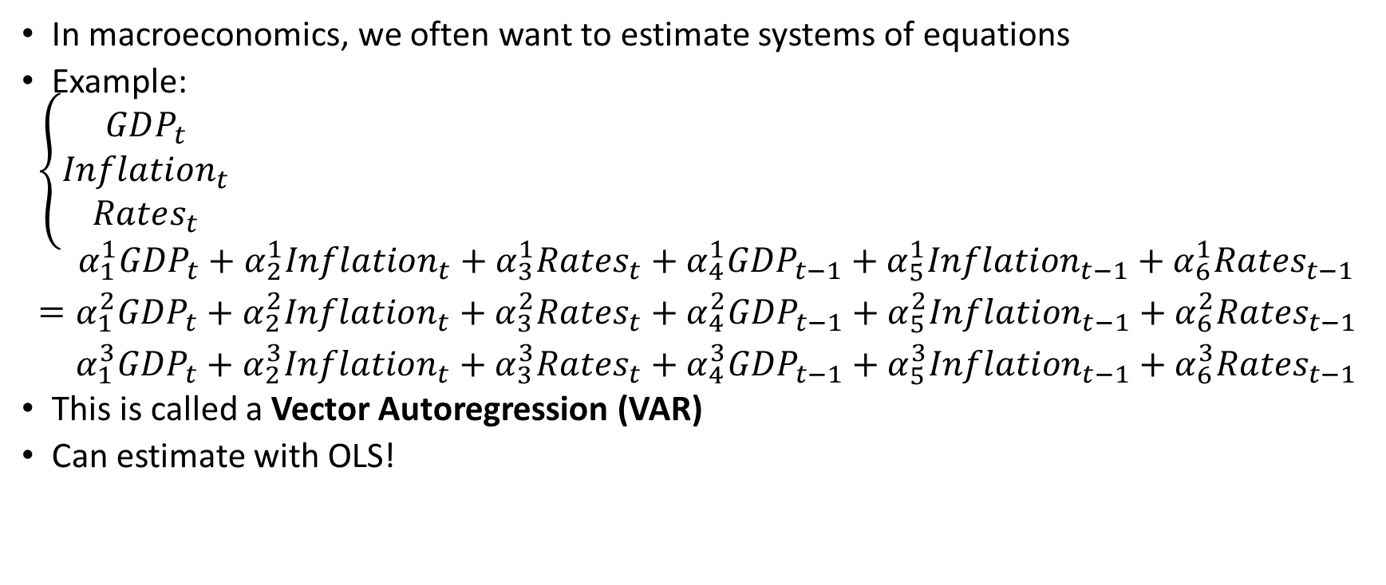
Vector Autoregressions
In macroeconomics, we often want to estimate systems of equations
Example:
$$\left\{\begin{aligned}GDP_{t} \\ Inflation_{t} \\ Rates_{t}\end{aligned}=\begin{aligned}α_{1}^{1}GDP_{t}+α_{2}^{1}Inflation_{t}+α_{3}^{1}Rates_{t}+α_{4}^{1}GDP_{t−1}+α_{5}^{1}Inflation_{t−1}+α_{6}^{1}Rates_{t−1} \\ α_{1}^{2}GDP_{t}+α_{2}^{2}Inflation_{t}+α_{3}^{2}Rates_{t}+α_{4}^{2}GDP_{t−1}+α_{5}^{2}Inflation_{t−1}+α_{6}^{2}Rates_{t−1} \\ α_{1}^{3}GDP_{t}+α_{2}^{3}Inflation_{t}+α_{3}^{3}Rates_{t}+α_{4}^{3}GDP_{t−1}+α_{5}^{3}Inflation_{t−1}+α_{6}^{3}Rates_{t−1}\end{aligned}\right.$$
This is called a Vector Autoregression (VAR)
Can estimate with OLS!

