Slide 1
Lecture 11
Pooled and Panel Data
April 18, 2023

Slide 2
Introduction
Most commonly, our datasets are a combination of cross-section and time series: multiple observations over multiple time periods
Pooled Cross Section
Different units, different time periods
Usually, repeated sampling from a population at different points in time
Panel Data
Same units, different time periods
Also called “longitudinal”… follows same individuals over time
Examples: data on counties or states over time, long-term experiments

Slide 3
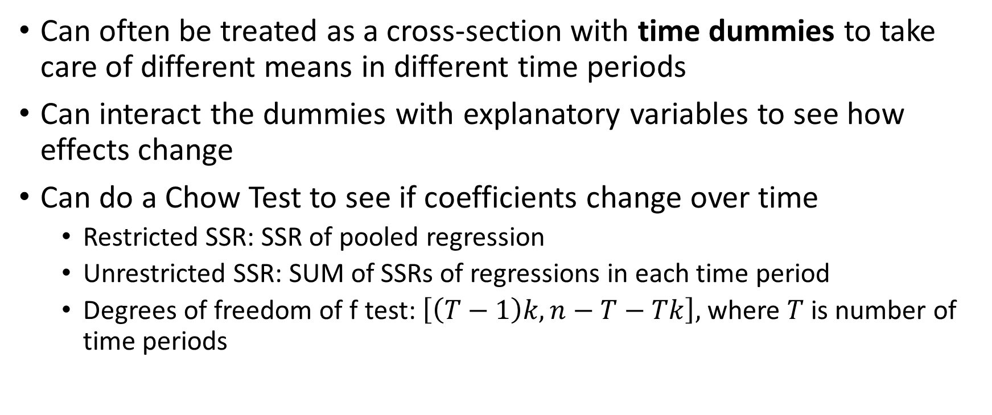
Pooling Independent Cross Sections
Can often be treated as a cross-section with time dummies to take care of different means in different time periods
Can interact the dummies with explanatory variables to see how effects change
Can do a Chow Test to see if coefficients change over time
Restricted SSR: SSR of pooled regression
Unrestricted SSR: SUM of SSRs of regressions in each time period
Degrees of freedom of f test: $\left[\left(T−1\right)k,n−T−Tk\right],$where $T$ is number of time periods

Slide 4
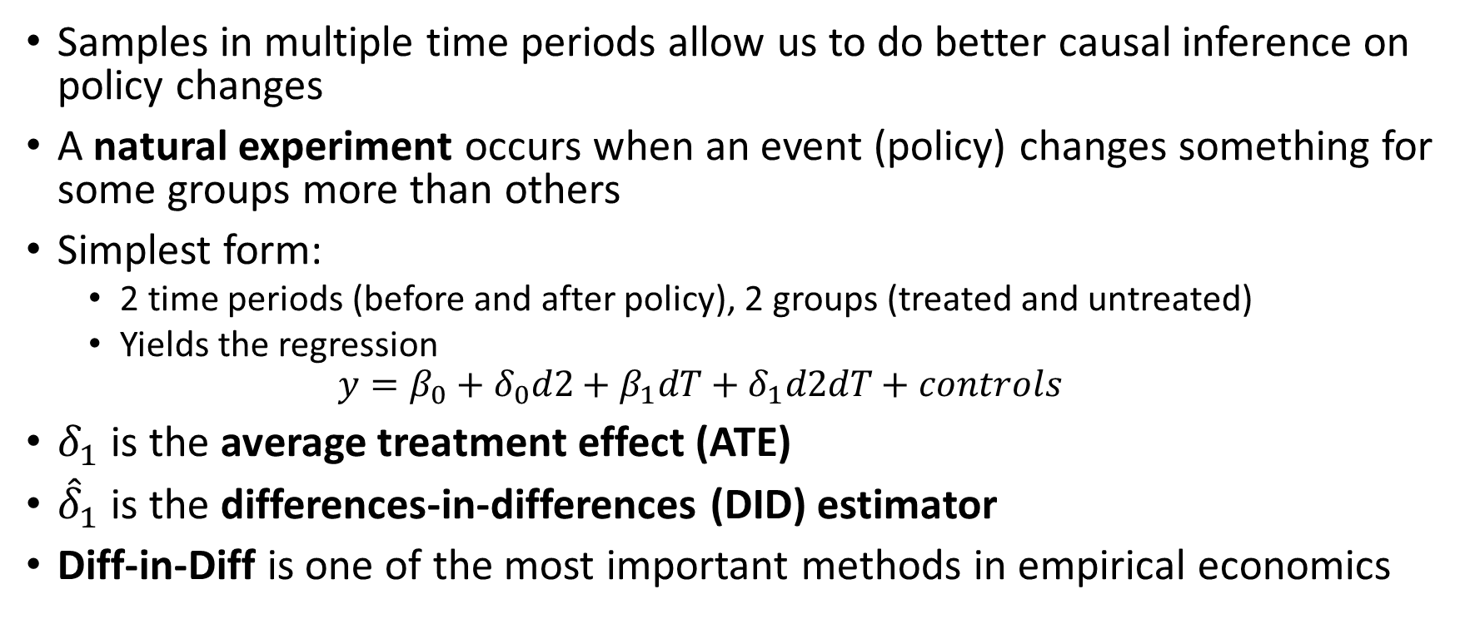
Natural Experiments and Policy Analysis
Samples in multiple time periods allow us to do better causal inference on policy changes
A natural experiment occurs when an event (policy) changes something for some groups more than others
Simplest form:
2 time periods (before and after policy), 2 groups (treated and untreated)
Yields the regression
$$y=β_{0}+δ_{0}d2+β_{1}dT+δ_{1}d2dT+controls$$
$δ_{1}$ is the average treatment effect (ATE)
${\hat{δ}}_{1}$ is the differences-in-differences (DID) estimator
Diff-in-Diff is one of the most important methods in empirical economics

Slide 5
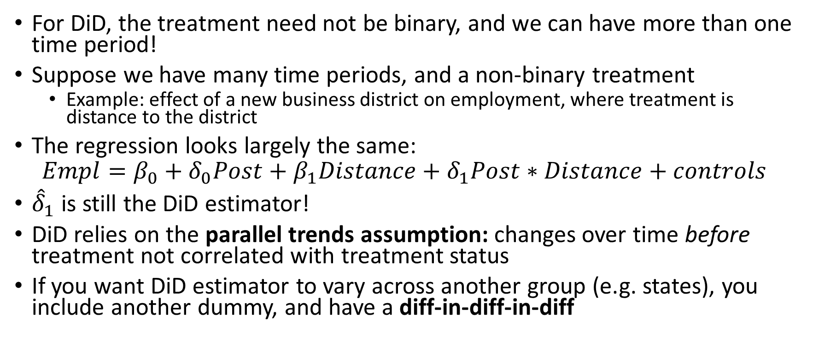
More on Diff-in-Diff
For DiD, the treatment need not be binary, and we can have more than one time period!
Suppose we have many time periods, and a non-binary treatment
Example: effect of a new business district on employment, where treatment is distance to the district
The regression looks largely the same:
$$Empl=β_{0}+δ_{0}Post+β_{1}Distance+δ_{1}Post∗Distance+controls$$
${\hat{δ}}_{1}$ is still the DiD estimator!
DiD relies on the parallel trends assumption: changes over time before treatment not correlated with treatment status
If you want DiD estimator to vary across another group (e.g. states), you include another dummy, and have a diff-in-diff-in-diff

Slide 6
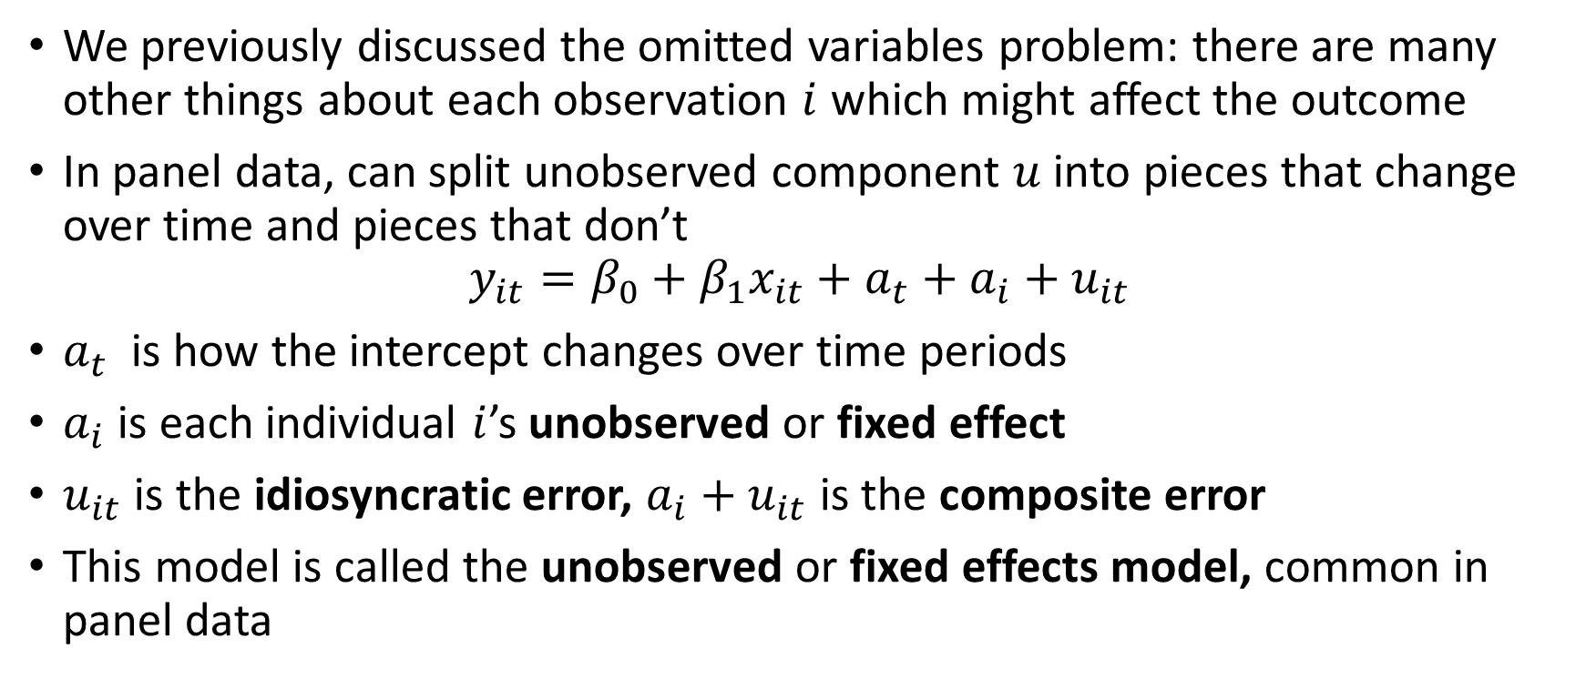
Panel Data: The Fixed Effects Model
We previously discussed the omitted variables problem: there are many other things about each observation $i$ which might affect the outcome
In panel data, can split unobserved component $u$ into pieces that change over time and pieces that don’t
$$y_{it}=β_{0}+β_{1}x_{it}+a_{t}+a_{i}+u_{it}$$
$a_{t}$is how the intercept changes over time periods
$a_{i}$ is each individual $i$’s unobserved or fixed effect
$u_{it}$ is the idiosyncratic error, $a_{i}+u_{it}$ is the composite error
This model is called the unobserved or fixed effects model, common in panel data

Slide 7
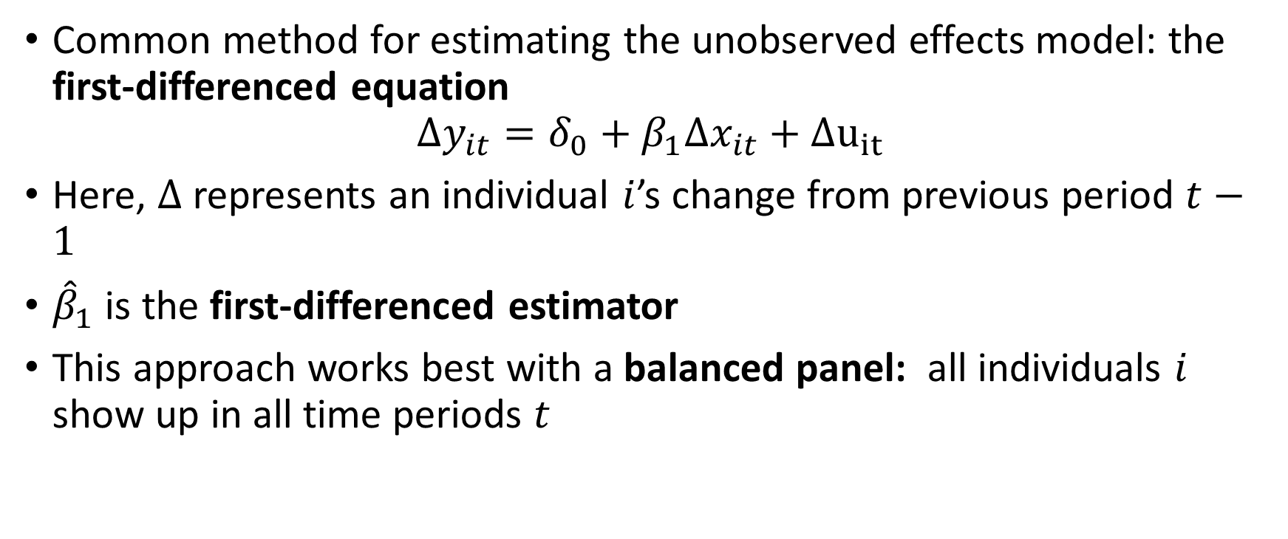
First Difference Estimation
Common method for estimating the unobserved effects model: the first-differenced equation
$$Δy_{it}=δ_{0}+β_{1}Δx_{it}+Δu_{it}$$
Here, $Δ$ represents an individual $i$’s change from previous period $t−1$
${\hat{β}}_{1}$ is the first-differenced estimator
This approach works best with a balanced panel: all individuals $i$ show up in all time periods $t$

Slide 8
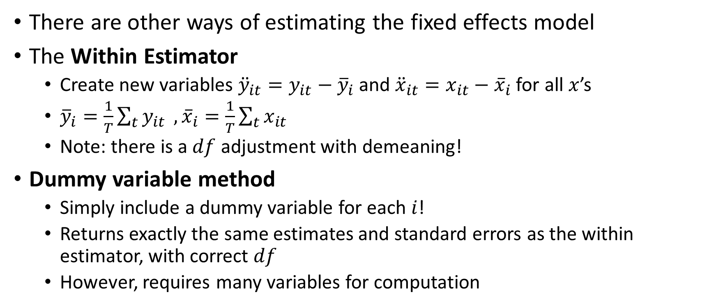
Fixed Effects Estimation
There are other ways of estimating the fixed effects model
The Within Estimator
Create new variables ${\ddot{y}}_{it}=y_{it}−{\overline{y}}_{i}$and ${\ddot{x}}_{it}=x_{it}−{\overline{x}}_{i}$ for all $x$’s
${\overline{y}}_{i}=\frac{1}{T}\sum_{t}{y_{it}} ,{\overline{x}}_{i}=\frac{1}{T}\sum_{t}{x_{it}}$
Note: there is a $df$ adjustment with demeaning!
Dummy variable method
Simply include a dummy variable for each $i$!
Returns exactly the same estimates and standard errors as the within estimator, with correct $df$
However, requires many variables for computation

Slide 9
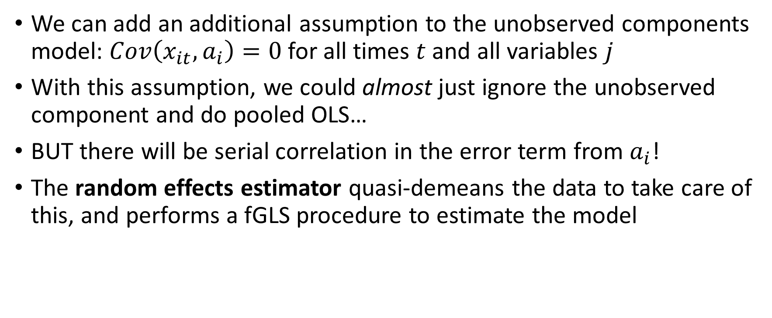
Random Effects Estimation
We can add an additional assumption to the unobserved components model: $Cov\left(x_{it},a_{i}\right)=0$for all times $t$ and all variables $j$
With this assumption, we could almost just ignore the unobserved component and do pooled OLS…
BUT there will be serial correlation in the error term from $a_{i}$!
The random effects estimator quasi-demeans the data to take care of this, and performs a fGLS procedure to estimate the model

Slide 10
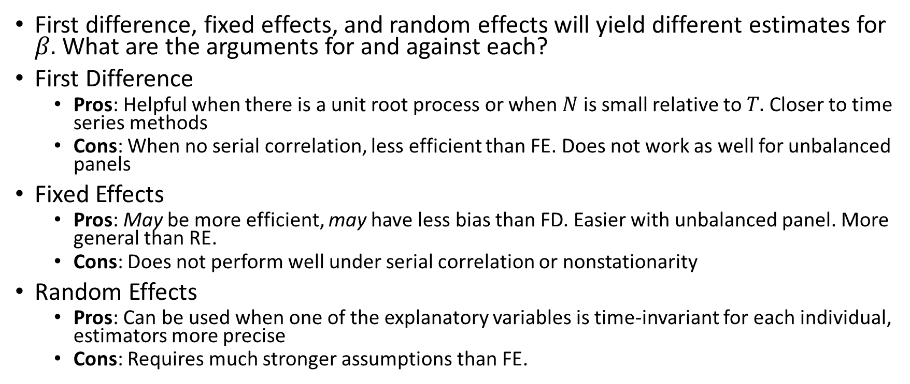
Comparing Panel Data Methods
First difference, fixed effects, and random effects will yield different estimates for $β.$What are the arguments for and against each?
First Difference
Pros: Helpful when there is a unit root process or when $N$ is small relative to $T.$ Closer to time series methods
Cons: When no serial correlation, less efficient than FE. Does not work as well for unbalanced panels
Fixed Effects
Pros: May be more efficient, may have less bias than FD. Easier with unbalanced panel. More general than RE.
Cons: Does not perform well under serial correlation or nonstationarity
Random Effects
Pros: Can be used when one of the explanatory variables is time-invariant for each individual, estimators more precise
Cons: Requires much stronger assumptions than FE.

Slide 11
Correlated Random Effects
What if we might want to use RE but don’t want to make the zero correlation assumption?
We can try to estimate the correlation and do RE with the rest
The estimates will be the same as FE, but may be more precise
Also allows us to see if regular RE is valid
Details in Wooldridge section 14-3

Slide 12
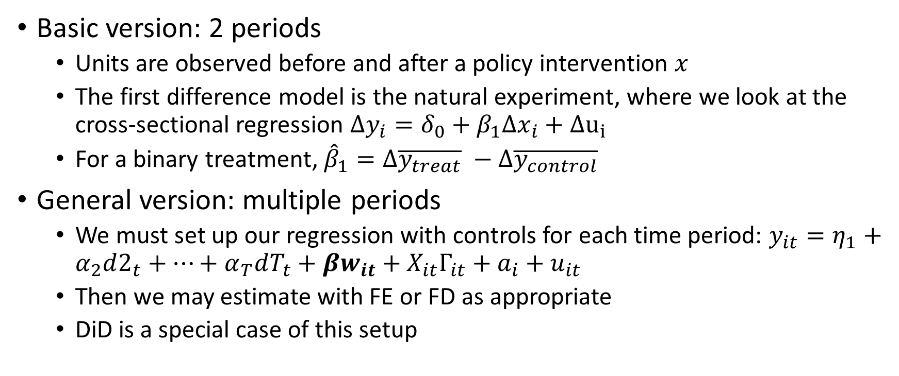
Policy Analysis with Panel Data
Basic version: 2 periods
Units are observed before and after a policy intervention $x$
The first difference model is the natural experiment, where we look at the cross-sectional regression $Δy_{i}=δ_{0}+β_{1}Δx_{i}+Δu_{i}$
For a binary treatment, ${\hat{β}}_{1}=Δ\overline{y_{treat}} −Δ\overline{y_{control}}$
General version: multiple periods
We must set up our regression with controls for each time period: $y_{it}=η_{1}+α_{2}d2_{t}+…+α_{T}dT_{t}+βw_{it}+X_{it}Γ_{it}+a_{i}+u_{it}$
Then we may estimate with FE or FD as appropriate
DiD is a special case of this setup

Slide 13
Applying Panel Methods to Other Data Structures
We might be able to apply these techniques to data without time variation
But if there is variation across multiple groups, fixed-effect-type techniques may be helpful
Data may exist in clusters, such as individuals in a family

Slide 14
Cluster-Robust Standard Errors
In panel data, our data exist in clusters: at least at the levels of t and i
There may be a specific type of heteroskedasticity in which errors within a cluster are correlated with each other
This is particularly salient when a certain policy appears for some clusters and not others
Thankfully, we have an option to compute cluster-robust standard errors
We should always do this when we suspect clustering

