Slide 1
Lecture 12
Instrumental Variables
April 25, 2023

Slide 2
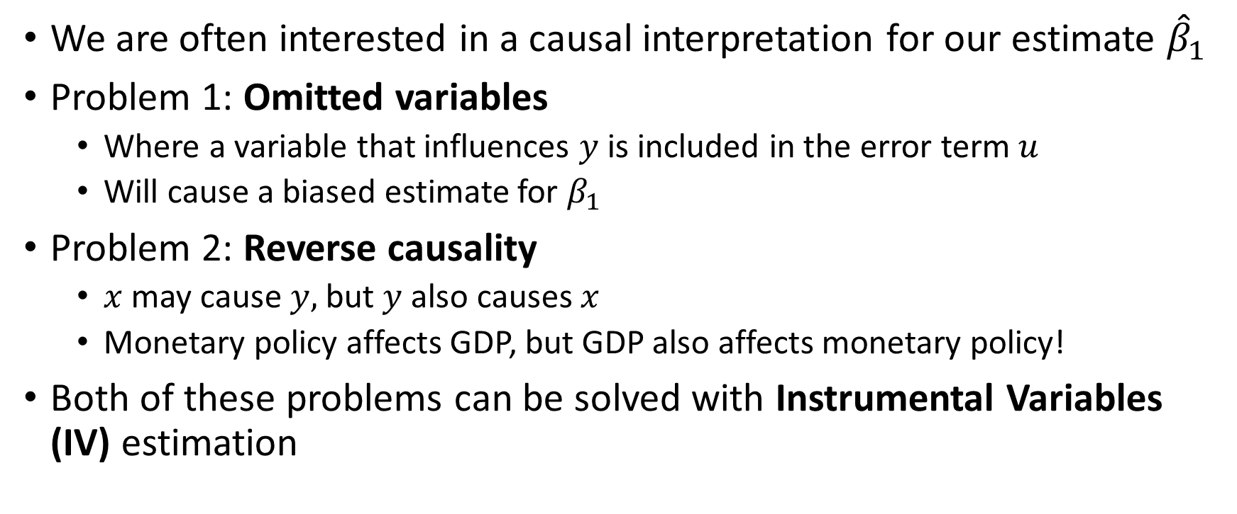
Causal Inference: Two Common Problems
We are often interested in a causal interpretation for our estimate ${\hat{β}}_{1}$
Problem 1: Omitted variables
Where a variable that influences $y$ is included in the error term $u$
Will cause a biased estimate for $β_{1}$
Problem 2: Reverse causality
$x$ may cause $y,$ but $y$ also causes $x$
Monetary policy affects GDP, but GDP also affects monetary policy!
Both of these problems can be solved with Instrumental Variables (IV) estimation

Slide 3
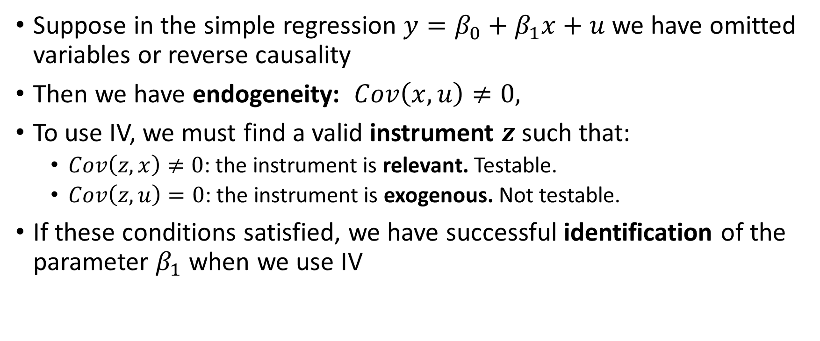
IV in a Simple Regression
Suppose in the simple regression $y=β_{0}+β_{1}x+u$ we have omitted variables or reverse causality
Then we have endogeneity: $Cov\left(x,u\right)≠0,$
To use IV, we must find a valid instrument $z$such that:
$Cov\left(z,x\right)≠0$: the instrument is relevant. Testable.
$Cov\left(z,u\right)=0$: the instrument is exogenous. Not testable.
If these conditions satisfied, we have successful identification of the parameter $β_{1}$ when we use IV

Slide 4
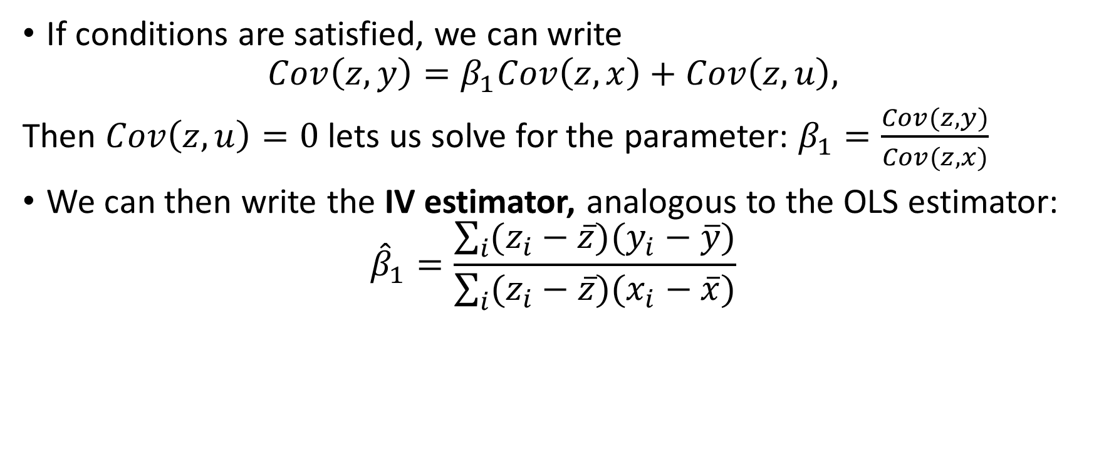
Simple IV Estimator
If conditions are satisfied, we can write
$$Cov\left(z,y\right)=β_{1}Cov\left(z,x\right)+Cov\left(z,u\right),$$
Then $Cov\left(z,u\right)=0$ lets us solve for the parameter: $β_{1}=\frac{Cov(z,y)}{Cov(z,x)}$
We can then write the IV estimator, analogous to the OLS estimator:
$${\hat{β}}_{1}=\frac{\sum_{i}{(z_{i}−\overline{z})(y_{i}−\overline{y})}}{\sum_{i}{(z_{i}−\overline{z})(x_{i}−\overline{x})}}$$

Slide 5
Examples of Instruments
In a regression of GDP on government spending:
Consumption is relevant but not exogenous
Premier League soccer scores are exogenous but not relevant
Military spending is exogenous and relevant
Other examples of instruments
Last name as an instrument for military service in Vietnam War
Rainfall as an instrument for some economic activity
Colonial mortality rates as an instrument for modern institutions
Monetary policy “surprises” as an instrument for economic activity

Slide 6
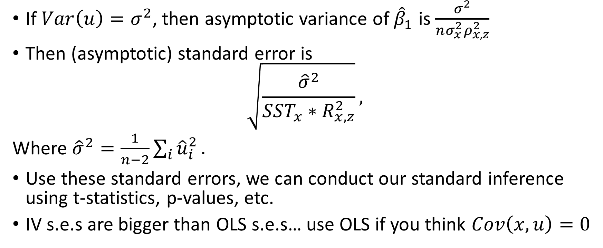
Statistical Inference with IV
If $Var\left(u\right)=σ^{2}$, then asymptotic variance of ${\hat{β}}_{1}$ is $\frac{σ^{2}}{nσ_{x}^{2}ρ_{x,z}^{2}}$
Then (asymptotic) standard error is
$$\sqrt{\frac{{\hat{σ}}^{2}}{SST_{x}∗R_{x,z}^{2}}},$$
Where ${\hat{σ}}^{2}=\frac{1}{n−2}\sum_{i}{{\hat{u}}_{i}^{2}}.$
Use these standard errors, we can conduct our standard inference using t-statistics, p-values, etc.
IV s.e.s are bigger than OLS s.e.s… use OLS if you think $Cov\left(x,u\right)=0$

Slide 7
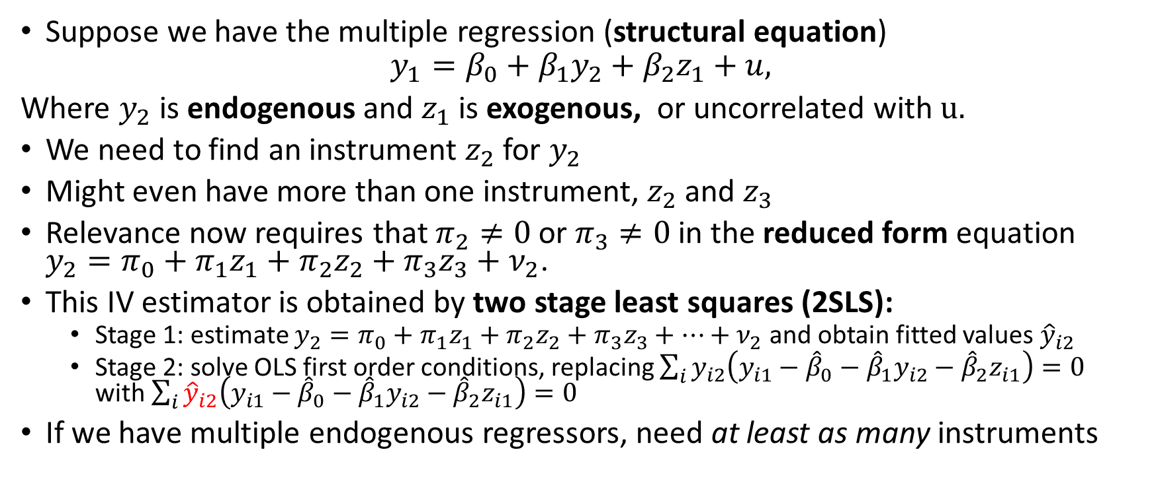
IV in Multiple Regression Model
Suppose we have the multiple regression (structural equation)
$$y_{1}=β_{0}+β_{1}y_{2}+β_{2}z_{1}+u,$$
Where $y_{2}$ is endogenous and $z_{1}$ is exogenous, or uncorrelated with $u.$
We need to find an instrument $z_{2}$ for $y_{2}$
Might even have more than one instrument, $z_{2}$ and $z_{3}$
Relevance now requires that $π_{2}≠0$or $π_{3}≠0$ in the reduced form equation $y_{2}=π_{0}+π_{1}z_{1}+π_{2}z_{2}+π_{3}z_{3}+ν_{2}$.
This IV estimator is obtained by two stage least squares (2SLS):
Stage 1: estimate $y_{2}=π_{0}+π_{1}z_{1}+π_{2}z_{2}+π_{3}z_{3}+…+ν_{2}$ and obtain fitted values ${\hat{y}}_{i2}$
Stage 2: solve OLS first order conditions, replacing $\sum_{i}{y_{i2}\left(y_{i1}−{\hat{β}}_{0}−{\hat{β}}_{1}y_{i2}−{\hat{β}}_{2}z_{i1}\right)=0 }$ with $\sum_{i}{{\hat{y}}_{i2}\left(y_{i1}−{\hat{β}}_{0}−{\hat{β}}_{1}y_{i2}−{\hat{β}}_{2}z_{i1}\right)=0 }$
If we have multiple endogenous regressors, need at least as many instruments

Slide 8
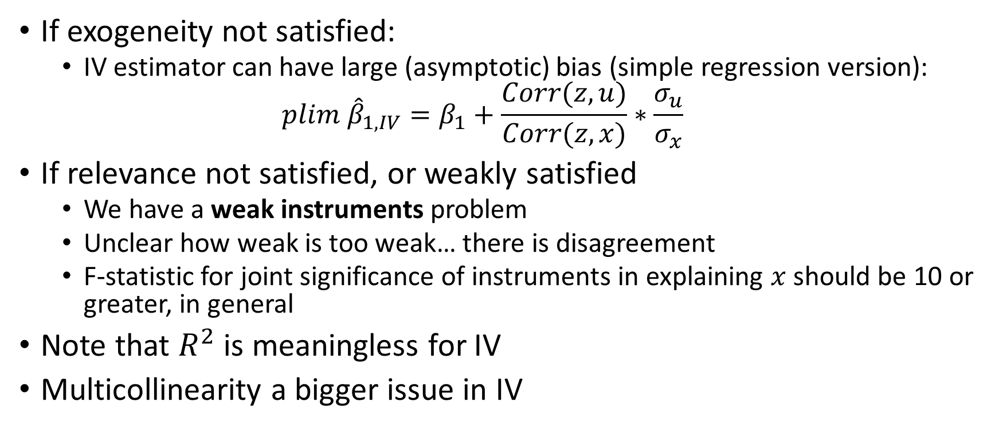
Potential IV Issues
If exogeneity not satisfied:
IV estimator can have large (asymptotic) bias (simple regression version):
$$plim {\hat{β}}_{1,IV}=β_{1}+\frac{Corr(z,u)}{Corr(z,x)}∗\frac{σ_{u}}{σ_{x}}$$
If relevance not satisfied, or weakly satisfied
We have a weak instruments problem
Unclear how weak is too weak… there is disagreement
F-statistic for joint significance of instruments in explaining $x$should be 10 or greater, in general
Note that $R^{2}$ is meaningless for IV
Multicollinearity a bigger issue in IV

Slide 9
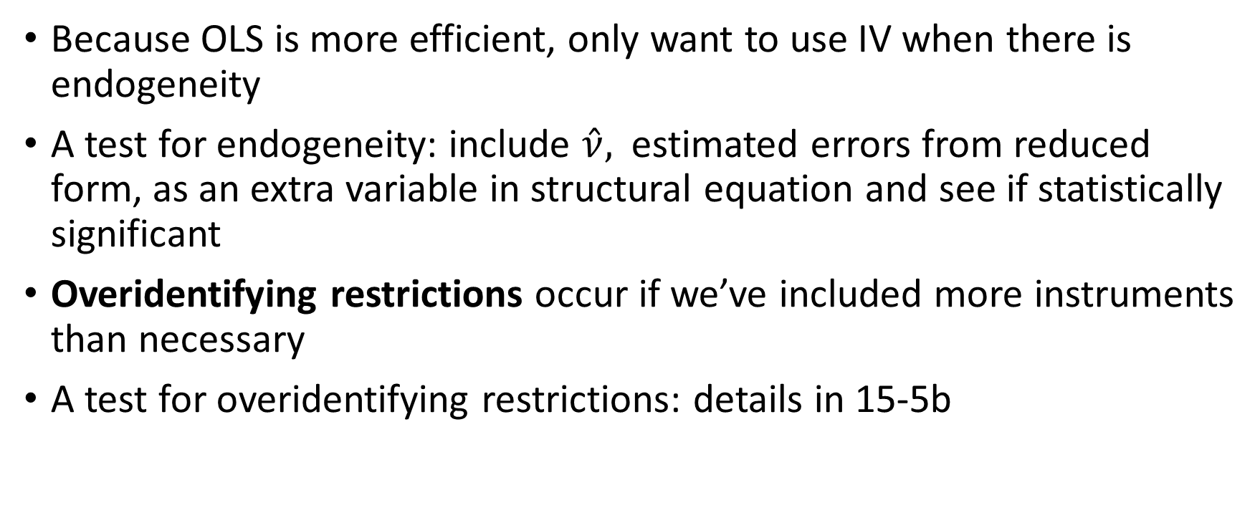
Testing for Endogeneity and Overidentifying Restrictions
Because OLS is more efficient, only want to use IV when there is endogeneity
A test for endogeneity: include $\hat{ν},$ estimated errors from reduced form, as an extra variable in structural equation and see if statistically significant
Overidentifying restrictions occur if we’ve included more instruments than necessary
A test for overidentifying restrictions: details in 15-5b

Slide 10
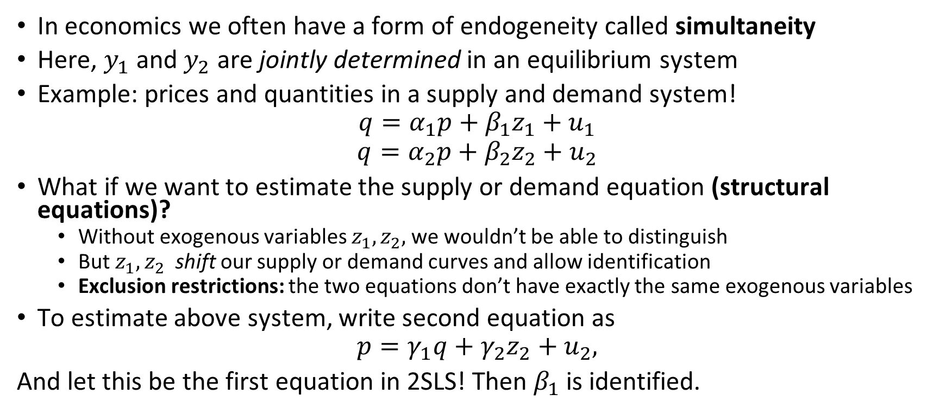
Simultaneous Equations Models
In economics we often have a form of endogeneity called simultaneity
Here, $y_{1}$ and $y_{2}$ are jointly determined in an equilibrium system
Example: prices and quantities in a supply and demand system!
$$q=α_{1}p+β_{1}z_{1}+u_{1}$$
$$q=α_{2}p+β_{2}z_{2}+u_{2}$$
What if we want to estimate the supply or demand equation (structural equations)?
Without exogenous variables $z_{1},z_{2},$ we wouldn’t be able to distinguish
But $z_{1},z_{2}$ shift our supply or demand curves and allow identification
Exclusion restrictions: the two equations don’t have exactly the same exogenous variables
To estimate above system, write second equation as
$$p=γ_{1}q+γ_{2}z_{2}+u_{2},$$
And let this be the first equation in 2SLS! Then $β_{1}$is identified.

