Slide 1
Econometrics: Lecture 7
Binary Variables
March 7, 2023

Slide 2
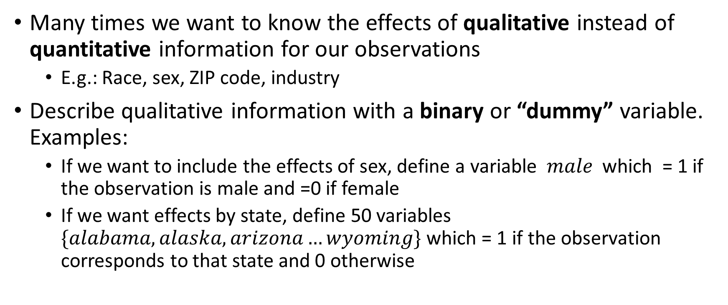
Qualitative Information
Many times we want to know the effects of qualitative instead of quantitative information for our observations
E.g.: Race, sex, ZIP code, industry
Describe qualitative information with a binary or “dummy” variable. Examples:
If we want to include the effects of sex, define a variable $male$which = 1 if the observation is male and =0 if female
If we want effects by state, define 50 variables $\{alabama, alaska, arizona…wyoming\}$ which = 1 if the observation corresponds to that state and 0 otherwise

Slide 3
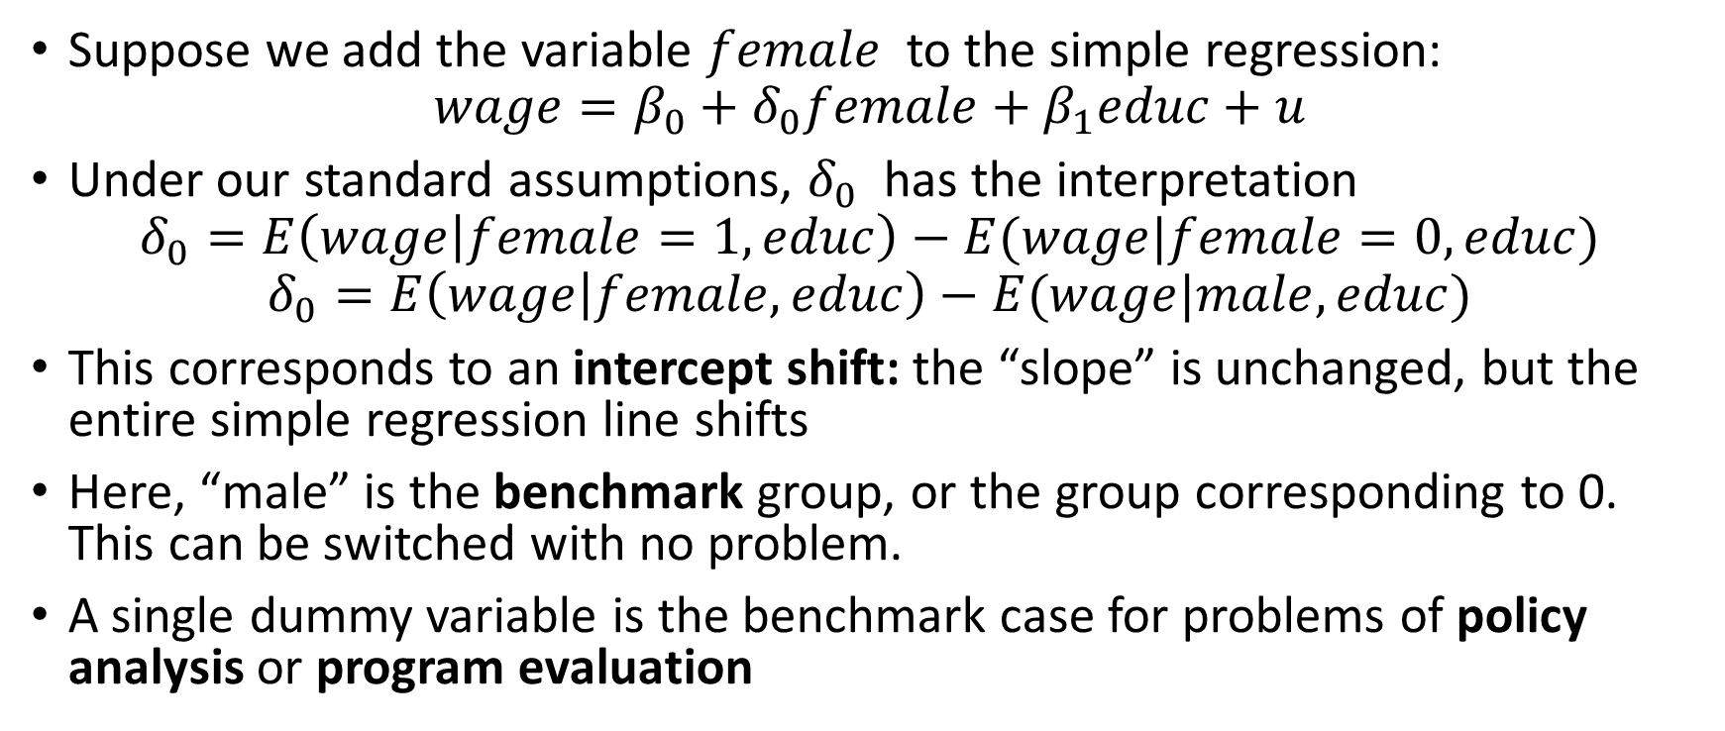
Regression with a Single Dummy Variable
Suppose we add the variable $female$ to the simple regression:
$$wage=β_{0}+δ_{0}female+β_{1}educ+u$$
Under our standard assumptions, $δ_{0}$ has the interpretation
$$δ_{0}=E\left(wage | female=1,educ\right)−E(wage|female=0,educ)$$
$$δ_{0}=E\left(wage | female,educ\right)−E(wage|male,educ)$$
This corresponds to an intercept shift: the “slope” is unchanged, but the entire simple regression line shifts
Here, “male” is the benchmark group, or the group corresponding to 0. This can be switched with no problem.
A single dummy variable is the benchmark case for problems of policy analysis or program evaluation

Slide 4
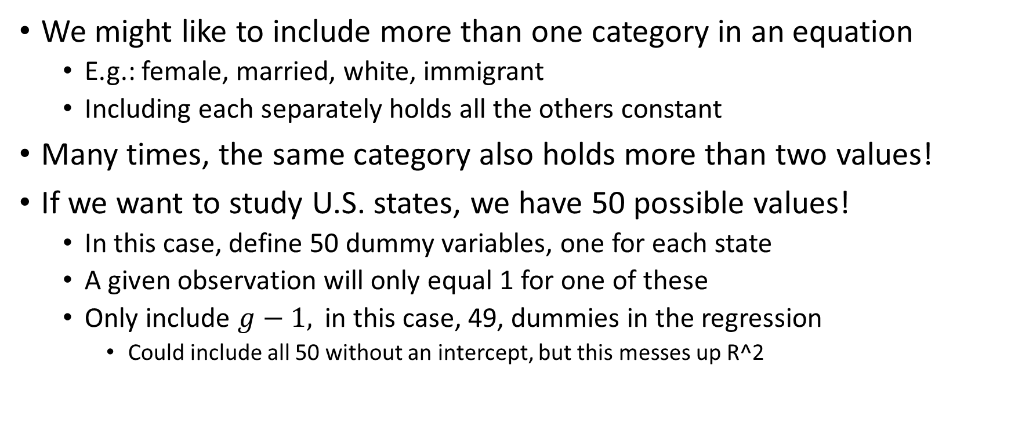
Dummy Variables for Multiple Categories
We might like to include more than one category in an equation
E.g.: female, married, white, immigrant
Including each separately holds all the others constant
Many times, the same category also holds more than two values!
If we want to study U.S. states, we have 50 possible values!
In this case, define 50 dummy variables, one for each state
A given observation will only equal 1 for one of these
Only include $g−1,$ in this case, 49, dummies in the regression
Could include all 50 without an intercept, but this messes up R^2

Slide 5
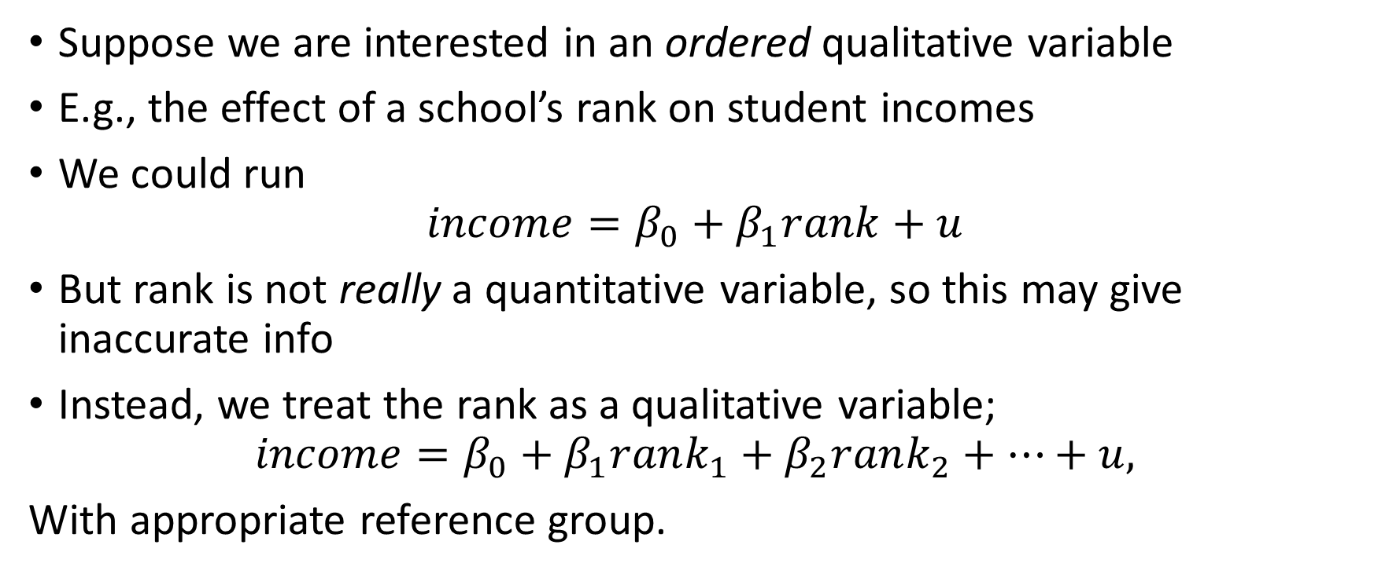
Ordinal Information
Suppose we are interested in an ordered qualitative variable
E.g., the effect of a school’s rank on student incomes
We could run
$$income=β_{0}+β_{1}rank+u$$
But rank is not really a quantitative variable, so this may give inaccurate info
Instead, we treat the rank as a qualitative variable;
$$income=β_{0}+β_{1}rank_{1}+β_{2}rank_{2}+…+u,$$
With appropriate reference group.

Slide 6
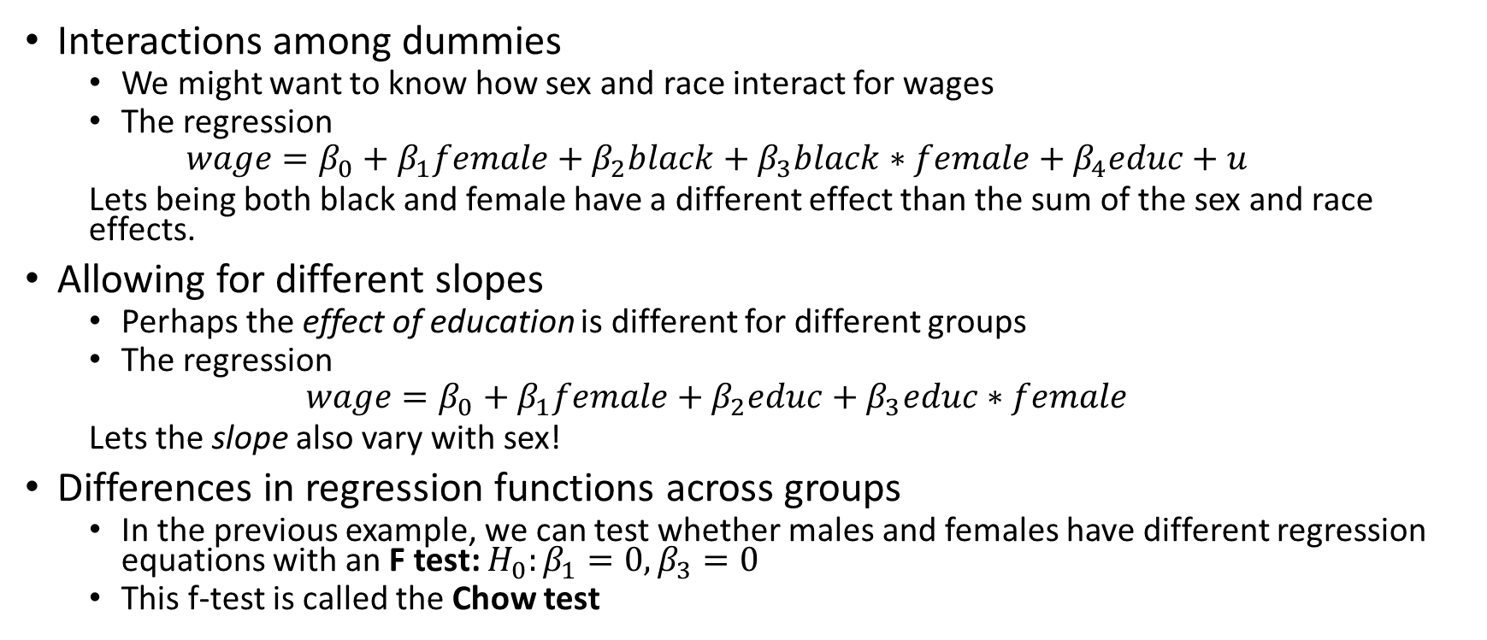
Interactions with Dummies
Interactions among dummies
We might want to know how sex and race interact for wages
The regression
$$wage=β_{0}+β_{1}female+β_{2}black+β_{3}black∗female+β_{4}educ+u$$
Lets being both black and female have a different effect than the sum of the sex and race effects.
Allowing for different slopes
Perhaps the effect of education is different for different groups
The regression
$$wage=β_{0}+β_{1}female+β_{2}educ+β_{3}educ∗female$$
Lets the slope also vary with sex!
Differences in regression functions across groups
In the previous example, we can test whether males and females have different regression equations with an F test: $H_{0}:β_{1}=0,β_{3}=0$
This f-test is called the Chow test

Slide 7
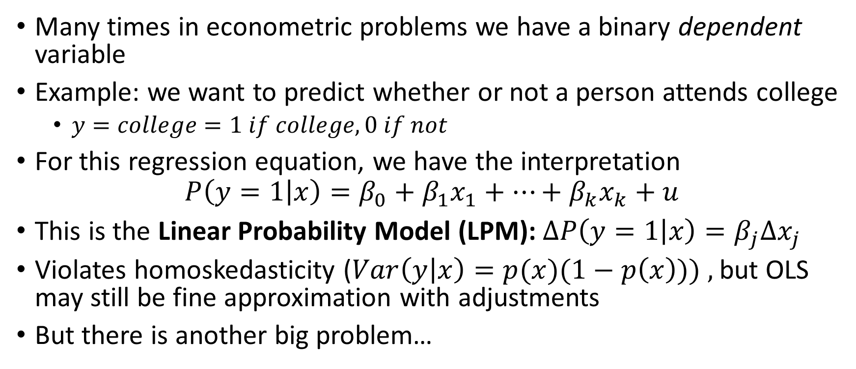
Binary Dependent Variables
Many times in econometric problems we have a binary dependent variable
Example: we want to predict whether or not a person attends college
$y=college=1 if college, 0 if not$
For this regression equation, we have the interpretation
$$P\left(y=1 | x\right)=β_{0}+β_{1}x_{1}+…+β_{k}x_{k}+u$$
This is the Linear Probability Model (LPM): $ΔP\left(y=1 | x\right)=β_{j}Δx_{j}$
Violates homoskedasticity ($Var\left(y | x\right)=p(x)(1−p\left(x\right))) ,$but OLS may still be fine approximation with adjustments
But there is another big problem…

Slide 8
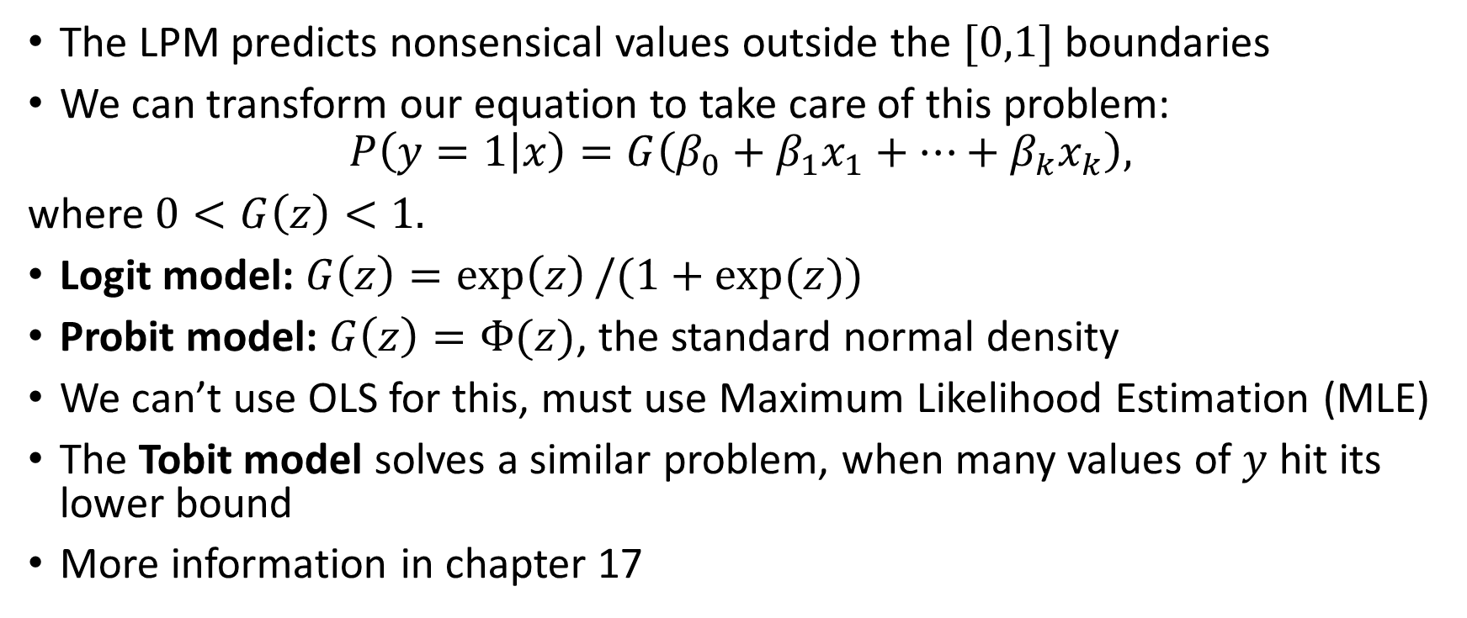
Linear Probability Model Techniques
The LPM predicts nonsensical values outside the $[0,1]$ boundaries
We can transform our equation to take care of this problem:
$$P\left(y=1 | x\right)=G\left(β_{0}+β_{1}x_{1}+…+β_{k}x_{k}\right),$$
where $0<G\left(z\right)<1.$
Logit model: $G\left(z\right)=\exp\left(z\right)/(1+exp⁡(z))$
Probit model: $G\left(z\right)=Φ(z)$, the standard normal density
We can’t use OLS for this, must use Maximum Likelihood Estimation (MLE)
The Tobit model solves a similar problem, when many values of $y$ hit its lower bound
More information in chapter 17

Slide 9
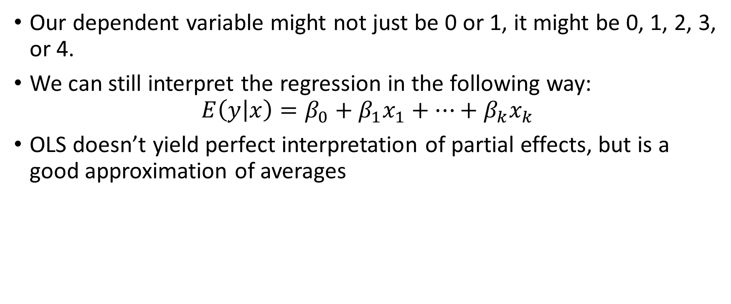
Discrete Dependent Variables
Our dependent variable might not just be 0 or 1, it might be 0, 1, 2, 3, or 4.
We can still interpret the regression in the following way:
$$E\left(y | x\right)=β_{0}+β_{1}x_{1}+…+β_{k}x_{k}$$
OLS doesn’t yield perfect interpretation of partial effects, but is a good approximation of averages

