Slide 1
Econometrics: Lecture 8
Heteroskedasticity
March 28, 2023

Slide 2
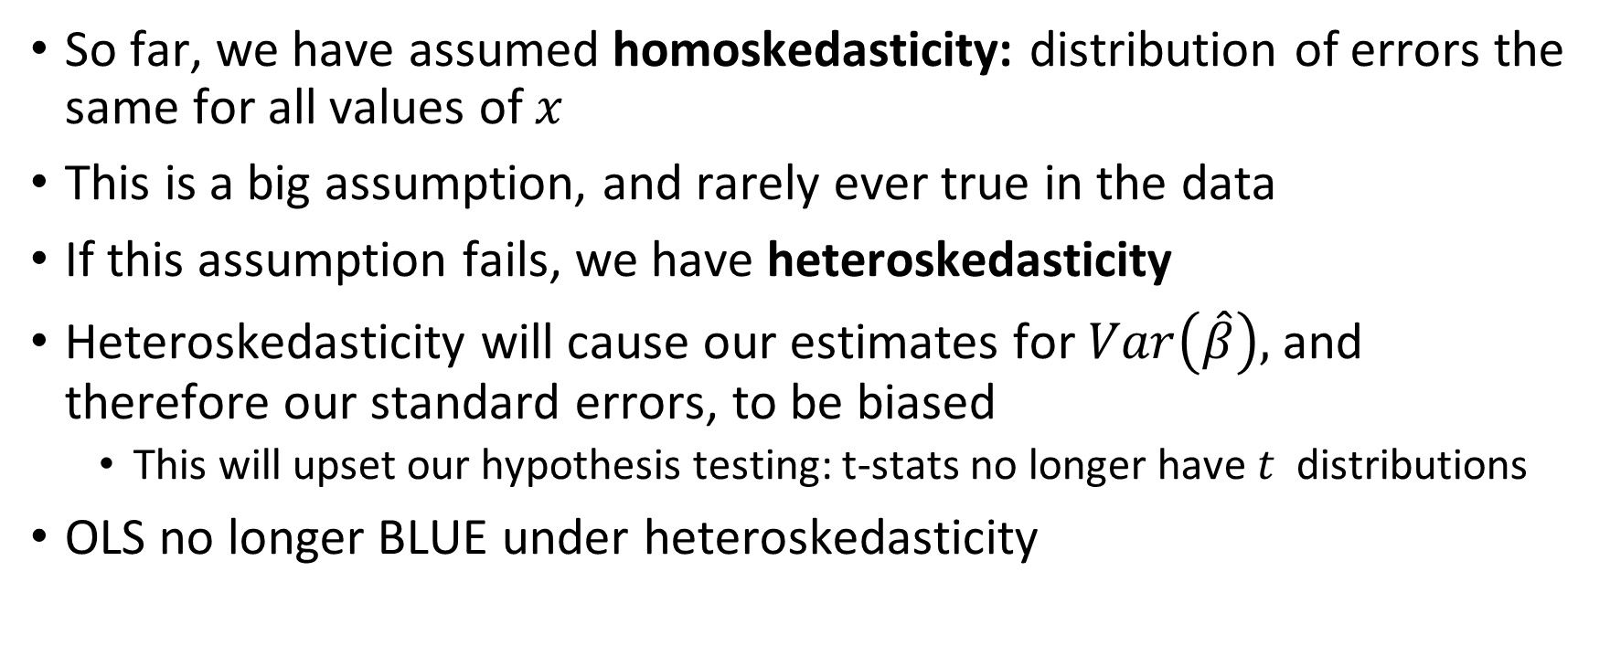
Motivation
So far, we have assumed homoskedasticity: distribution of errors the same for all values of $x$
This is a big assumption, and rarely ever true in the data
If this assumption fails, we have heteroskedasticity
Heteroskedasticity will cause our estimates for $Var\left(\hat{β}\right),$ and therefore our standard errors, to be biased
This will upset our hypothesis testing: t-stats no longer have $t$ distributions
OLS no longer BLUE under heteroskedasticity

Slide 3
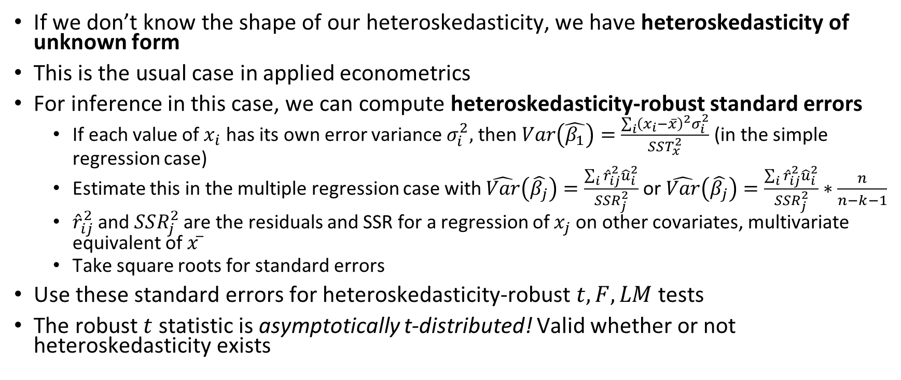
Heteroskedasticity-Robust Inference with OLS
If we don’t know the shape of our heteroskedasticity, we have heteroskedasticity of unknown form
This is the usual case in applied econometrics
For inference in this case, we can compute heteroskedasticity-robust standard errors
If each value of $x_{i}$ has its own error variance $σ_{i}^{2},$ then $Var\left(\hat{β_{1}}\right)=\frac{\sum_{i}{{\left(x_{i}−\overline{x}\right)}^{2}σ_{i}^{2}}}{SST_{x}^{2}}$ (in the simple regression case)
Estimate this in the multiple regression case with $\hat{Var}\left(\hat{β_{j}}\right)=\frac{\sum_{i}{{\hat{r}}_{ij}^{2}{\hat{u}}_{i}^{2}}}{SSR_{j}^{2}}$or $\hat{Var}\left(\hat{β_{j}}\right)=\frac{\sum_{i}{{\hat{r}}_{ij}^{2}{\hat{u}}_{i}^{2}}}{SSR_{j}^{2}}∗\frac{n}{n−k−1}$
${\hat{r}}_{ij}^{2}$and $SSR_{j}^{2}$ are the residuals and SSR for a regression of $x_{j}$ on other covariates, multivariate equivalent of $x ̅$
Take square roots for standard errors
Use these standard errors for heteroskedasticity-robust $t, F, LM$ tests
The robust $t$ statistic is asymptotically t-distributed! Valid whether or not heteroskedasticity exists

Slide 4
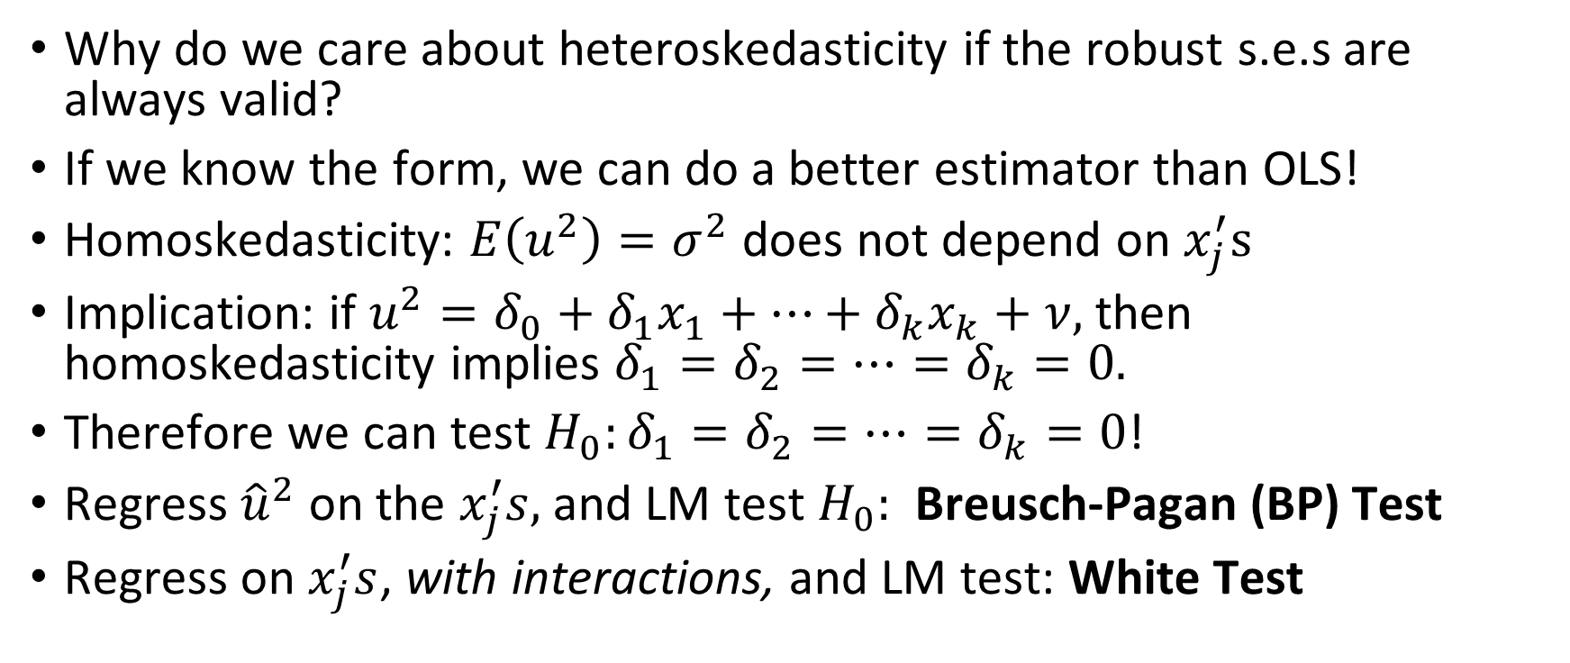
Testing for Heteroskedasticity
Why do we care about heteroskedasticity if the robust s.e.s are always valid?
If we know the form, we can do a better estimator than OLS!
Homoskedasticity: $E\left(u^{2}\right)=σ^{2}$ does not depend on $x_{j}^{′}s$
Implication: if $u^{2}=δ_{0}+δ_{1}x_{1}+…+δ_{k}x_{k}+ν,$ then homoskedasticity implies $δ_{1}=δ_{2}=…=δ_{k}=0.$
Therefore we can test $H_{0}:δ_{1}=δ_{2}=…=δ_{k}=0$!
Regress ${\hat{u}}^{2}$ on the $x_{j}^{′}s,$and LM test $H_{0}:$ Breusch-Pagan (BP) Test
Regress on $x_{j}^{′}s$, with interactions, and LM test: White Test

Slide 5
When Heteroskedasticity is Known
When we know the form of the heteroskedasticity, we can do better than OLS (recall, no longer BLUE)
We can use weighted least squares (WLS) estimation, which will be more efficient than OLS
WLS minimizes the weighted sum of squared residuals, less weight on high variance observations
Two main functional forms we’ll examine:
Heteroskedasticity known up to a multiplicative constant
Heteroskedasticity must be estimated

Slide 6
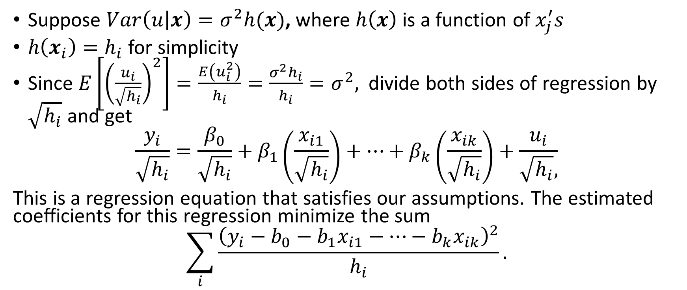
Heteroskedasticity: Multiplicative Constant
Suppose $Var\left(u | x\right)=σ^{2}h(x)$, where $h\left(x\right)$ is a function of $x_{j}^{′}s$
$h\left(x_{i}\right)=h_{i}$ for simplicity
Since $E\left[{\left(\frac{u_{i}}{\sqrt{h_{i}}}\right)}^{2}\right]=\frac{E\left(u_{i}^{2}\right)}{h_{i}}=\frac{σ^{2}h_{i}}{h_{i}}=σ^{2},$ divide both sides of regression by $\sqrt{h_{i}}$ and get
$$\frac{y_{i}}{\sqrt{h_{i}}}=\frac{β_{0}}{\sqrt{h_{i}}}+β_{1}\left(\frac{x_{i1}}{\sqrt{h_{i}}}\right)+…+β_{k}\left(\frac{x_{ik}}{\sqrt{h_{i}}}\right)+\frac{u_{i}}{\sqrt{h_{i}},}$$
This is a regression equation that satisfies our assumptions. The estimated coefficients for this regression minimize the sum
$$\sum_{i}{\frac{{\left(y_{i}−b_{0}−b_{1}x_{i1}−…−b_{k}x_{ik}\right)}^{2}}{h_{i}}.}$$

Slide 7
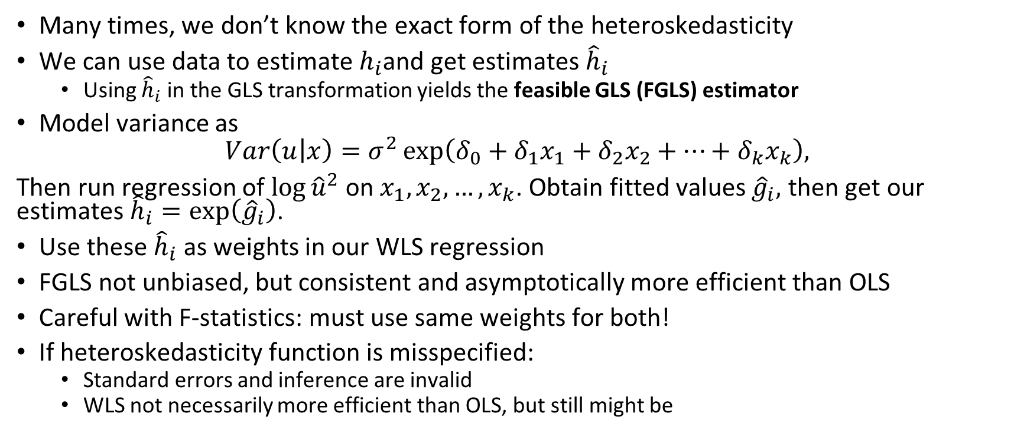
Estimated Heteroskedasticity Function
Many times, we don’t know the exact form of the heteroskedasticity
We can use data to estimate $h_{i}$and get estimates ${\hat{h}}_{i}$
Using ${\hat{h}}_{i}$ in the GLS transformation yields the feasible GLS (FGLS) estimator
Model variance as
$$Var\left(u | x\right)=σ^{2}\exp\left(δ_{0}+δ_{1}x_{1}+δ_{2}x_{2}+…+δ_{k}x_{k}\right),$$
Then run regression of $\log{{\hat{u}}^{2}}$on $x_{1},x_{2},…,x_{k}$. Obtain fitted values ${\hat{g}}_{i},$ then get our estimates ${\hat{h}}_{i}=\exp\left({\hat{g}}_{i}\right)$.
Use these ${\hat{h}}_{i}$ as weights in our WLS regression
FGLS not unbiased, but consistent and asymptotically more efficient than OLS
Careful with F-statistics: must use same weights for both!
If heteroskedasticity function is misspecified:
Standard errors and inference are invalid
WLS not necessarily more efficient than OLS, but still might be

Slide 8
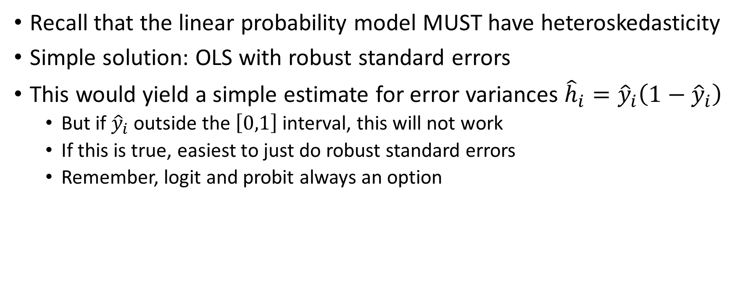
The Linear Probability Model
Recall that the linear probability model MUST have heteroskedasticity
Simple solution: OLS with robust standard errors
This would yield a simple estimate for error variances ${\hat{h}}_{i}={\hat{y}}_{i}\left(1−{\hat{y}}_{i}\right)$
But if ${\hat{y}}_{i}$ outside the $\left[0,1\right]$ interval, this will not work
If this is true, easiest to just do robust standard errors
Remember, logit and probit always an option

