Slide 1
Lecture 9
Specification and Data Problems
April 4, 2023

Slide 2
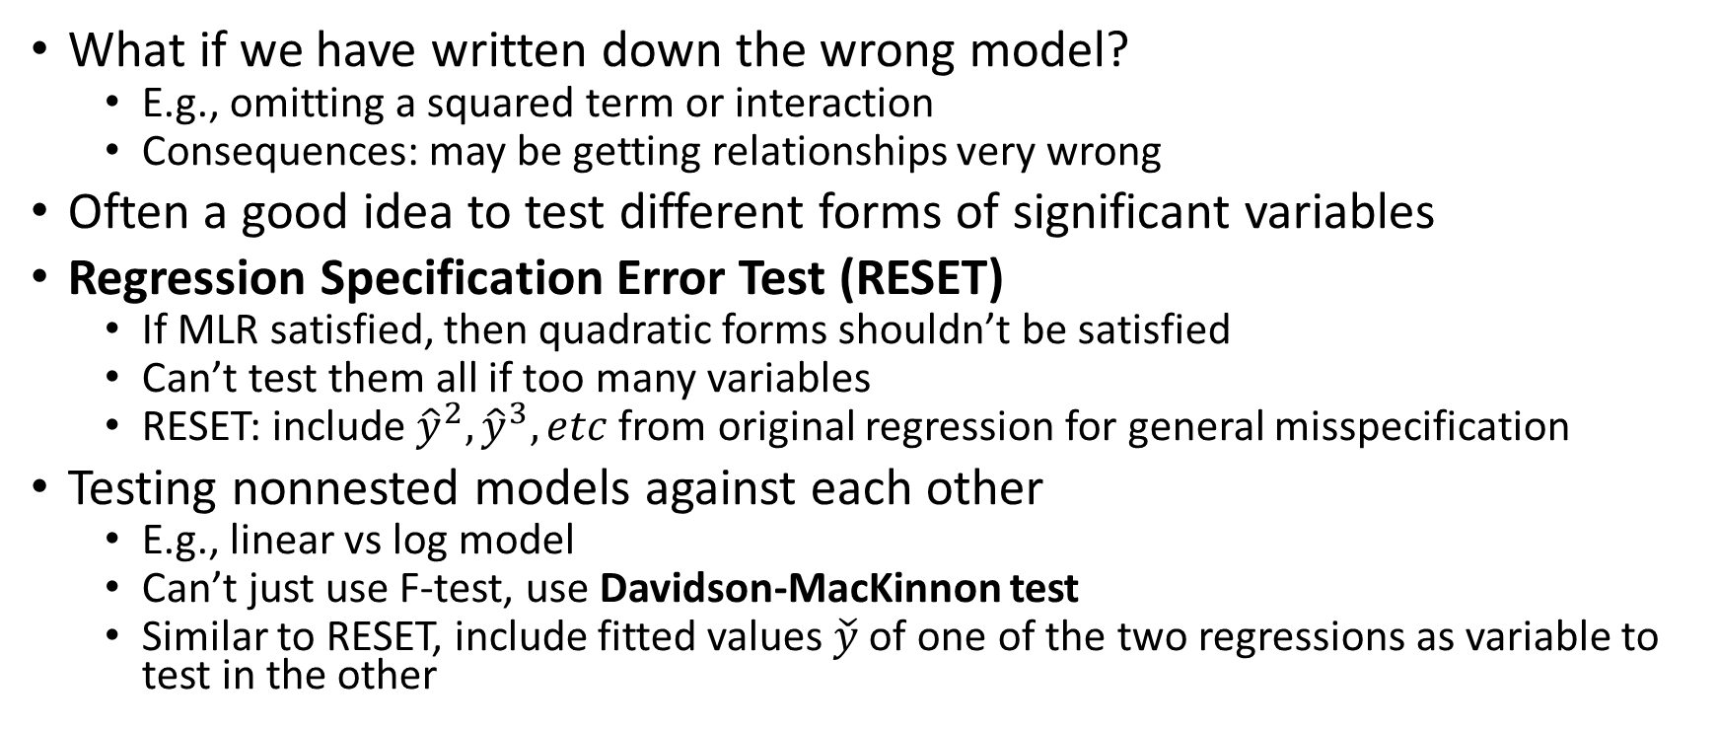
Functional Form Misspecification
What if we have written down the wrong model?
E.g., omitting a squared term or interaction
Consequences: may be getting relationships very wrong
Often a good idea to test different forms of significant variables
Regression Specification Error Test (RESET)
If MLR satisfied, then quadratic forms shouldn’t be satisfied
Can’t test them all if too many variables
RESET: include ${\hat{y}}^{2}, {\hat{y}}^{3}, etc$ from original regression for general misspecification
Testing nonnested models against each other
E.g., linear vs log model
Can’t just use F-test, use Davidson-MacKinnon test
Similar to RESET, include fitted values $\check{y}$ of one of the two regressions as variable to test in the other

Slide 3
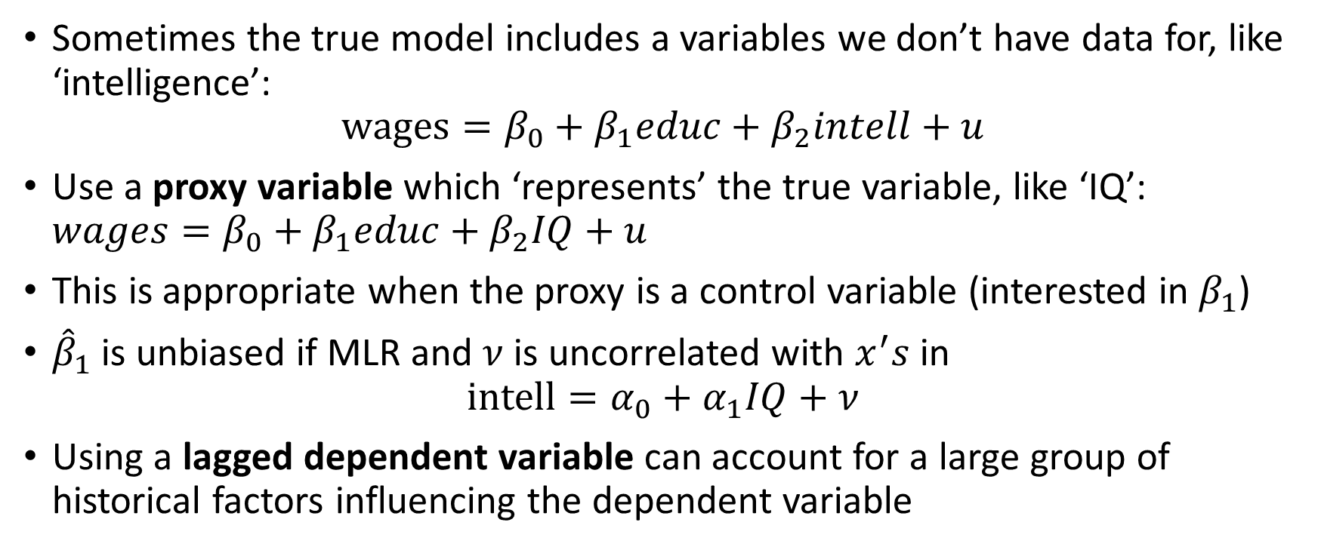
Proxy Variables
Sometimes the true model includes a variables we don’t have data for, like ‘intelligence’:
$$wages=β_{0}+β_{1}educ+β_{2}intell+u$$
Use a proxy variable which ‘represents’ the true variable, like ‘IQ’: $wages=β_{0}+β_{1}educ+β_{2}IQ+u$
This is appropriate when the proxy is a control variable (interested in $β_{1}$)
${\hat{β}}_{1}$ is unbiased if MLR and $ν$ is uncorrelated with $x^{′}s$ in
$$intell=α_{0}+α_{1}IQ+ν$$
Using a lagged dependent variable can account for a large group of historical factors influencing the dependent variable

Slide 4
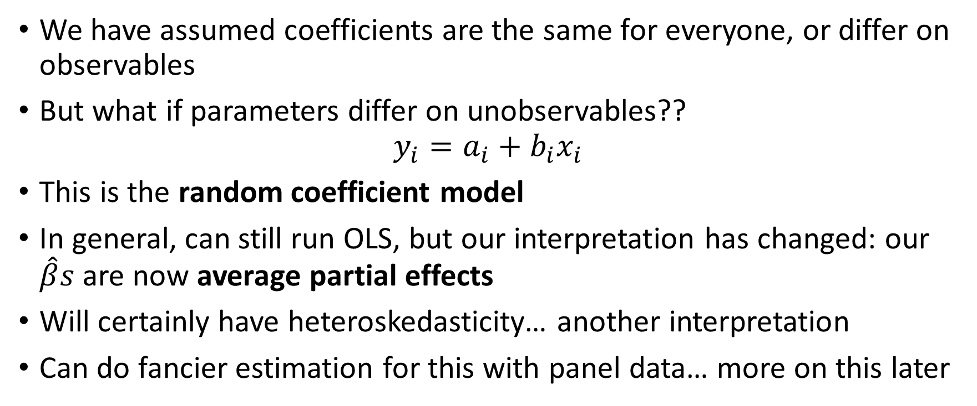
Models with Random Slopes
We have assumed coefficients are the same for everyone, or differ on observables
But what if parameters differ on unobservables??
$$y_{i}=a_{i}+b_{i}x_{i}$$
This is the random coefficient model
In general, can still run OLS, but our interpretation has changed: our $\hat{β}s$ are now average partial effects
Will certainly have heteroskedasticity… another interpretation
Can do fancier estimation for this with panel data… more on this later

Slide 5
Measurement Error Introduction
In most applied work we work with variables that are not perfectly estimated
Example: unemployment rate. Relies on household surveys to generate data. Cannot observe every person.
Similar to proxy variable case, but more direct link between true variable and variable in regression
You should always suspect measurement error. The question is whether it is big enough to be a problem
Can be in dependent or independent variable

Slide 6
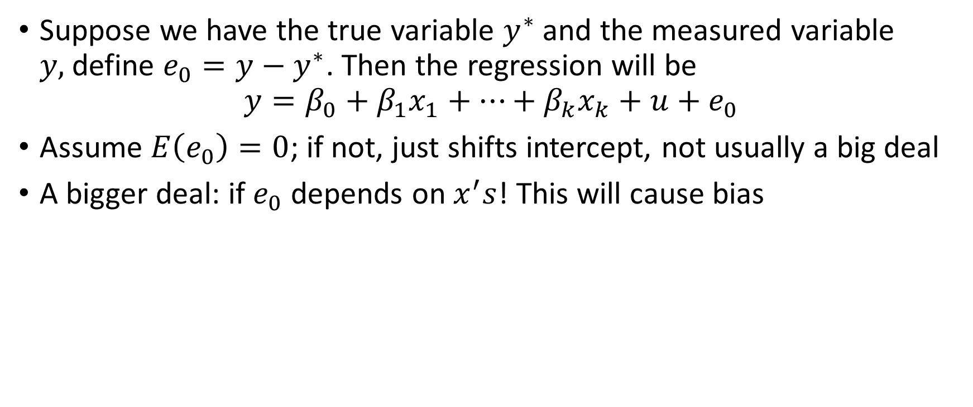
Measurement Error in the Dependent Variable
Suppose we have the true variable $y^{∗}$ and the measured variable $y,$define $e_{0}=y−y^{∗}$. Then the regression will be
$$y=β_{0}+β_{1}x_{1}+…+β_{k}x_{k}+u+e_{0}$$
Assume $E\left(e_{0}\right)=0$; if not, just shifts intercept, not usually a big deal
A bigger deal: if $e_{0}$ depends on $x^{′}s$! This will cause bias

Slide 7
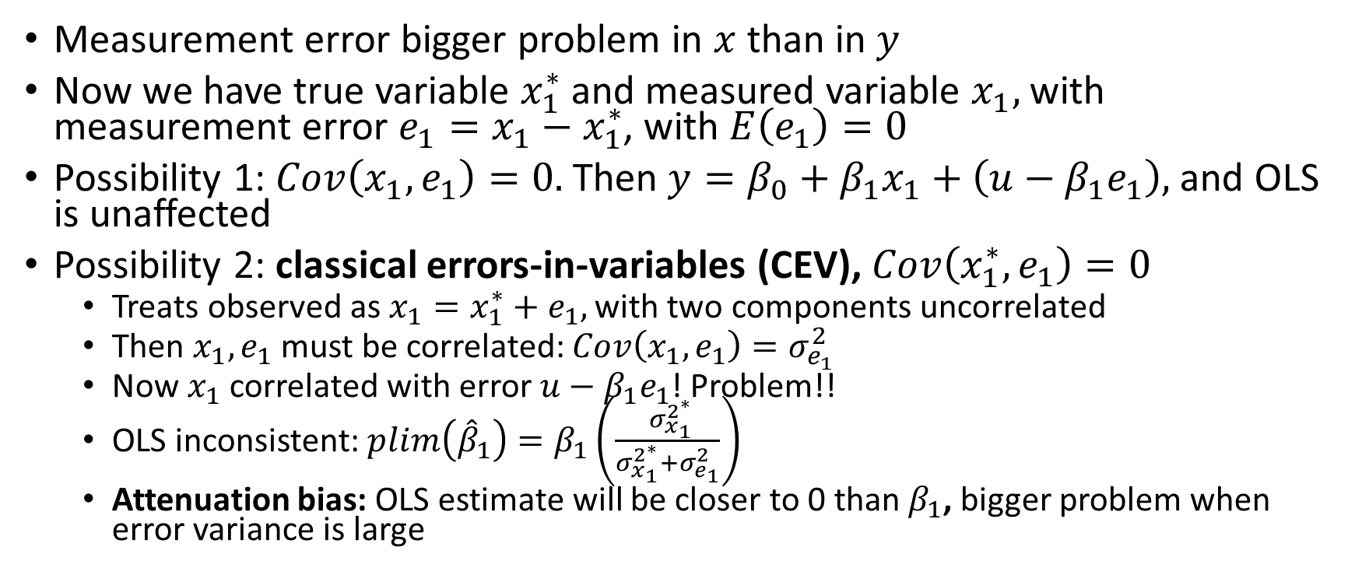
Measurement Error in an Explanatory Variable
Measurement error bigger problem in $x$ than in $y$
Now we have true variable $x_{1}^{∗}$and measured variable $x_{1},$ with measurement error $e_{1}=x_{1}−x_{1}^{∗}$, with $E\left(e_{1}\right)=0$
Possibility 1: $Cov\left(x_{1},e_{1}\right)=0.$ Then $y=β_{0}+β_{1}x_{1}+\left(u−β_{1}e_{1}\right),$and OLS is unaffected
Possibility 2: classical errors-in-variables (CEV), $Cov\left(x_{1}^{∗},e_{1}\right)=0$
Treats observed as $x_{1}=x_{1}^{∗}+e_{1},$ with two components uncorrelated
Then $x_{1},e_{1}$must be correlated: $Cov\left(x_{1},e_{1}\right)=σ_{e_{1}}^{2}$
Now $x_{1}$ correlated with error $u−β_{1}e_{1}$! Problem!!
OLS inconsistent: $plim\left({\hat{β}}_{1}\right)=β_{1}\left(\frac{ σ_{x_{1}}^{2^{∗}}}{σ_{x_{1}}^{2^{∗}}+σ_{e_{1}}^{2}}\right)$
Attenuation bias: OLS estimate will be closer to 0 than $β_{1}$, bigger problem when error variance is large

Slide 8
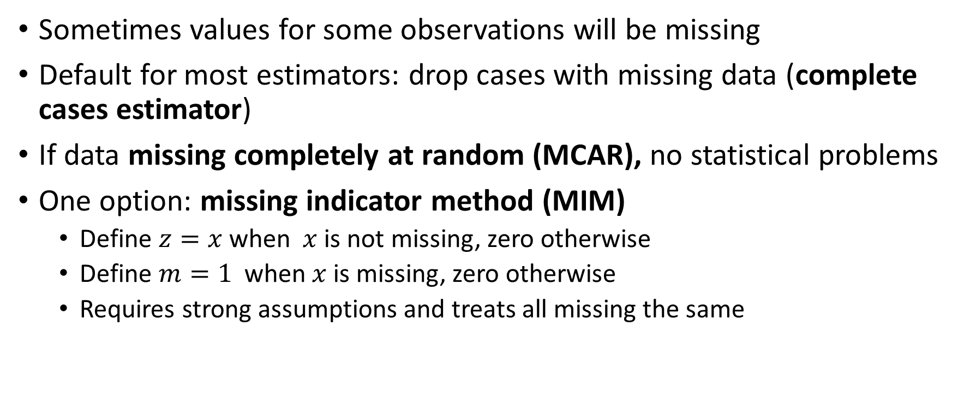
Missing Data
Sometimes values for some observations will be missing
Default for most estimators: drop cases with missing data (complete cases estimator)
If data missing completely at random (MCAR), no statistical problems
One option: missing indicator method (MIM)
Define $z=x$ when $x$is not missing, zero otherwise
Define $m=1$ when $x$is missing, zero otherwise
Requires strong assumptions and treats all missing the same

Slide 9
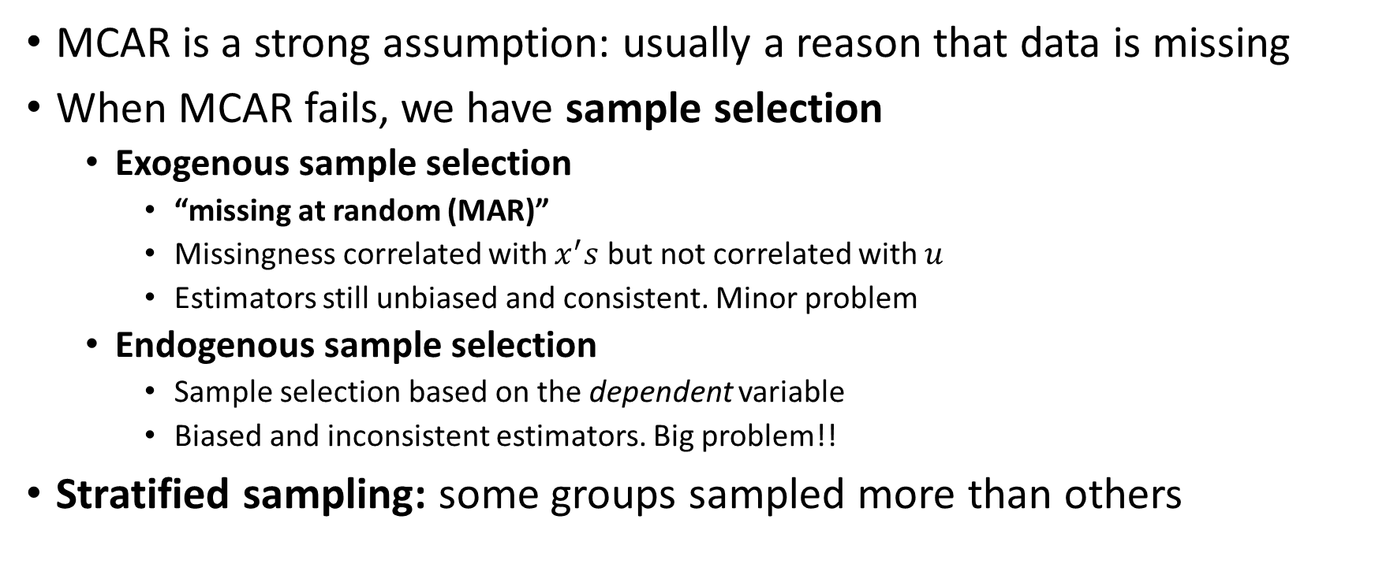
Nonrandom Samples
MCAR is a strong assumption: usually a reason that data is missing
When MCAR fails, we have sample selection
Exogenous sample selection
“missing at random (MAR)”
Missingness correlated with $x^{′}s$ but not correlated with $u$
Estimators still unbiased and consistent. Minor problem
Endogenous sample selection
Sample selection based on the dependent variable
Biased and inconsistent estimators. Big problem!!
Stratified sampling: some groups sampled more than others

Slide 10
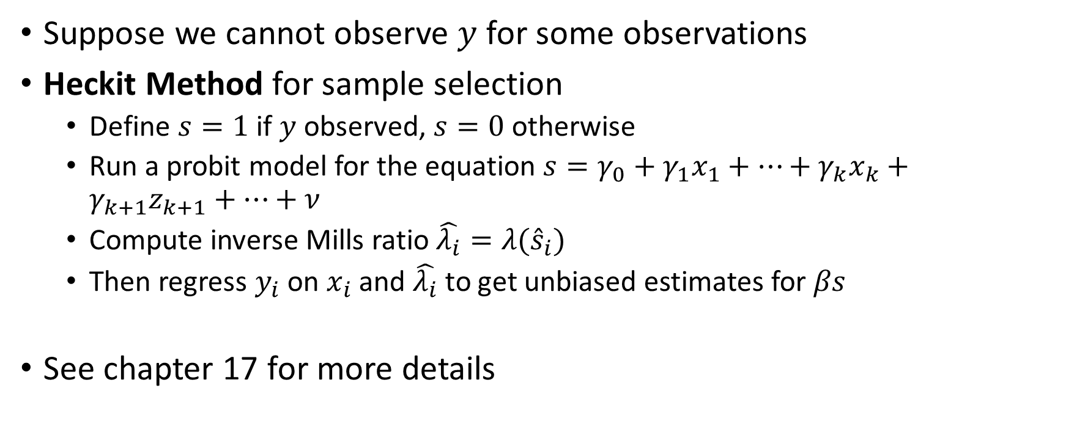
Dealing with Endogenous Sample Selection
Suppose we cannot observe $y$ for some observations
Heckit Method for sample selection
Define $s=1$ if $y$ observed, $s=0$otherwise
Run a probit model for the equation $s=γ_{0}+γ_{1}x_{1}+…+γ_{k}x_{k}+γ_{k+1}z_{k+1}+…+ν$
Compute inverse Mills ratio $\hat{λ_{i}}=λ({\hat{s}}_{i})$
Then regress $y_{i}$ on $x_{i}$ and $\hat{λ_{i}}$ to get unbiased estimates for $βs$
See chapter 17 for more details

Slide 11
Outliers
An outlier observation has a big observation on the estimated coefficients
Unclear whether to drop these outliers. May be beneficial by providing important variation
Studentized residuals:
Define a dummy variable for an observation and include it in regression
The size of this coefficient is the residual for this observation from a regression line using all the other variables
Large t-statistic implies a large outlier

