Slide 1
Econometrics: Lecture 1
Introduction, Probability and Statistics Review
January 24, 2023

Slide 2
Introduction

Slide 3
Introduction to Econometrics
What is econometrics?
Econometrics is the use of statistical methods for the analysis of economic phenomena.
How is econometrics different from statistics?
Based on classical statistics: real-world application
Often focused on causal relationships between variables
Usually based on observational rather than experimental data

Slide 4
Observational Data
Ideally, causality is best determined in a controlled experiment
Example: efficacy of a medical intervention
In a properly randomized experiment, causal interpretation is straightforward
The social sciences rarely provide controlled experiments
We must rely on observational data
We collect these data passively, we must find them out in the world

Slide 5
Examples of Econometric Questions
What is the effect of a college degree on lifetime earnings?
What will inflation be next month?
Does the effect of the corporate income tax on investment vary by industry?

Slide 6
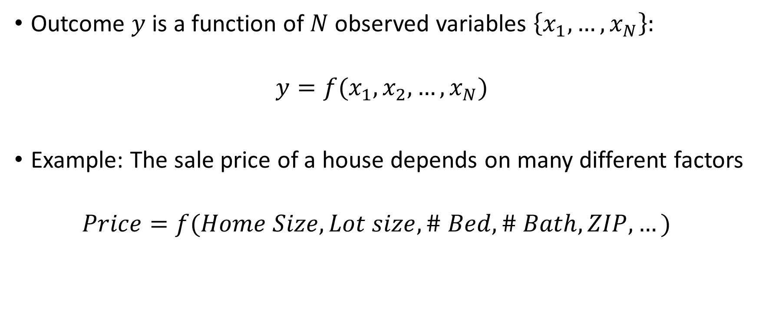
The Basic Econometric Model
Outcome $y$ is a function of $N$ observed variables $\left\{x_{1},…,x_{N}\right\}:$
$$y=f(x_{1},x_{2},…,x_{N})$$
Example: The sale price of a house depends on many different factors
$$Price=f(Home Size, Lot size, \# Bed, \# Bath, ZIP,…)$$

Slide 7
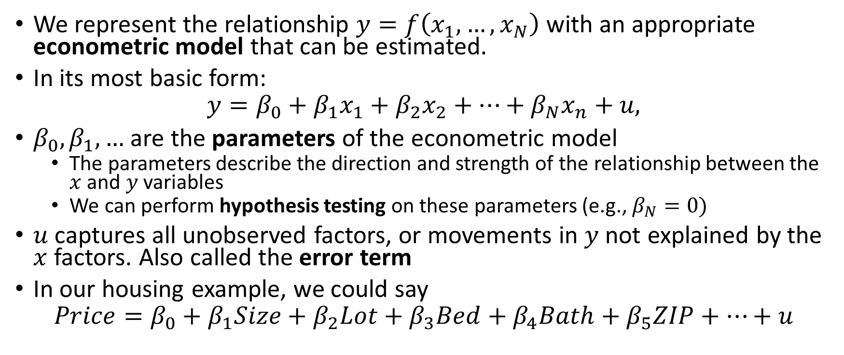
The Basic Econometric Model
We represent the relationship $y=f\left(x_{1},…,x_{N}\right)$with an appropriate econometric model that can be estimated.
In its most basic form:
$$y=β_{0}+β_{1}x_{1}+β_{2}x_{2}+…+β_{N}x_{n}+u,$$
$β_{0},β_{1},…$ are the parameters of the econometric model
The parameters describe the direction and strength of the relationship between the $x$ and $y$ variables
We can perform hypothesis testing on these parameters (e.g., $β_{N}=0)$
$u$ captures all unobserved factors, or movements in $y$ not explained by the $x$ factors. Also called the error term
In our housing example, we could say
$$Price=β_{0}+β_{1}Size+β_{2}Lot+β_{3}Bed+β_{4}Bath+β_{5}ZIP+…+u$$

Slide 8
Economic Data Structures
Cross-sectional data
Sample of many units taken at a single point in time
E.g., 1000 firms surveyed in January 2023
Often assume these units obtained by random sampling (see below)
Violations of random sampling require advanced techniques
Not all variables need correspond to the same period
E.g., effect of an early education program in 2000 on college enrollment in 2013

Slide 9
Economic Data Structures
Cross-sectional data
Time series data
Consists of one or more variables evolving over time
Common in macroeconomics: quarterly GDP, monthly inflation, daily interest rates
Can almost never assume observations are independent
Must account for dependencies before standard methods can be used
Must also pay attention to seasonality
Raw employment numbers highly dependent on month of the year

Slide 10
Economic Data Structures
Cross-sectional data
Time series data
Pooled cross sections
Units drawn from different time periods
E.g., a random sample of schools before and after a policy change
Units not necessarily the same in different periods!

Slide 11
Economic Data Structures
Cross-sectional data
Time series data
Pooled cross sections
Panel data
Sample of the same units across multiple time periods
Consists of a separate time series for each unit
E.g., annual financial information for all publicly traded firms from 1980-2022
Allows researcher to control for unobserved individual characteristics
Common data structure across economics

Slide 12
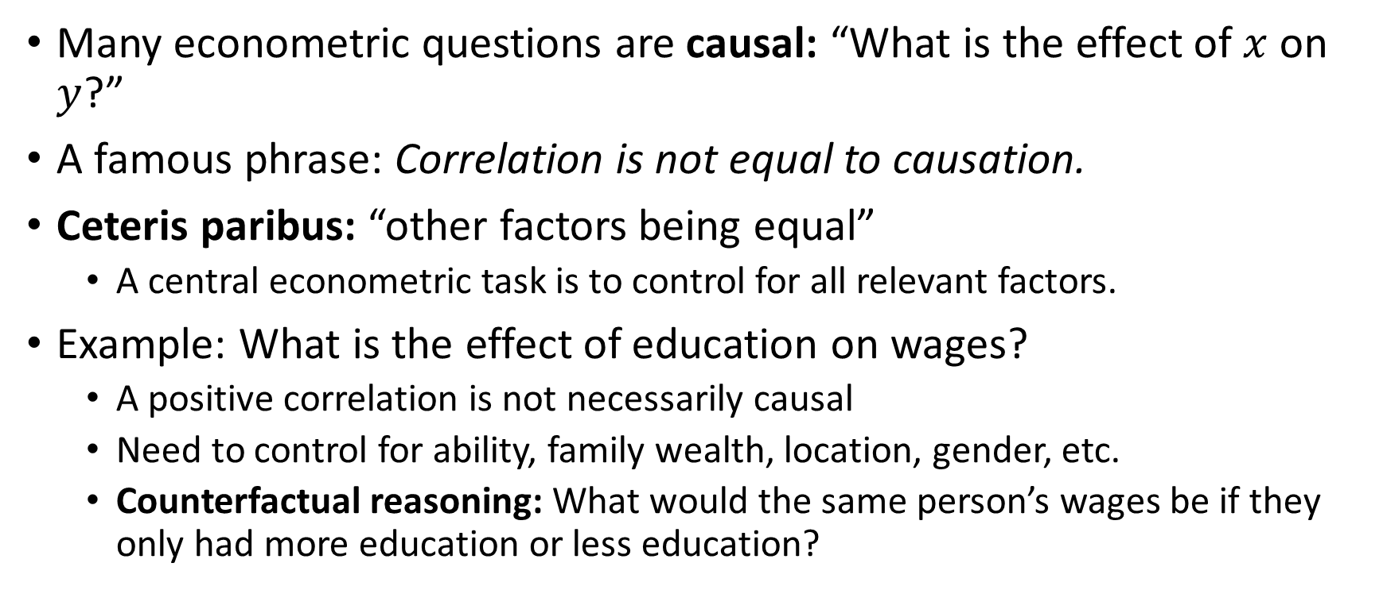
Causal Inference
Many econometric questions are causal: “What is the effect of $x$ on $y$?”
A famous phrase: Correlation is not equal to causation.
Ceteris paribus: “other factors being equal”
A central econometric task is to control for all relevant factors.
Example: What is the effect of education on wages?
A positive correlation is not necessarily causal
Need to control for ability, family wealth, location, gender, etc.
Counterfactual reasoning: What would the same person’s wages be if they only had more education or less education?

Slide 13
Probability Review

Slide 14
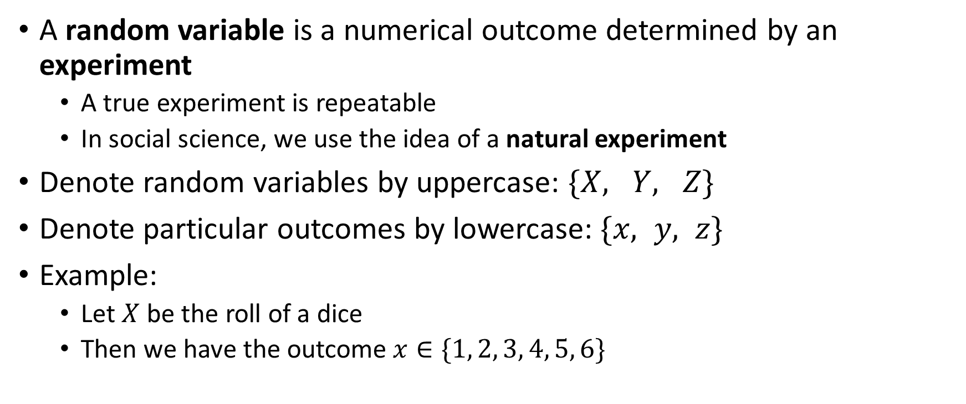
Random Variables
A random variable is a numerical outcome determined by an experiment
A true experiment is repeatable
In social science, we use the idea of a natural experiment
Denote random variables by uppercase: $\{X, Y, Z\}$
Denote particular outcomes by lowercase: $\{x, y, z\}$
Example:
Let $X$ be the roll of a dice
Then we have the outcome $x∈\{1, 2, 3, 4, 5, 6\}$

Slide 15
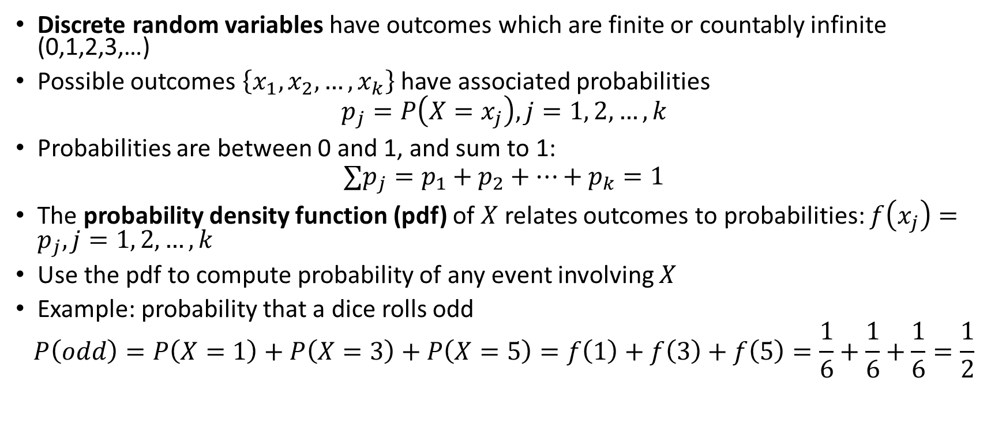
Discrete Random Variables
Discrete random variables have outcomes which are finite or countably infinite (0,1,2,3,…)
Possible outcomes $\left\{x_{1},x_{2},…,x_{k}\right\}$have associated probabilities
$$p_{j}=P\left(X=x_{j}\right), j=1, 2, …, k$$
Probabilities are between 0 and 1, and sum to 1:
$$∑p_{j}=p_{1}+p_{2}+…+p_{k}=1$$
The probability density function (pdf) of $X$relates outcomes to probabilities: $f\left(x_{j}\right)=p_{j}, j=1, 2, …, k$
Use the pdf to compute probability of any event involving $X$
Example: probability that a dice rolls odd
$$P\left(odd\right)=P\left(X=1\right)+P\left(X=3\right)+P\left(X=5\right)=f\left(1\right)+f\left(3\right)+f\left(5\right)=\frac{1}{6}+\frac{1}{6}+\frac{1}{6}=\frac{1}{2}$$

Slide 16
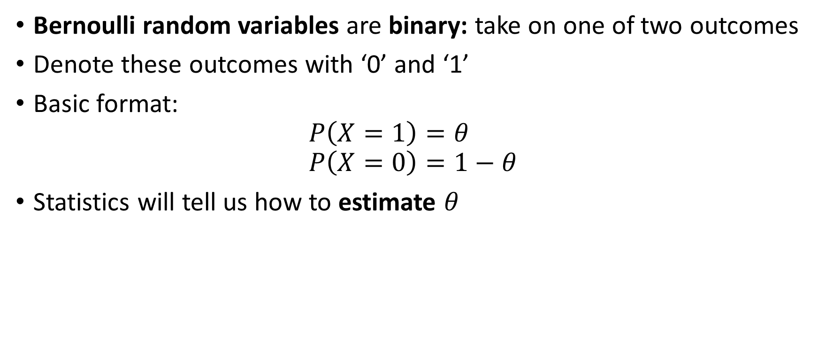
Bernoulli Random Variables
Bernoulli random variables are binary: take on one of two outcomes
Denote these outcomes with ‘0’ and ‘1’
Basic format:
$$P\left(X=1\right)=θ$$
$$P\left(X=0\right)=1−θ$$
Statistics will tell us how to estimate $θ$

Slide 17
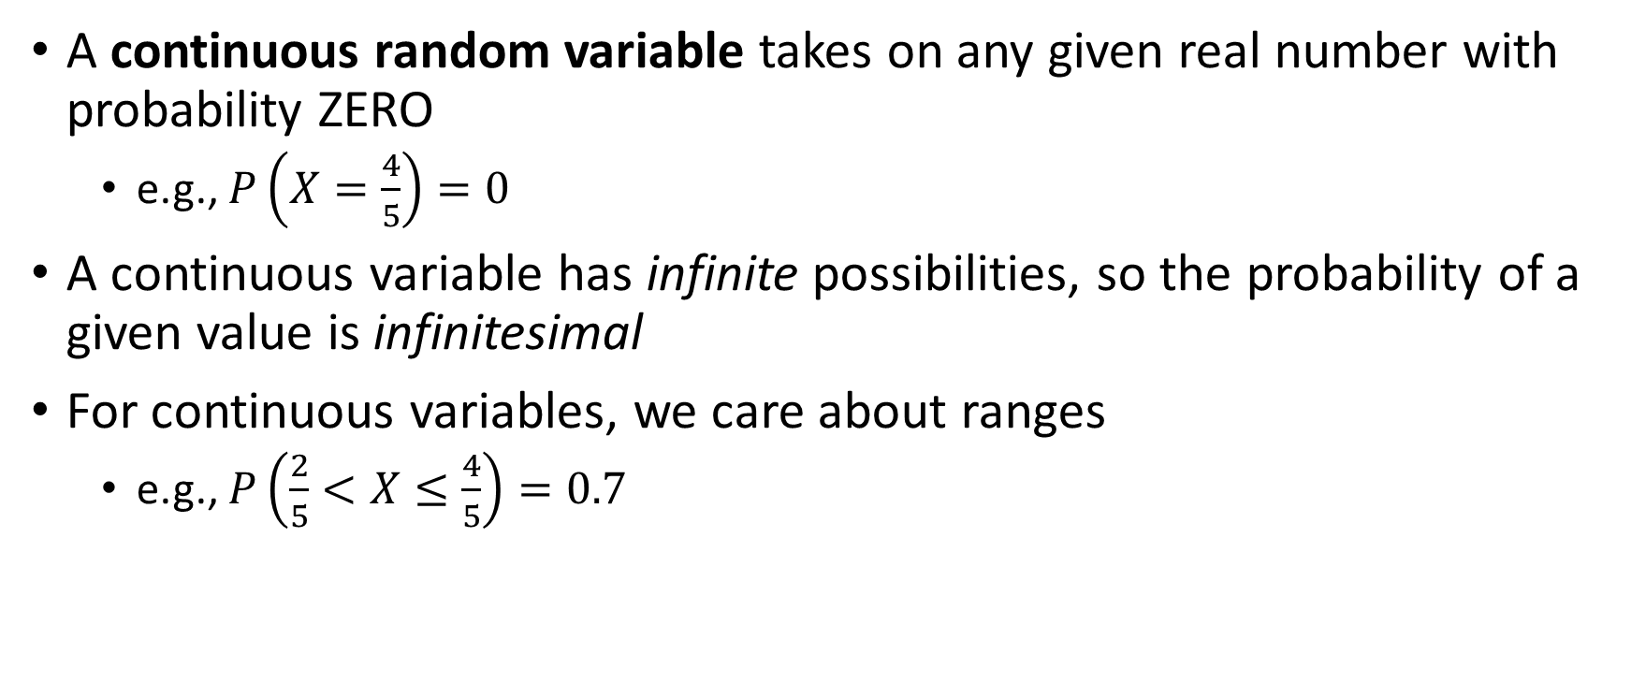
Continuous Random Variables
A continuous random variable takes on any given real number with probability ZERO
e.g., $P\left(X=\frac{4}{5}\right)=0$
A continuous variable has infinite possibilities, so the probability of a given value is infinitesimal
For continuous variables, we care about ranges
e.g., $P\left(\frac{2}{5}<X≤\frac{4}{5}\right)=0.7$

Slide 18
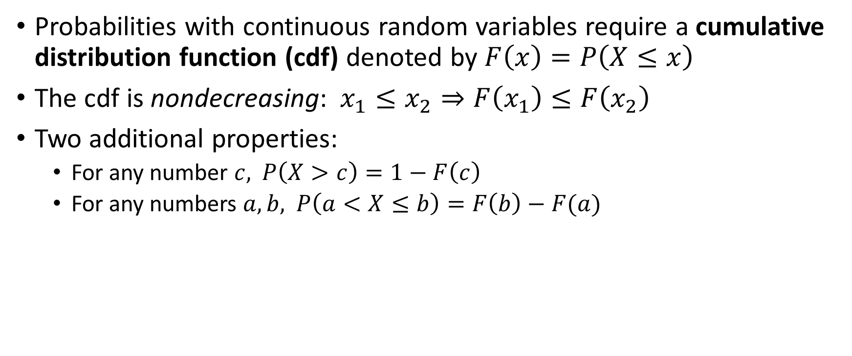
Cumulative Distribution Function
Probabilities with continuous random variables require a cumulative distribution function (cdf) denoted by $F\left(x\right)=P\left(X≤x\right)$
The cdf is nondecreasing: $x_{1}≤x_{2}⇒F\left(x_{1}\right)≤F\left(x_{2}\right)$
Two additional properties:
For any number $c,$ $P\left(X>c\right)=1−F\left(c\right)$
For any numbers $a,b,$ $P\left(a<X≤b\right)=F\left(b\right)−F(a)$

Slide 19
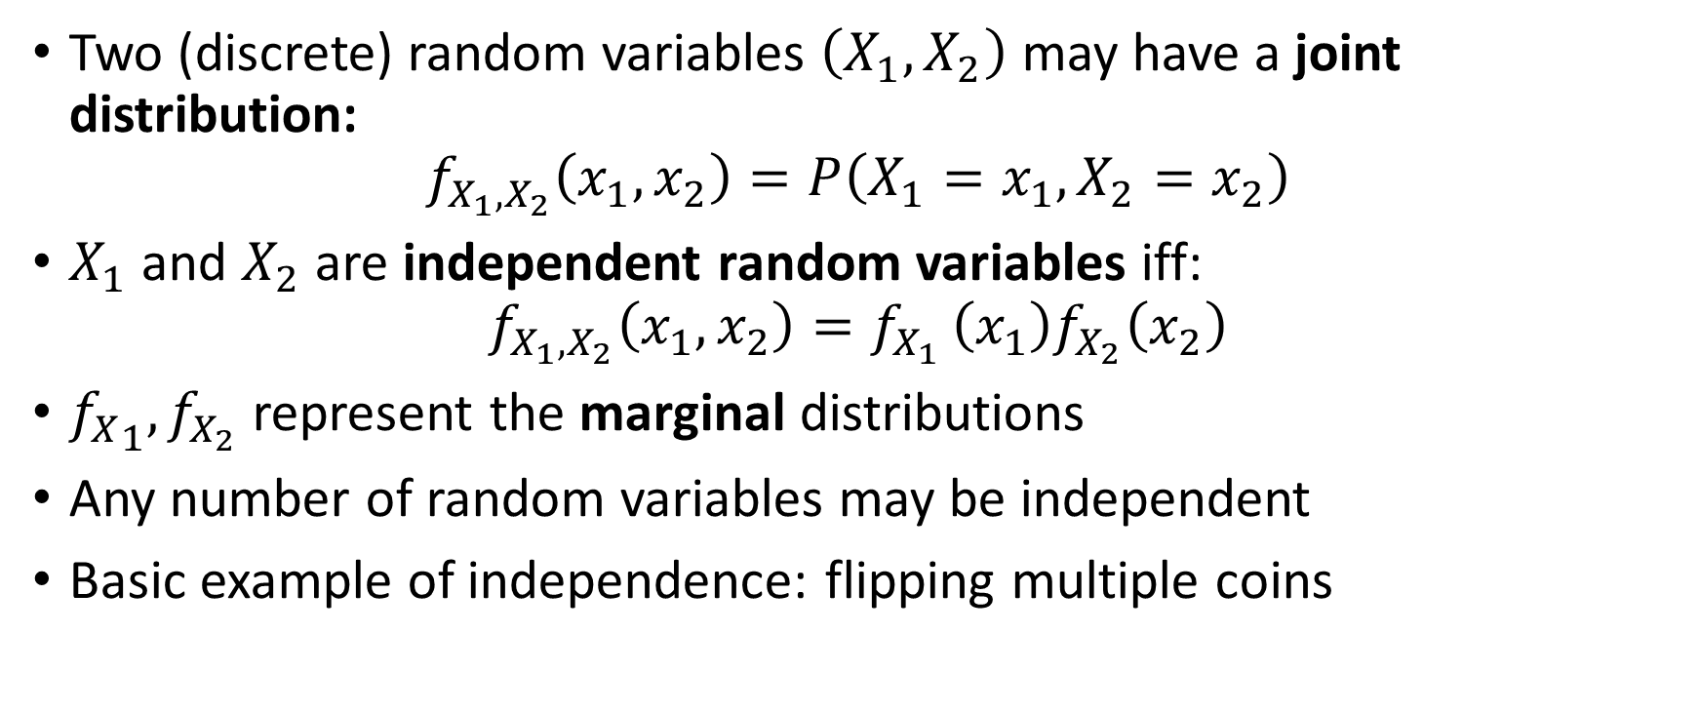
Joint Distributions
Two (discrete) random variables $\left(X_{1},X_{2}\right)$ may have a joint distribution:
$$f_{X_{1},X_{2}}\left(x_{1},x_{2}\right)=P\left(X_{1}=x_{1},X_{2}=x_{2}\right)$$
$X_{1}$ and $X_{2}$ are independent random variables iff:
$$f_{X_{1},X_{2}}\left(x_{1},x_{2}\right)=f_{X_{1} }\left(x_{1}\right)f_{X_{2}}\left(x_{2}\right)$$
${f_{X}}_{1},f_{X_{2}}$ represent the marginal distributions
Any number of random variables may be independent
Basic example of independence: flipping multiple coins

Slide 20
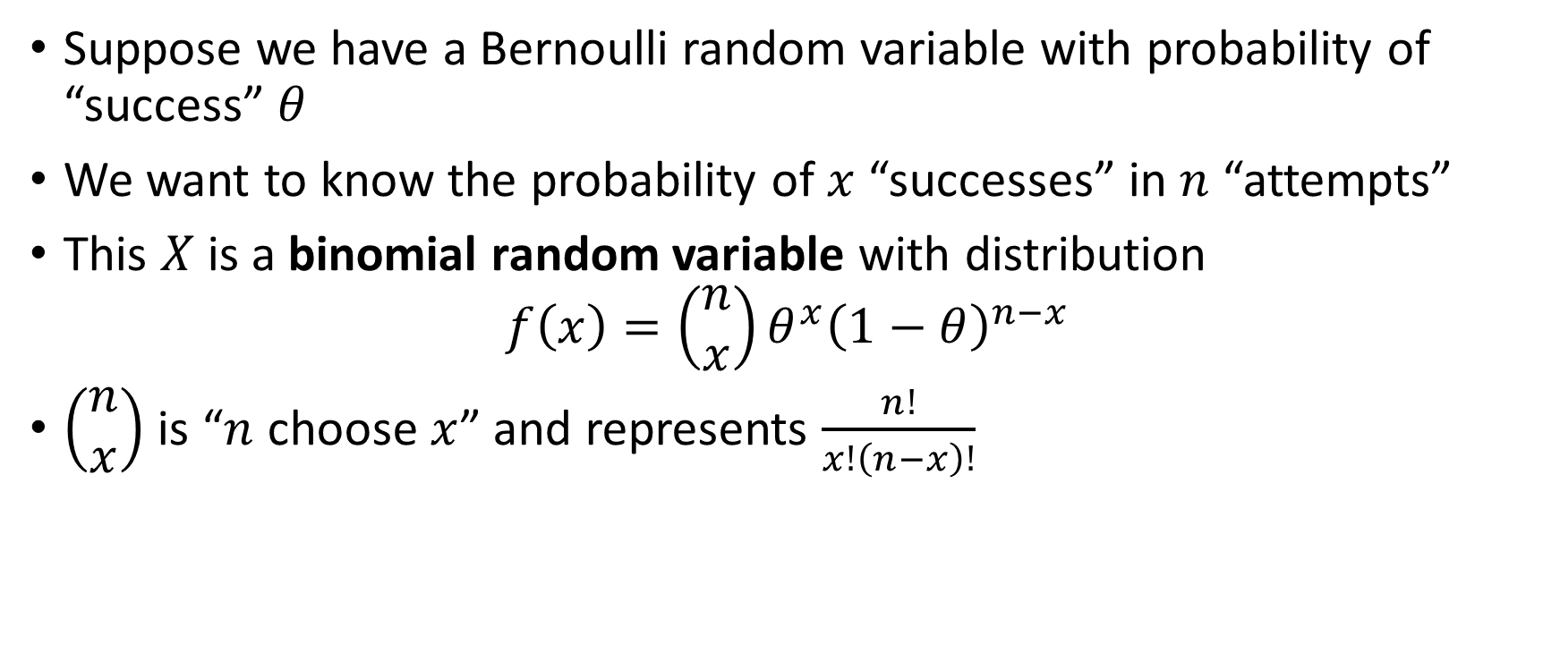
Binomial Distribution
Suppose we have a Bernoulli random variable with probability of “success” $θ$
We want to know the probability of $x$ “successes” in $n$ “attempts”
This $X$is a binomial random variable with distribution
$$f\left(x\right)=\left(\begin{matrix}n \\ x\end{matrix}\right)θ^{x}{\left(1−θ\right)}^{n−x}$$
$\left(\begin{matrix}n \\ x\end{matrix}\right)$ is “$n$ choose $x$” and represents $\frac{n!}{x!\left(n−x\right)!}$

Slide 21

Conditional Distribution
What is the probability of $Y=y$ conditional on knowing that $X=x$?
The conditional density function gives the answer:
$$f_{Y|X}\left(y | x\right)=f_{X,Y}(x,y)/f_{X}(x)$$
For discrete random variables, this is exactly $P(Y=y|X=x)$

Slide 22
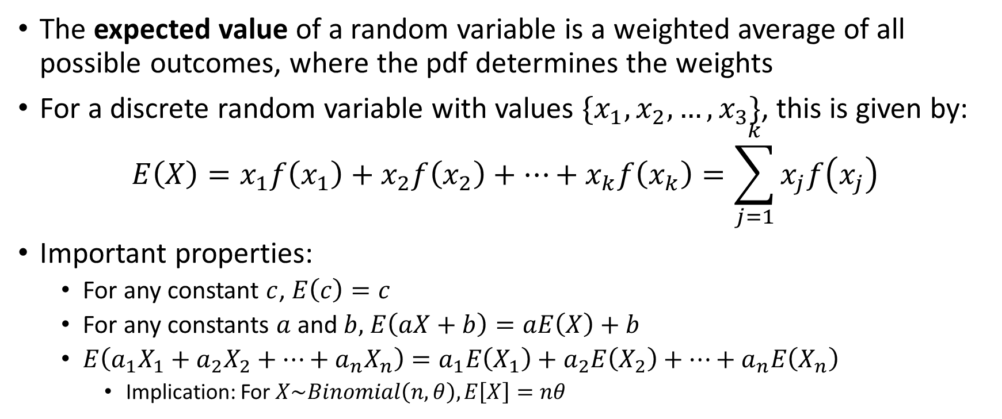
Expected Value
The expected value of a random variable is a weighted average of all possible outcomes, where the pdf determines the weights
For a discrete random variable with values $\{x_{1},x_{2},…,x_{3}\}$, this is given by:
$$E\left(X\right)=x_{1}f\left(x_{1}\right)+x_{2}f\left(x_{2}\right)+…+x_{k}f\left(x_{k}\right)=\sum_{j=1}^{k}{x_{j}f\left(x_{j}\right)}$$
Important properties:
For any constant $c$, $E\left(c\right)=c$
For any constants $a$ and $b,$ $E\left(aX+b\right)=aE\left(X\right)+b$
$E\left(a_{1}X_{1}+a_{2}X_{2}+…+a_{n}X_{n}\right)=a_{1}E\left(X_{1}\right)+a_{2}E\left(X_{2}\right)+…+a_{n}E\left(X_{n}\right)$
Implication: For $X\sim Binomial\left(n,θ\right), E\left[X\right]=nθ$

Slide 23
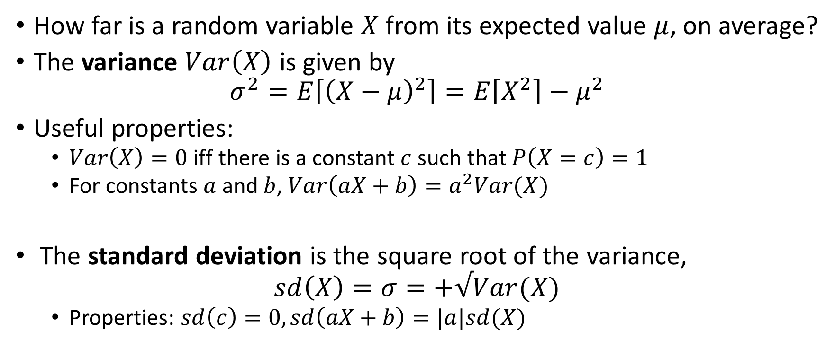
Measures of Variability
How far is a random variable $X$ from its expected value $μ$, on average?
The variance $Var\left(X\right)$ is given by
$$σ^{2}=E\left[{\left(X−μ\right)}^{2}\right]=E\left[X^{2}\right]−μ^{2}$$
Useful properties:
$Var\left(X\right)=0$iff there is a constant $c$ such that $P\left(X=c\right)=1$
For constants $a$and $b$, $Var\left(aX+b\right)=a^{2}Var(X)$
The standard deviation is the square root of the variance,
$$sd\left(X\right)=σ=+√Var(X)$$
Properties: $sd\left(c\right)=0, sd\left(aX+b\right)=|a|sd(X)$

Slide 24
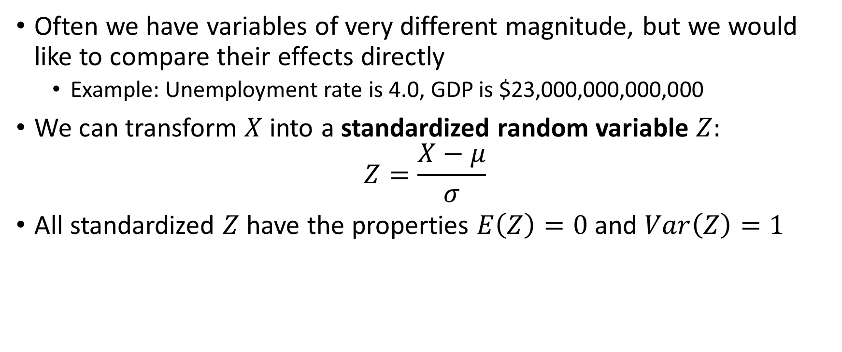
Standardizing a Random Variable
Often we have variables of very different magnitude, but we would like to compare their effects directly
Example: Unemployment rate is 4.0, GDP is $23,000,000,000,000
We can transform $X$ into a standardized random variable $Z:$
$$Z=\frac{X−μ}{σ}$$
All standardized $Z$ have the properties $E\left(Z\right)=0$ and $Var\left(Z\right)=1$

Slide 25
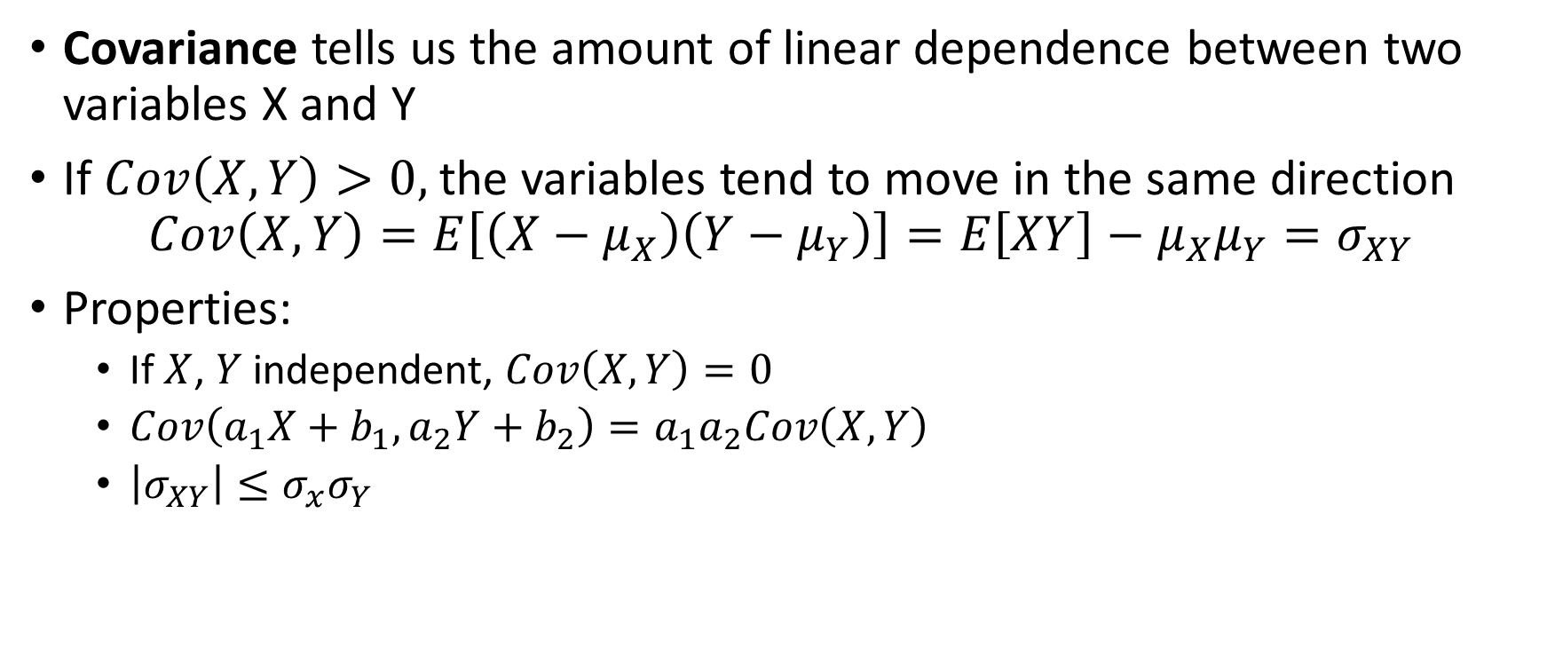
Covariance
Covariance tells us the amount of linear dependence between two variables X and Y
If $Cov\left(X,Y\right)>0,$the variables tend to move in the same direction
$$Cov\left(X,Y\right)=E\left[\left(X−μ_{X}\right)\left(Y−μ_{Y}\right)\right]=E\left[XY\right]−μ_{X}μ_{Y}=σ_{XY}$$
Properties:
If $X$, $Y$ independent, $Cov\left(X,Y\right)=0$
$Cov\left(a_{1}X+b_{1},a_{2}Y+b_{2}\right)=a_{1}a_{2}Cov\left(X,Y\right)$
$\left|σ_{XY}\right|≤σ_{x}σ_{Y}$

Slide 26
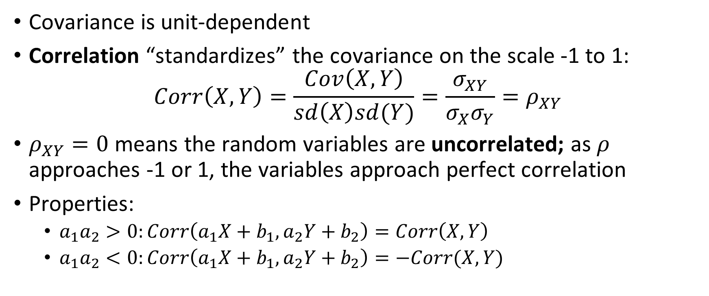
Correlation
Covariance is unit-dependent
Correlation “standardizes” the covariance on the scale -1 to 1:
$$Corr\left(X,Y\right)=\frac{Cov\left(X,Y\right)}{sd\left(X\right)sd(Y)}=\frac{σ_{XY}}{σ_{X}σ_{Y}}=ρ_{XY}$$
$ρ_{XY}=0$ means the random variables are uncorrelated; as $ρ$ approaches -1 or 1, the variables approach perfect correlation
Properties:
$a_{1}a_{2}>0:Corr\left(a_{1}X+b_{1},a_{2}Y+b_{2}\right)=Corr\left(X,Y\right)$
$a_{1}a_{2}<0:Corr\left(a_{1}X+b_{1},a_{2}Y+b_{2}\right)=−Corr(X,Y)$

Slide 27
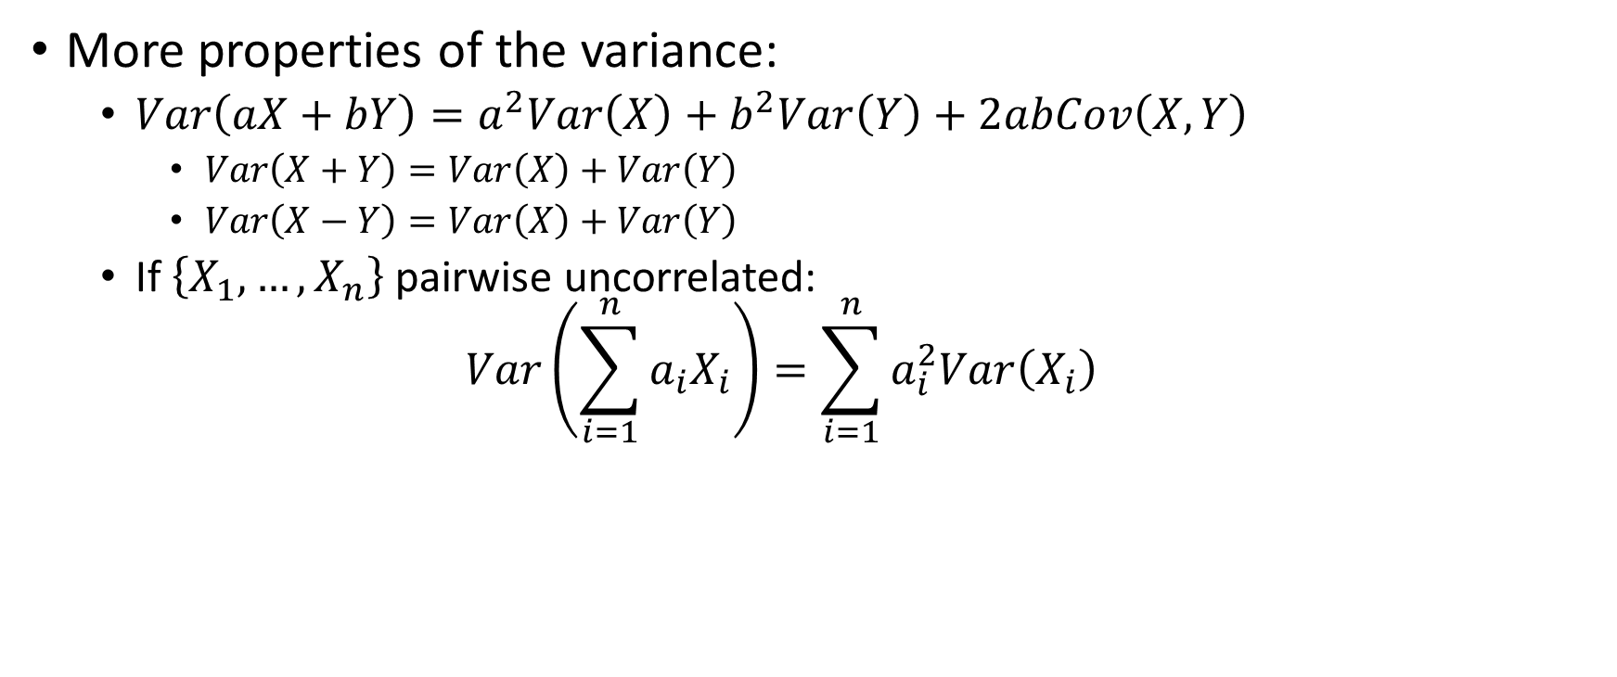
Variance, Part 2
More properties of the variance:
$Var\left(aX+bY\right)=a^{2}Var\left(X\right)+b^{2}Var\left(Y\right)+2abCov\left(X,Y\right)$
$Var\left(X+Y\right)=Var\left(X\right)+Var\left(Y\right)$
$Var\left(X−Y\right)=Var\left(X\right)+Var\left(Y\right)$
If $\left\{X_{1},…,X_{n}\right\}$pairwise uncorrelated:
$$Var\left(\sum_{i=1}^{n}{a_{i}X_{i}}\right)=\sum_{i=1}^{n}{a_{i}^{2}Var\left(X_{i}\right)}$$

Slide 28
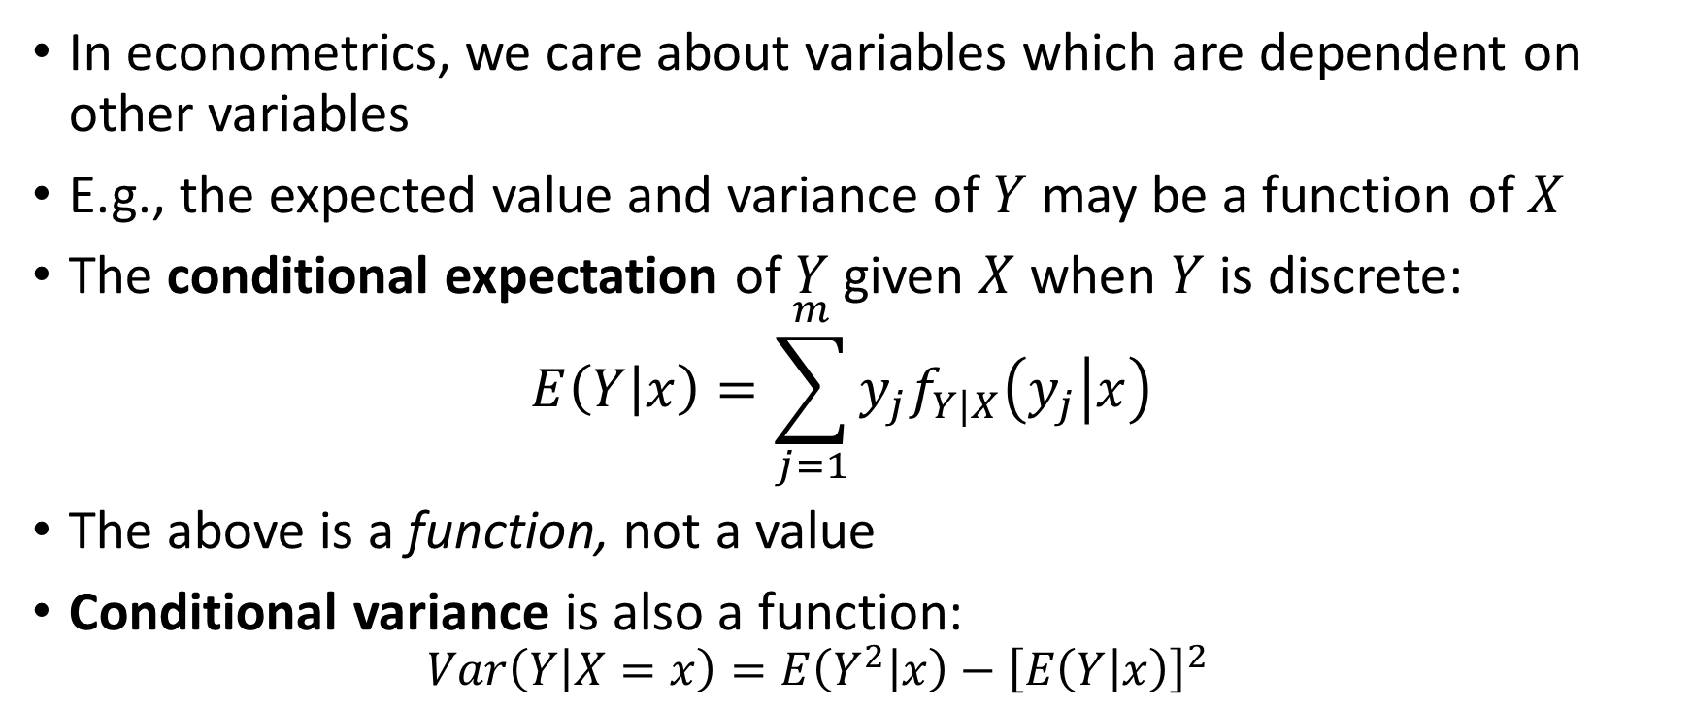
Conditional Expectation and Variance
In econometrics, we care about variables which are dependent on other variables
E.g., the expected value and variance of $Y$ may be a function of $X$
The conditional expectation of $Y$ given $X$ when $Y$ is discrete:
$$E\left(Y | x\right)=\sum_{j=1}^{m}{y_{j}f_{Y|X}\left(y_{j} | x\right) }$$
The above is a function, not a value
Conditional variance is also a function:
$$Var\left(Y | X=x\right)=E\left(Y^{2} | x\right)−{\left[E\left(Y | x\right)\right]}^{2}$$

Slide 29
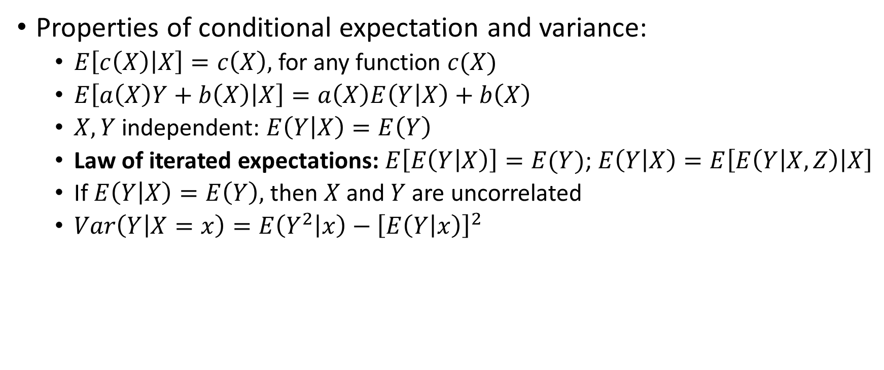
Conditional Expectation and Variance
Properties of conditional expectation and variance:
$E\left[c\left(X\right) | X\right]=c\left(X\right),$for any function $c(X)$
$E\left[a\left(X\right)Y+b\left(X\right) | X\right]=a\left(X\right)E\left(Y | X\right)+b\left(X\right)$
$X,Y$independent: $E\left(Y | X\right)=E\left(Y\right)$
Law of iterated expectations: $E\left[E\left(Y | X\right)\right]=E(Y)$; $E\left(Y | X\right)=E\left[E\left(Y | X,Z\right) | X\right]$
If $E\left(Y | X\right)=E\left(Y\right),$then $X$and $Y$ are uncorrelated
$Var\left(Y | X=x\right)=E\left(Y^{2} | x\right)−{\left[E\left(Y | x\right)\right]}^{2}$

Slide 30
Statistics Review

Slide 31
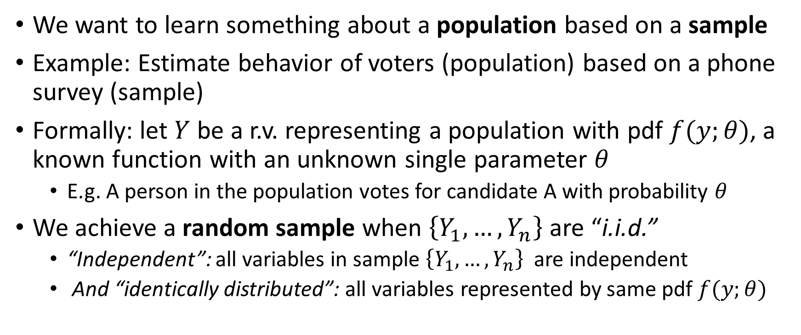
Statistical Inference and Sampling
We want to learn something about a population based on a sample
Example: Estimate behavior of voters (population) based on a phone survey (sample)
Formally: let $Y$ be a r.v. representing a population with pdf $f(y;θ)$, a known function with an unknown single parameter $θ$
E.g. A person in the population votes for candidate A with probability $θ$
We achieve a random sample when $\left\{Y_{1},…,Y_{n}\right\}$are “i.i.d.”
“Independent”: all variables in sample $\left\{Y_{1},…,Y_{n}\right\}$ are independent
And “identically distributed”: all variables represented by same pdf $f(y;θ)$

Slide 32
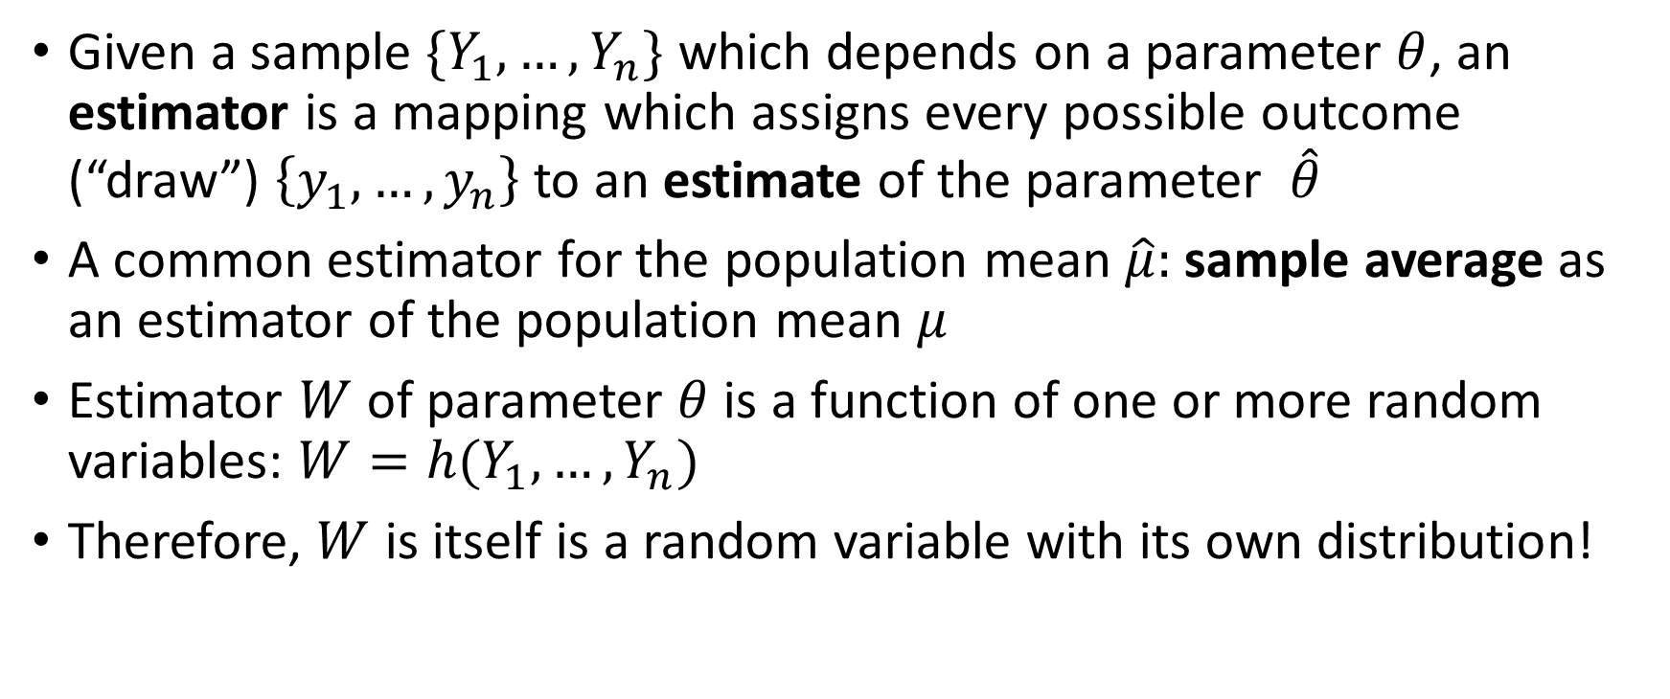
Estimators and Estimates
Given a sample $\{Y_{1},…,Y_{n}\}$ which depends on a parameter $θ$, an estimator is a mapping which assigns every possible outcome (“draw”) $\left\{y_{1},…,y_{n}\right\}$to an estimate of the parameter $\hat{θ}$
A common estimator for the population mean $\hat{μ}:$sample average as an estimator of the population mean $μ$
Estimator $W$ of parameter $θ$ is a function of one or more random variables: $W=h(Y_{1},…,Y_{n})$
Therefore, $W$ is itself is a random variable with its own distribution!

Slide 33
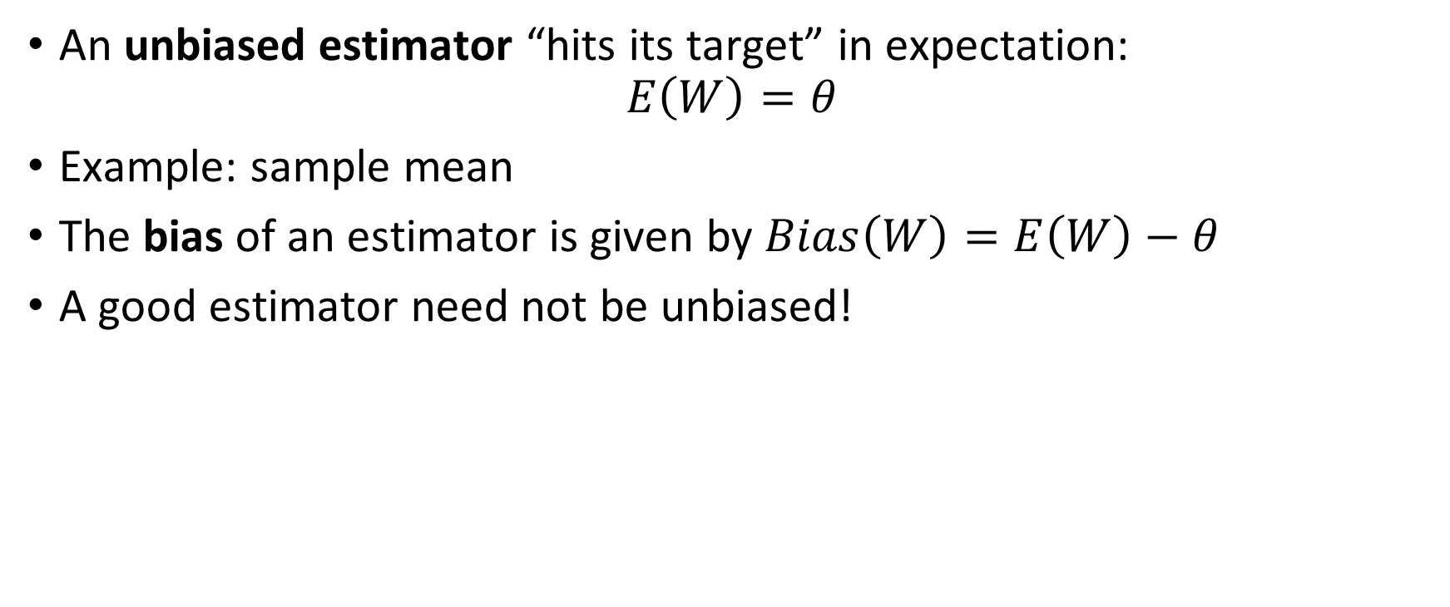
Bias
An unbiased estimator “hits its target” in expectation:
$$E\left(W\right)=θ$$
Example: sample mean
The bias of an estimator is given by $Bias\left(W\right)=E\left(W\right)−θ$
A good estimator need not be unbiased!

Slide 34
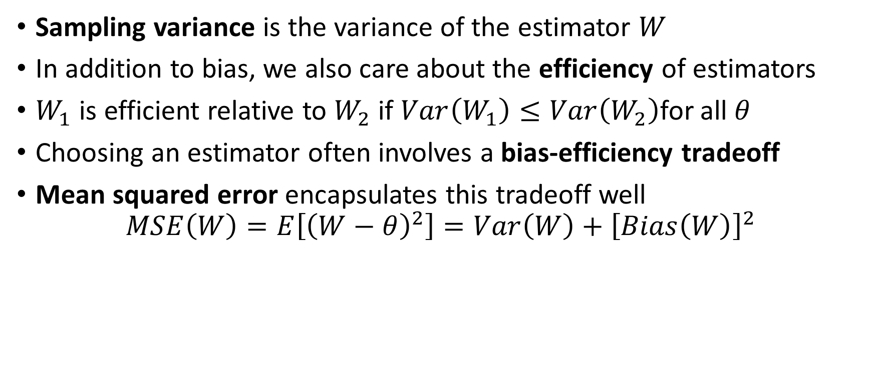
Efficiency
Sampling variance is the variance of the estimator $W$
In addition to bias, we also care about the efficiency of estimators
$W_{1}$ is efficient relative to $W_{2}$ if $Var\left(W_{1}\right)≤Var\left(W_{2}\right)$for all $θ$
Choosing an estimator often involves a bias-efficiency tradeoff
Mean squared error encapsulates this tradeoff well
$$MSE\left(W\right)=E\left[{\left(W−θ\right)}^{2}\right]=Var\left(W\right)+{\left[Bias\left(W\right)\right]}^{2}$$

Slide 35
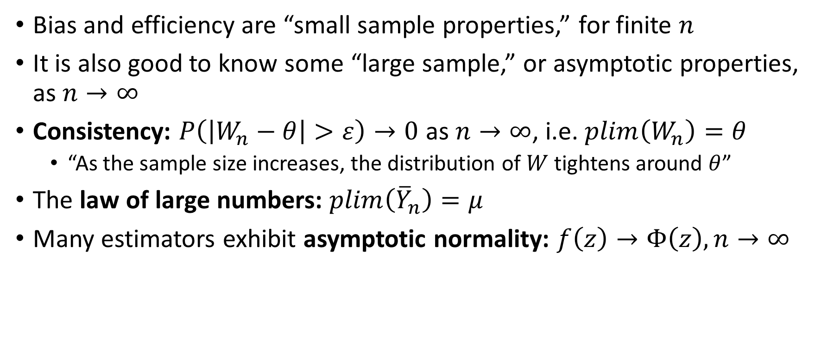
Asymptotic Properties of Estimators
Bias and efficiency are “small sample properties,” for finite $n$
It is also good to know some “large sample,” or asymptotic properties, as $n→∞$
Consistency: $P\left(\left|W_{n}−θ\right|>ε\right)→0$ as $n→∞$, i.e. $plim\left(W_{n}\right)=θ$
“As the sample size increases, the distribution of $W$ tightens around $θ$”
The law of large numbers: $plim\left({\overline{Y}}_{n}\right)=μ$
Many estimators exhibit asymptotic normality: $f\left(z\right)→Φ\left(z\right), n→∞$

Slide 36
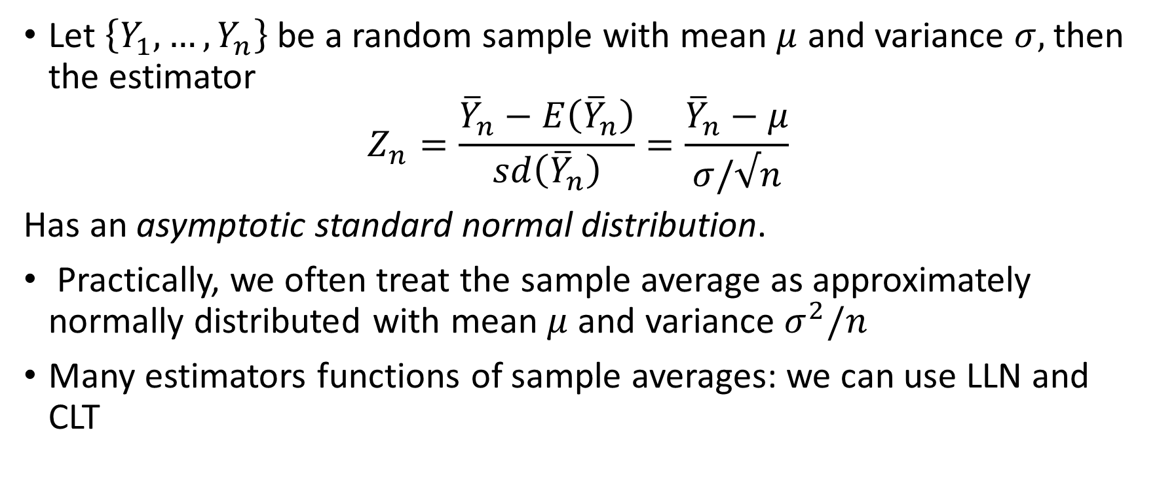
Central Limit Theorem
Let $\left\{Y_{1},…,Y_{n}\right\}$be a random sample with mean $μ$ and variance $σ,$then the estimator
$$Z_{n}=\frac{{\overline{Y}}_{n}−E\left({\overline{Y}}_{n}\right)}{sd\left({\overline{Y}}_{n}\right)}=\frac{{\overline{Y}}_{n}−μ}{σ/√n}$$
Has an asymptotic standard normal distribution.
Practically, we often treat the sample average as approximately normally distributed with mean $μ$ and variance $σ^{2}/n$
Many estimators functions of sample averages: we can use LLN and CLT

Slide 37
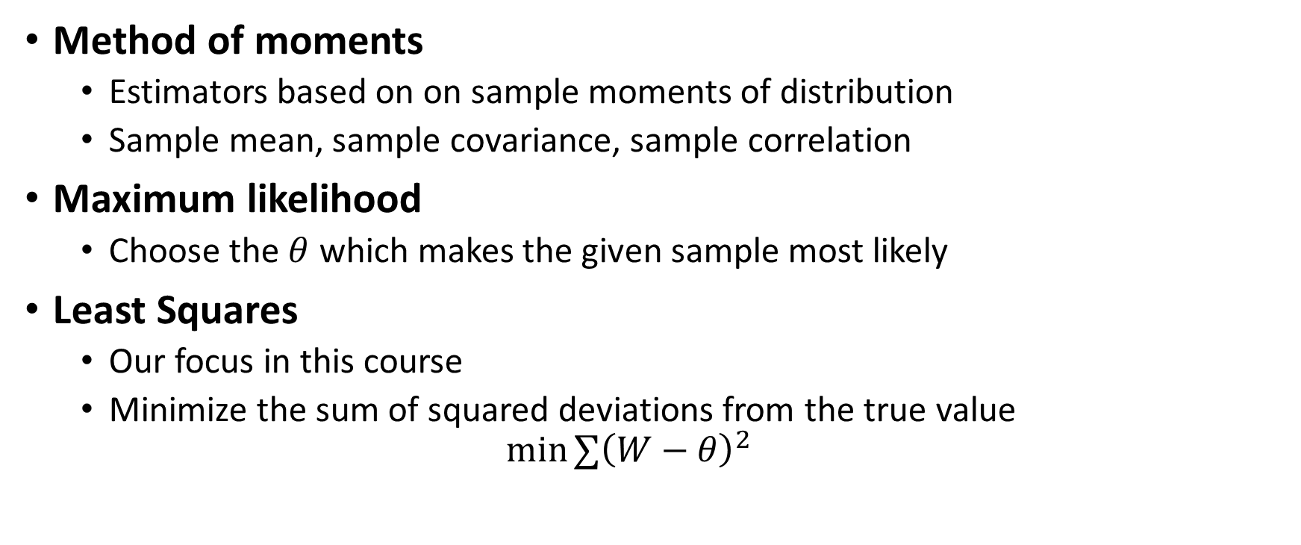
Approaches to Parameter Estimation
Method of moments
Estimators based on on sample moments of distribution
Sample mean, sample covariance, sample correlation
Maximum likelihood
Choose the $θ$ which makes the given sample most likely
Least Squares
Our focus in this course
Minimize the sum of squared deviations from the true value
$$\min{∑{\left(W−θ\right)}^{2}}$$

Slide 38
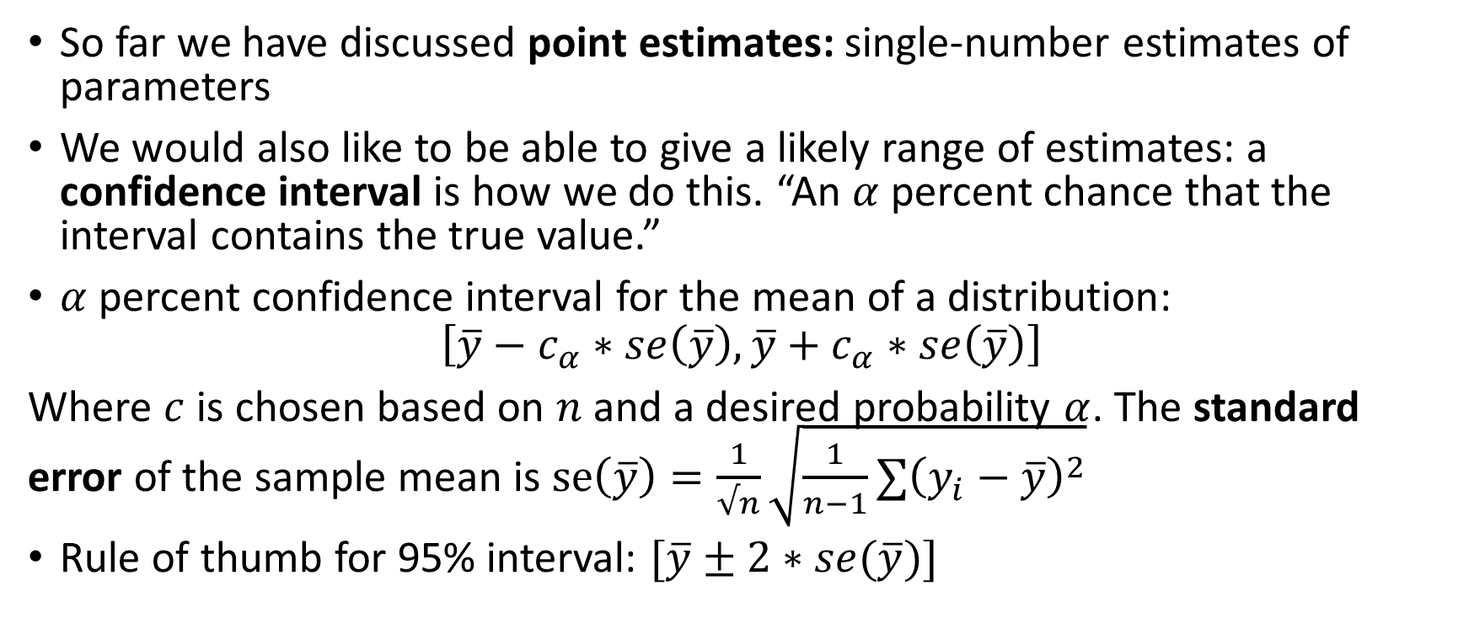
Interval Estimation and Confidence Intervals
So far we have discussed point estimates: single-number estimates of parameters
We would also like to be able to give a likely range of estimates: a confidence interval is how we do this. “An $α$percent chance that the interval contains the true value.”
$α$ percent confidence interval for the mean of a distribution:
$$\left[\overline{y}−c_{α}∗se\left(\overline{y}\right),\overline{y}+c_{α}∗se\left(\overline{y}\right)\right]$$
Where $c$ is chosen based on $n$ and a desired probability $α$. The standard error of the sample mean is $se\left(\overline{y}\right)=\frac{1}{√n}\sqrt{\frac{1}{n−1}∑{\left(y_{i}−\overline{y}\right)}^{2}}$
Rule of thumb for 95% interval: $[\overline{y}±2∗se(\overline{y})]$

Slide 39
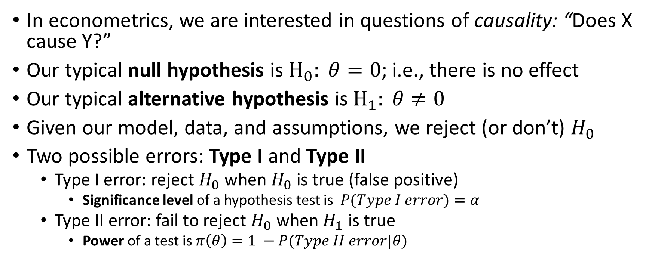
Hypothesis Testing
In econometrics, we are interested in questions of causality: “Does X cause Y?”
Our typical null hypothesis is $H_{0}: θ=0$; i.e., there is no effect
Our typical alternative hypothesis is $H_{1}: θ≠0$
Given our model, data, and assumptions, we reject (or don’t) $H_{0}$
Two possible errors: Type I and Type II
Type I error: reject $H_{0}$ when $H_{0}$ is true (false positive)
Significance level of a hypothesis test is $P(Type I error)=α$
Type II error: fail to reject $H_{0}$ when $H_{1}$ is true
Power of a test is $π\left(θ\right)=1 −P(Type II error|θ)$

Slide 40
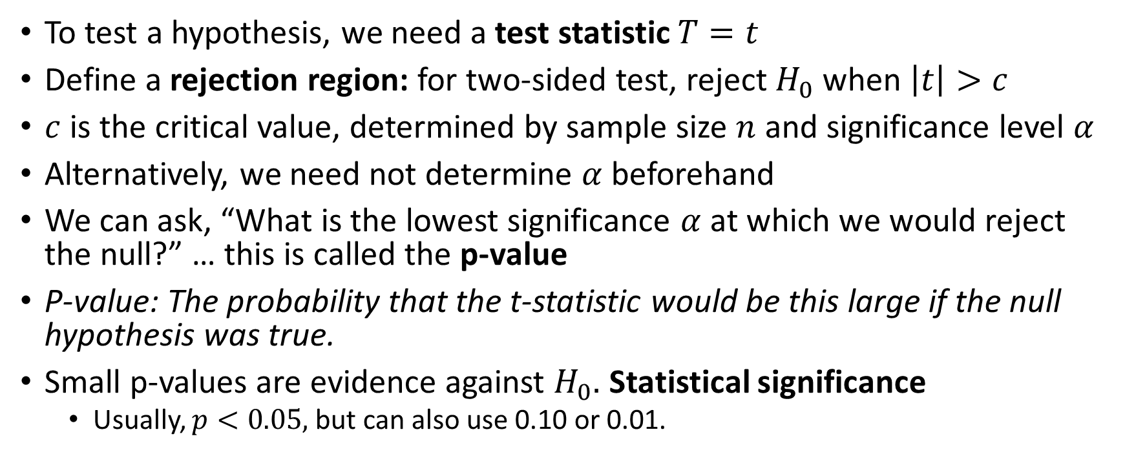
Hypothesis Testing
To test a hypothesis, we need a test statistic $T=t$
Define a rejection region: for two-sided test, reject $H_{0}$ when $\left|t\right|>c$
$c$ is the critical value, determined by sample size $n$ and significance level $α$
Alternatively, we need not determine $α$ beforehand
We can ask, “What is the lowest significance $α$ at which we would reject the null?” … this is called the p-value
P-value: The probability that the t-statistic would be this large if the null hypothesis was true.
Small p-values are evidence against $H_{0}.$ Statistical significance
Usually, $p<0.05,$but can also use 0.10 or 0.01.

