Slide 1
Econometrics: Lecture 2
The Simple Regression Model, Part 1
January 31, 2023

Slide 2
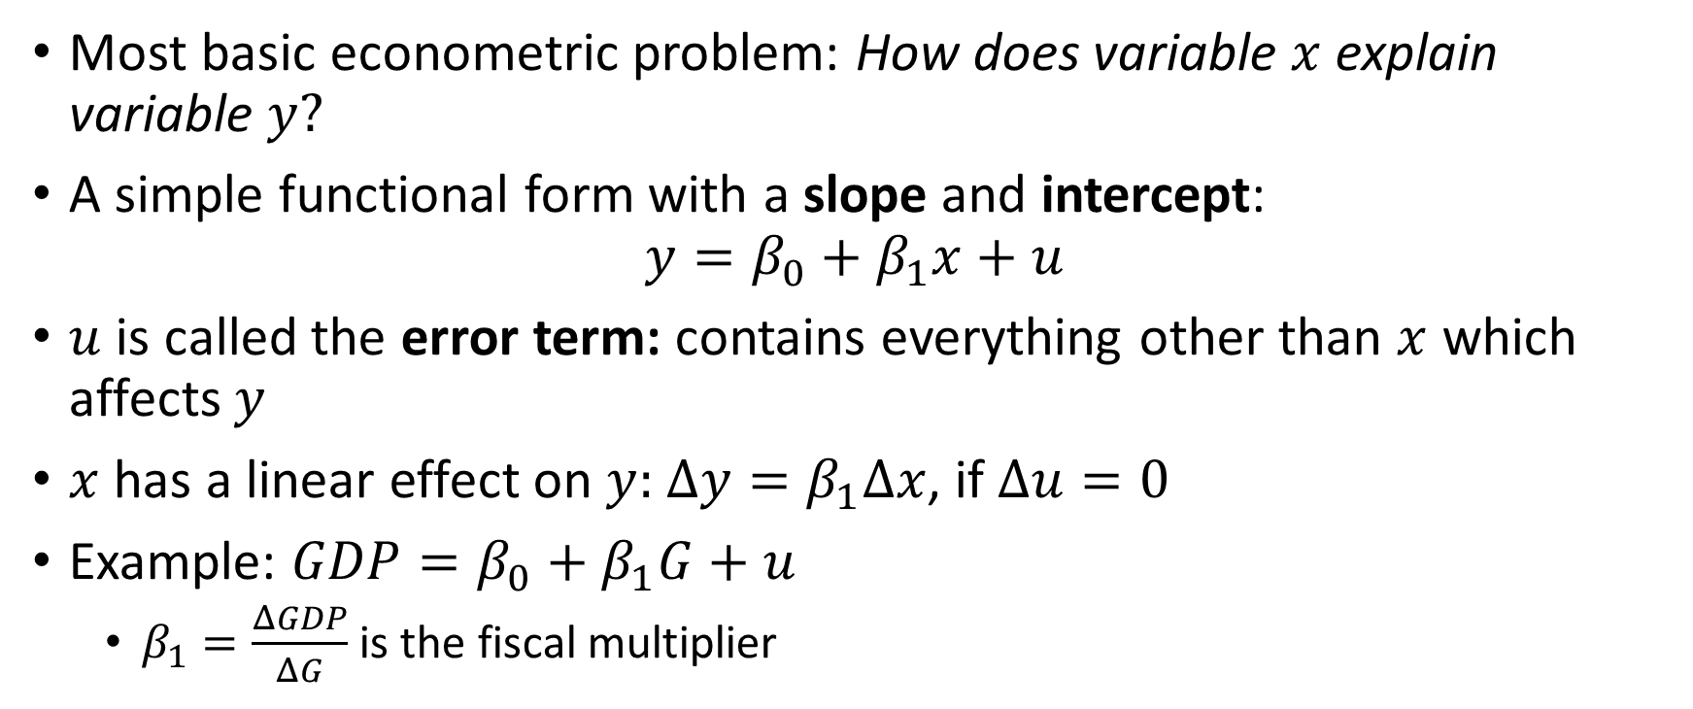
Definition of the Simple Regression Model
Most basic econometric problem: How does variable $x$ explain variable $y?$
A simple functional form with a slope and intercept:
$$y=β_{0}+β_{1}x+u$$
$u$ is called the error term: contains everything other than $x$ which affects $y$
$x$ has a linear effect on $y:$ $Δy=β_{1}Δx$, if $Δu=0$
Example: $GDP=β_{0}+β_{1}G+u$
$β_{1}=\frac{ΔGDP}{ΔG}$ is the fiscal multiplier

Slide 3
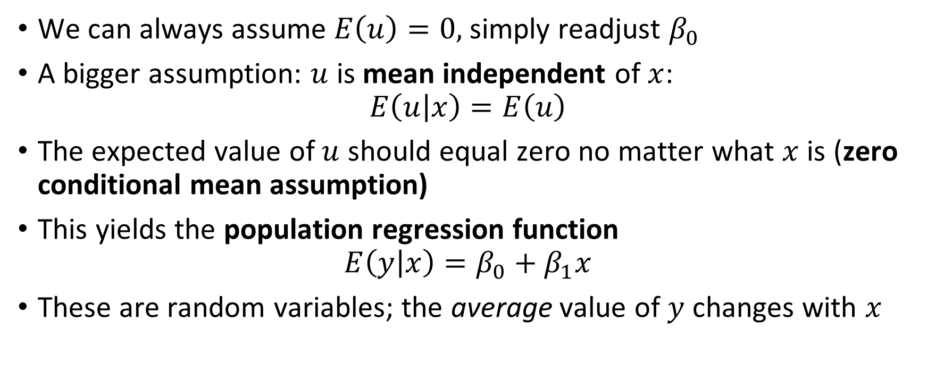
Simple Regression Model Assumptions
We can always assume $E\left(u\right)=0,$simply readjust $β_{0}$
A bigger assumption: $u$ is mean independent of $x$:
$$E\left(u | x\right)=E\left(u\right)$$
The expected value of $u$ should equal zero no matter what $x$ is (zero conditional mean assumption)
This yields the population regression function
$$E\left(y | x\right)=β_{0}+β_{1}x$$
These are random variables; the average value of $y$ changes with $x$

Slide 4
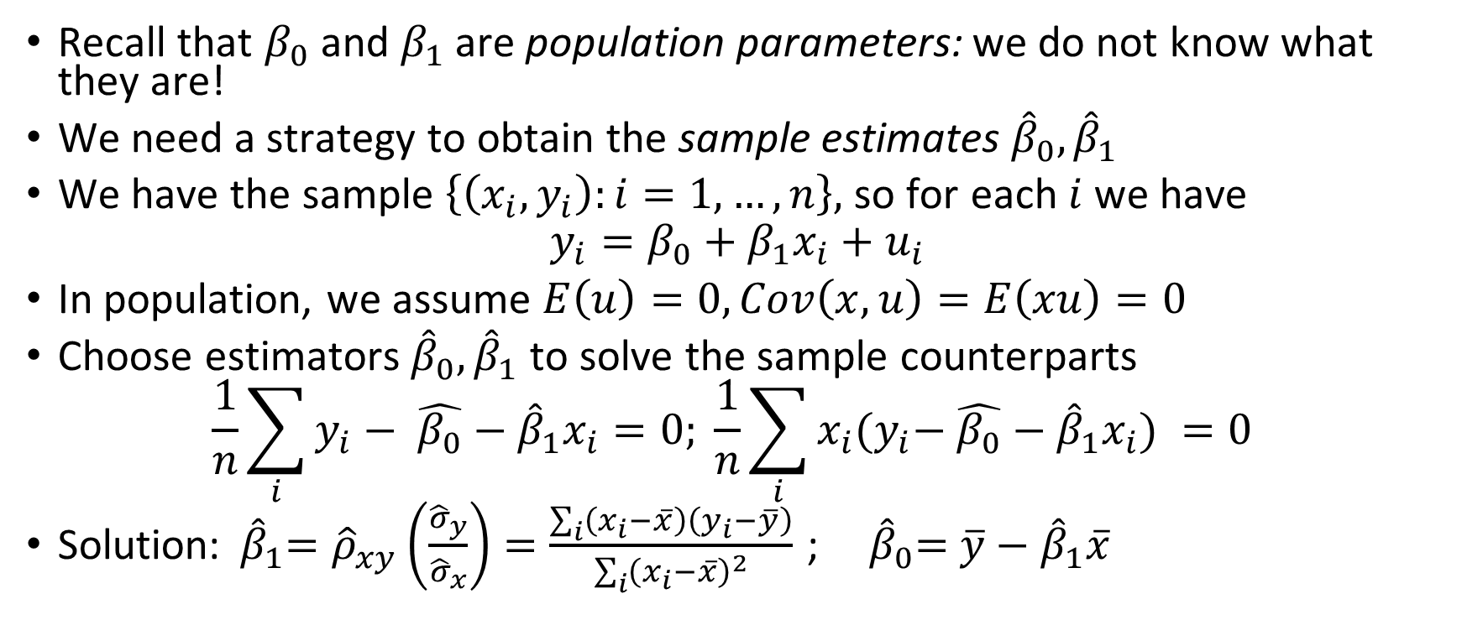
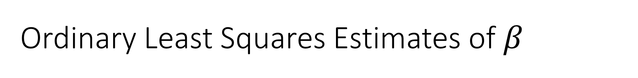
Ordinary Least Squares Estimates of $β$
Recall that $β_{0}$ and $β_{1}$ are population parameters: we do not know what they are!
We need a strategy to obtain the sample estimates ${\hat{β}}_{0},{\hat{β}}_{1}$
We have the sample $\left\{\left(x_{i},y_{i}\right):i=1,…,n\right\},$ so for each $i$ we have
$$y_{i}=β_{0}+β_{1}x_{i}+u_{i}$$
In population, we assume $E\left(u\right)=0, Cov\left(x,u\right)=E\left(xu\right)=0$
Choose estimators${ \hat{β}}_{0},{\hat{β}}_{1}$ to solve the sample counterparts
$$\frac{1}{n}\sum_{i}{y_{i}− \hat{β_{0}}−{\hat{β}}_{1}x_{i}=0; }\frac{1}{n}\sum_{i}{x_{i}{(y}_{i}− \hat{β_{0}}−{\hat{β}}_{1}x_{i}) =0 }$$
Solution:${ \hat{β}}_{1}={\hat{ρ}}_{xy}\left(\frac{{\hat{σ}}_{y}}{{\hat{σ}}_{x}}\right)=\frac{\sum_{i}{\left(x_{i}−\overline{x}\right)\left(y_{i}−\overline{y}\right)}}{\sum_{i}{{\left(x_{i}−\overline{x}\right)}^{2}}}$ ;${ \hat{β}}_{0}=$ $\overline{y}−{\hat{β}}_{1}\overline{x}$

Slide 5
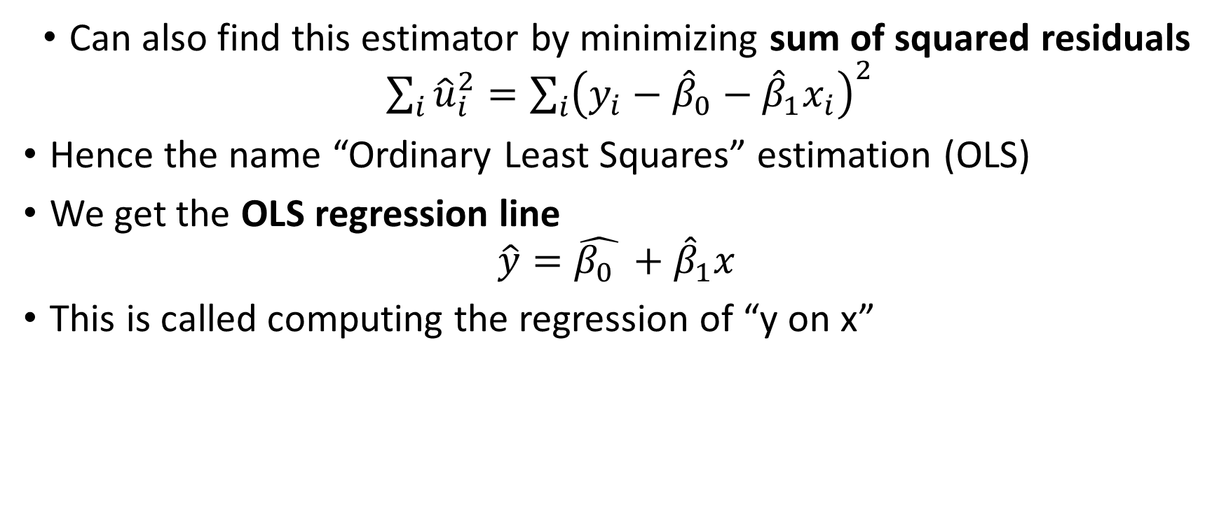
Ordinary Least Squares Estimates of $β$
Can also find this estimator by minimizing sum of squared residuals $\sum_{i}{{\hat{u}}_{i}^{2}=\sum_{i}{{\left(y_{i}−{\hat{β}}_{0}−{\hat{β}}_{1}x_{i}\right)}^{2}}}$
Hence the name “Ordinary Least Squares” estimation (OLS)
We get the OLS regression line
$$\hat{y}=\hat{β_{0} }+{\hat{β}}_{1}x$$
This is called computing the regression of “y on x”

Slide 6
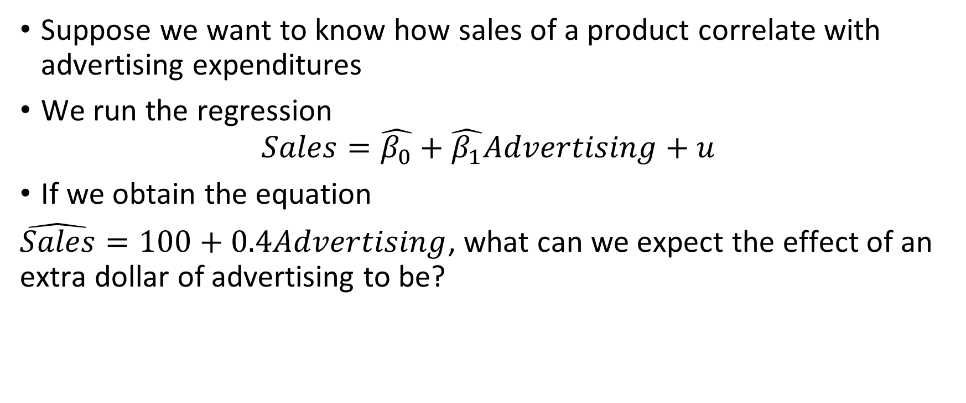
Example of OLS
Suppose we want to know how sales of a product correlate with advertising expenditures
We run the regression
$$Sales=\hat{β_{0}}+\hat{β_{1}}Advertising+u$$
If we obtain the equation
$\hat{Sales}=100+0.4Advertising$, what can we expect the effect of an extra dollar of advertising to be?

Slide 7
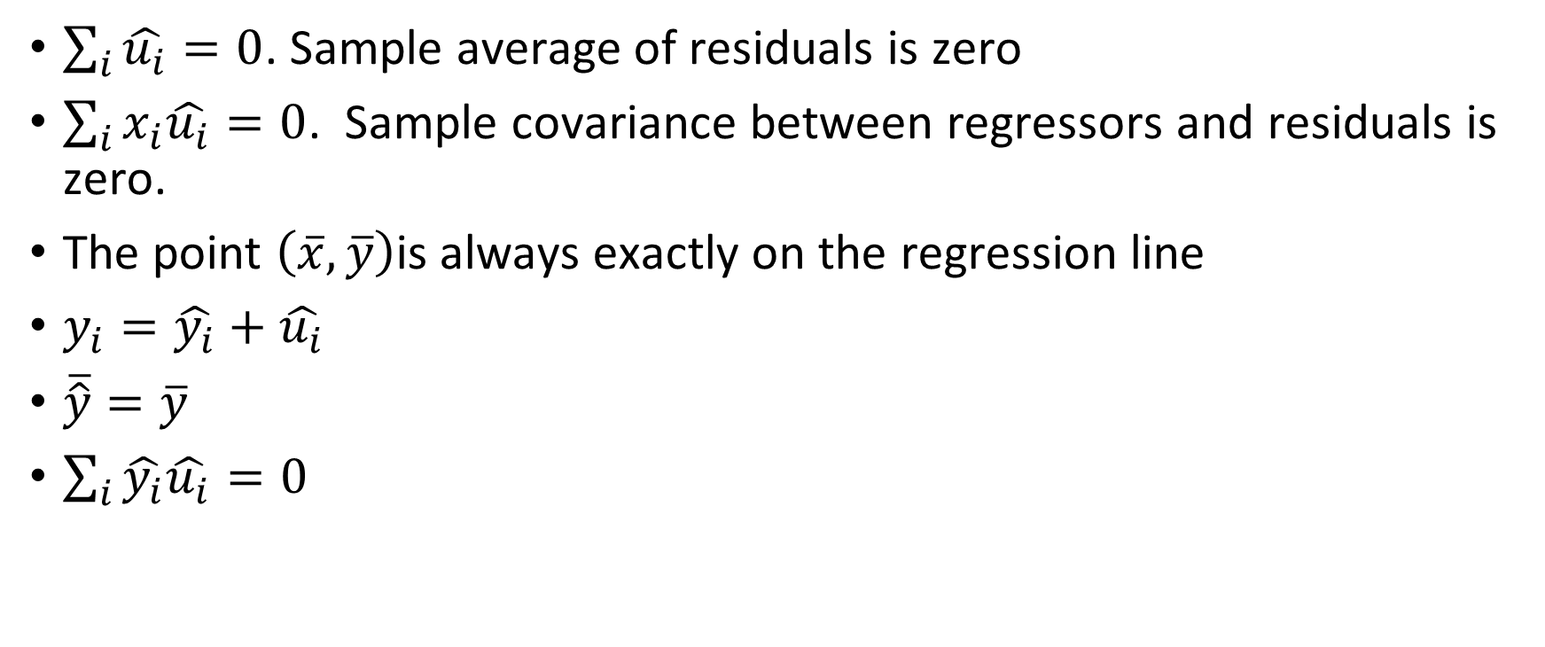
Some Properties of OLS Statistics
$\sum_{i}{\hat{u_{i}}=0}$. Sample average of residuals is zero
$\sum_{i}{x_{i}\hat{u_{i}}}=0$. Sample covariance between regressors and residuals is zero.
The point $\left(\overline{x},\overline{y}\right)$is always exactly on the regression line
$y_{i}=\hat{y_{i}}+\hat{u_{i}}$
$\overline{\hat{y}}=\overline{y}$
$\sum_{i}{\hat{y_{i}}\hat{u_{i}}}=0$

Slide 8
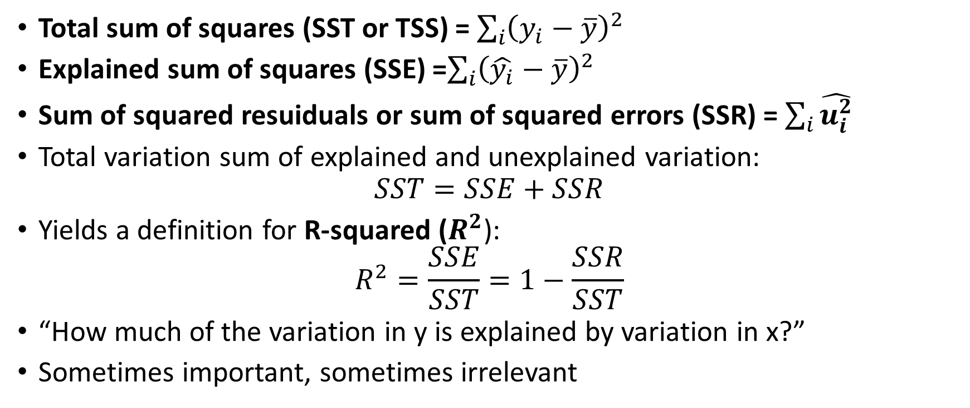
Goodness-of-Fit
Total sum of squares (SST or TSS) = $\sum_{i}{{\left(y_{i}−\overline{y}\right)}^{2}}$
Explained sum of squares (SSE) =$\sum_{i}{{\left(\hat{y_{i}}−\overline{y}\right)}^{2}}$
Sum of squared resuiduals or sum of squared errors (SSR) = $\sum_{i}{\hat{u_{i}^{2}}}$
Total variation sum of explained and unexplained variation:
$$SST=SSE+SSR$$
Yields a definition for R-squared ($R^{2}$):
$$R^{2}=\frac{SSE}{SST}=1−\frac{SSR}{SST}$$
“How much of the variation in y is explained by variation in x?”
Sometimes important, sometimes irrelevant

Slide 9
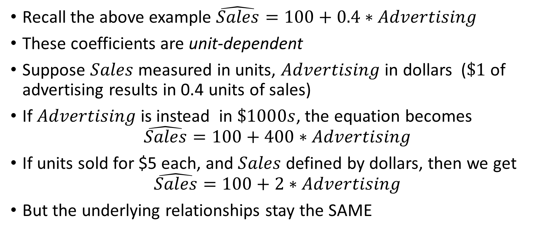
Units of Measurement
Recall the above example $\hat{Sales}=100+0.4∗Advertising$
These coefficients are unit-dependent
Suppose $Sales$ measured in units, $Advertising$ in dollars ($\$1$ of advertising results in 0.4 units of sales)
If $Advertising$is instead in $\$1000s$, the equation becomes
$$\hat{Sales}=100+400∗Advertising$$
If units sold for $5 each, and $Sales$ defined by dollars, then we get
$$\hat{Sales}=100+2∗Advertising$$
But the underlying relationships stay the SAME

Slide 10
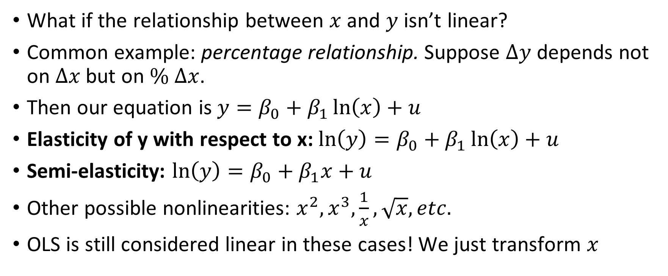
Nonlinearities
What if the relationship between $x$ and $y$ isn’t linear?
Common example: percentage relationship. Suppose $Δy$ depends not on $Δx$ but on $\% Δx$.
Then our equation is $y=β_{0}+β_{1}\ln\left(x\right)+u$
Elasticity of y with respect to x: $\ln\left(y\right)=β_{0}+β_{1}\ln\left(x\right)+u$
Semi-elasticity: $\ln\left(y\right)=β_{0}+β_{1}x+u$
Other possible nonlinearities: $x^{2}, x^{3},\frac{1}{x}, \sqrt{x}, etc.$
OLS is still considered linear in these cases! We just transform $x$

