Slide 1
Econometrics: Lecture 3
The Simple Regression Model, Part 2
February 7

Slide 2
OLS is BLUE
OLS is the
Best
Linear
Unbiased
Estimator
The OLS estimator has the lowest variance of all linear unbiased estimators
This is called the Gauss-Markov Theorem

Slide 3
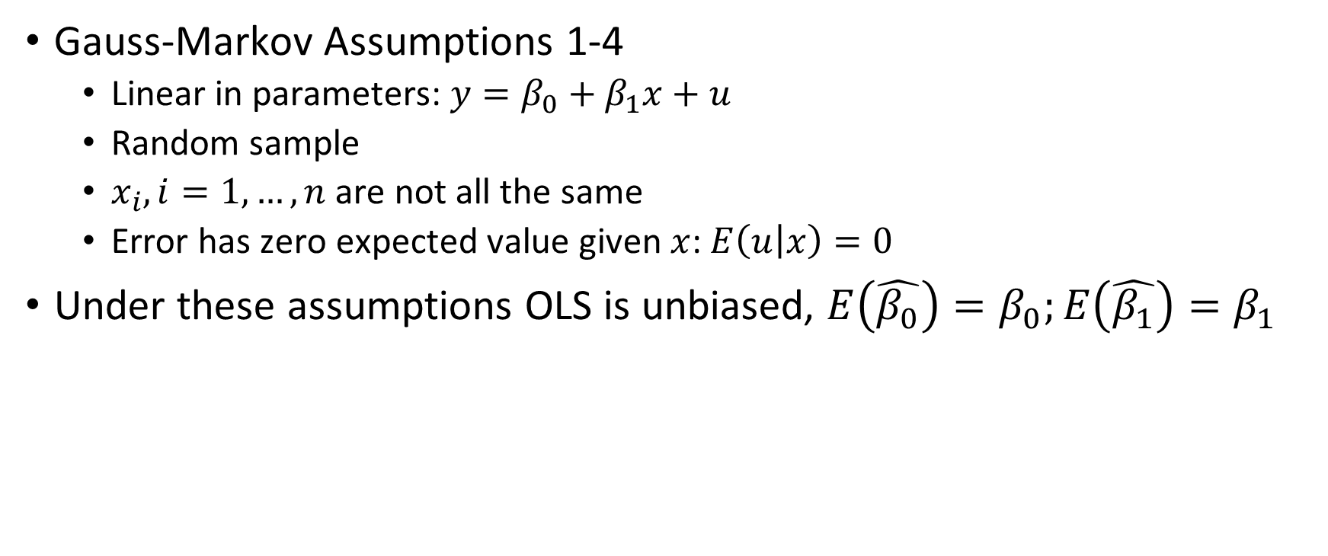
OLS is Unbiased
Gauss-Markov Assumptions 1-4
Linear in parameters: $y=β_{0}+β_{1}x+u$
Random sample
$x_{i}, i=1,…,n$ are not all the same
Error has zero expected value given $x$: $E\left(u | x\right)=0$
Under these assumptions OLS is unbiased, $E\left(\hat{β_{0}}\right)=β_{0};E\left(\hat{β_{1}}\right)=β_{1}$

Slide 4
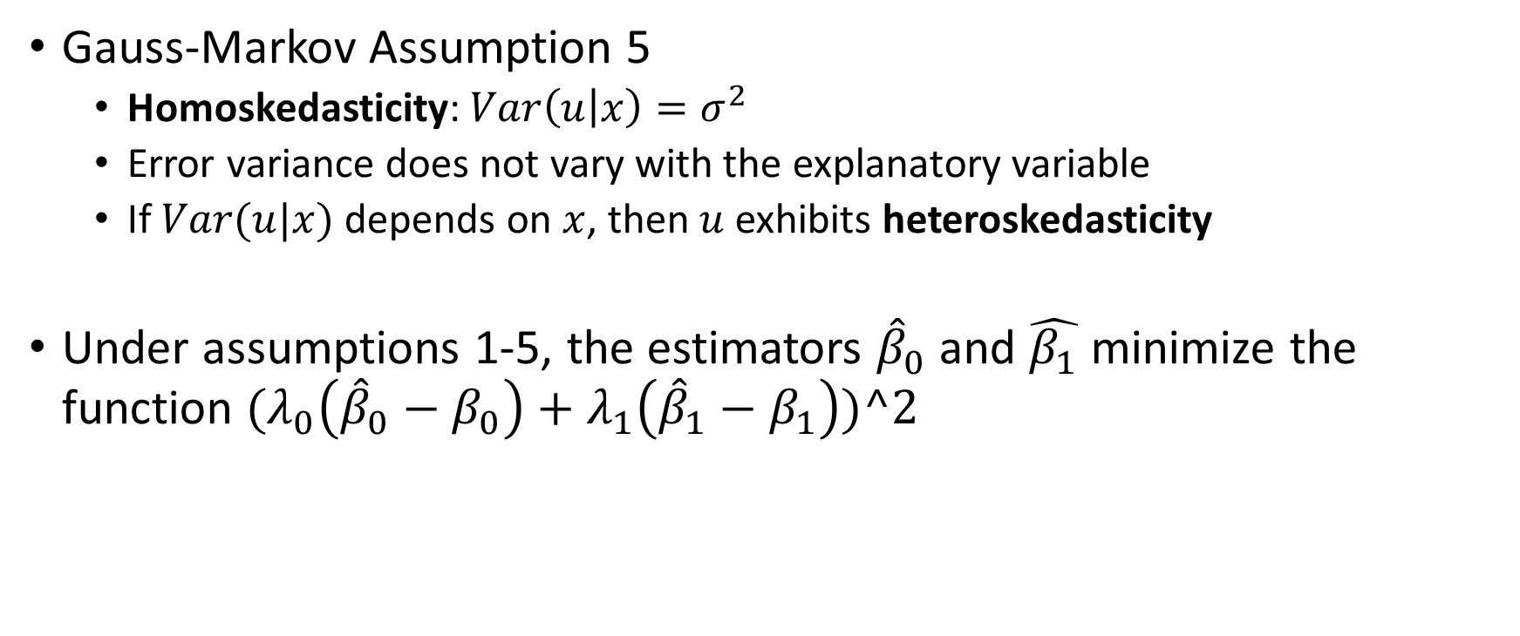
OLS is “Best”
Gauss-Markov Assumption 5
Homoskedasticity: $Var\left(u | x\right)=σ^{2}$
Error variance does not vary with the explanatory variable
If $Var(u|x)$ depends on $x$, then $u$ exhibits heteroskedasticity
Under assumptions 1-5, the estimators ${\hat{β}}_{0}$ and $\hat{β_{1}}$ minimize the function ${(λ}_{0}\left({\hat{β}}_{0}−β_{0}\right)+λ_{1}\left({\hat{β}}_{1}−β_{1}\right))^2$

Slide 5
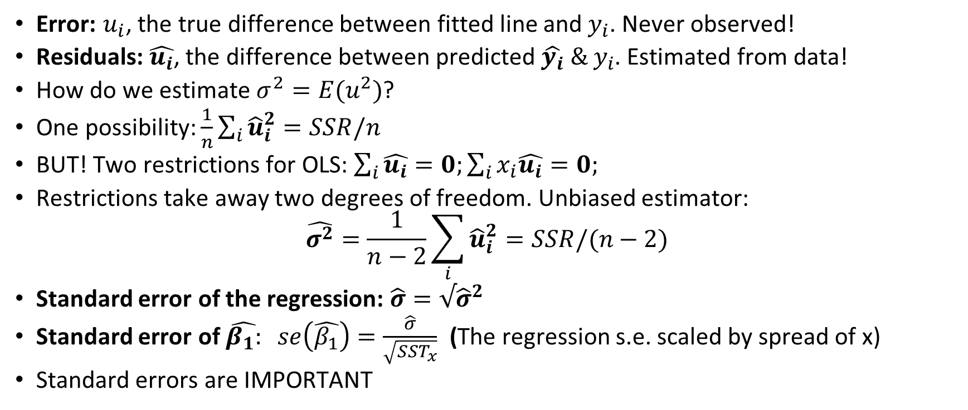
Estimating Error Variance
Error: $u_{i}$, the true difference between fitted line and $y_{i}$. Never observed!
Residuals: $\hat{u_{i}}$, the difference between predicted $\hat{y_{i}} \& y_{i}$. Estimated from data!
How do we estimate $σ^{2}=E(u^{2})$?
One possibility: $\frac{1}{n}\sum_{i}{{\hat{u}}_{i}^{2}=SSR/n}$
BUT! Two restrictions for OLS: $\sum_{i}{\hat{u_{i}}=0;}\sum_{i}{x_{i}\hat{u_{i}}=0;}$
Restrictions take away two degrees of freedom. Unbiased estimator:
$$\hat{σ^{2}}=\frac{1}{n−2}\sum_{i}{{\hat{u}}_{i}^{2}=SSR/(n−2)}$$
Standard error of the regression: $\hat{σ}=√{\hat{σ}}^{2}$
Standard error of $\hat{β_{1}:} se\left(\hat{β_{1}}\right)=\frac{\hat{σ}}{\sqrt{SST_{x}}}$ (The regression s.e. scaled by spread of x)
Standard errors are IMPORTANT

Slide 6
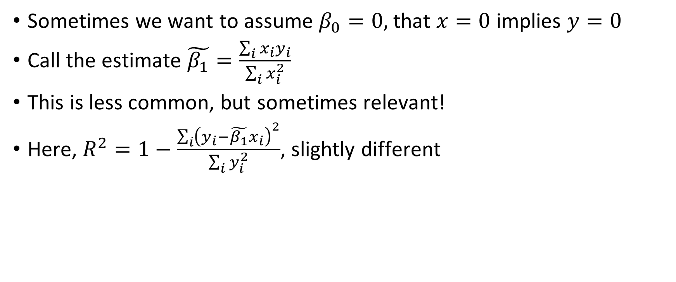
Regression through the origin
Sometimes we want to assume $β_{0}=0,$that $x=0$ implies $y=0$
Call the estimate $\tilde{β_{1}}=\frac{\sum_{i}{x_{i}y_{i}}}{\sum_{i}{x_{i}^{2}}}$
This is less common, but sometimes relevant!
Here, $R^{2}=1−\frac{\sum_{i}{{\left(y_{i}−\tilde{β_{1}}x_{i}\right)}^{2}}}{\sum_{i}{y_{i}^{2}}}$, slightly different

Slide 7
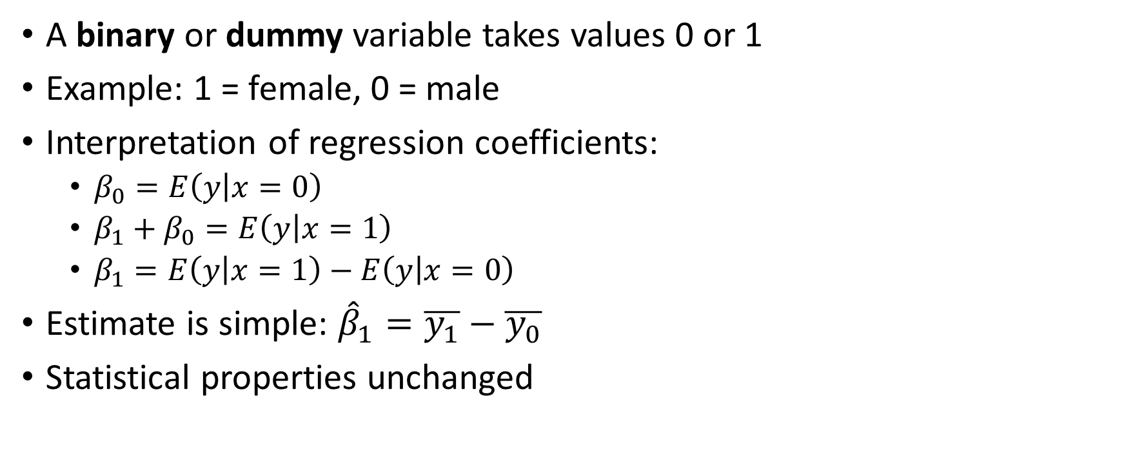
Regression on a binary explanatory variable
A binary or dummy variable takes values 0 or 1
Example: 1 = female, 0 = male
Interpretation of regression coefficients:
$β_{0}=E\left(y | x=0\right)$
$β_{1}+β_{0}=E\left(y | x=1\right)$
$β_{1}=E\left(y | x=1\right)−E\left(y | x=0\right)$
Estimate is simple: ${\hat{β}}_{1}=\overline{y_{1}}−\overline{y_{0}}$
Statistical properties unchanged

Slide 8
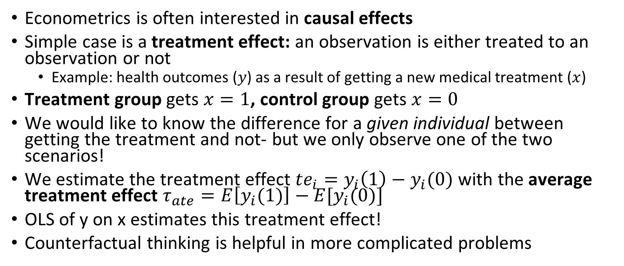
Treatment effects and counterfactual analysis
Econometrics is often interested in causal effects
Simple case is a treatment effect: an observation is either treated to an observation or not
Example: health outcomes ($y$) as a result of getting a new medical treatment ($x$)
Treatment group gets $x=1$, control group gets $x=0$
We would like to know the difference for a given individual between getting the treatment and not- but we only observe one of the two scenarios!
We estimate the treatment effect $te_{i}=y_{i}\left(1\right)−y_{i}(0)$ with the average treatment effect $τ_{ate}=E\left[y_{i}(1)\right]−E[y_{i}(0)]$
OLS of y on x estimates this treatment effect!
Counterfactual thinking is helpful in more complicated problems

