Slide 1
Econometrics: Lecture 4
Multiple Regression: Estimation
February 14, 2023

Slide 2
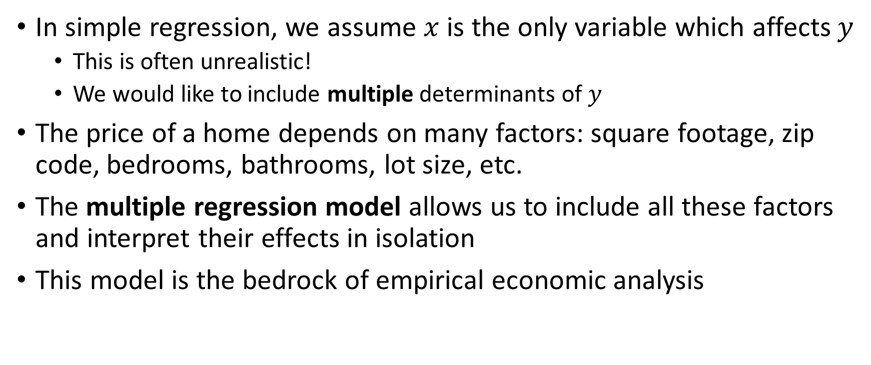
Multiple Regression Intro
In simple regression, we assume $x$ is the only variable which affects $y$
This is often unrealistic!
We would like to include multiple determinants of $y$
The price of a home depends on many factors: square footage, zip code, bedrooms, bathrooms, lot size, etc.
The multiple regression model allows us to include all these factors and interpret their effects in isolation
This model is the bedrock of empirical economic analysis

Slide 3
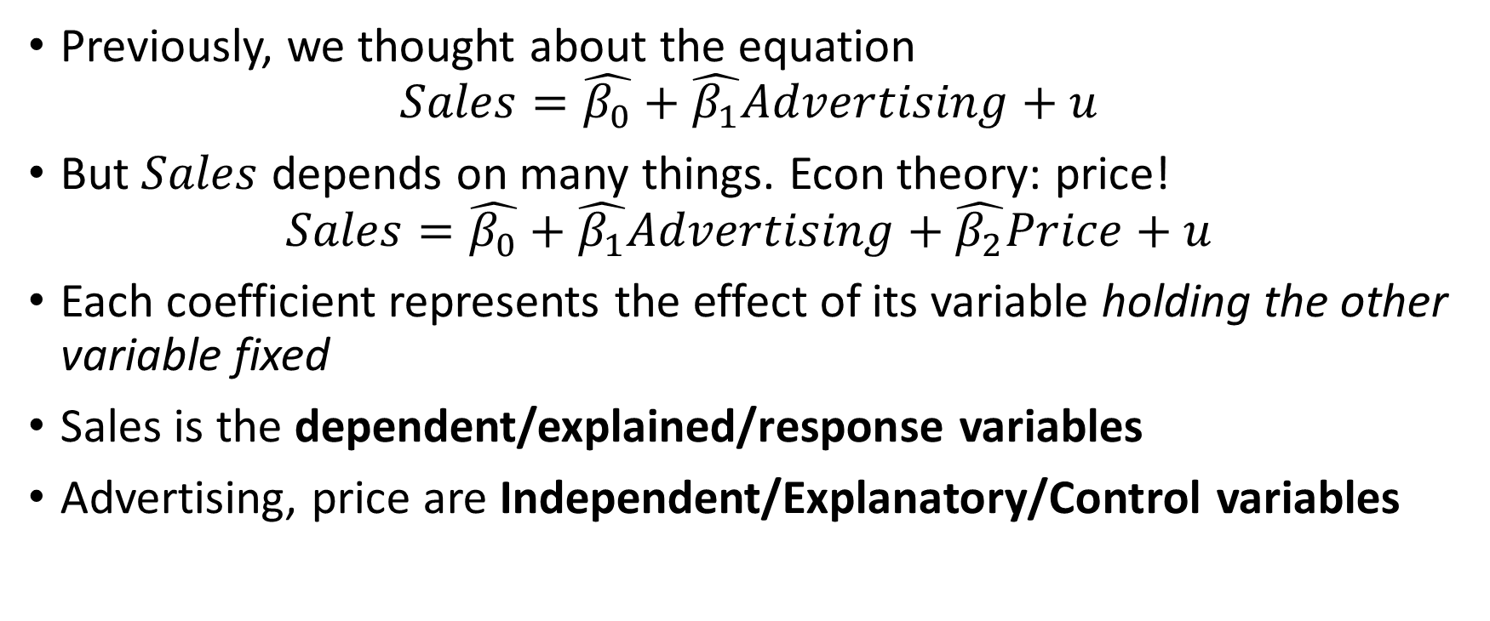
Motivation
Previously, we thought about the equation
$$Sales=\hat{β_{0}}+\hat{β_{1}}Advertising+u$$
But $Sales$ depends on many things. Econ theory: price!
$$Sales=\hat{β_{0}}+\hat{β_{1}}Advertising+\hat{β_{2}}Price+u$$
Each coefficient represents the effect of its variable holding the other variable fixed
Sales is the dependent/explained/response variables
Advertising, price are Independent/Explanatory/Control variables

Slide 4
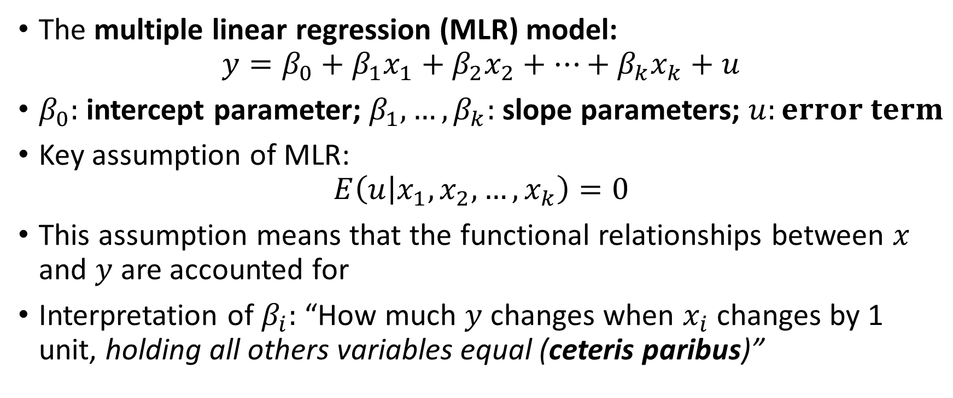
The General Model
The multiple linear regression (MLR) model:
$$y=β_{0}+β_{1}x_{1}+β_{2}x_{2}+…+β_{k}x_{k}+u$$
$β_{0}:$ intercept parameter; $β_{1},…,β_{k}:$slope parameters; $u:error term$
Key assumption of MLR:
$$E\left(u | x_{1},x_{2},…,x_{k}\right)=0$$
This assumption means that the functional relationships between $x$ and $y$ are accounted for
Interpretation of $β_{i}:$ “How much $y$ changes when $x_{i}$ changes by 1 unit, holding all others variables equal (ceteris paribus)”

Slide 5
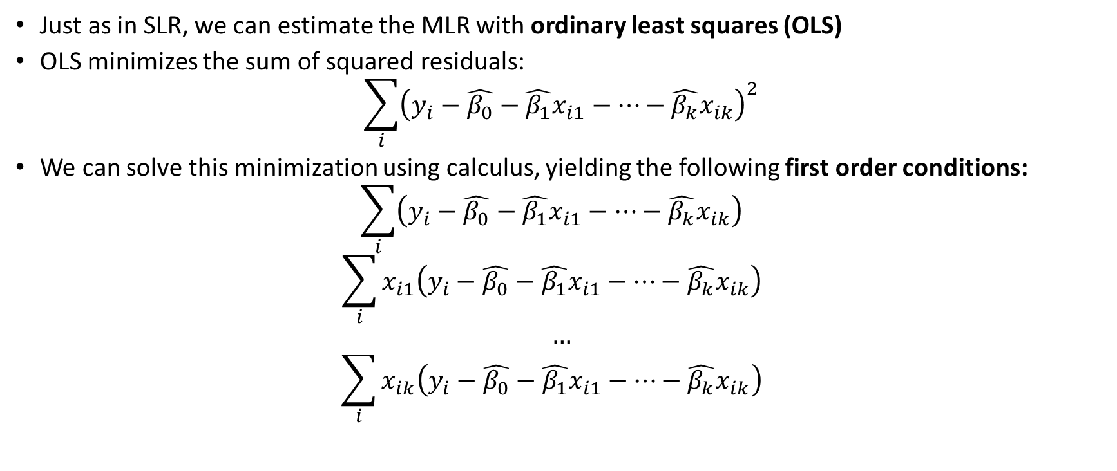
The OLS Estimates
Just as in SLR, we can estimate the MLR with ordinary least squares (OLS)
OLS minimizes the sum of squared residuals:
$$\sum_{i}{{\left(y_{i}−\hat{β_{0}}−\hat{β_{1}}x_{i1}−…−\hat{β_{k}}x_{ik}\right)}^{2}}$$
We can solve this minimization using calculus, yielding the following first order conditions:
$$\sum_{i}{{\left(y_{i}−\hat{β_{0}}−\hat{β_{1}}x_{i1}−…−\hat{β_{k}}x_{ik}\right)}^{}}$$
$$\sum_{i}{{x_{i1}\left(y_{i}−\hat{β_{0}}−\hat{β_{1}}x_{i1}−…−\hat{β_{k}}x_{ik}\right)}^{}}$$
$$…$$
$$\sum_{i}{x_{ik}{\left(y_{i}−\hat{β_{0}}−\hat{β_{1}}x_{i1}−…−\hat{β_{k}}x_{ik}\right)}^{}}$$

Slide 6
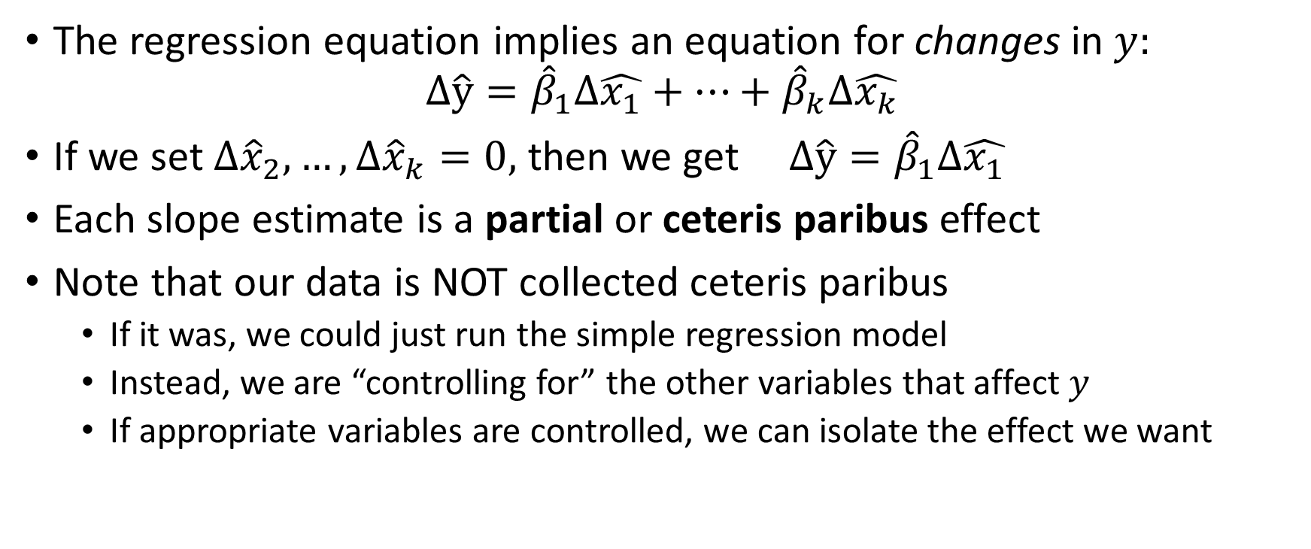
Interpreting the Estimates
The regression equation implies an equation for changes in $y:$
$$Δ\hat{y}={\hat{β}}_{1}Δ\hat{x_{1}}+…+{\hat{β}}_{k}Δ\hat{x_{k}}$$
If we set $Δ{\hat{x}}_{2},…,Δ{\hat{x}}_{k}=0,$ then we get $Δ\hat{y}={\hat{β}}_{1}Δ\hat{x_{1}}$
Each slope estimate is a partial or ceteris paribus effect
Note that our data is NOT collected ceteris paribus
If it was, we could just run the simple regression model
Instead, we are “controlling for” the other variables that affect $y$
If appropriate variables are controlled, we can isolate the effect we want

Slide 7
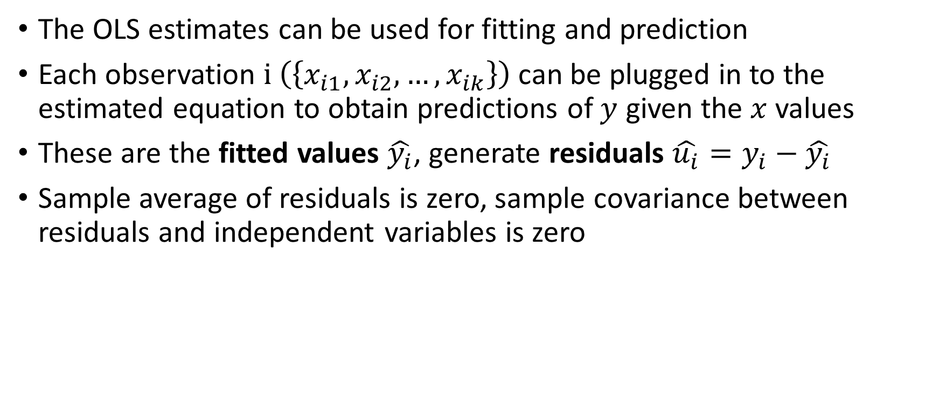
Fitted Values and Residuals
The OLS estimates can be used for fitting and prediction
Each observation $i \left(\left\{x_{i1},x_{i2},…,x_{ik}\right\}\right)$can be plugged in to the estimated equation to obtain predictions of $y$ given the $x$values
These are the fitted values $\hat{y_{i}}$, generate residuals $\hat{u_{i}}=y_{i}−\hat{y_{i}}$
Sample average of residuals is zero, sample covariance between residuals and independent variables is zero

Slide 8
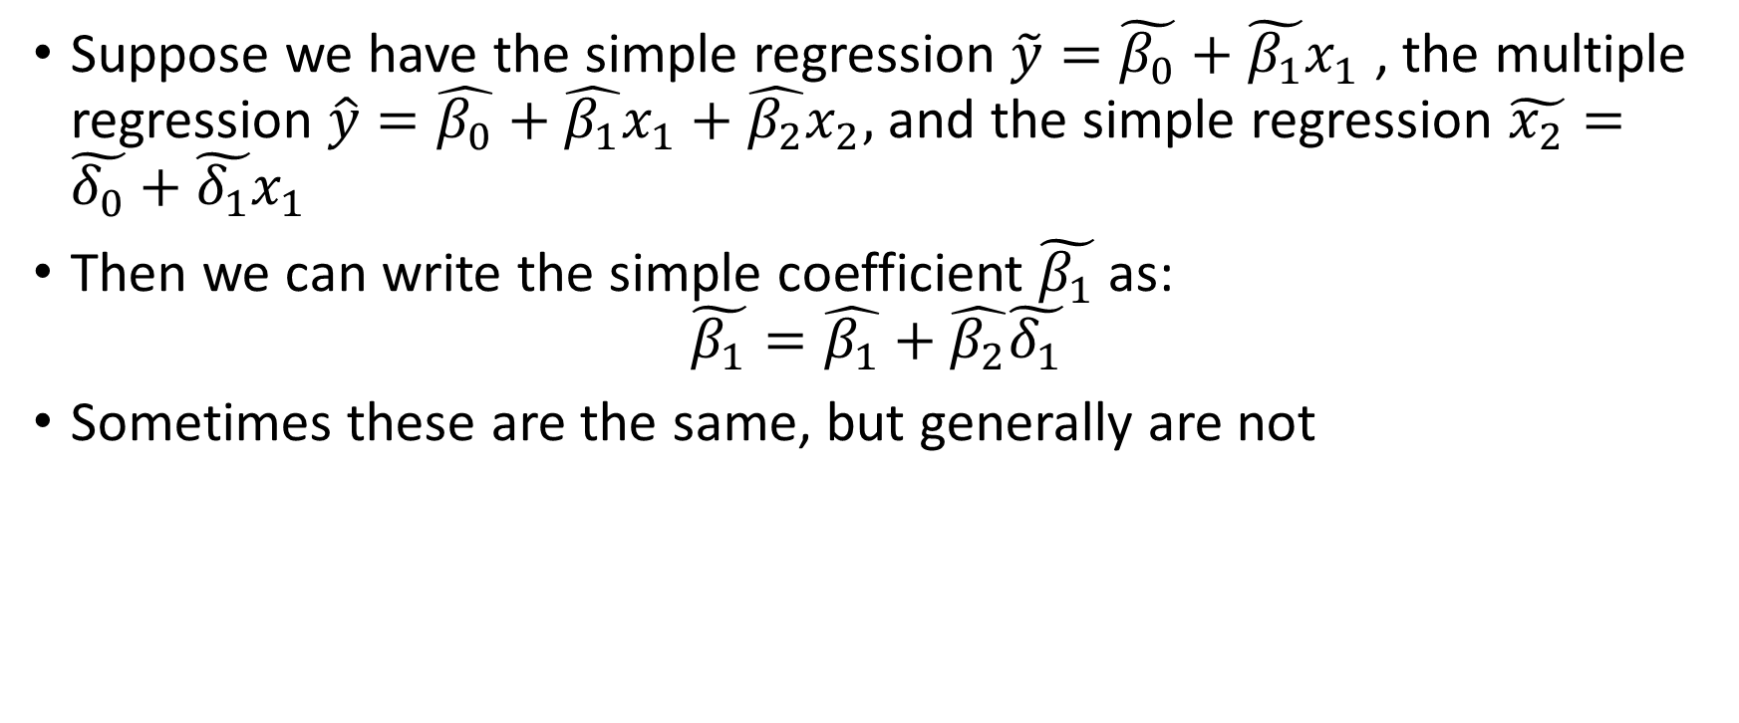
Comparing Simple and Multiple Regression
Suppose we have the simple regression $\tilde{y}=\tilde{β_{0}}+\tilde{β_{1}}x_{1}$ , the multiple regression $\hat{y}=\hat{β_{0}}+\hat{β_{1}}x_{1}+\hat{β_{2}}x_{2},$ and the simple regression $\tilde{x_{2}}=\tilde{δ_{0}}+\tilde{δ_{1}}x_{1}$
Then we can write the simple coefficient $\tilde{β_{1}}$as:
$$\tilde{β_{1}}=\hat{β_{1}}+\hat{β_{2}}\tilde{δ_{1}}$$
Sometimes these are the same, but generally are not

Slide 9
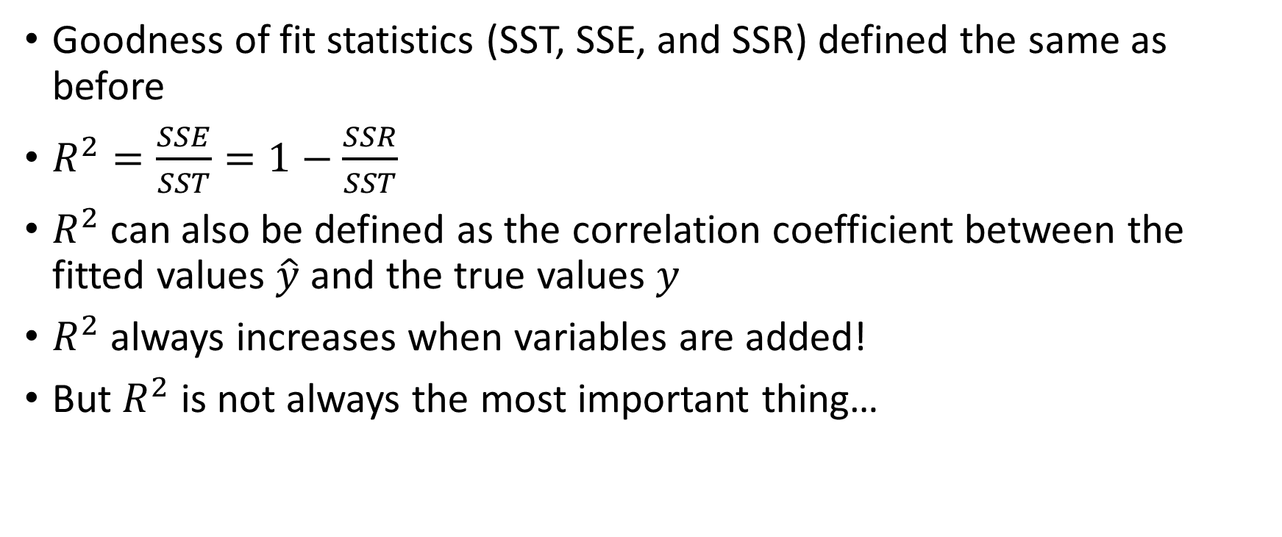
Goodness-of-Fit
Goodness of fit statistics (SST, SSE, and SSR) defined the same as before
$R^{2}=\frac{SSE}{SST}=1−\frac{SSR}{SST}$
$R^{2}$ can also be defined as the correlation coefficient between the fitted values $\hat{y}$ and the true values $y$
$R^{2}$always increases when variables are added!
But $R^{2}$ is not always the most important thing…

Slide 10
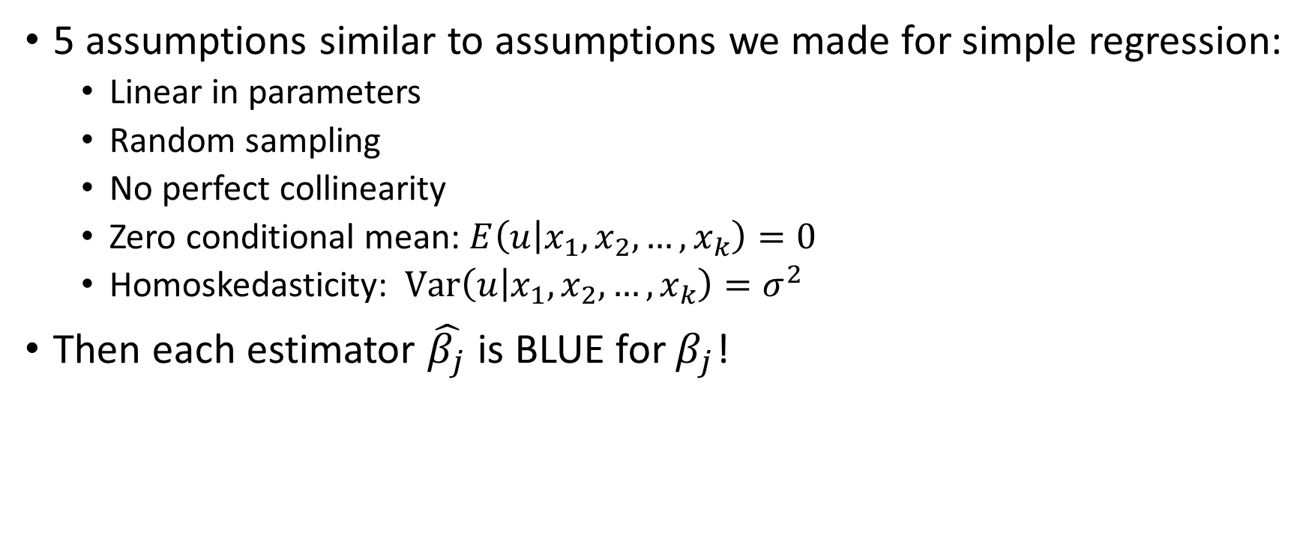
Properties of OLS Estimators
5 assumptions similar to assumptions we made for simple regression:
Linear in parameters
Random sampling
No perfect collinearity
Zero conditional mean: $E\left(u | x_{1},x_{2},…,x_{k}\right)=0$
Homoskedasticity: $Var\left(u | x_{1},x_{2},…,x_{k}\right)=σ^{2}$
Then each estimator $\hat{β_{j}}$ is BLUE for $β_{j}$!

Slide 11
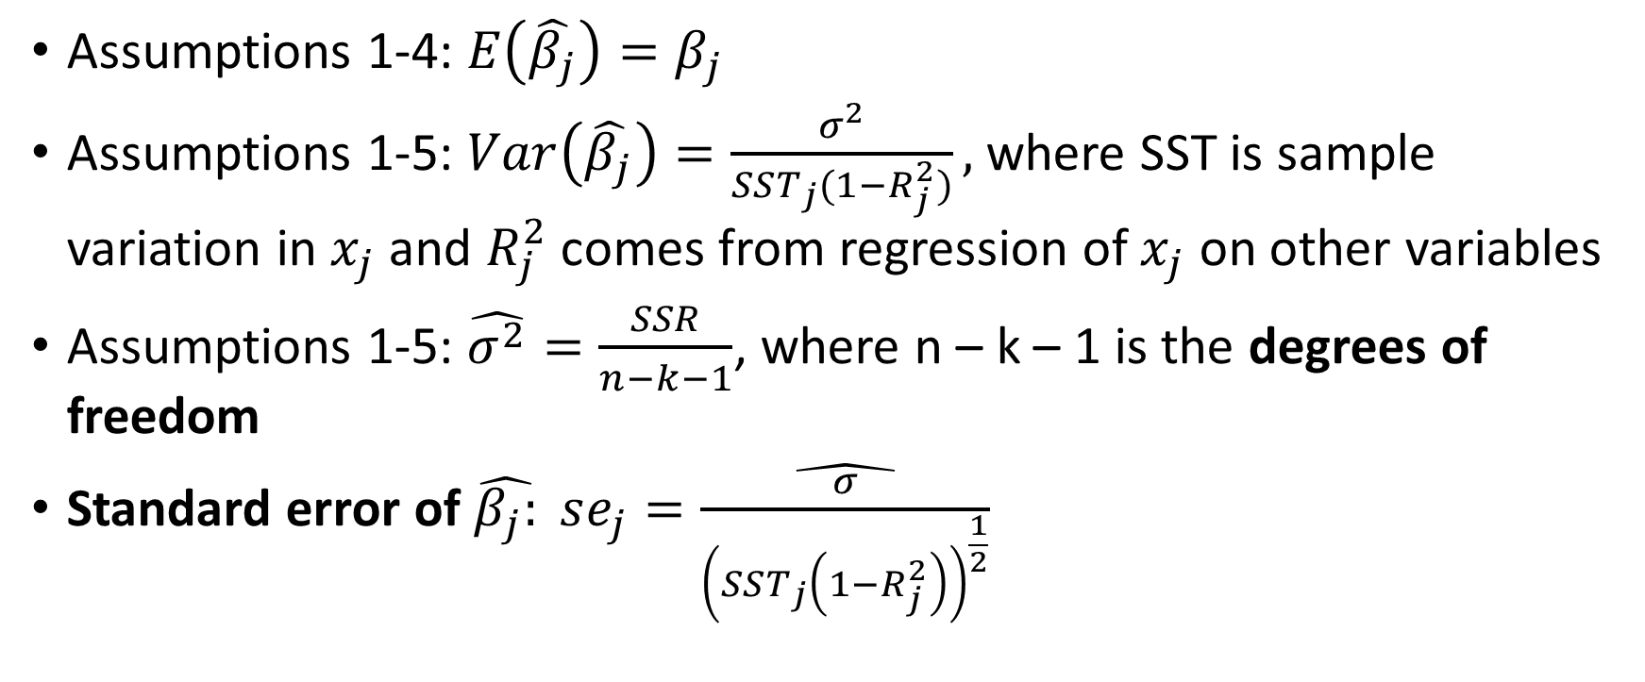
Properties of OLS Estimators
Assumptions 1-4: $E\left(\hat{β_{j}}\right)=β_{j}$
Assumptions 1-5: $Var\left(\hat{β_{j}}\right)=\frac{σ^{2}}{SST_{j}(1−R_{j}^{2})},$where SST is sample variation in $x_{j}$ and $R_{j}^{2}$ comes from regression of $x_{j}$ on other variables
Assumptions 1-5: $\hat{σ^{2}}=\frac{SSR}{n−k−1}$, where n – k – 1 is the degrees of freedom
Standard error of $\hat{β_{j}:} se_{j}=\hat{\frac{σ}{{\left(SST_{j}\left(1−R_{j}^{2}\right)\right)}^{\frac{1}{2}}}}$

Slide 12
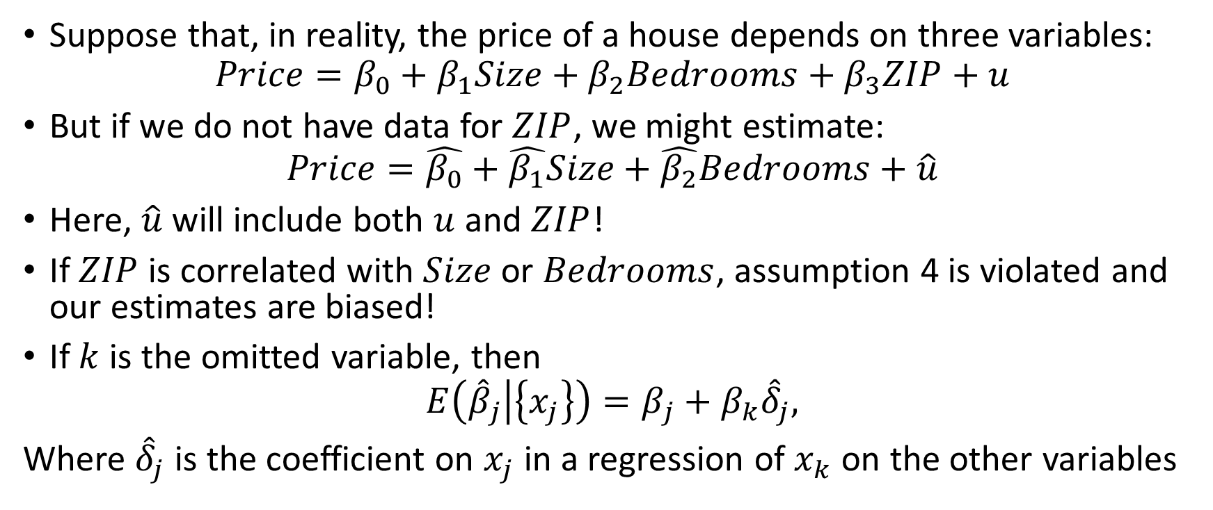
Problem 1: Omitted Variable Bias
Suppose that, in reality, the price of a house depends on three variables:
$$Price=β_{0}+β_{1}Size+β_{2}Bedrooms+β_{3}ZIP+u$$
But if we do not have data for $ZIP$, we might estimate:
$$Price=\hat{β_{0}}+\hat{β_{1}}Size+\hat{β_{2}}Bedrooms+\hat{u}$$
Here, $\hat{u}$ will include both $u$ and $ZIP$!
If $ZIP$ is correlated with $Size$ or $Bedrooms$, assumption 4 is violated and our estimates are biased!
If $k$ is the omitted variable, then
$$E\left({\hat{β}}_{j} | \left\{x_{j}\right\}\right)=β_{j}+β_{k}{\hat{δ}}_{j},$$
Where ${\hat{δ}}_{j}$ is the coefficient on $x_{j}$ in a regression of $x_{k}$ on the other variables

Slide 13
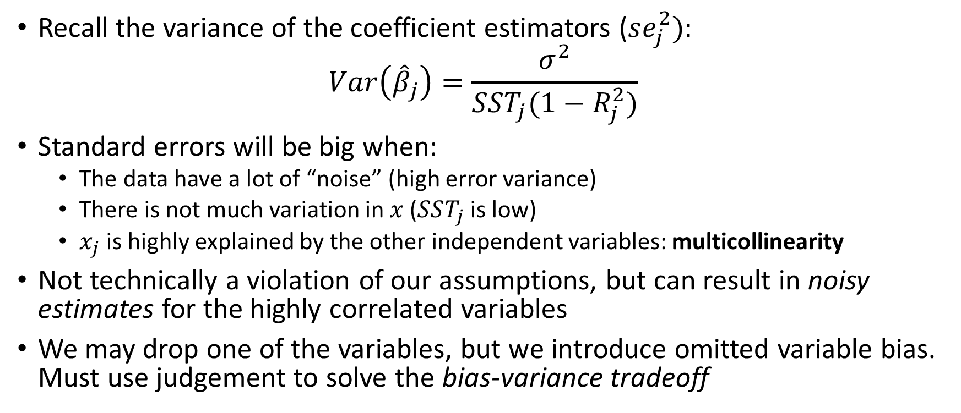
Problem 2: Multicollinearity
Recall the variance of the coefficient estimators ($se_{j}^{2}):$
$$Var\left({\hat{β}}_{j}\right)=\frac{σ^{2}}{SST_{j}(1−R_{j}^{2})}$$
Standard errors will be big when:
The data have a lot of “noise” (high error variance)
There is not much variation in $x$ ($SST_{j}$ is low)
$x_{j}$ is highly explained by the other independent variables: multicollinearity
Not technically a violation of our assumptions, but can result in noisy estimates for the highly correlated variables
We may drop one of the variables, but we introduce omitted variable bias. Must use judgement to solve the bias-variance tradeoff

Slide 14
Common Uses for Multiple Regression
Prediction
Measuring tradeoffs
Test for differences across groups
Causal effects

