Slide 1
Econometrics: Lecture 5
Multiple Regression: Inference
February 21, 2023

Slide 2
Motivation
In Econometrics, we are often interested in testing whether or not a certain relationship exists
The size of a coefficient matters, but we also need to know if it is statistically significant
Statistical significance: unlikely that random data would generate this coefficient if there was no effect
In policy analysis and causal questions, we only care about a coefficient if it is statistically significant
We don’t care about estimated relationships that could have easily arisen from random noise. We want true relationships
Testing the hypothesis that no effect exists

Slide 3
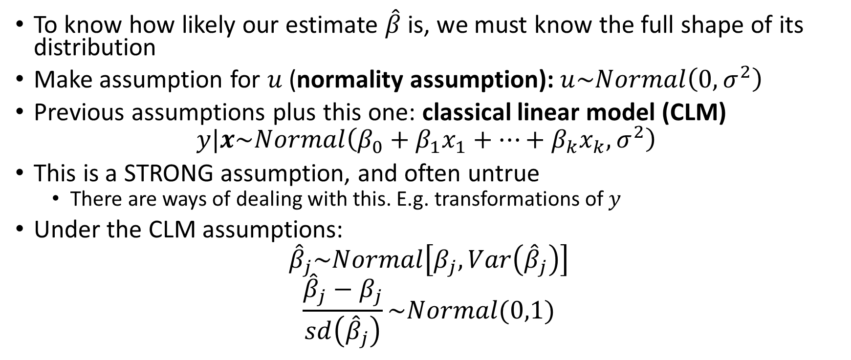
Sampling Distributions of the OLS Estimators
To know how likely our estimate $\hat{β}$is, we must know the full shape of its distribution
Make assumption for $u$ (normality assumption): $u\sim Normal\left(0,σ^{2}\right)$
Previous assumptions plus this one: classical linear model (CLM)
$$y|x\sim Normal\left(β_{0}+β_{1}x_{1}+…+β_{k}x_{k},σ^{2}\right)$$
This is a STRONG assumption, and often untrue
There are ways of dealing with this. E.g. transformations of $y$
Under the CLM assumptions:
$${\hat{β}}_{j}\sim Normal\left[β_{j},Var\left({\hat{β}}_{j}\right)\right]$$
$$\frac{{\hat{β}}_{j}−β_{j}}{sd\left({\hat{β}}_{j}\right)}\sim Normal(0,1)$$

Slide 4
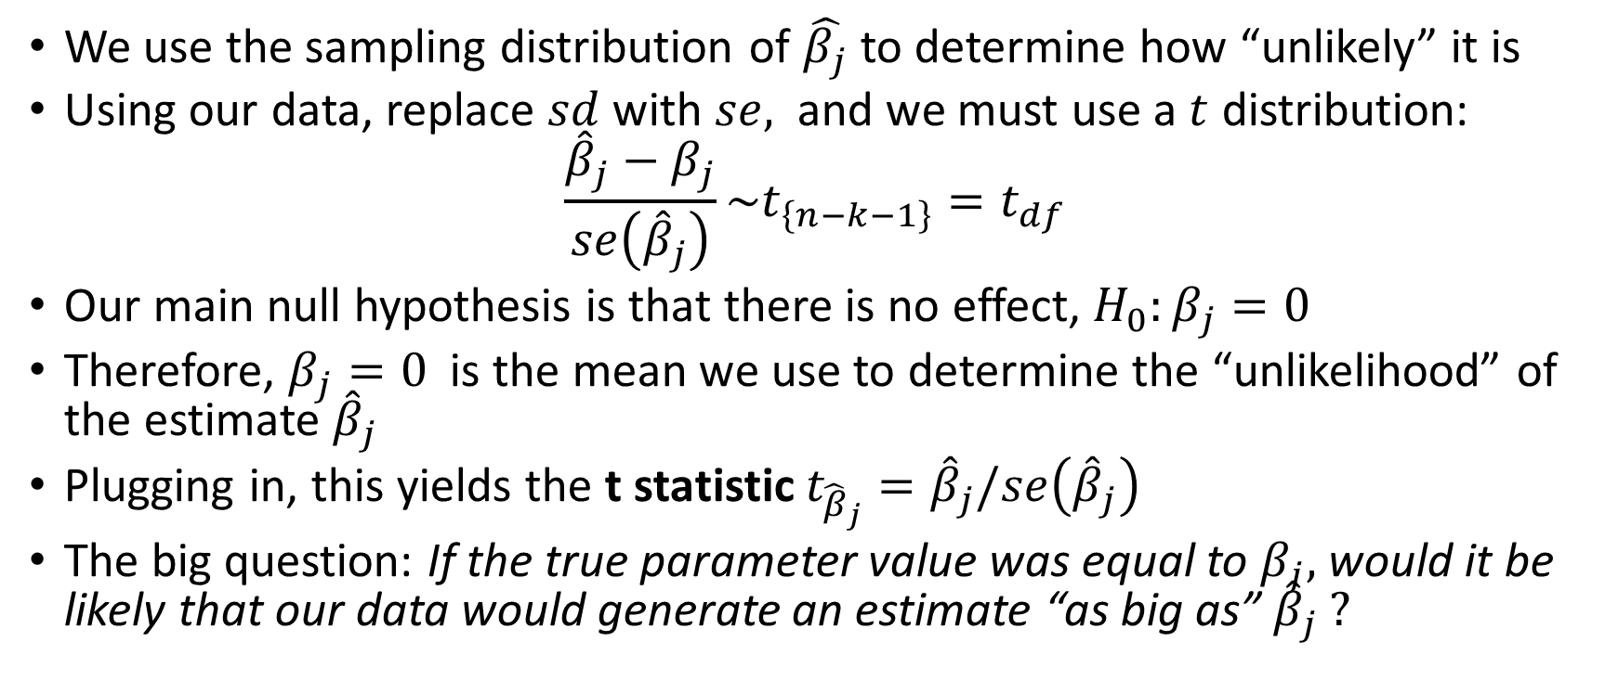
Hypothesis Testing of a Single Parameter
We use the sampling distribution of $\hat{β_{j}}$to determine how “unlikely” it is
Using our data, replace $sd$ with $se,$ and we must use a $t$ distribution:
$$\frac{{\hat{β}}_{j}−β_{j}}{se\left({\hat{β}}_{j}\right)}\sim t_{\left\{n−k−1\right\}}=t_{df}$$
Our main null hypothesis is that there is no effect, $H_{0}:β_{j}=0$
Therefore, $β_{j}=0$ is the mean we use to determine the “unlikelihood” of the estimate ${\hat{β}}_{j}$
Plugging in, this yields the t statistic $t_{{\hat{β}}_{j}}={\hat{β}}_{j}/se\left({\hat{β}}_{j}\right)$
The big question: If the true parameter value was equal to $β_{j},$ would it be likely that our data would generate an estimate “as big as” ${\hat{β}}_{j} ?$

Slide 5
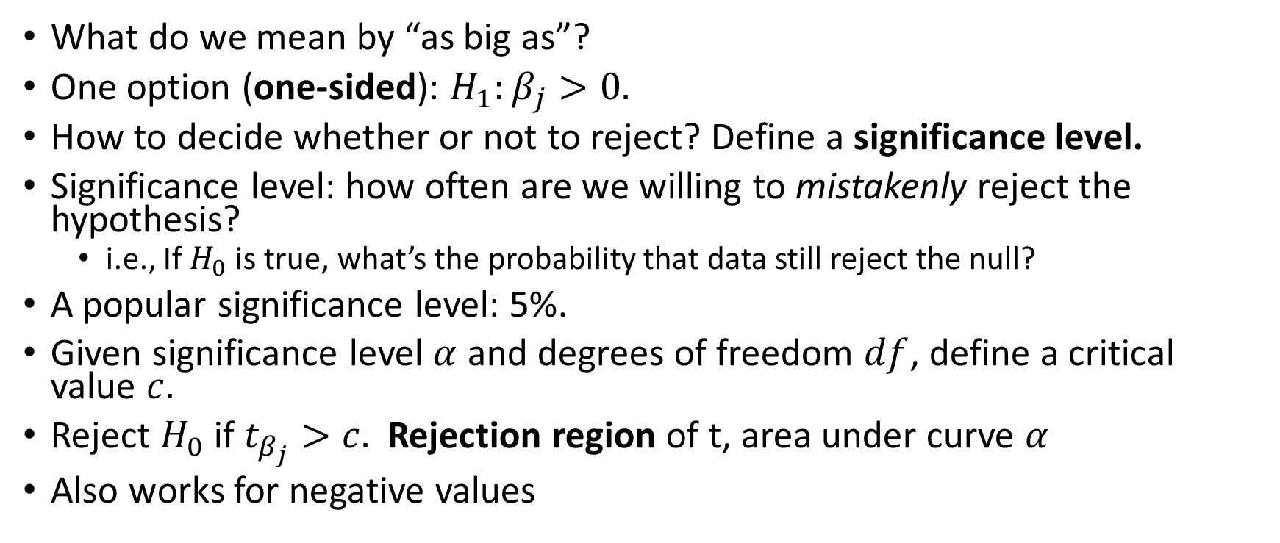
One Sided Tests
What do we mean by “as big as”?
One option (one-sided): $H_{1}:β_{j}>0.$
How to decide whether or not to reject? Define a significance level.
Significance level: how often are we willing to mistakenly reject the hypothesis?
i.e., If $H_{0}$ is true, what’s the probability that data still reject the null?
A popular significance level: 5%.
Given significance level $α$ and degrees of freedom $df$, define a critical value $c.$
Reject $H_{0}$ if $t_{β_{j}}>c.$ Rejection region of t, area under curve $α$
Also works for negative values

Slide 6
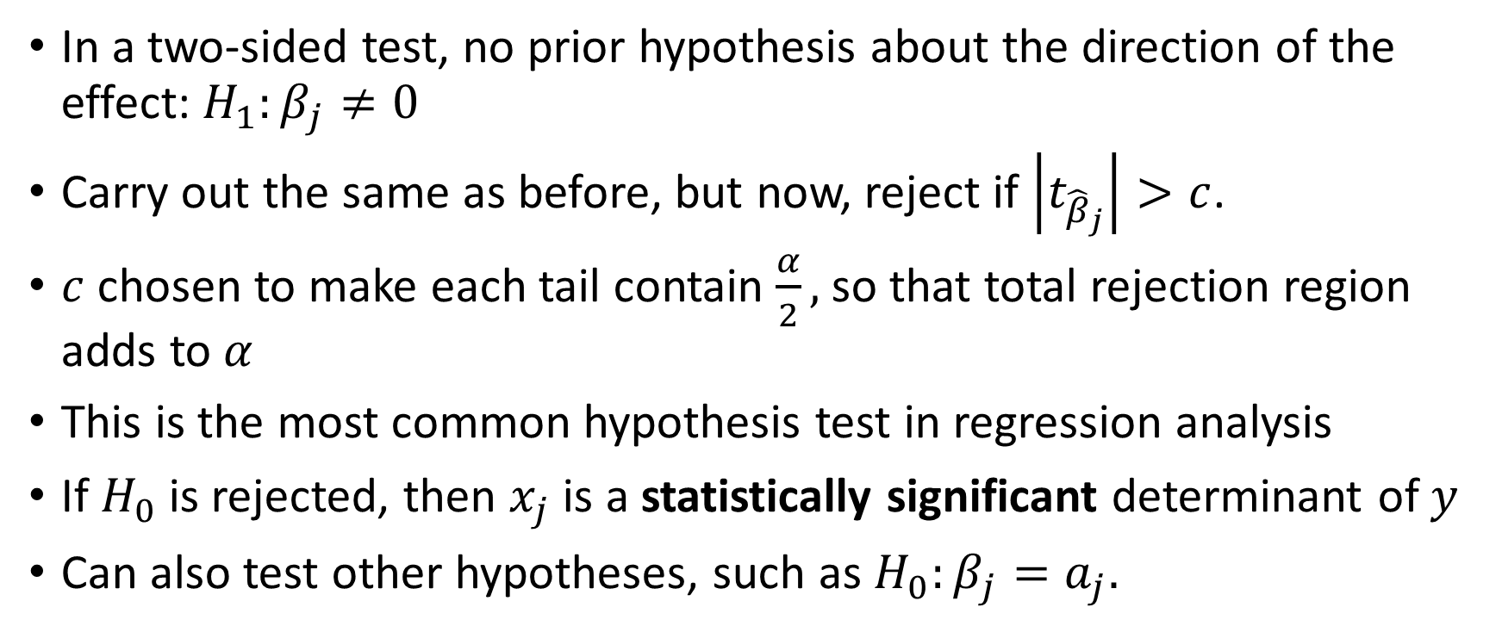
Two-Sided Tests
In a two-sided test, no prior hypothesis about the direction of the effect: $H_{1}:β_{j}≠0$
Carry out the same as before, but now, reject if $\left|t_{{\hat{β}}_{j}}\right|>c$.
$c$ chosen to make each tail contain $\frac{α}{2},$ so that total rejection region adds to $α$
This is the most common hypothesis test in regression analysis
If $H_{0}$ is rejected, then $x_{j}$ is a statistically significant determinant of $y$
Can also test other hypotheses, such as $H_{0}:β_{j}=a_{j}.$

Slide 7
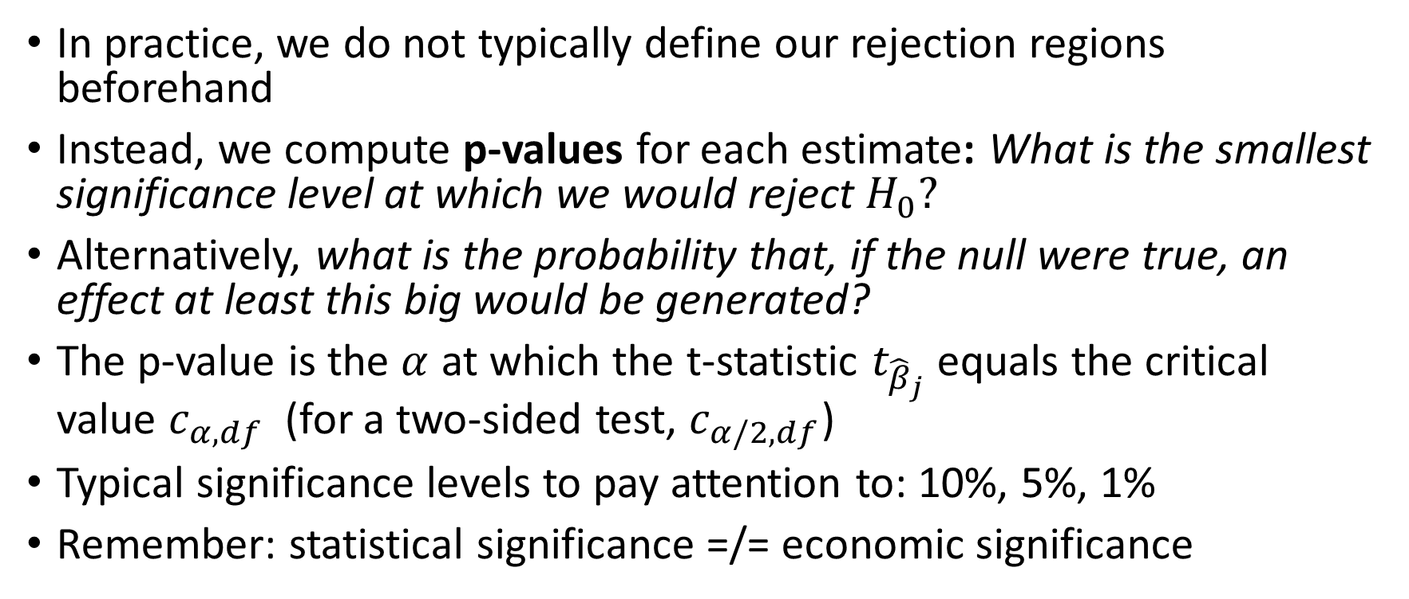
P-values and Statistical Significance
In practice, we do not typically define our rejection regions beforehand
Instead, we compute p-values for each estimate: What is the smallest significance level at which we would reject $H_{0}?$
Alternatively, what is the probability that, if the null were true, an effect at least this big would be generated?
The p-value is the $α$ at which the t-statistic $t_{{\hat{β}}_{j}}$ equals the critical value $c_{α,df}$ (for a two-sided test, $c_{α/2,df}$)
Typical significance levels to pay attention to: 10%, 5%, 1%
Remember: statistical significance =/= economic significance

Slide 8
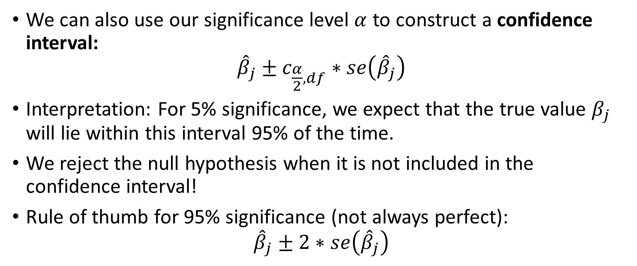
Confidence Intervals
We can also use our significance level $α$ to construct a confidence interval:
$${\hat{β}}_{j}±c_{\frac{α}{2},df}∗se\left({\hat{β}}_{j}\right)$$
Interpretation: For 5% significance, we expect that the true value $β_{j}$ will lie within this interval 95% of the time.
We reject the null hypothesis when it is not included in the confidence interval!
Rule of thumb for 95% significance (not always perfect):
$${\hat{β}}_{j}±2∗se\left({\hat{β}}_{j}\right)$$

Slide 9
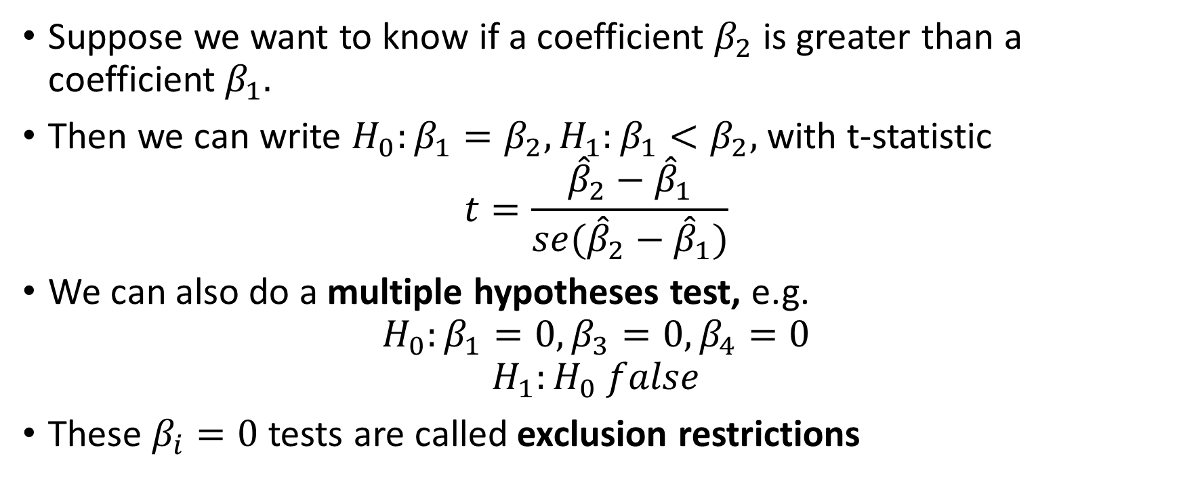
Testing Linear Restrictions of Parameters
Suppose we want to know if a coefficient $β_{2}$ is greater than a coefficient $β_{1}.$
Then we can write $H_{0}:β_{1}=β_{2}, H_{1}:β_{1}<β_{2},$with t-statistic
$$t=\frac{{\hat{β}}_{2}−{\hat{β}}_{1}}{{se(\hat{β}}_{2}−{\hat{β}}_{1})}$$
We can also do a multiple hypotheses test, e.g.
$$H_{0}:β_{1}=0,β_{3}=0,β_{4}=0$$
$$H_{1}:H_{0} false$$
These $β_{i}=0$ tests are called exclusion restrictions

Slide 10
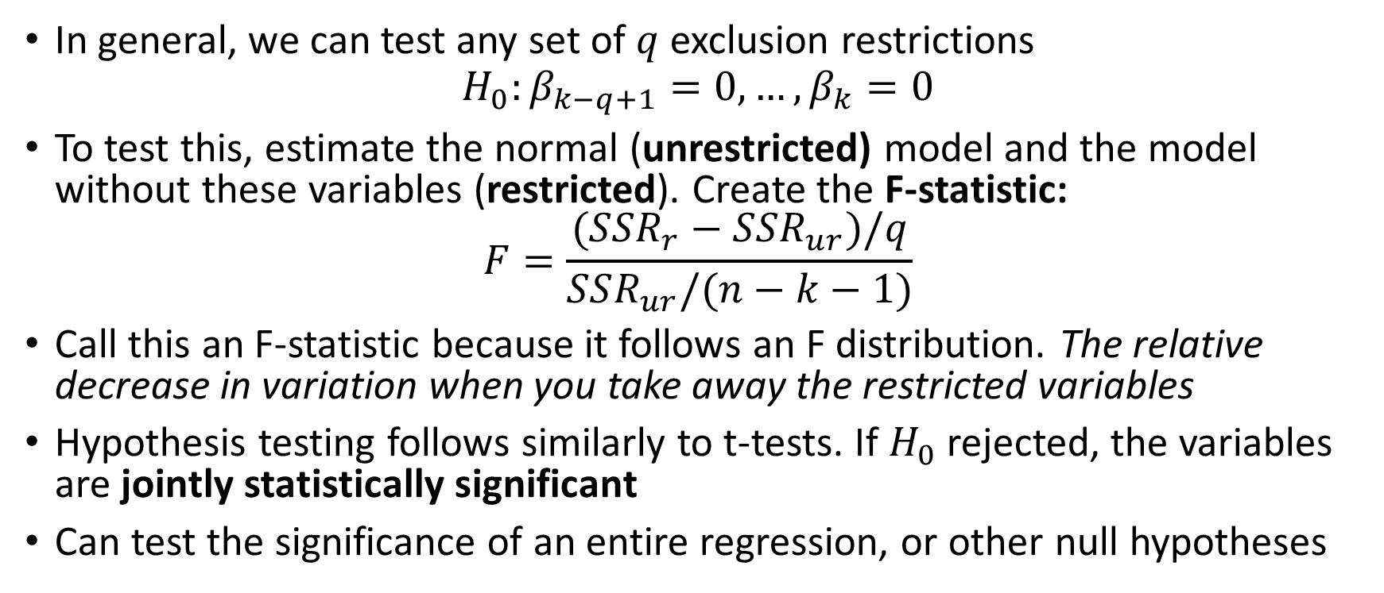
Testing Exclusion Restrictions
In general, we can test any set of $q$exclusion restrictions
$$H_{0}:β_{k−q+1}=0,…,β_{k}=0$$
To test this, estimate the normal (unrestricted) model and the model without these variables (restricted). Create the F-statistic:
$$F=\frac{(SSR_{r}−SSR_{ur})/q}{SSR_{ur}/(n−k−1)}$$
Call this an F-statistic because it follows an F distribution. The relative decrease in variation when you take away the restricted variables
Hypothesis testing follows similarly to t-tests. If $H_{0}$ rejected, the variables are jointly statistically significant
Can test the significance of an entire regression, or other null hypotheses

Slide 11

Reporting Regression Results
Typically, regression output reports the coefficient estimates along with standard errors.
Sample size and $R^{2}$ are also typically reported
Example: Acemoglu, Johnson, and Robinson (2001)

Slide 12
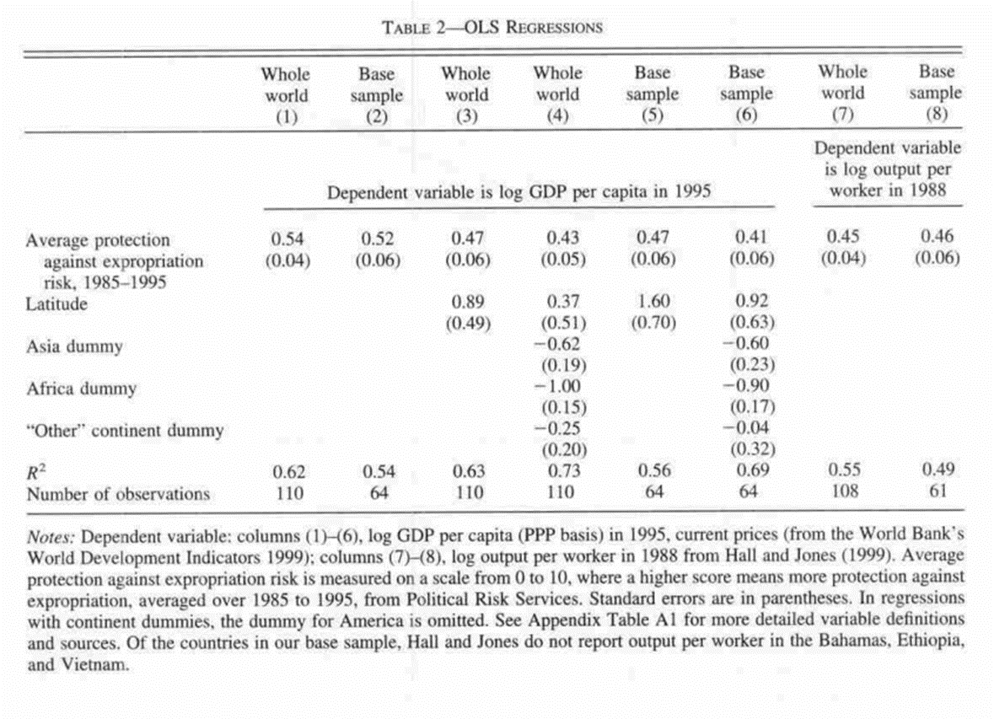
Acemoglu, Johnson, and Robinson (2001)

Slide 13
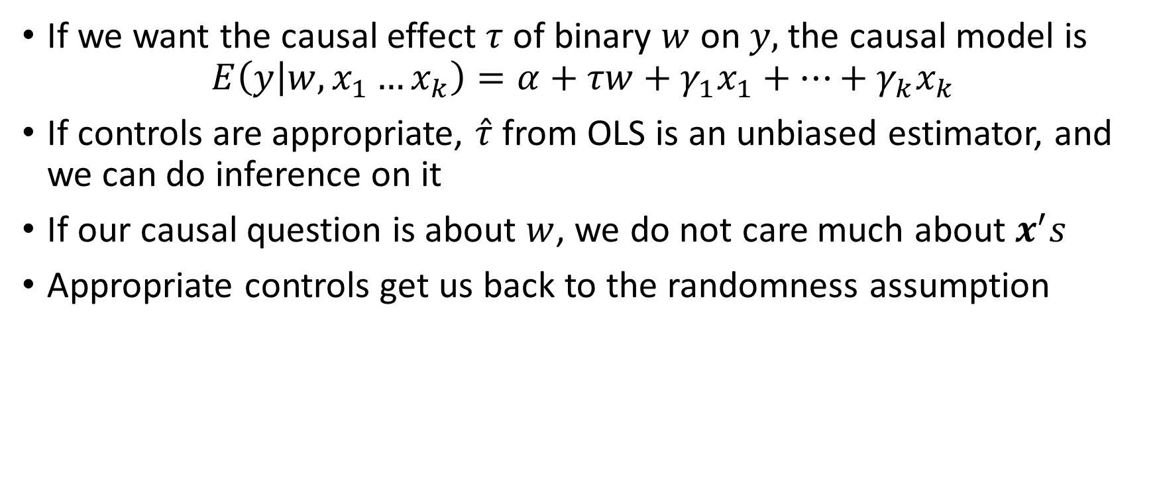
Causal Effects and Policy Analysis
If we want the causal effect $τ$ of binary $w$ on $y,$the causal model is
$$E\left(y | w,x_{1}…x_{k}\right)=α+τw+γ_{1}x_{1}+…+γ_{k}x_{k}$$
If controls are appropriate, $\hat{τ}$ from OLS is an unbiased estimator, and we can do inference on it
If our causal question is about $w$, we do not care much about $x^{′}s$
Appropriate controls get us back to the randomness assumption

