Slide 1
Econometrics: Lecture 6
Asymptotics and Further Issues
March 7, 2023

Slide 2
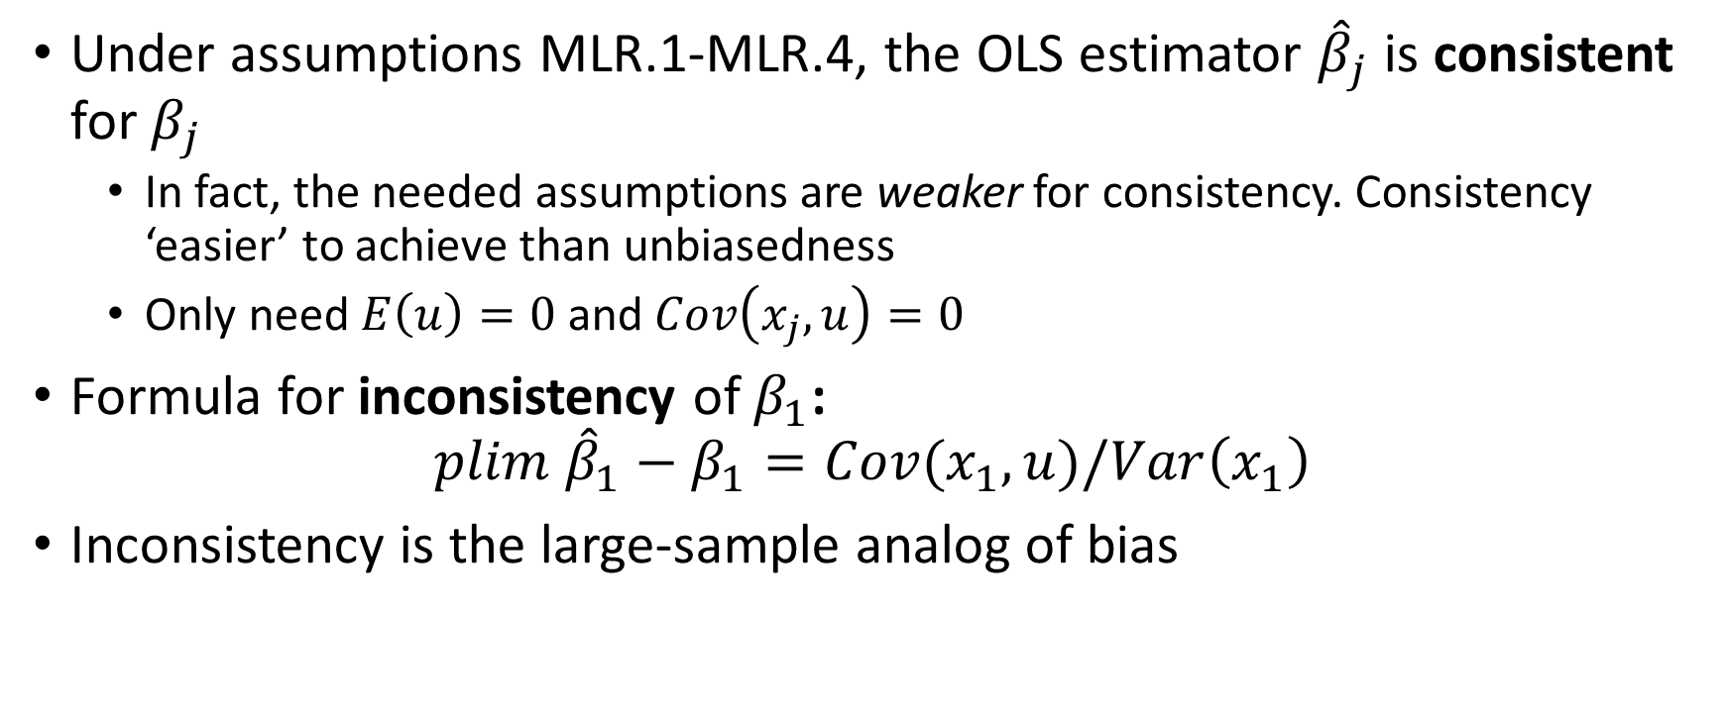
Consistency of OLS
Under assumptions MLR.1-MLR.4, the OLS estimator ${\hat{β}}_{j}$ is consistent for $β_{j}$
In fact, the needed assumptions are weaker for consistency. Consistency ‘easier’ to achieve than unbiasedness
Only need $E\left(u\right)=0$ and $Cov\left(x_{j},u\right)=0$
Formula for inconsistency of $β_{1}$:
$$plim {\hat{β}}_{1}−β_{1}=Cov(x_{1},u)/Var\left(x_{1}\right)$$
Inconsistency is the large-sample analog of bias

Slide 3
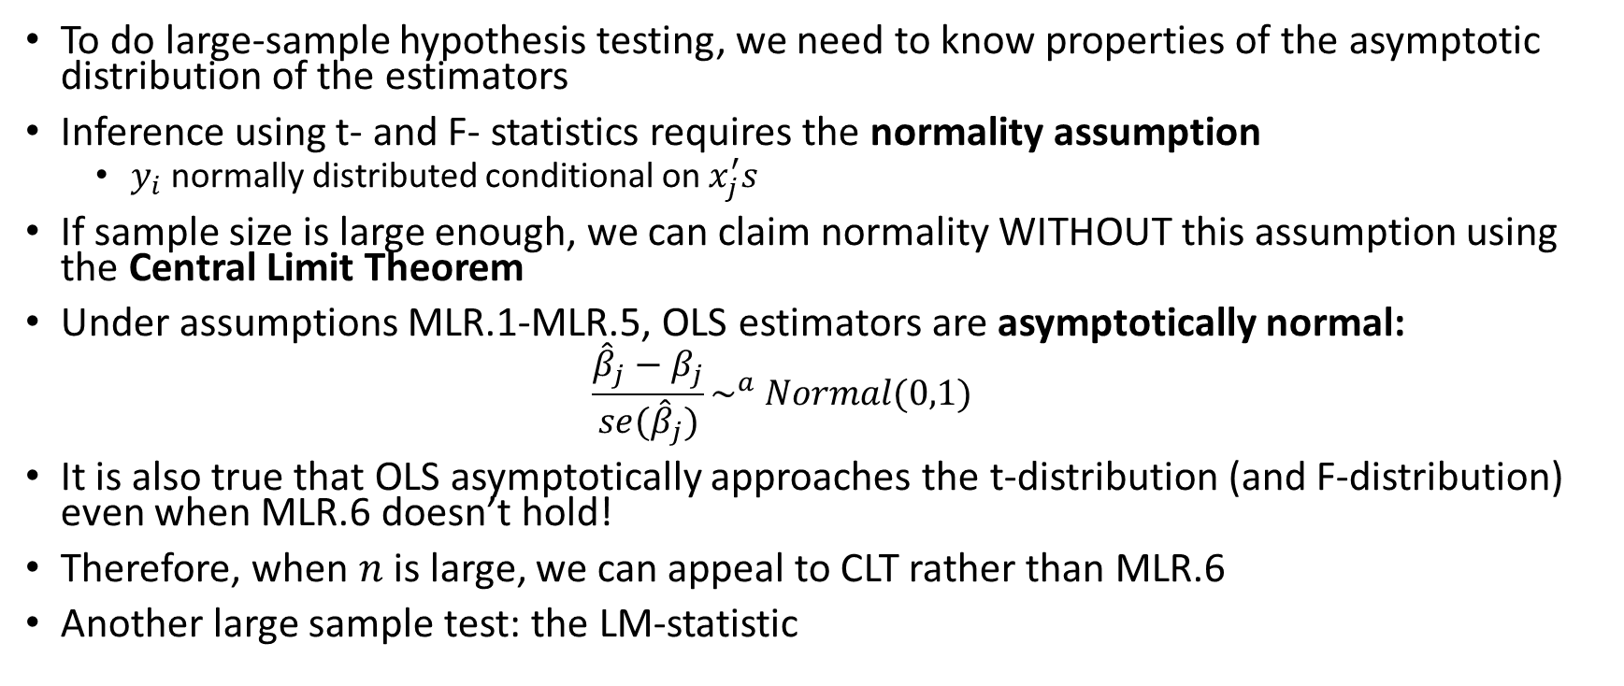
Asymptotic Normality of OLS & Inference
To do large-sample hypothesis testing, we need to know properties of the asymptotic distribution of the estimators
Inference using t- and F- statistics requires the normality assumption
$y_{i}$ normally distributed conditional on $x_{j}^{′}s$
If sample size is large enough, we can claim normality WITHOUT this assumption using the Central Limit Theorem
Under assumptions MLR.1-MLR.5, OLS estimators are asymptotically normal:
$$\frac{{\hat{β}}_{j}−β_{j}}{se({\hat{β}}_{j})}\sim ^{a} Normal(0,1)$$
It is also true that OLS asymptotically approaches the t-distribution (and F-distribution) even when MLR.6 doesn’t hold!
Therefore, when $n$ is large, we can appeal to CLT rather than MLR.6
Another large sample test: the LM-statistic

Slide 4
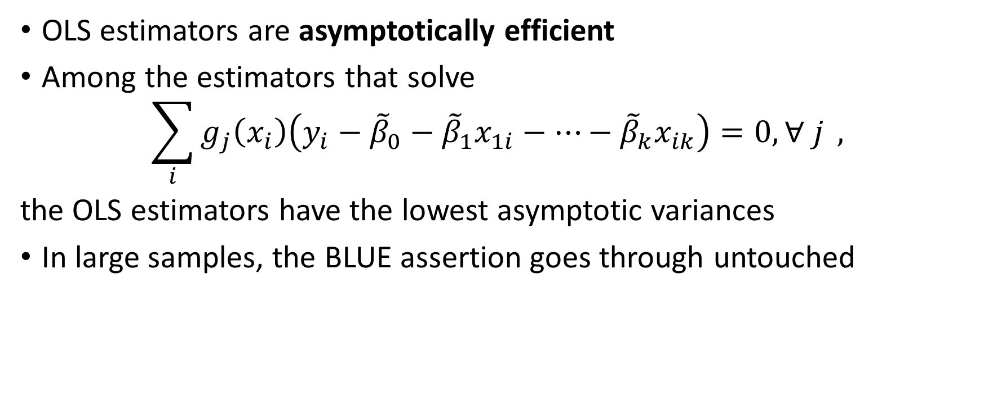
Asymptotic Efficiency of OLS
OLS estimators are asymptotically efficient
Among the estimators that solve
$$\sum_{i}{g_{j}\left(x_{i}\right)\left(y_{i}−{\tilde{β}}_{0}−{\tilde{β}}_{1}x_{1i}−…−{\tilde{β}}_{k}x_{ik}\right)=0, ∀ j} ,$$
the OLS estimators have the lowest asymptotic variances
In large samples, the BLUE assertion goes through untouched

Slide 5
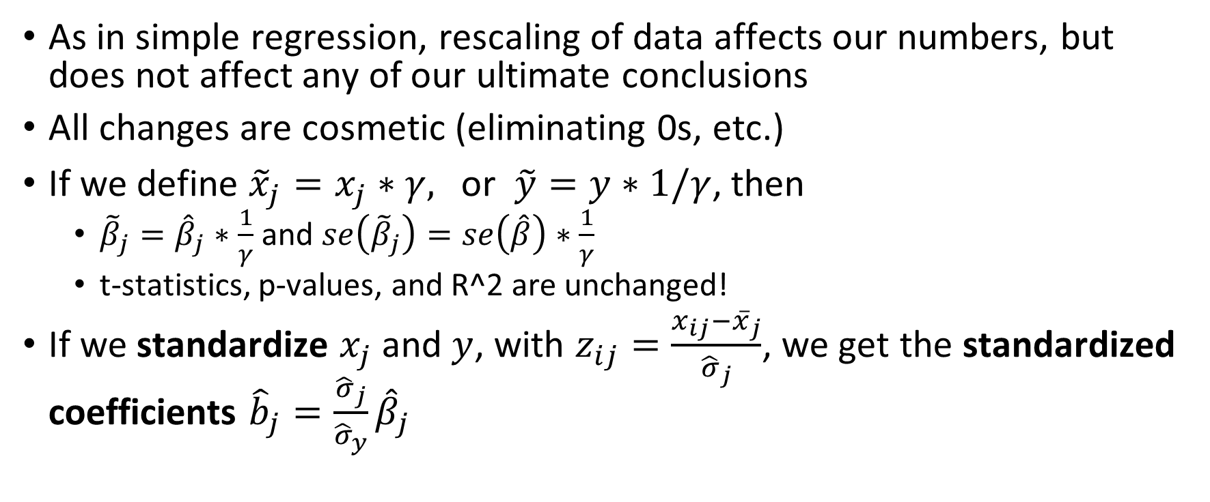
Data Rescaling and Units
As in simple regression, rescaling of data affects our numbers, but does not affect any of our ultimate conclusions
All changes are cosmetic (eliminating 0s, etc.)
If we define ${\tilde{x}}_{j}=x_{j}∗γ,$ or $\tilde{y}=y∗1/γ$, then
${\tilde{β}}_{j}={\hat{β}}_{j}∗\frac{1}{γ}$ and $se\left({\tilde{β}}_{j}\right)=se\left(\hat{β}\right)∗\frac{1}{γ}$
t-statistics, p-values, and R^2 are unchanged!
If we standardize $x_{j}$ and $y$, with $z_{ij}=\frac{x_{ij}−{\overline{x}}_{j}}{{\hat{σ}}_{j}}$, we get the standardized coefficients ${\hat{b}}_{j}=\frac{{\hat{σ}}_{j}}{{\hat{σ}}_{y}}{\hat{β}}_{j}$

Slide 6
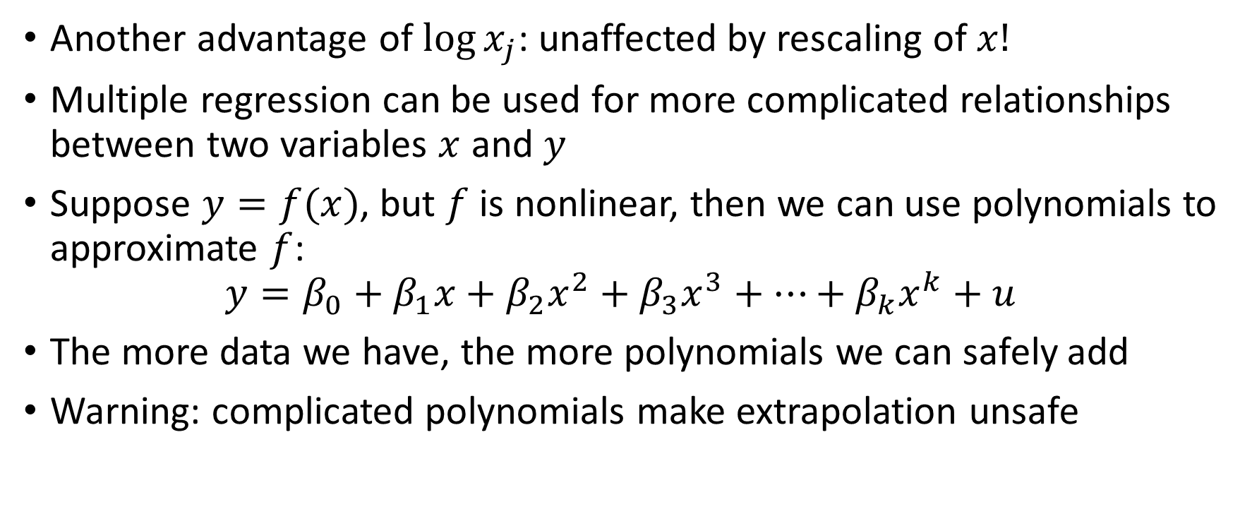
Logs and Polynomials
Another advantage of $\log{x_{j}}$: unaffected by rescaling of $x!$
Multiple regression can be used for more complicated relationships between two variables $x$ and $y$
Suppose $y=f(x)$, but $f$ is nonlinear, then we can use polynomials to approximate $f$:
$$y=β_{0}+β_{1}x+β_{2}x^{2}+β_{3}x^{3}+…+β_{k}x^{k}+u$$
The more data we have, the more polynomials we can safely add
Warning: complicated polynomials make extrapolation unsafe

Slide 7
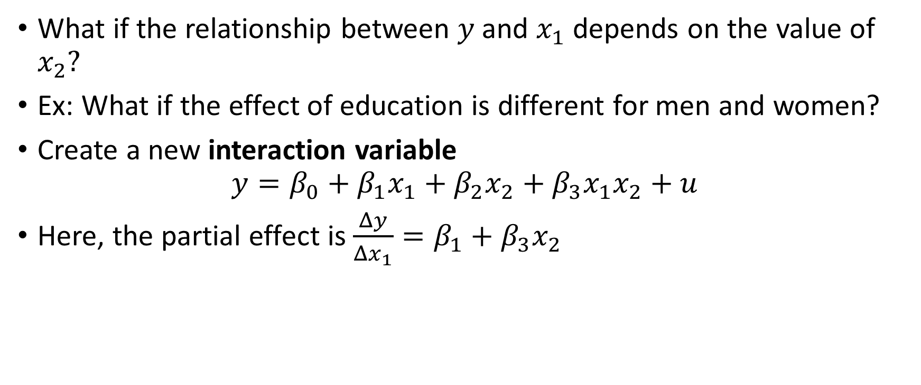
Interaction Terms
What if the relationship between $y$and $x_{1}$ depends on the value of $x_{2}?$
Ex: What if the effect of education is different for men and women?
Create a new interaction variable
$$y=β_{0}+β_{1}x_{1}+β_{2}x_{2}+β_{3}x_{1}x_{2}+u$$
Here, the partial effect is $\frac{Δy}{Δx_{1}}=β_{1}+β_{3}x_{2}$

Slide 8
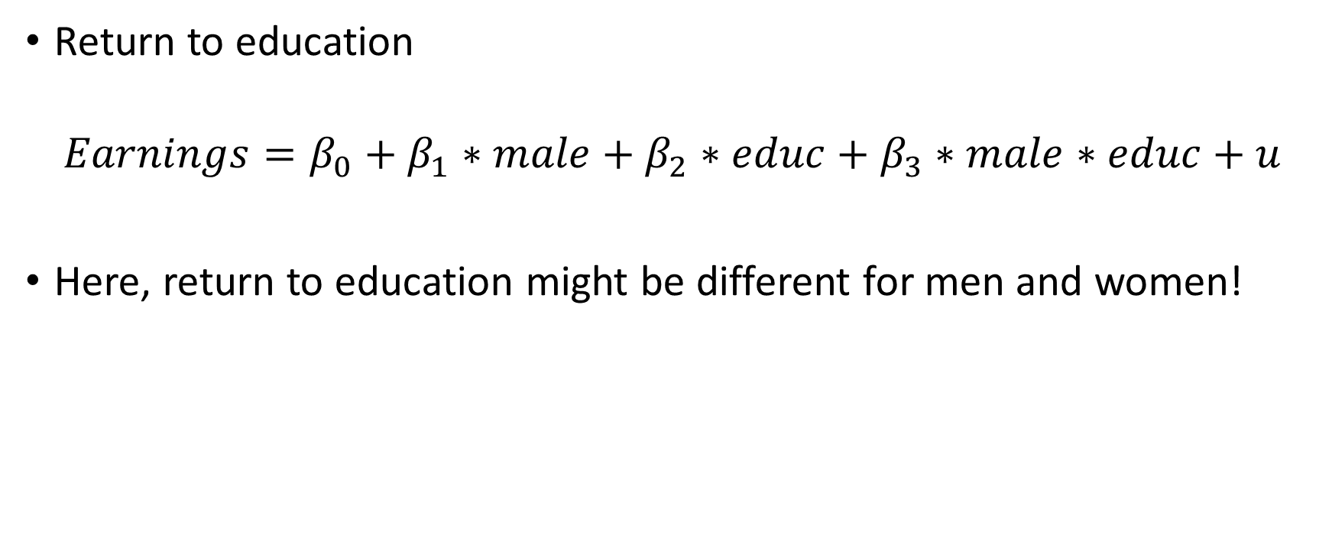
Interaction Term Example
Return to education
$$Earnings=β_{0}+β_{1}∗male+β_{2}∗educ+β_{3}∗male∗educ+u$$
Here, return to education might be different for men and women!

Slide 9

Average Partial Effects
We have seen that the partial effect of $x_{j}$ on $y$ may vary depending on its own values or the values of other variables
We can compute the average partial effect, where the partial effect is computed for each unit $i$ and averaged

Slide 10
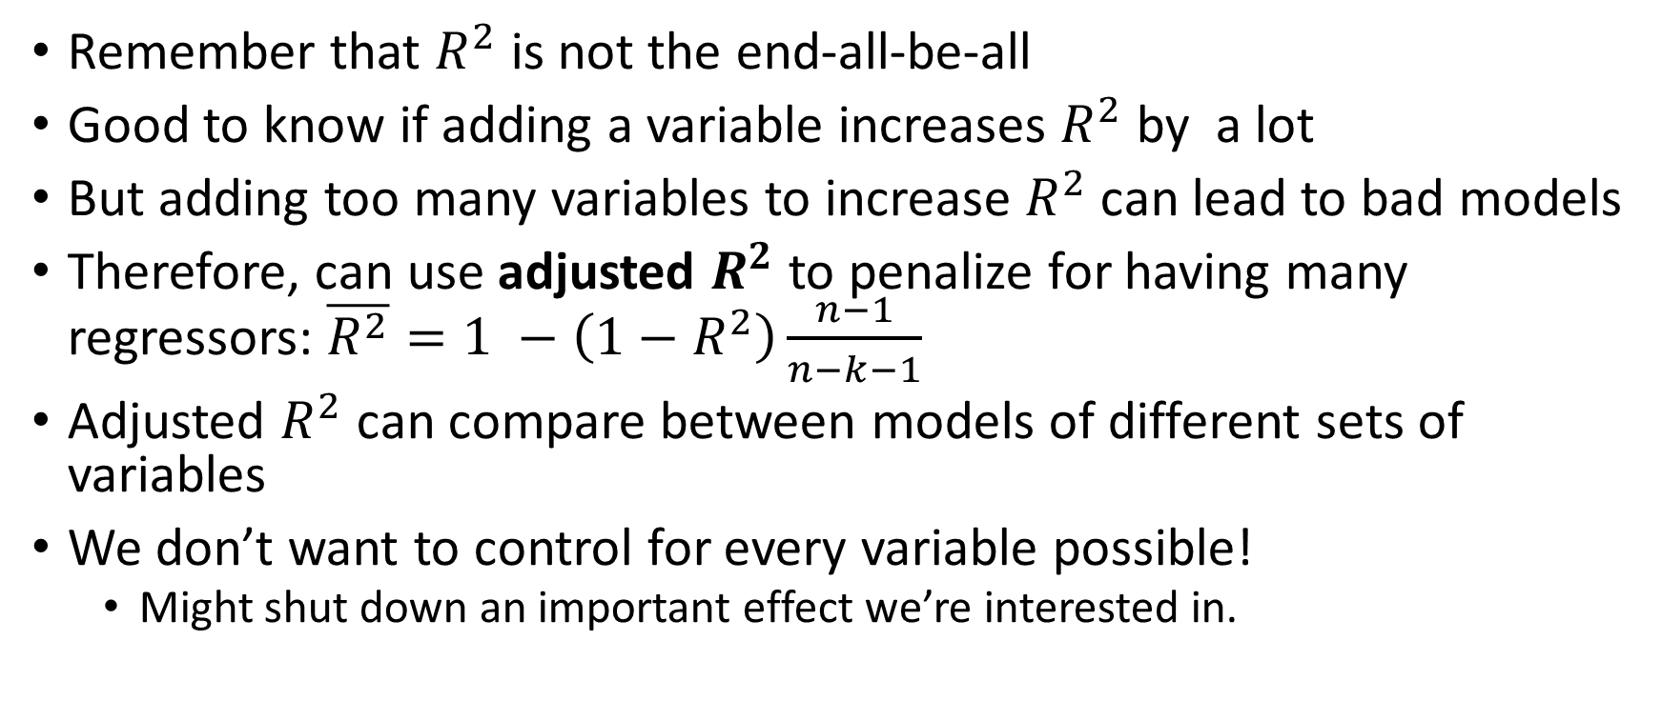
Goodness-of-fit and Regressor Selection
Remember that $R^{2}$ is not the end-all-be-all
Good to know if adding a variable increases $R^{2}$ by a lot
But adding too many variables to increase $R^{2}$ can lead to bad models
Therefore, can use adjusted $R^{2}$ to penalize for having many regressors: $\overline{R^{2}}=1 −\left(1−R^{2}\right)\frac{n−1}{n−k−1}$
Adjusted $R^{2}$ can compare between models of different sets of variables
We don’t want to control for every variable possible!
Might shut down an important effect we’re interested in.

Slide 11
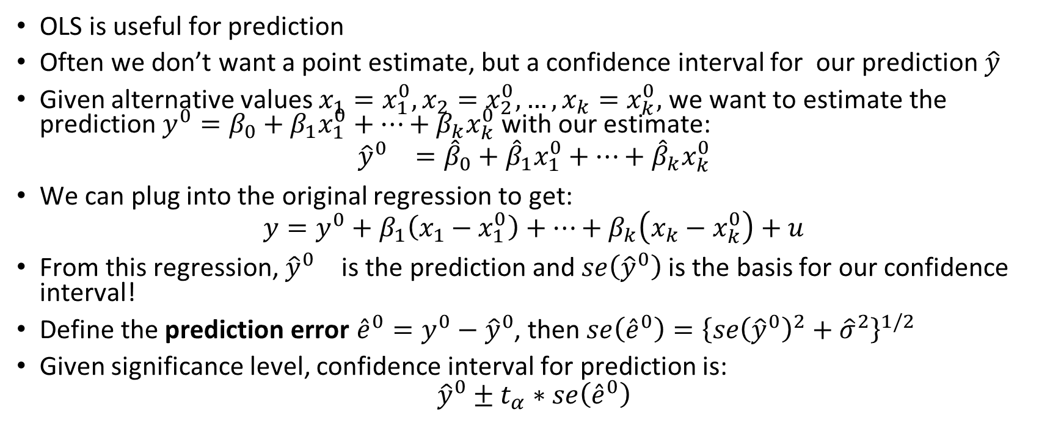
Prediction
OLS is useful for prediction
Often we don’t want a point estimate, but a confidence interval for our prediction $\hat{y}$
Given alternative values $x_{1}=x_{1}^{0},x_{2}=x_{2}^{0},…,x_{k}=x_{k}^{0},$ we want to estimate the prediction $y^{0}=β_{0}+β_{1}x_{1}^{0}+…+β_{k}x_{k}^{0}$with our estimate:
$${{\hat{y}}^{0}}_{}={\hat{β}}_{0}+{\hat{β}}_{1}x_{1}^{0}+…+{\hat{β}}_{k}x_{k}^{0}$$
We can plug into the original regression to get:
$$y=y^{0}+β_{1}\left(x_{1}−x_{1}^{0}\right)+…+β_{k}\left(x_{k}−x_{k}^{0}\right)+u$$
From this regression, ${{\hat{y}}^{0}}_{}$ is the prediction and $se\left({\hat{y}}^{0}\right)$ is the basis for our confidence interval!
Define the prediction error ${\hat{e}}^{0}=y^{0}−{\hat{y}}^{0}$, then $se\left({\hat{e}}^{0}\right)={\left\{se{\left({\hat{y}}^{0}\right)}^{2}+{\hat{σ}}^{2}\right\}}^{1/2}$
Given significance level, confidence interval for prediction is:
$${\hat{y}}^{0}±t_{α}∗se\left({\hat{e}}^{0}\right)$$

Slide 12
Residual Analysis
We can look at individual observations to see if observations are above or below their prediction value
In pricing regressions, this can tell us whether something was “overpriced” or “underpriced”
Can be used to think about other unobserved characteristics
Example: sports analytics
Advanced models can tell you how many wins a team should have based on its statistics
If a team has more wins than predicted wins, can attribute to “luck” or “good coaching”

Slide 13
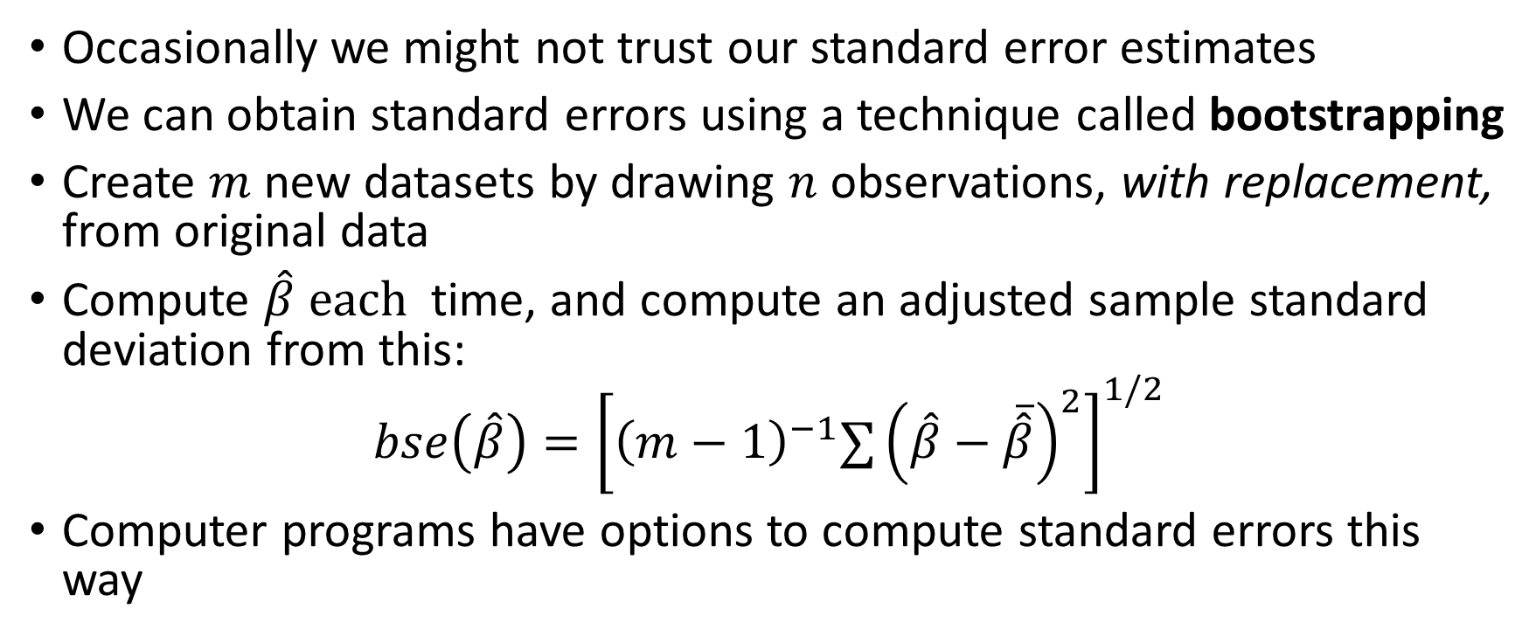
Bootstrapping
Occasionally we might not trust our standard error estimates
We can obtain standard errors using a technique called bootstrapping
Create $m$ new datasets by drawing $n$ observations, with replacement, from original data
Compute $\hat{β} each$ time, and compute an adjusted sample standard deviation from this:
$$bse\left(\hat{β}\right)={\left[{\left(m−1\right)}^{−1}∑{\left(\hat{β}−\overline{\hat{β}}\right)}^{2}\right]}^{1/2}$$
Computer programs have options to compute standard errors this way

