Slide 1
PluriTestTM Report

Slide 2
Summary of Services
Project Summary:
Service Description:
The transcriptome of all samples were analyzed and processed in the PluriTest™ algorithm to generate a Pluripotency and Novelty Score
The Pluripotency Score is based on many samples (pluripotent, somatic, and tissues) in the stem cell model matrix which consists of an extensive reference set of >450 cell/tissue types, including 223 hESC lines, 41 iPSC lines, somatic cells, and tissues. Samples with positive pluripotency values are more similar to the pluripotent samples in the model matrix than to all other classes of samples in the matrix.
The Novelty Score is based on well-characterized PSCs in the stem cell model matrix. A low novelty score indicates that the tested sample can be well reconstructed based on existing data from other well-characterized iPSC and ESC lines. A high novelty score indicates that there are patterns in the tested sample that cannot be explained by the existing database of well-characterized, karyotypically normal pluripotent stem cells.
Partially differentiated pluripotent cells, teratocarcinoma cells, or karyotypically abnormal embryonic stem cells may have a high pluripotency score but cannot be reconstructed well with data from well-characterized, normal pluripotent stem cells, and thus are expected to have a high novelty score.
Borderline Results:
Samples that are flagged as borderline rather than pluripotent is an indication that the tested sample(s) have a molecular signature that is slightly different from the database samples. The database samples are based on a limited number of PSC lines, so it is not entirely unlikely that a sample may differ. Since there are many different ways to reprogram cells, the core pluripotency may be maintained, but there could be molecular or epigenetic differences affecting a portion of the genes.
Materials & Methods:
RNA Purification:
Cells were prepared according to the PureLink™ RNA Mini Kit (Catalog #: 12183025) and quantified using the NanoDrop™
GeneChip® Preparation:
100 ng total RNA was used to prepare the GeneChip® for the PluriTest™

Slide 3
PluriTestTM Results

Slide 4
Appendix

Slide 5
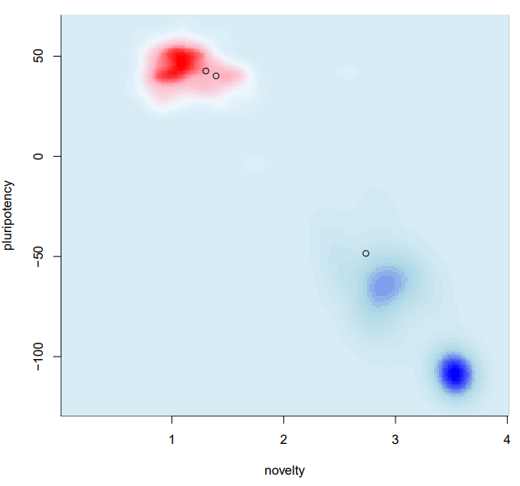
PluriTestTM Results Navigation
The PluriTest analysis tool confirms pluripotency via two separate scores: pluripotency and novelty.
The pluripotency score is an indication of how strongly a reference set of pluripotency signatures are expressed in the samples analyzed.
The novelty score is assigned based on well-characterized pluripotent stem cells in the reference set and indicates the general model fit for a given sample.
These two scores are combined into a pluripotency plot to indicate the pluripotency of your samples in comparison to the reference cell lines.
Pluripotent samples will cluster in the pluripotent reference data set (red cloud). A positive control sample is included.
Non-Pluripotent samples will cluster in the non-pluripotent reference data set (blue cloud). A negative control sample is included.
A published article on the basis and findings behind the PluriTest Assay can be found here
Figure 1: Pluripotency Plot. The pluripotency plot window provides a visual representation of the tested samples in the analysis. The pluripotency and novelty x/y scatter plot combines the pluripotency score on the y-axis with the novelty score on the x-axis. The red and blue background hint to the empirical distribution of the pluripotent (red) and non-pluripotent (blue) samples in the reference data set. A non-iPSC sample was included in this experiment to serve as a negative control representing non-pluripotency.
Disclaimer: This assay was conducted solely for the listed investigator/institution. The results of this assay are for research use only.

Slide 6
PluriTestTM Assay Services Frequently Asked Questions (1 of 2)
What is PluriTest Assay and how does it work?
  The PluriTest™ Assay is an RNA microarray-based assay for pluripotency assessment that provides an alternative to the teratoma assay based on global gene expression data. The PluriTest™ Analysis bioinformatics tool compares the transcriptional profile of a sample to an extensive reference set of >450 cell/tissues types, including 223 hESC lines, 41 iPSC lines, somatic cells, and tissues. PluriTest™ Analysis confirms pluripotency marker expression using two separate scores: pluripotency and novelty. The pluripotency score indicates how strongly a model-base pluripotency signature is expressed in the samples analyzed. The novelty score indicates the general model fit for a given sample. See Nat Methods 8:315 (2011) for more information.
How many cells are required to run one experiment?
  We require a cell pellet of at least 2 million cells per sample.
What if I get a sample that is borderline for pluripotency?
  Sample(s) that are flagged as borderline rather than pluripotent indicates that the tested sample(s) have a molecular signature that is slightly different from the database samples. The database samples are based on a limited number of PSC lines, so it is not entirely unlikely that a sample may differ. Since there are many different ways to reprogram cells, the core pluripotency may be maintained, but there could be molecular or epigenetic differences affecting gene expression.
How is my sample categorized as pass, borderline or fail?
  Using thresholds empirically set based on the reference set, the computed Pluripotency and Novelty scores are used to categorize a sample as ‘pass’, ‘borderline’ and ‘fail’ with respect to pluripotency status
    We label samples with ‘pass’ if a Pluripotency Score > 20 and a Novelty Score < 1.67 is observed.
    We label samples with ‘borderline’ if the Pluripotency Score is ≤ 20 and ≥ -10, and a Novelty Score of < 1.67 is observed. These results indicate that a sample may show pluripotent features but should be further evaluated by qPCR based assays such as ScoreCard for factors that could explain differences.
    We label samples with ‘fail’ if the Pluripotency Score is <, and a Novelty Score of > 1.67 is observed.

Slide 7
PluriTestTM Assay Services Frequently Asked Questions (2 of 2)
We have some feeder-dependent iPSC lines that need to be tested for Pluritest. Could we send the cell pellet cultured on feeders or do we need to provide feeder-free samples?
  The probes on the microarray are for human cells and are theoretically expected to not cross-react with mouse cells and should not affect the Pluritest outcome. Based on internal validations, we have seen that if more than 25% of the cells are MEFs, the Pluritest assay will fail the sample, and identify it as not pluripotent. We recommend feeder-free cells for most accurate results.
Can the PluriTest determine whether or not my sample has been contaminated with other cell types?
  We have artificially mixed in non iPSC mRNA into PSC mRNA and do not see any effect on Pluritest up to 5% of contamination. Higher percentages of contaminating cells cause an increased novelty score and decreased pluripotency score.
I understand that this is genome wide microarray based. Would you be able to generate comparative gene expression analyses between the different samples (eg. correlation plots or heat maps)?
  We do not provide any additional data analysis beyond Pluritest. We do however provide the raw microarray data that can be used to perform further analysis.
Can you provide the methodology used for PluriTest?
  The protocol we follow for array preparation can be found here: PluriTest-Compatible PrimeView Assays for Pluripotency Confirmation | Thermo Fisher Scientific - US, at the bottom under the Resources list there should be a “User Guide: Genechip 3’ IVT”. That’s the protocol that’s followed for the assay and should contain detailed information on the methods. However, we don’t have specific method/version number to supply for the PluriTest protocol.
  There is also a paper on the PluriTest assay which can be found here: A bioinformatic assay for pluripotency in human cells - PubMed (nih.gov).
Can PluriTest detect Naïve Pluripotency?
  We do not have any data to share with regard to how Naïve Pluripotency would look on the Pluripotency plot, however we were able to find the following key markers of naïve pluripotency within the PluriTest gene expression data: KLF4, TFCP2L1, DPPA3, DPPA5, CD7, F11R

Slide 8
Please submit any follow-up questions to CUBCharacterizationServices@thermofisher.com
For Research Use Only. Not for use in diagnostic procedures. © 2023 Thermo Fisher Scientific Inc. All rights reserved. All trademarks are the property of Thermo Fisher Scientific and its subsidiaries unless otherwise specified. OMIM is a trademark of Johns Hopkins University.

