Slide 1
Closure
closure is all around you in JavaScript, you just have to recognize and embrace it.

Slide 2
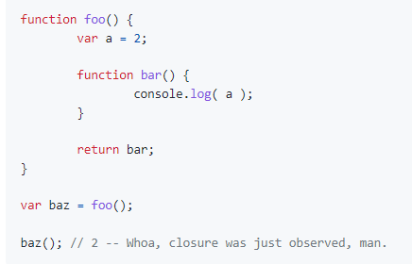
What is Closure
Closure is when a function is able to remember and access its lexical scope even when that function is executing outside its lexical scope.
lexical scope is scope that is defined at lexing time. In other words, lexical scope is based on where variables and blocks of scope are authored, by you, at write time, and thus is (mostly) set in stone by the time the lexer processes your code.
After foo() executed, normally we would expect that the entirety of the inner scope of foo() would be collected by gc, but the "magic" of closures does not let this happen.
bar() still has a reference to that scope, and that reference is called closure.

Slide 3
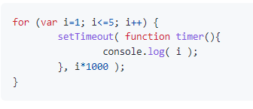
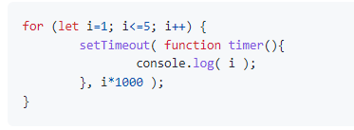
Loops + Closure
The most common example used to illustrate closure is for-loop.
6 6 6 6 6
1 2 3 4 5
Block scoping and closure working hand-in-hand, solving all the world's problems.

Slide 4
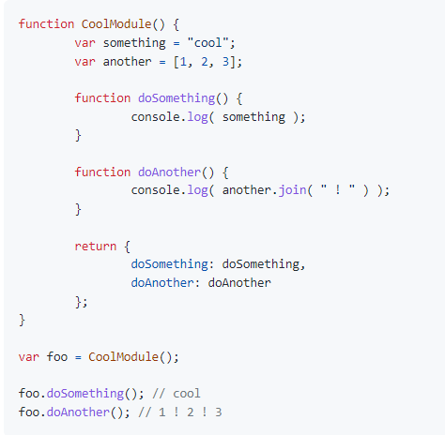
Modules
There are other code patterns which leverage the power of closure but which do not on the surface appear to be about callbacks. Let's examine the most powerful of them: the module.
Firstly, CoolModule() is just a function, but it has to be invoked for there to be a module instance created
Secondly, the CoolModule() function returns an object, denoted by the object-literal syntax { key: value, ... }. It's appropriate to think of this object return value as essentially a public API for our module.
The doSomething() and doAnother() functions have closure over the inner scope of the module "instance" (arrived at by actually invoking CoolModule()).

Slide 5
Example

Slide 6
Thank You

