Slide 1
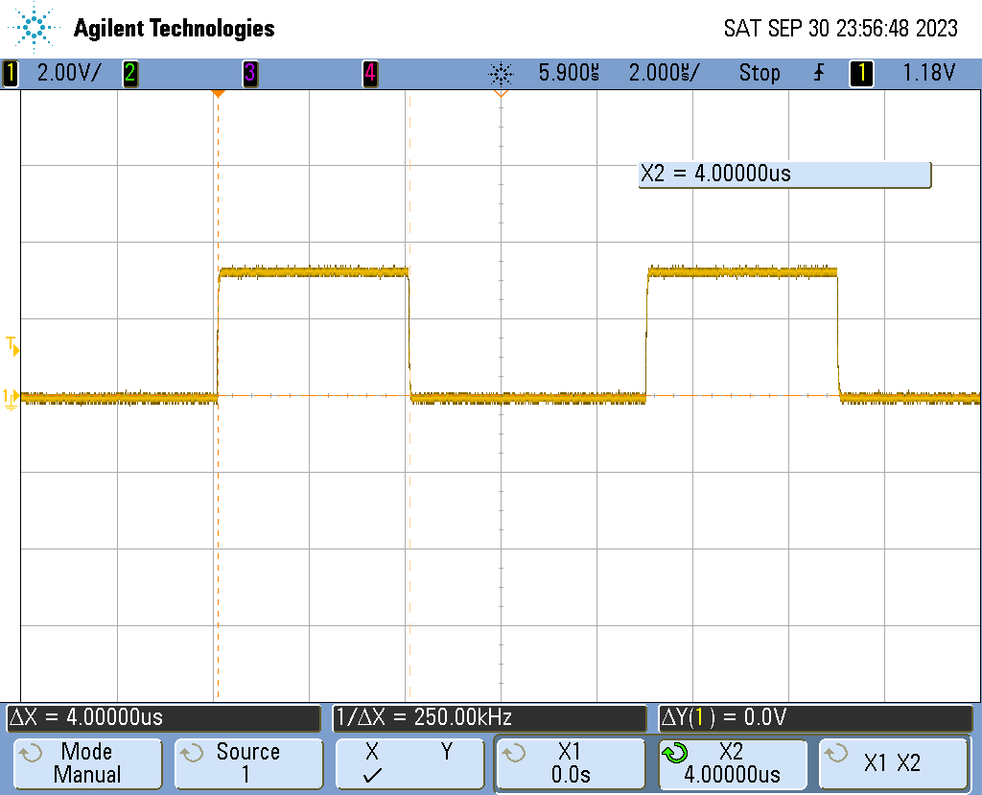
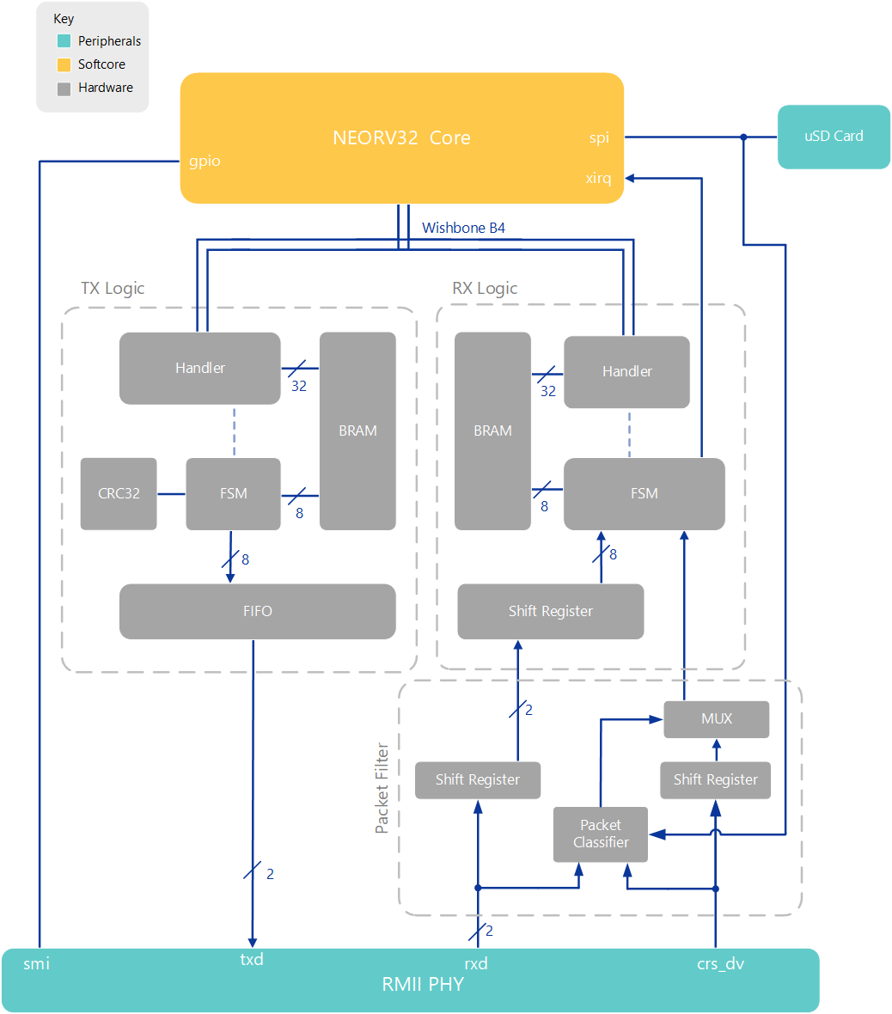
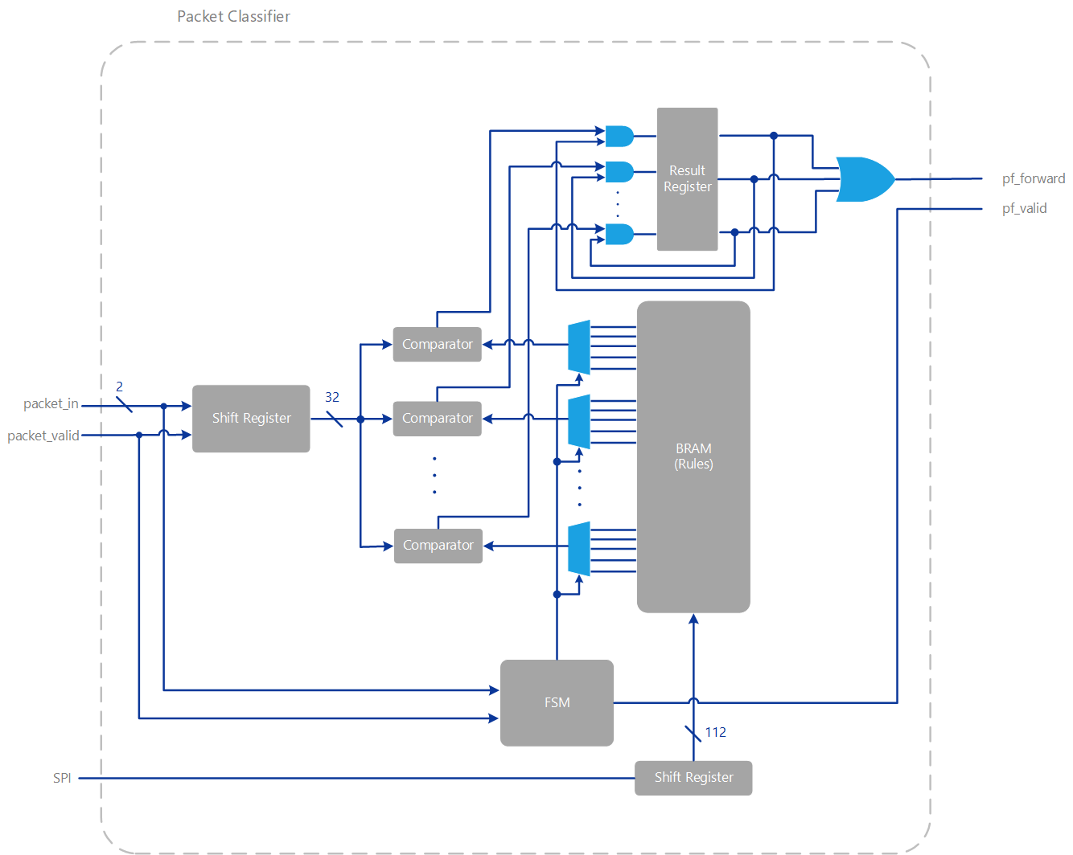
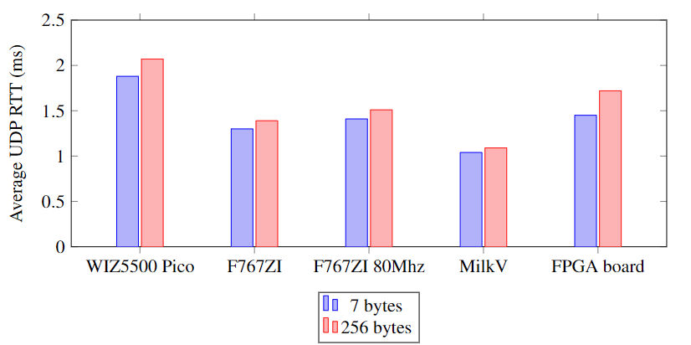
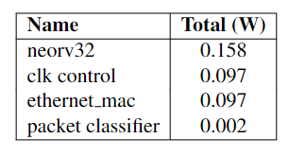
FPGA Ethernet Packet Filter with Webserver
Matthew Gilpin, Supervised by Dr Matthew D’Souza
PROJECT SCOPE
76,000 cybercrime reports in Australia in 2021-22 financial year.
Growth of IoT will greatly increase this figure.
Embedded systems are generally low power and may forgo protection.
Aim: Improve embedded security and decrease latency and power requirements for packet filtering.
Implement an IPv4-based hardware firewall with configurable packet filter and web interface.
Limitations:
Only supporting the 5-tuple fields - Destination IP, Source IP, Destination Port, Source Port and protocol.
BACKGROUND
FPGAs provide a platform to design custom digital logic – great for designs that may change and development. Cheaper and faster turn around time than ASICs in low quantities.
FPGA allow for complete control over data and hardware. Can design lower latency hardware.
Previous papers achieved a latency of 61.266us with 5-typle binding packet filter on FPGA.
Many packet filters exist and filter differently, some do deep packet inspection (out of scope)
Packet filters can be implemented in many ways to save resources, but slower.
Networks are hierarchical and are layered based. Layer 1 – Physical interface, Layer 2 - Link Layer, Layer 3 – Network Layer, Layer 4 – Transport Layer, Layer 5+ Application Layer.. Packet filtering typically happens in layer 3 and 4.
Hardware support allows for wirespeed throughput with the lowest latency.
TECHNOLOGIES
Xilinx Artix 7 100T FPGA.
NEORV32 RISC-V softcore
LAN8720A RMII PHY
MAC over Wisbone B4 Classic
- Written from the ground up
- 32bits wide memory mapped.
- computes CRC32 on the fly
Hardware packet filter supports currently 8 rules and does parallel comparisons on all 8 rules at a time.
Hardware filtering takes place at the RMII level.
FreeRTOS-Plus-TCP handles layer 3 and up including webserver.
Webapp designed in Vue.js with Tailwindcss for styling. Static single page application – Less network traffic
Webapp uses REST API
RESULTS
4uS of latency added
Wirespeed – 100Mbit/s
Measured 0.51W power consumption

