Slide 1
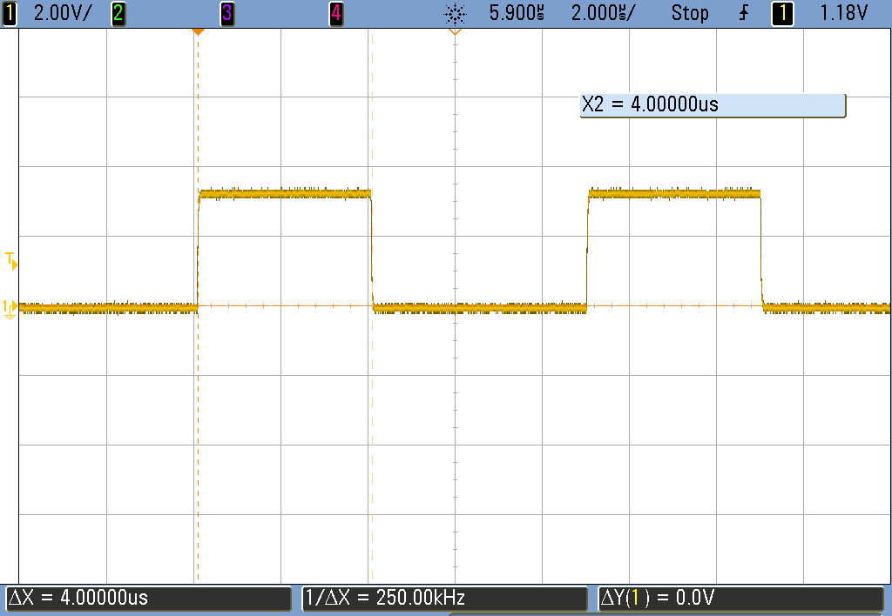
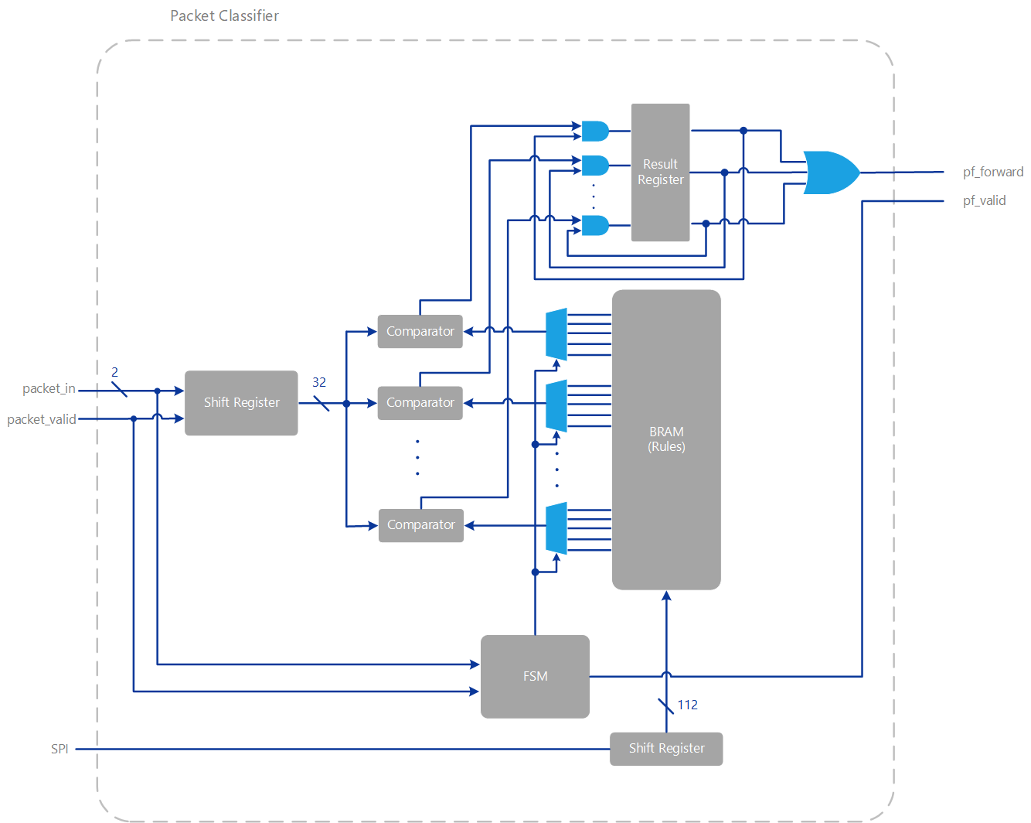
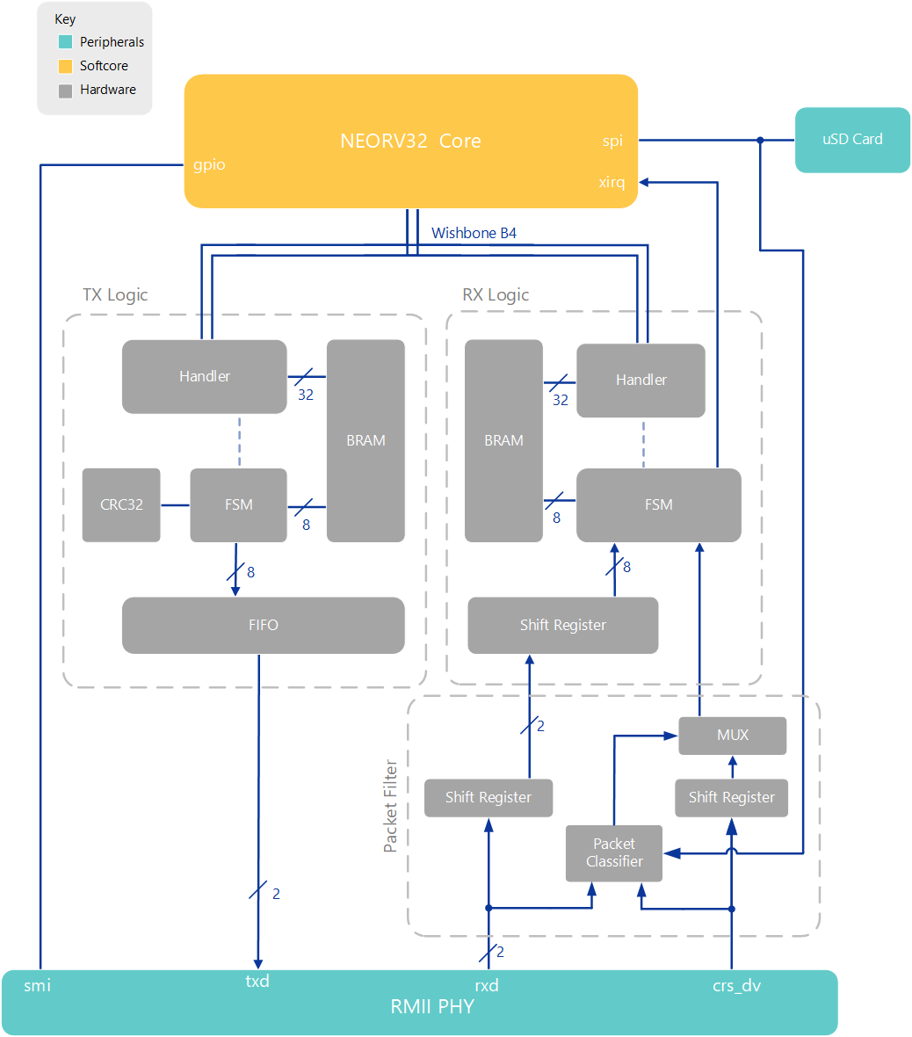
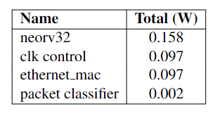
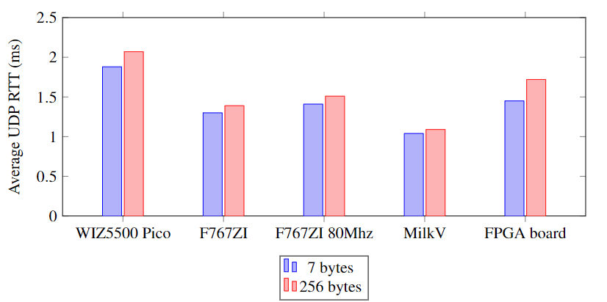
FPGA Ethernet Packet Filter with Webserver
Matthew Gilpin, Supervised by Dr Matthew D’Souza
PROJECT SCOPE
76,000 cybercrime reports in Australia in 2021-22 financial year.
Growth of IoT will greatly increase this figure – creates more opportunity.
Embedded systems are generally power constrained and may forgo protection.
BACKGROUND
Firewalls are the first line of defence against bad actors by restricting network access to private networks.
Many types of packet filters exist and operate differently. Most common is a 5-tuple binding firewall which inspects the Destination IP, Source IP, Destination Port, Source Port and Protocol fields.
Packet filtering typically occurs in Network and Link layers. Deep packet inspection can also inspect application layer (out of scope).
FPGAs are a class of programmable logic that use lookup tables and flip flops to implement digital logic for complete control over data and hardware parallelisation.
Previous papers achieved a latency of 61.266us with 5-typle binding packet filter on FPGA. Goal: achieve lower latency.
DESIGN
Digilent Nexys A7 Development Board
- Xilinx Artix 7 100T FPGA.
- LAN8720A RMII PHY
NEORV32 RISC-V softcore at 80Mhz
Ethernet Controller over Wishbone Classic
- 32-bit wide memory mapped peripheral
- computes CRC32 on the fly
- designed from scratch
FreeRTOS-Plus-TCP handles layer 3 and up including webserver.
Webapp designed in Vue.js with Tailwindcss for styling. Static single page application – Less network traffic. Uses RESTful API for data transfer and configuration.
RESULTS
Wire-speed firewall – 100Mbit/s
4us of latency added
Total measured 0.51W power. Packet filter logic consumes ~2mW
Comparable to other platforms. Gap in the different size packets indicates limitation of CPU power.
Key: Hardware acceleration can reduce CPU load, improve latency and increase throughput due to parallelisation.
Aim: Improve embedded security while decreasing latency and power requirements for packet filtering.
Task: Implement an IPv4-based hardware firewall with configurable packet filter and web interface.
Limitation: Hardware packet filter supports 8 rules – comparison done in parallel.

