Slide 1
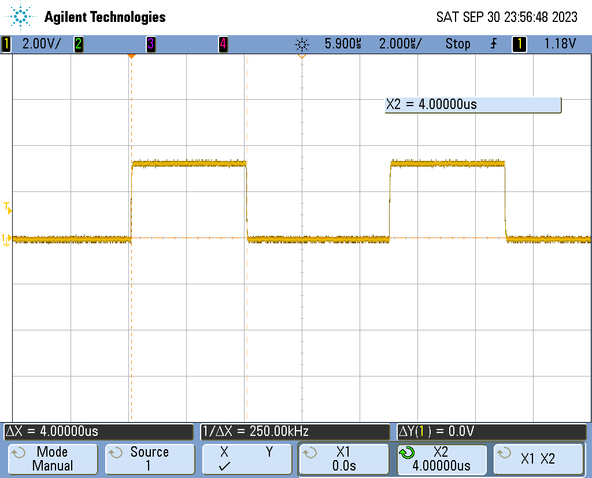
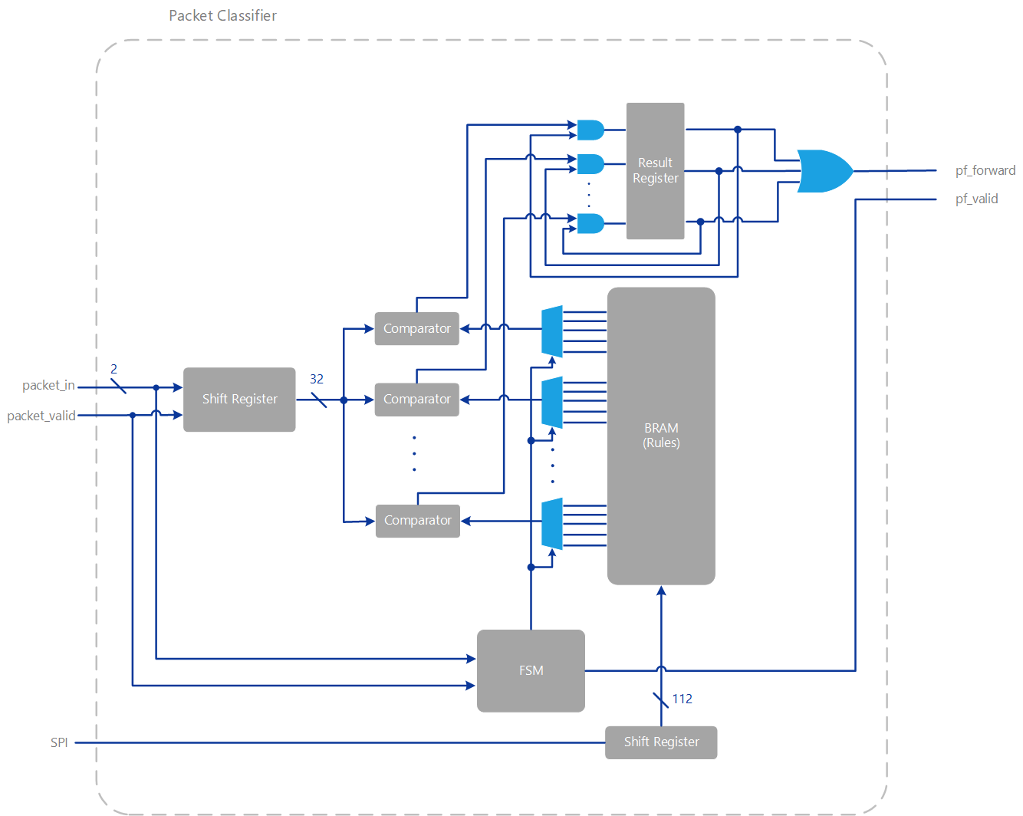
FPGA Ethernet Packet Filter with Webserver
Matthew Gilpin, Supervised by Dr Matthew D’Souza
PROJECT SCOPE
Increase embedded edge networks by using hardware based packet filters.
IPv4
BACKGROUND
Packet filters
TECHNOLOGIES
FPGA
RESULTS
4uS of latency added
Wirespeed – 100Mbit/s

