Slide 1
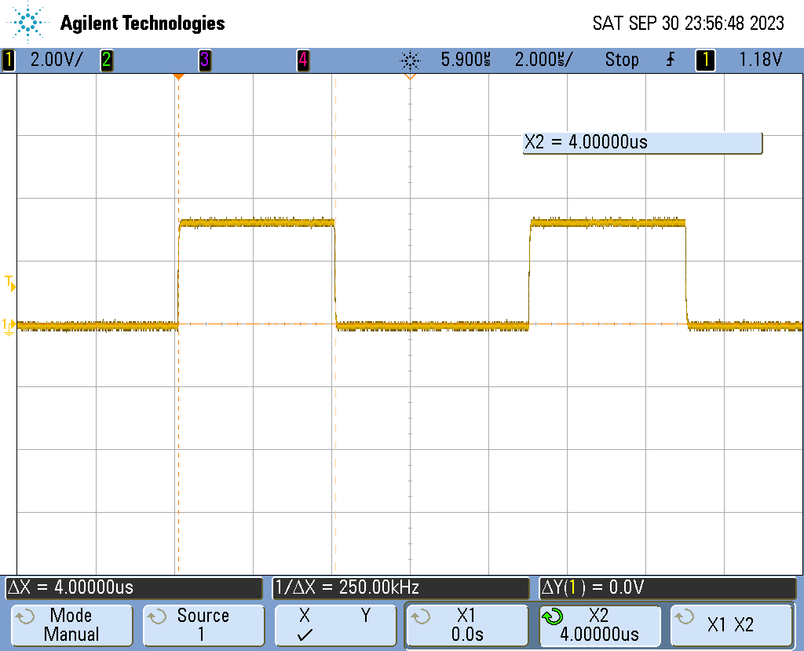
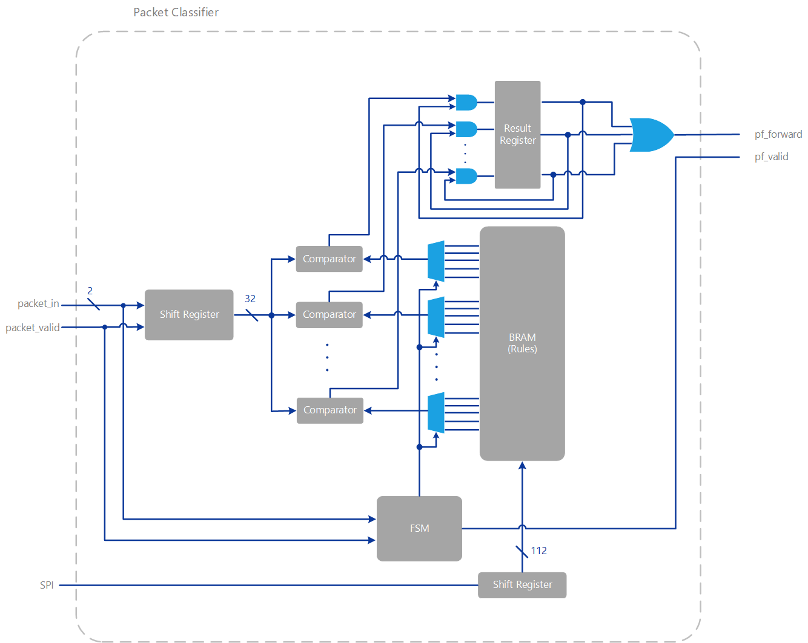
FPGA Ethernet Packet Filter with Webserver
Matthew Gilpin, Supervised by Dr Matthew D’Souza
PROJECT SCOPE
Increase embedded edge networks by using hardware based packet filters.
IPv4
Only supporting the 5-tuple fields - Destination IP, Source IP, Destination Port, Source Port and protocol.
Goal: implement a firewall to improve security in the embedded systems space
BACKGROUND
Packet filters
TECHNOLOGIES
Xilinx Artix 7 100T FPGA.
NEORV32 RISC-V softcore
LAN8720A RMII PHY
MAC over Wisbone B4 Classic
- Written from the ground up
- 32bits wide memory mapped.
- computes CRC32 on the fly
Hardware packet filter supports currently 8 rules and does parallel comparisons on all 8 rules at a time.
Hardware filtering takes place at the RMII level.
FreeRTOS-Plus-TCP handles layer 3 and up including webserver.
Webapp designed in Vue.js with Tailwindcss for styling. Static single page application – Less network traffic
Webapp uses REST API
RESULTS
4uS of latency added
Wirespeed – 100Mbit/s

