Slide 1
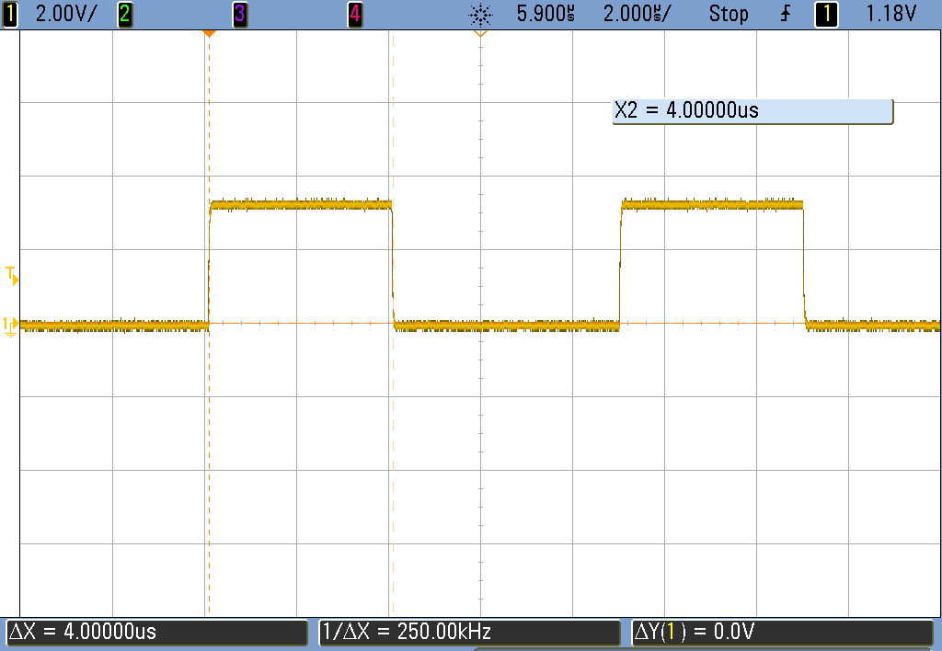
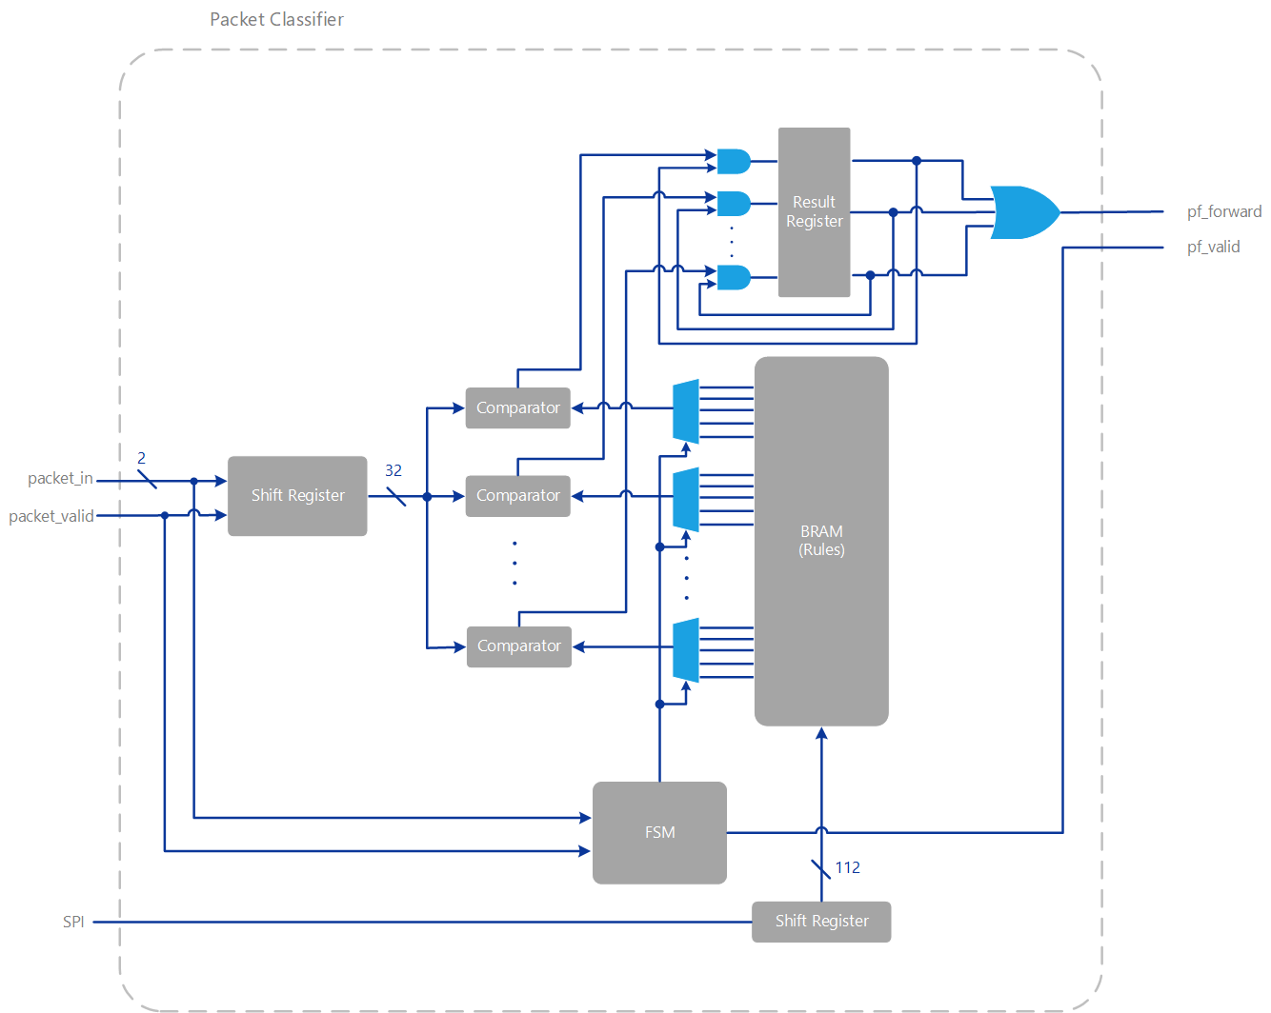
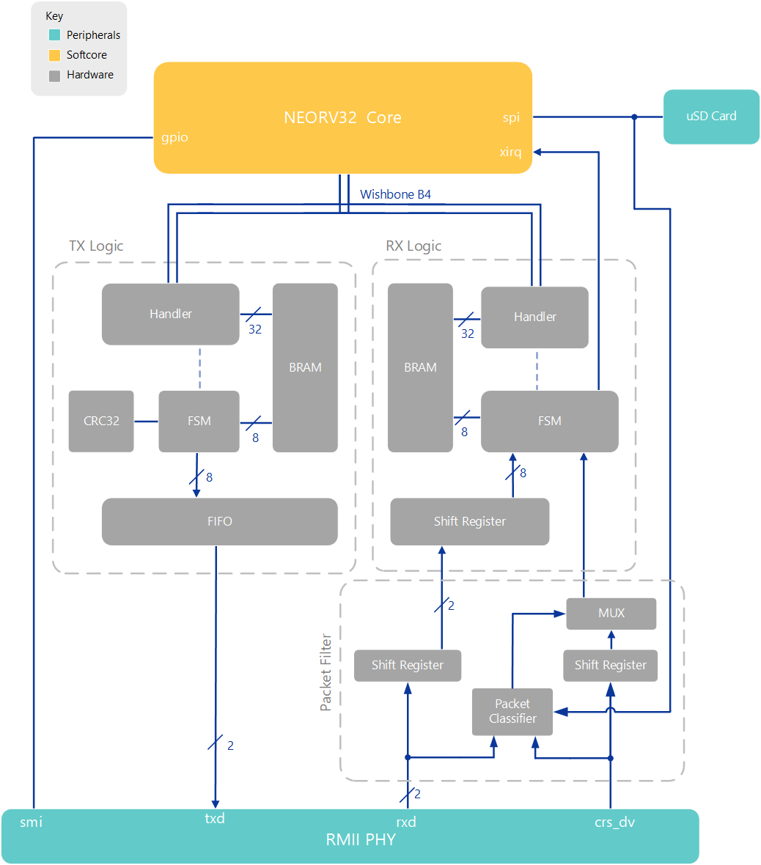
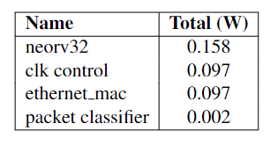
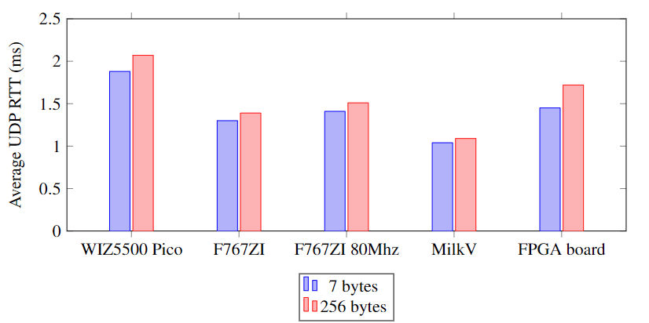
FPGA Ethernet Packet Filter with Webserver
Matthew Gilpin, Supervised by Dr Matthew D’Souza
PROJECT SCOPE
76,000 cybercrime reports in Australia in 2021-22 financial year.
Growth of IoT will greatly increase this figure.
Embedded systems are generally low power and may forgo protection.
Implement an IPv4-based hardware firewall with configurable packet filter and web interface.
Firewall inspects the 5-tuple fields - Dest. IP, Source IP, Dest. Port, Source Port and Protocol.
BACKGROUND
Firewalls are the first line of defence against bad actors by restricting network access to private networks.
Many types of packet filters exist and operate differently. For example deep packet inspection (out of scope). Packet filtering takes place in layers 3 and 4 (Network and Link Layers)
FPGAs are a class of programmable logic that use lookup tables and flip flops to implement digital logic. Cheaper and faster turn-around time than ASICs in low quantities.
FPGA allow for complete control over data and hardware parallelisation. Can design lower latency hardware.
Previous papers achieved a latency of 61.266us with 5-typle binding packet filter on FPGA. Goal: achieve lower latency.
TECHNOLOGIES
Digilent Nexys A7
- Xilinx Artix 7 100T FPGA.
- LAN8720A RMII PHY
NEORV32 RISC-V softcore at 80Mhz
Ethernet Controller over Wishbone Classic
- Written from the ground up
- 32bits wide memory mapped.
- computes CRC32 on the fly
FreeRTOS-Plus-TCP handles layer 3 and up including webserver.
Webapp designed in Vue.js with Tailwindcss for styling. Static single page application – Less network traffic. Uses RESTful API for data.
RESULTS
Wirespeed firewall – 100Mbit/s
4us of latency added
Total measured 0.51W power. Packet filter logic consumes ~2mW
Comparable to other platforms. Gap in the different size packets indicates limitation of CPU power.
Aim: Improve embedded security while decreasing latency and power requirements for packet filtering.
Key: Hardware packet filter supports 8 rules – comparison done in parallel.
Key: Filtering in hardware allows for wirespeed throughput with low latency due to parallelisation.

