Slide 1
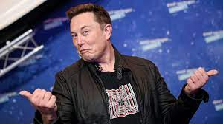
Capstone:
Predicting if Elon Musk’s tweets will have high traffic
By Matt Bildzok

Slide 2
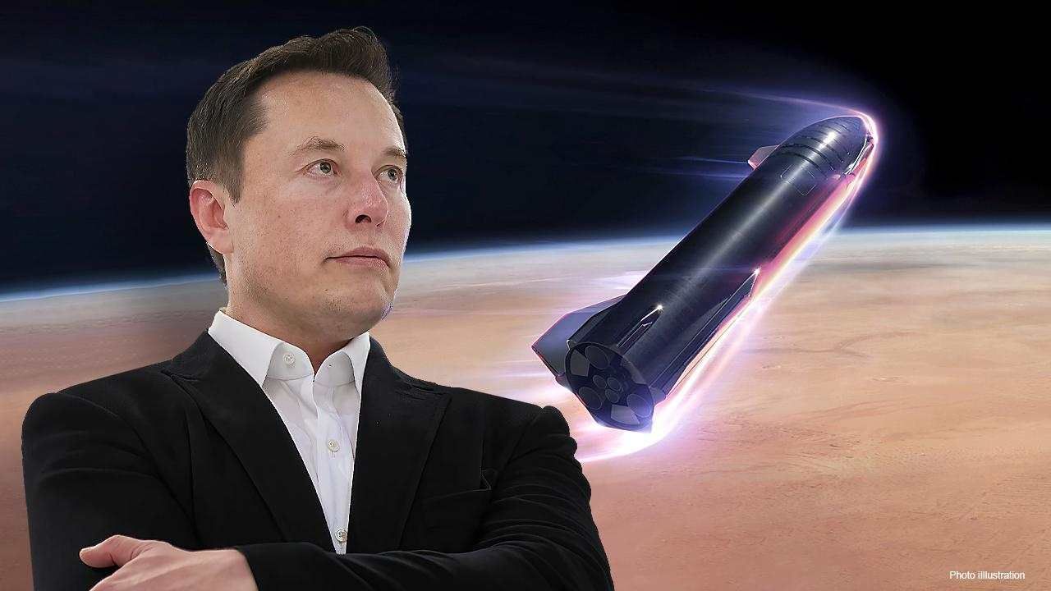
Who is Elon Musk and why does he matter?
Elon Musk is an entrepreneur from South Africa who created and runs the innovative companies of Tesla, SpaceX, and the Boring Company. He has become quite the influential entity in the modern day, with many people changing what they do based on his decisions.

Slide 3
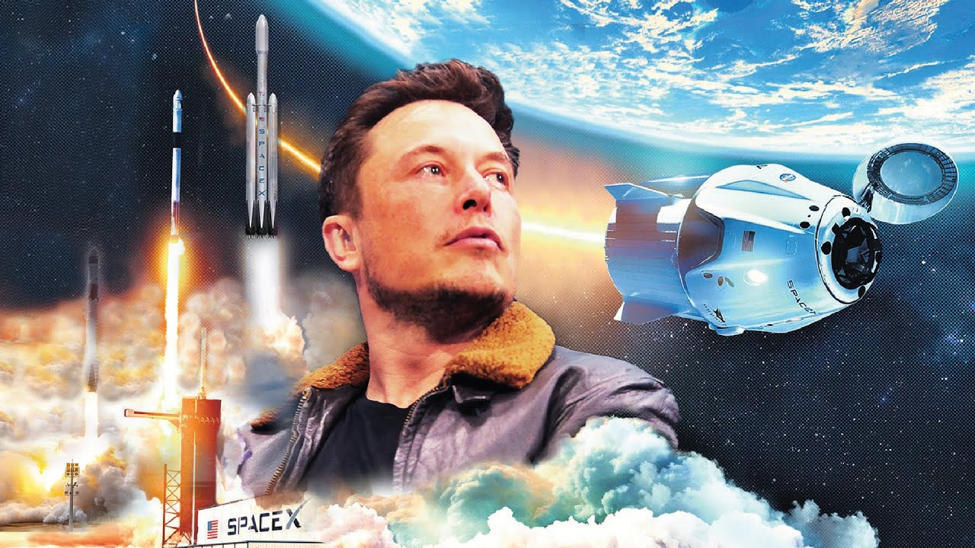
Elon Musk’s Influence
Elon Musk has helped to shape the face of the electric vehicle world, working on new technologies that can travel long distances on a single charge, and has expanded into Artificial Intelligence, mainly for automated cars that drive on their own. He has also created the Falcon 9 Rocket, the first reusable rocket that lands vertically, instead of detaching and hurling parts into the Earth’s oceans. He is also spearheading the journey to Mars ultimately colonize it and have a second home for humans, in the instance that something happens to Earth, such as a meteor strike, or nuclear war.

Slide 4
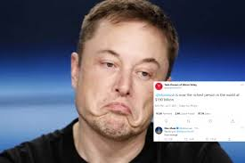
What will I be doing?
I will be looking at Elon Musk’s tweets and build a model that can determine if they have high traffic or become viral or not, based on what he tweets and what the context is.

Slide 5
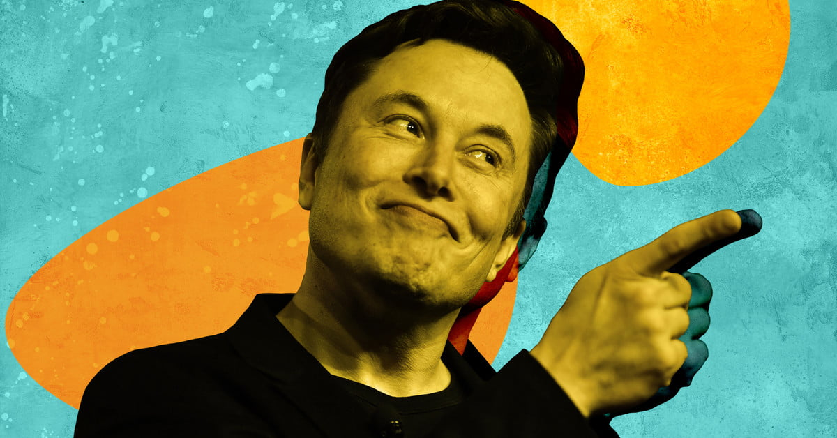
Twitter had taken too long to give me an API key for me to scrape the tweets I wanted, so I had to find an alternative way to gather the data. Luckily, Kaggle had a solid collection of his tweets from 2015-2020, totalling 9286 tweets, so I decided to work with that dataset.

Slide 6
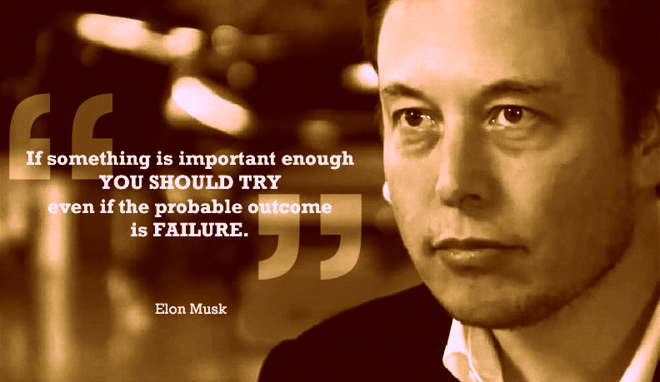
To determine if a tweet receives high traffic, I focused on the three main measures of such traffic, replies, retweets, and likes. I created a model for each to predict the probability of each becoming a success, or in other words, surpassing a certain threshold.

Slide 7
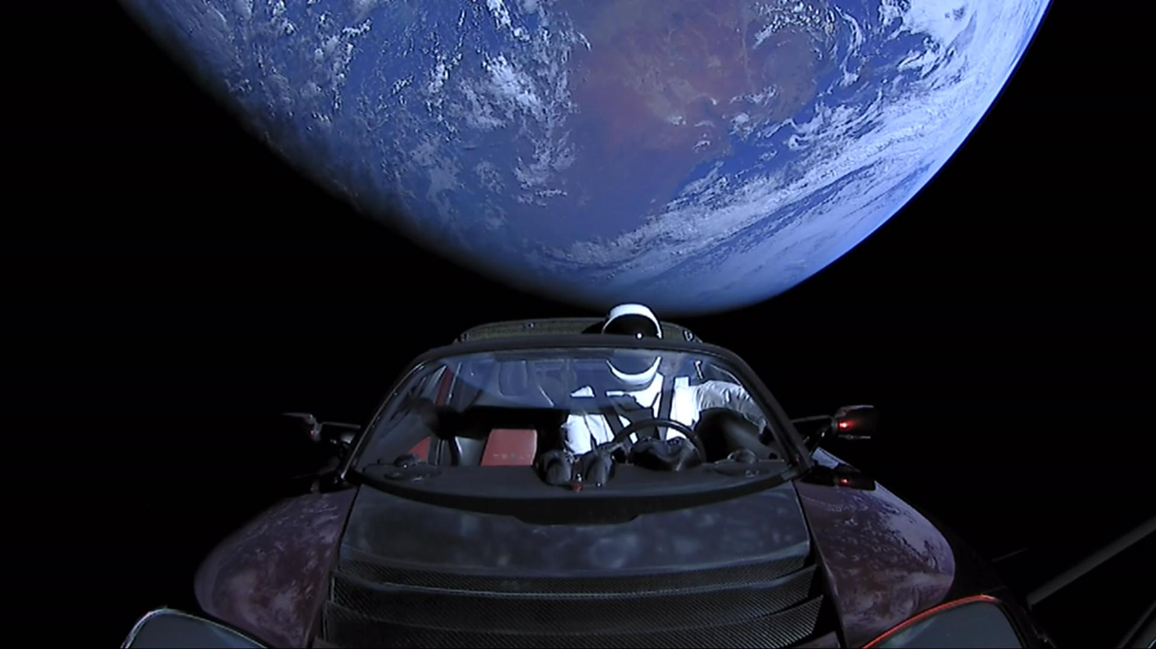
What models did I make?
After the EDA, I count Vectorized the tweets, and created LassoCV models to predict a range of numbers for the predictions, that took quite some time, so I then made new columns for successes, and ran Multinomial Naive Bayes models to predict if a tweet would be successful.
I also made models based off of Sentiment Analysis to further explore possible predictions.

Slide 8
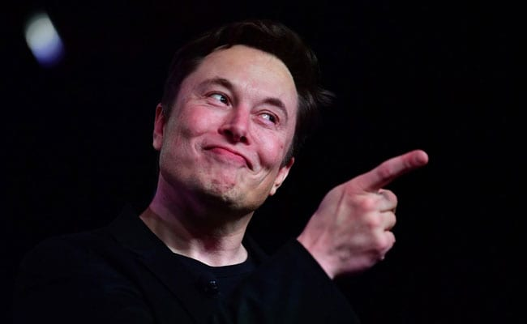
Due to Elon’s sheer magic, I found that with each model created for each measure of success, each one had an identical statistic, I lowered the benchmarks for each of the retweets, replies and likes 5 times , each time cutting them in half, and each time they all had similar outcomes.

Slide 9
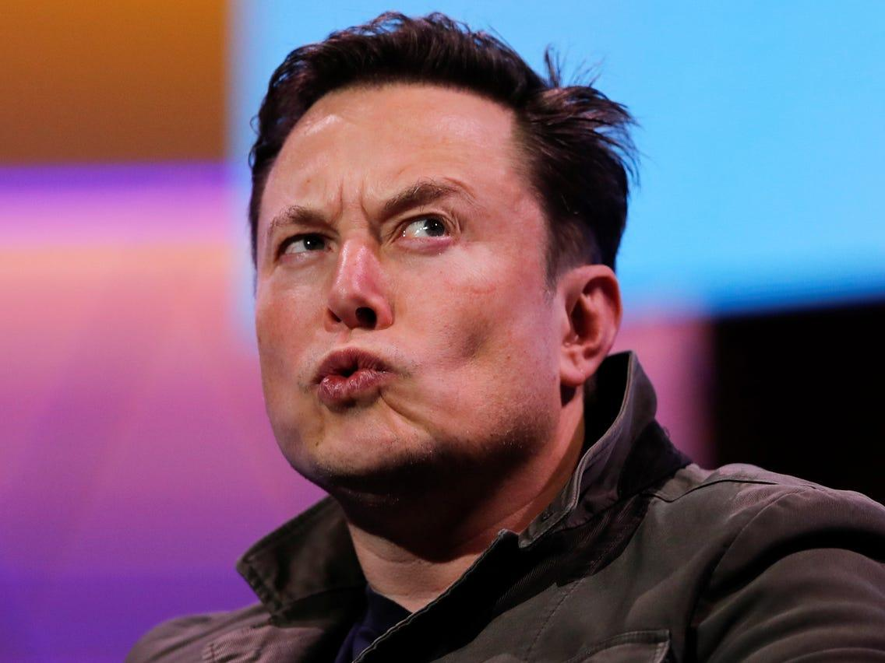
I noticed that this proved to be slightly more difficult than first thought, as over the course of 5 years, Elon’s following grew considerably, making older tweets harder to predict with the model.

Slide 10
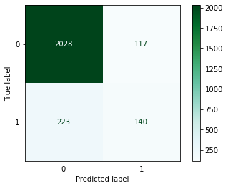
Each of my models looked very similar with similar accuracies

Slide 11
The base model had an accuracy of 85.5% of not being a success, and 14.5% of having high traffic, my models gave me an accuracy of 86.6%. However, running a Logistic Regression model on count vectorized tweets and sentiment analysis gave me an accuracy of 87.4%

Slide 12
What problems did I run into?
One problem I ran into was Twitter taking too long to get an API key, another was time, if I had more I would have included stock prices and potential changes due to what Elon tweets. This is what I would focus on the further improve my findings.

Slide 13
Conclusion:
In conclusion, I have built models that can give Elon and idea of what he can tweet and tweet about to receive high traffic and bring even more attention to his topics and plans

Slide 14
Thank you!

