Slide 1
The Market and Well Being
8/3/2021

Slide 2
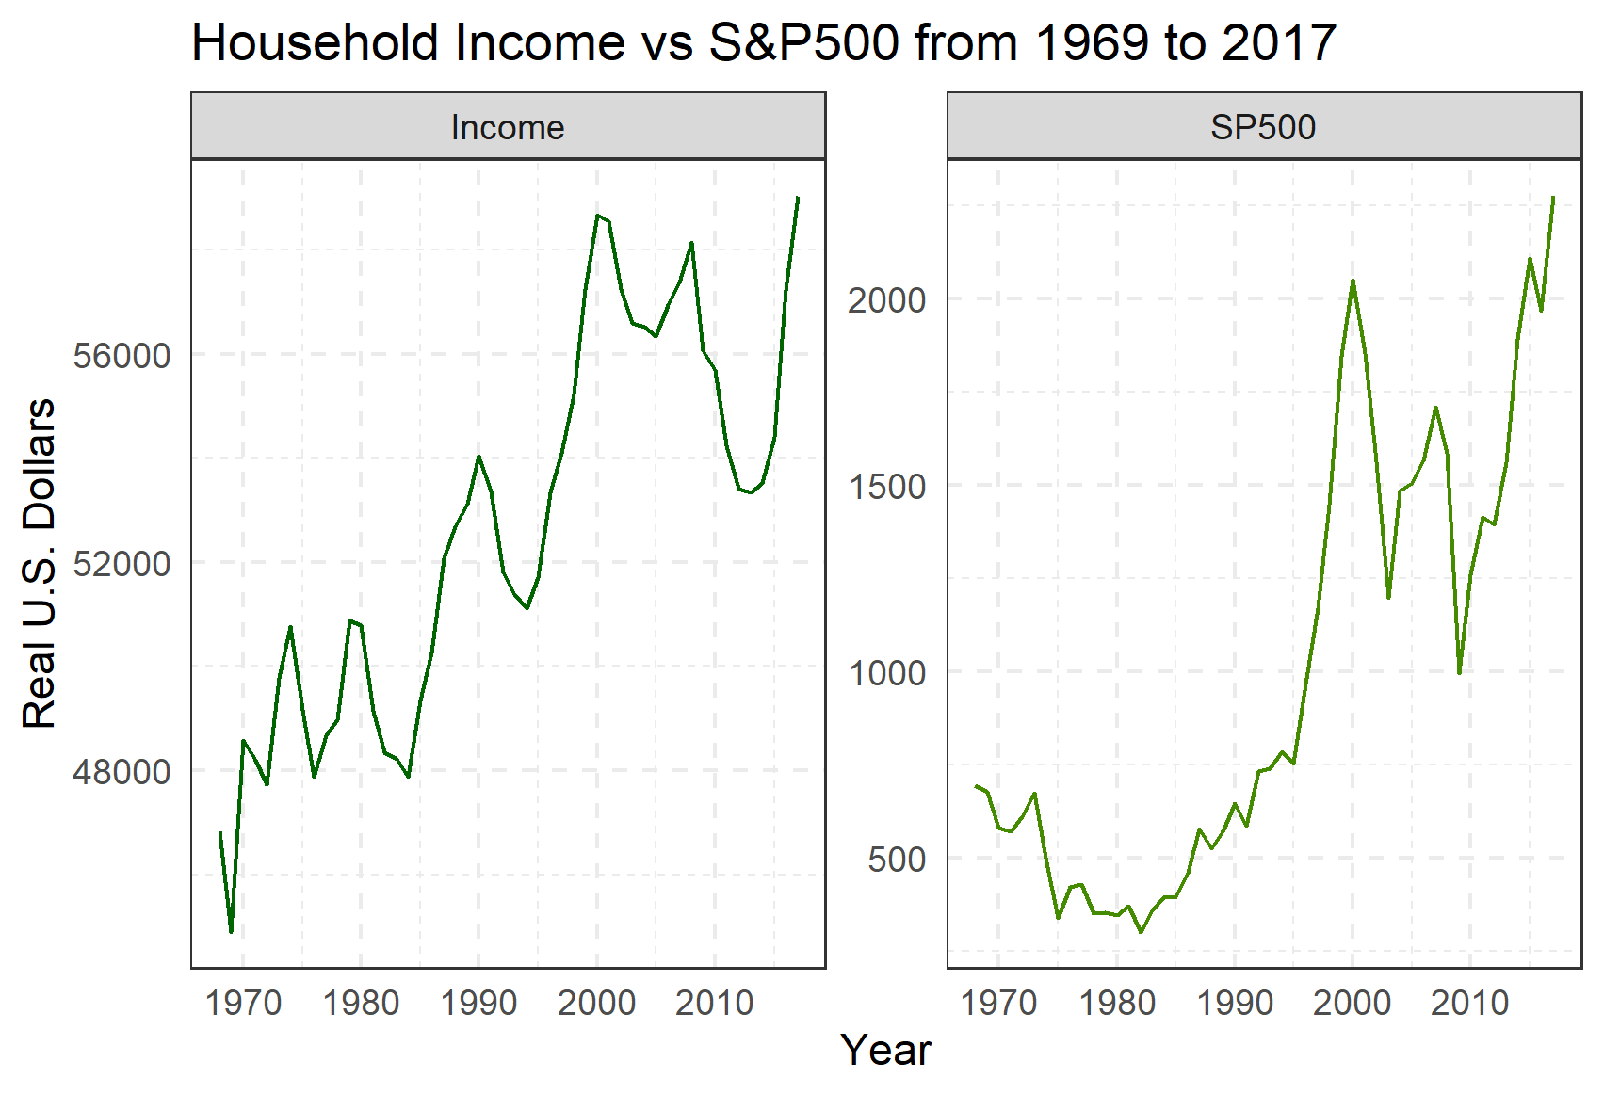
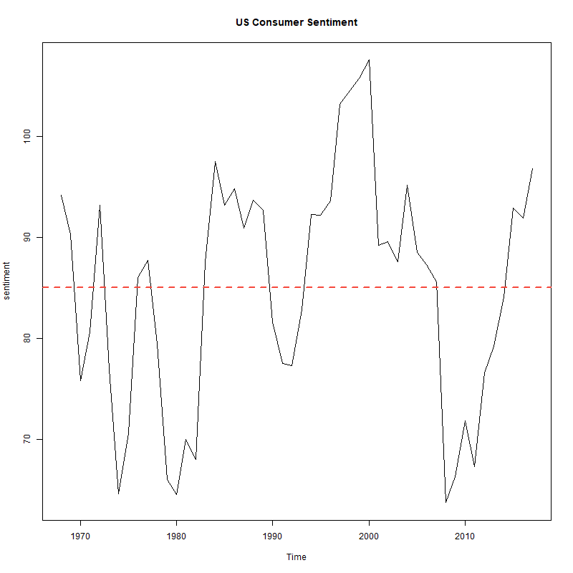
Project Goal Restatement
Initial Datasets
Additive Dataset
To explore the relationship between indicators of market success and the general well-being of the population.
Inflation adjusted S&P 500 (yearly 1969-2017)
U.S. Median Real Income (yearly 1969-2017)
University of Michigan Index of Consumer Sentiment

Slide 3
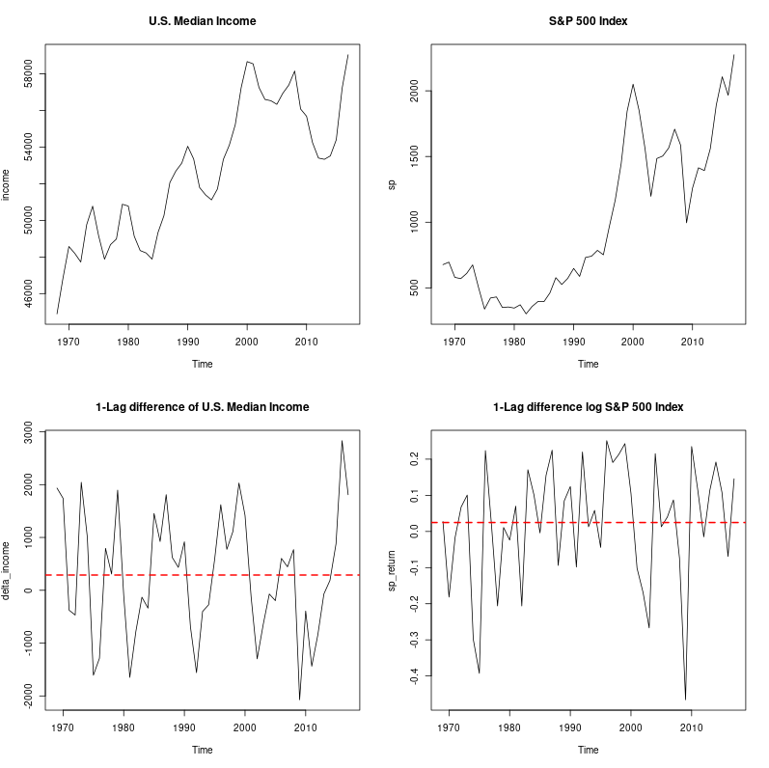
Transformation to Stationarity - Initial Datasets
Methodology
Difference of Logarithm Transformation (S&P 500)
Differencing (U.S. Median Income)
Interpretation
S&P 500 Series
Return of the index at year t
U.S. Median Income Series
Change in median income from year t-1 year to year t
Time series plots of the S&P 500 Index and U.S. Median Income, before and after transformations to stationarity.

Slide 4
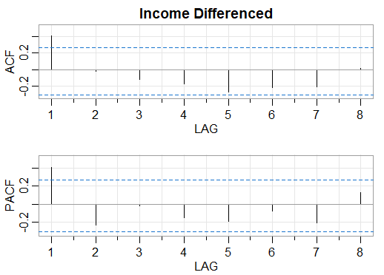
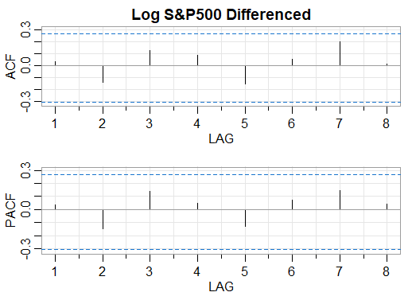
Autocorrelation and Partial Autocorrelation - Initial Datasets
Significant lag 1 in both ACF and PACF and cuts off for all larger lags
Indicative of AR(1) or ARMA(1,1) model
No significant ACF or PACF
Indicative of mean-only model

Slide 5
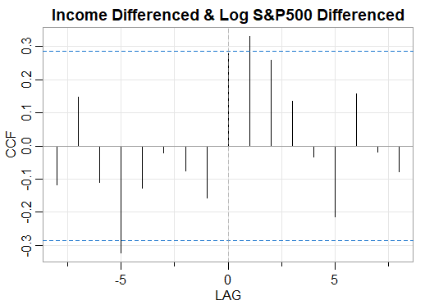
Cross-correlation - Initial Datasets
Next year’s differenced income positively correlated with this year’s log differenced S&P 500 value

Slide 6
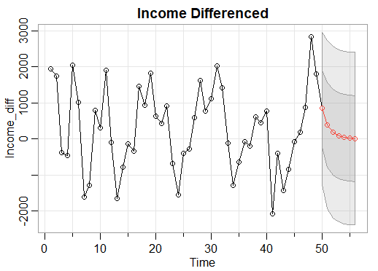
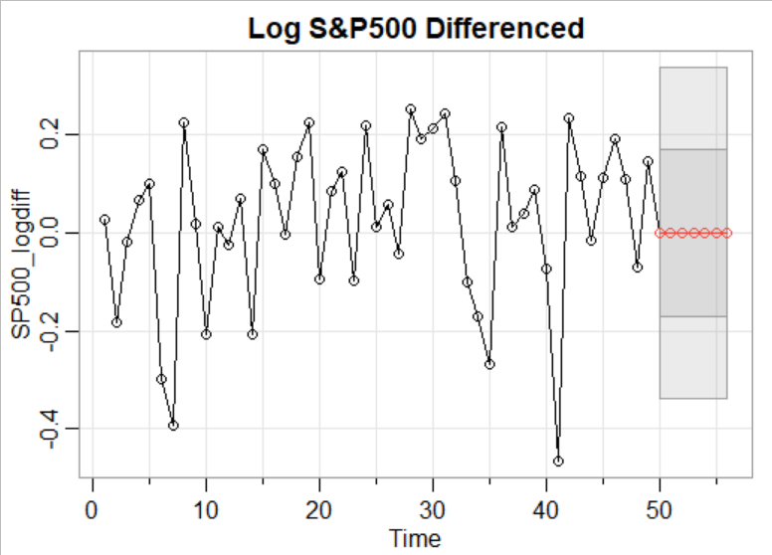
Fitting and Forecasting - Initial Datasets
AR(1) Fitted Model
Mean-Only Model
^
^
I_{t}= 0.465_{(0.132)} I_{t-1}
log(S_{t}) = 0.024_{(0.024)}

Slide 7
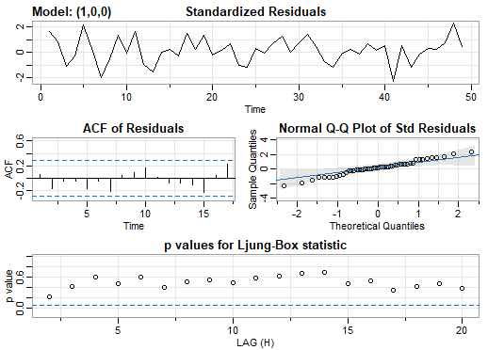
Diagnostics - Differenced Income
Standardized Residuals
Residuals are stationary
Vary about 0
Relatively constant variance
ACF of Residuals
Indicates residuals uncorrelated
Normal Q-Q Plot of Standard Residuals
Normality satisfied
All model assumptions are satisfied

Slide 8
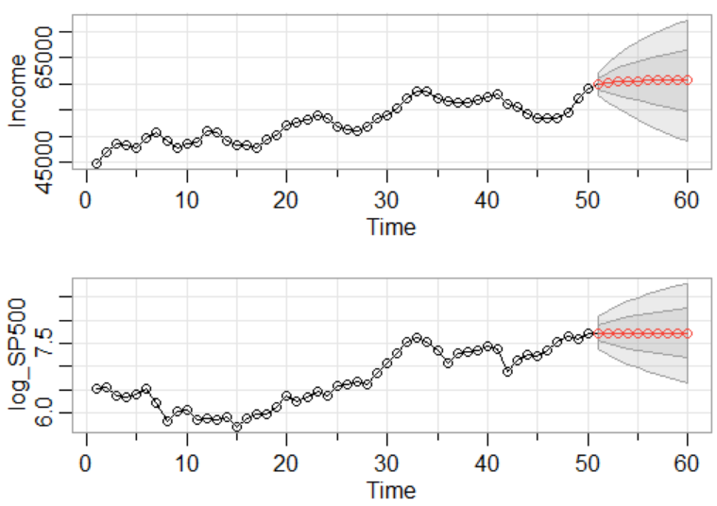
Fitting and Forecasting Integrated Models
ARI(1,1) model fit to I_{t}
Simple Integrated model fit to log(S_{t})

Slide 9
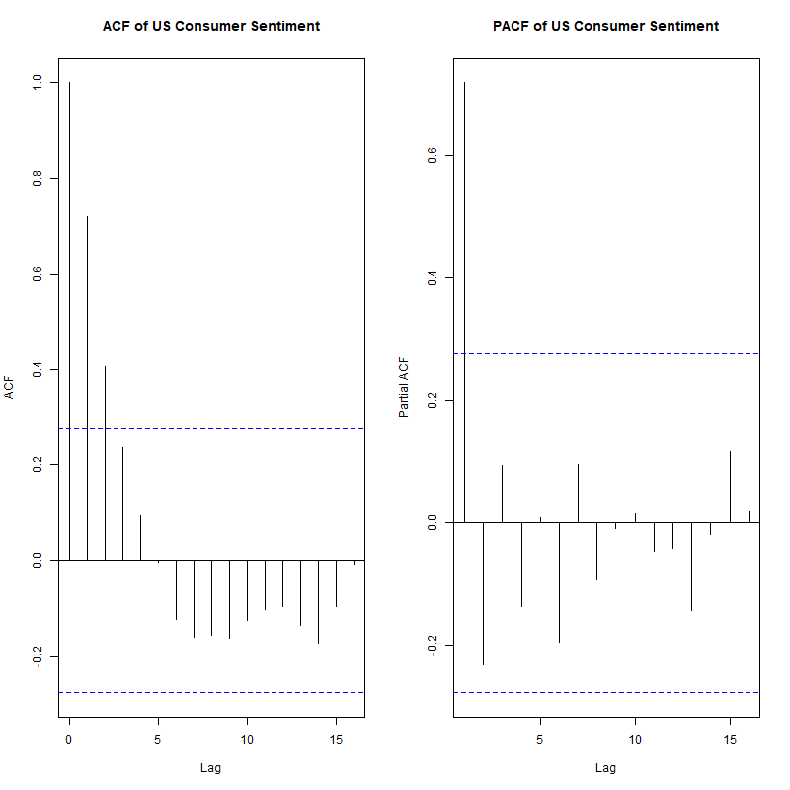
Introduction of Consumer Sentiment Time Series
Relatively stationary - no data transformation needed
Tail-off in ACF
Significant lag 1 in PACF

Slide 10
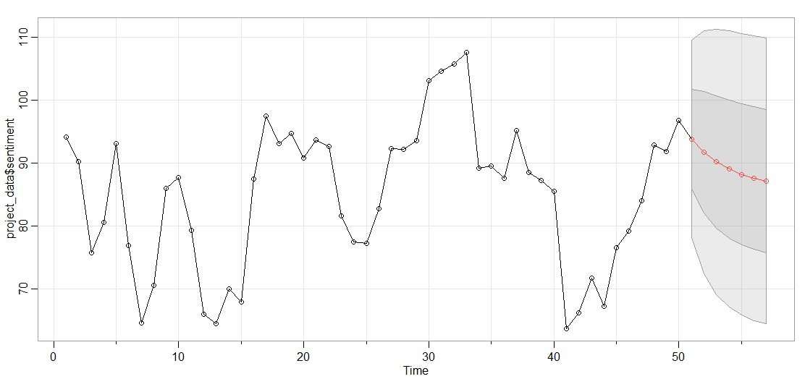
Fitting and Forecasting - Consumer Sentiment
AR(1) Fitted Model
^
^
C_{t}= 86.027_{(3.917)} + 0.73_{(0.095)}C_{t-1}

Slide 11
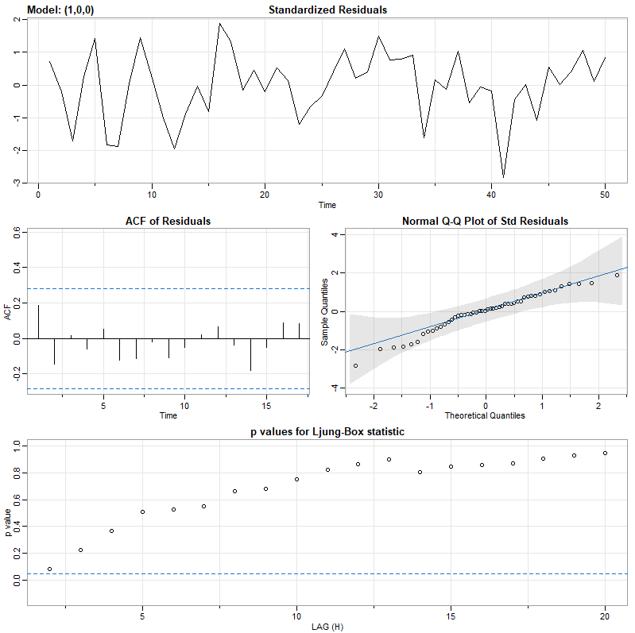
Diagnostics - Consumer Sentiment
Standardized Residuals
Residuals are stationary
Vary about 0
Relatively constant variance
ACF of Residuals
Indicates residuals uncorrelated
Normal Q-Q Plot of Standard Residuals
Normality satisfied
Ljung-Box Statistic
P-values all above 0.05
All model assumptions are satisfied

Slide 12
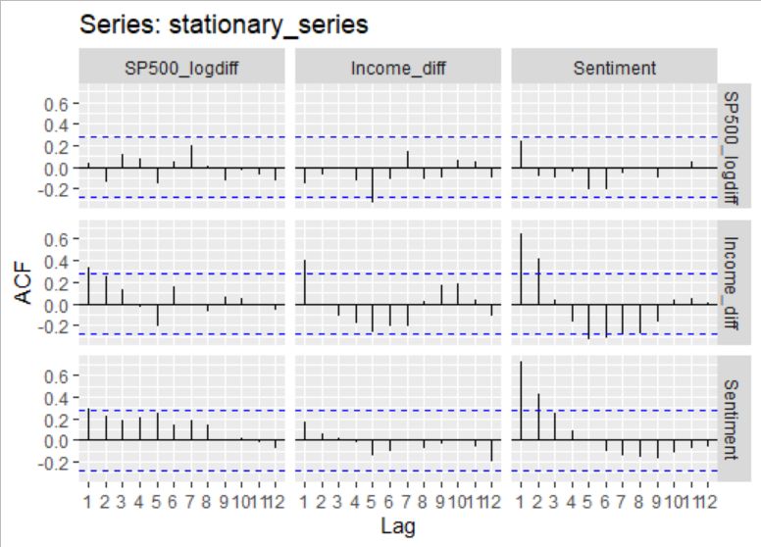
Cross-correlation - All Datasets
Consumer sentiment highly correlated with future values of the differenced income series. Very slight correlation between consumer sentiment and future log-differenced S&P 500 values.

Slide 13


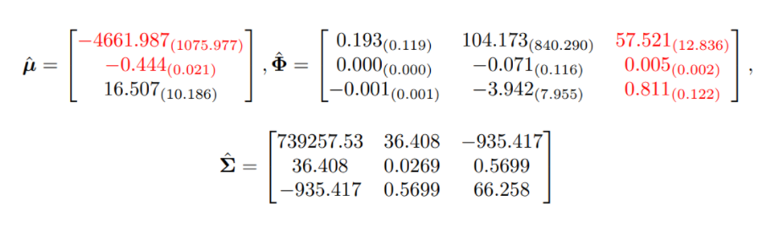
Multivariate Model
VAR(1) Fitted Model
Elements in red are statistically significant

Slide 14
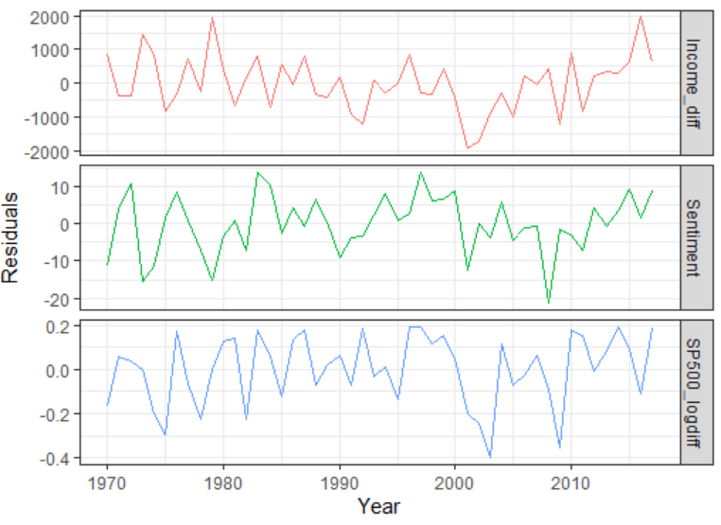
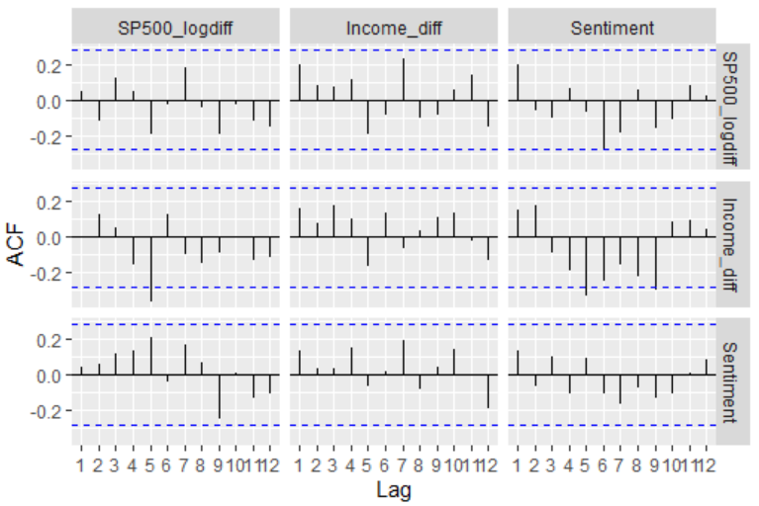
Residual Diagnostics for VAR(1) Model
Reasonably white noise
Vary about mean 0
Does not exhibit heteroskedasticity
Slight correlation between sentiment and differenced income residuals

Slide 15
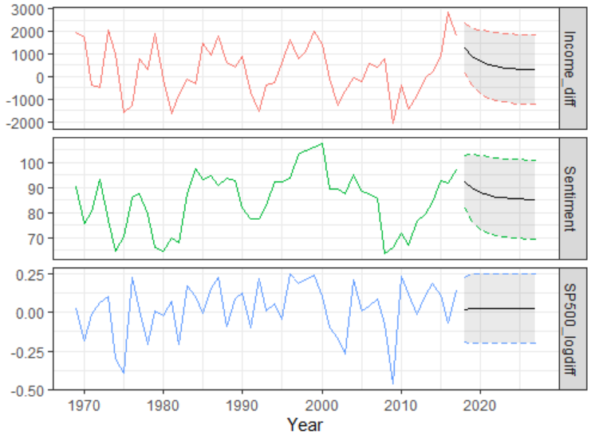
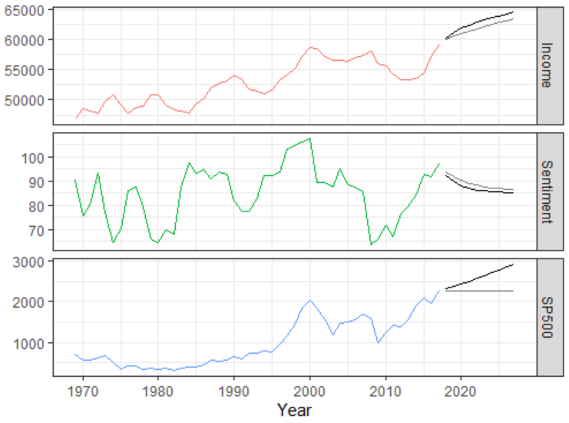
Predictions
VAR(1) Model
Original Series

Slide 16
Conclusions
The relationship between consumer sentiment, stock market performance, and median income is complex:
Much of our economy/financial market is speculative
Trading on Twitter sentiment, human behavior
There is some correlation between income and the S&P500
Pales in comparison to the relationship with the Consumer Sentiment Index
There is also an aspect of income reflected in the CSI

Slide 17
QUESTIONS?

