Slide 1

Offuture - Team Select
Matthew Hewitt, Karan Ruprah and Zeba Jahan

Slide 2
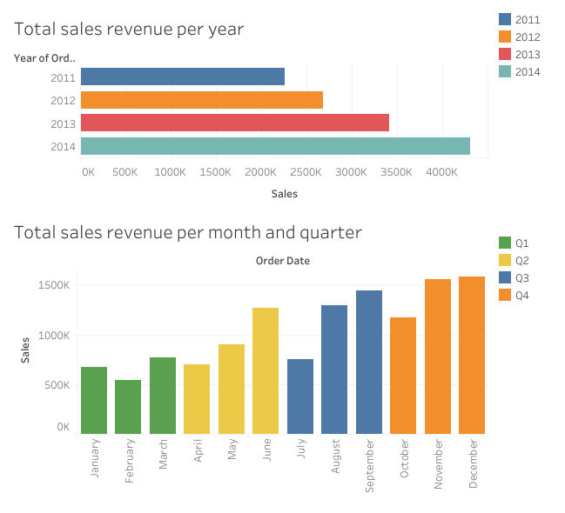
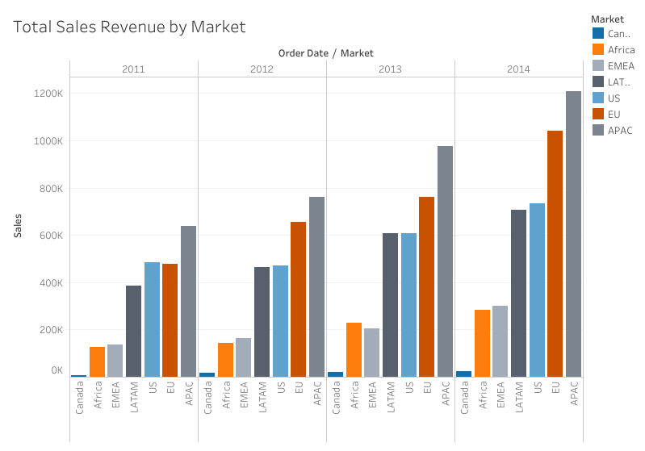
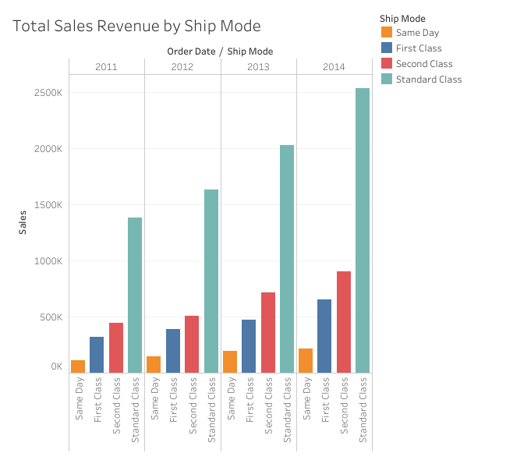
Sales Revenue
$2.3m to $4.3m in 3 years
APAC and EU markets 52%, Canada less than 1%
No real differences in Category
Consumer segment 51%
Standard class 60%, Same day 5%

Slide 3
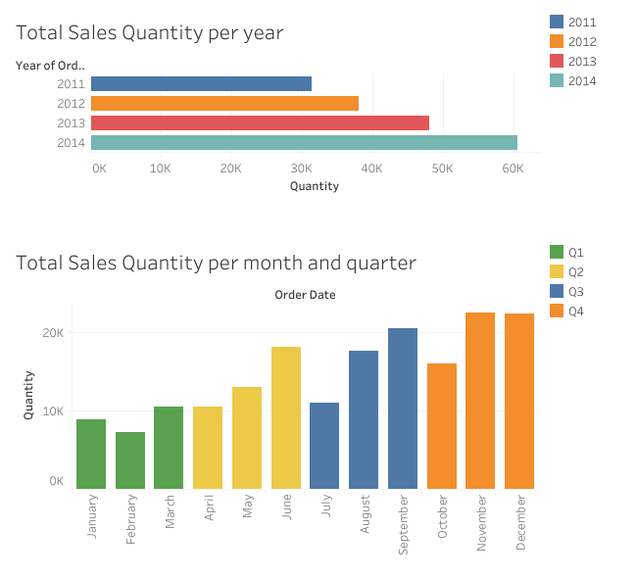
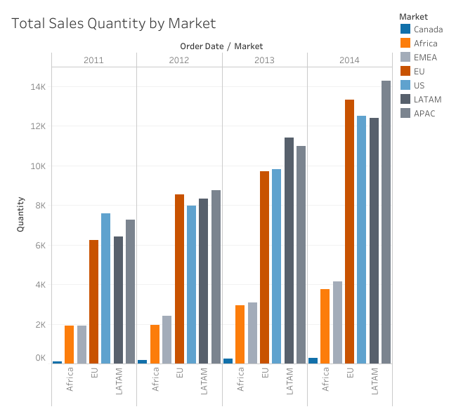
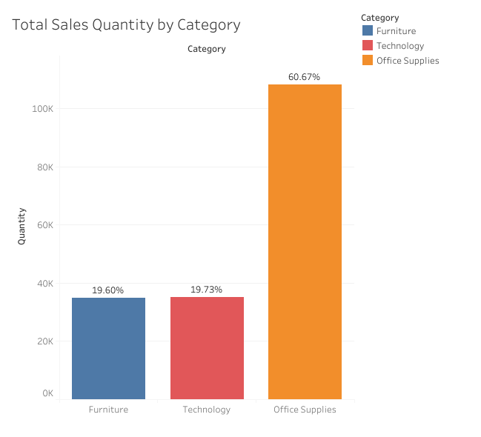
Sales Quantity
31k to 61k in 3 years
Canada less than 1%, APAC, LATAM, US and EU all between 21% to 24%
Office Supplies 61%, Technology and Furniture both 20%
Tables less than 2%
Consumer segment 52%
Standard class 60%, Same Day 5%

Slide 4
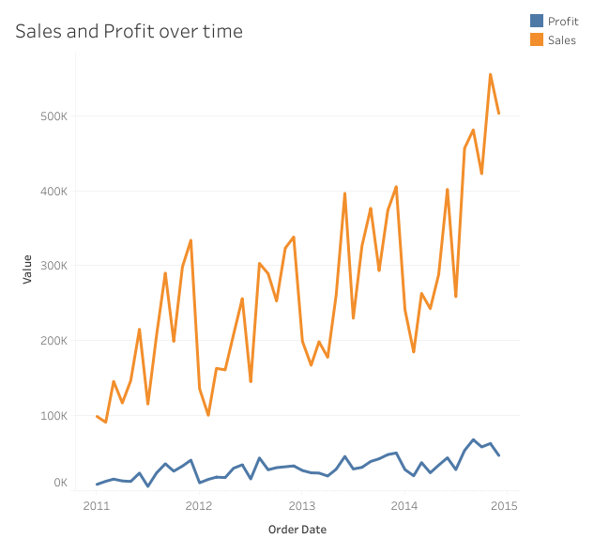
Notes:
Product category profit/sales ratio: Office supplies and Tech with 14% each and Furniture only 7%. Indicates an issue that needs further investigation.

Slide 5
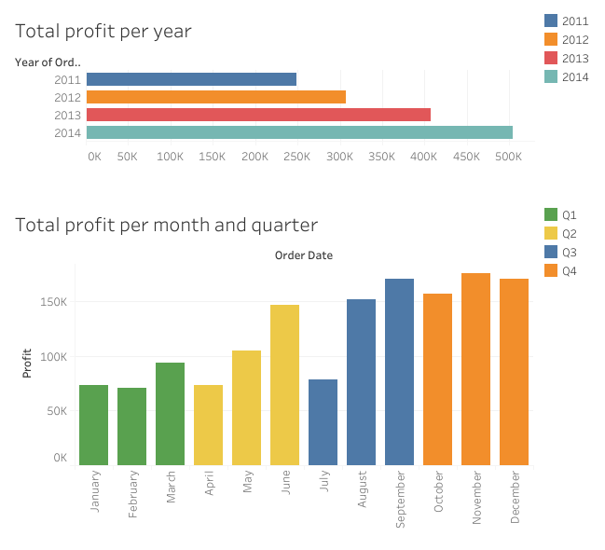
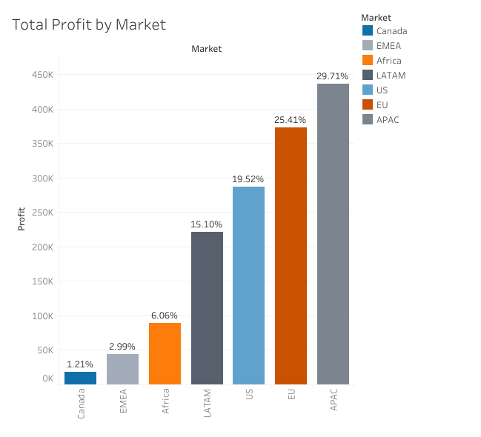
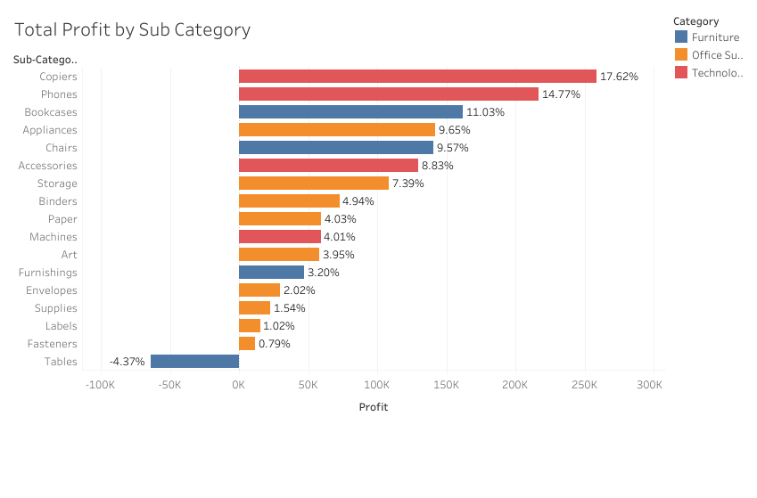
Profit
$249k to $504k in 3 years
APAC and EU 55%, Africa, EMEA and Canada just over 10%
Technology 45%, Office supplies 35%, Furniture 20%
Copiers and Phones 32%, Tables lost $64,000
Consumer segment 51%
Standard class 61%, Same Day 5%

Slide 6
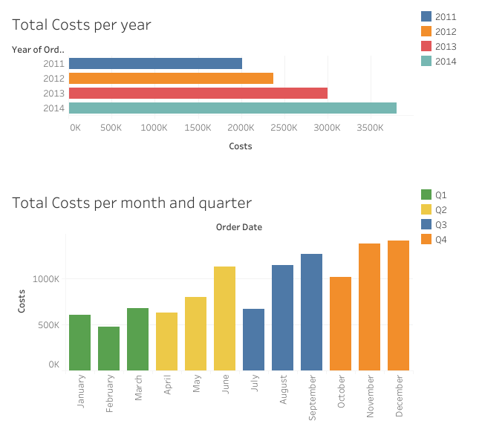
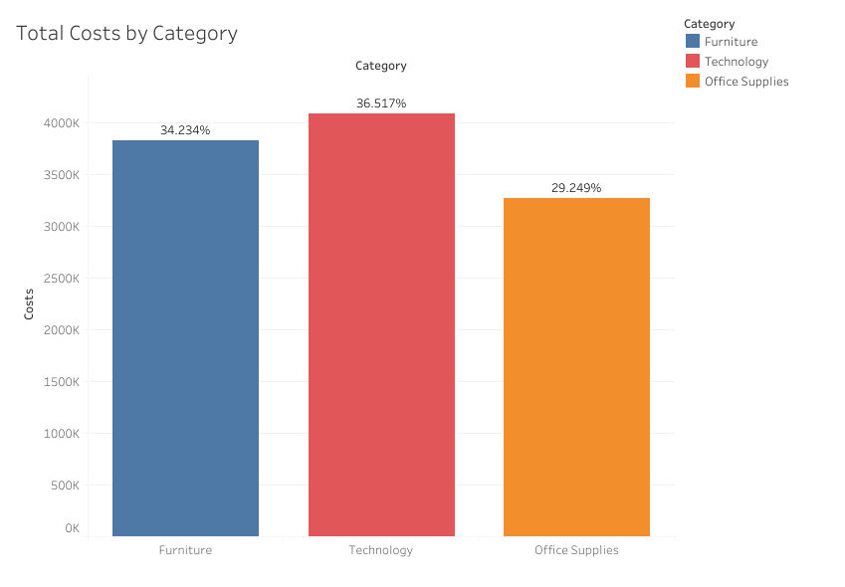
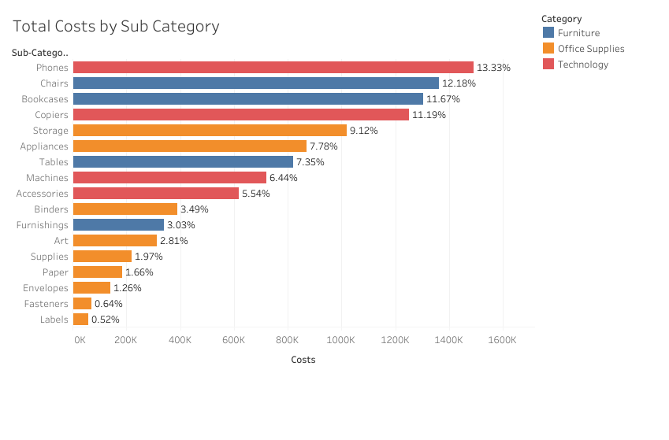
Costs
$2m to $3.8m in 3 years
APAC and EU 51%, Canada less than 1%
All categories within 29% to 37%
Tables 7%
Consumer Segment 52%
Standard class 61%, Same Day 5%

Slide 7
Discount
Cities | Tegucigalpa | Chicago | Houston | Bangkok | Manila
Sales Quantity | 1334 | 1132 | 1466 | 1083 | 1661
Average Discount | 0.41 | 0.38 | 0.38 | 0.36 | 0.35
Product sub Categories | Tables | Binders | Machines | Chairs | Bookcases | Furnishings | Phones | Appliances
Sales Quantity | 3083 | 21429 | 4906 | 12336 | 8310 | 11225 | 11870 | 6078
Average Discount | 0.29 | 0.18 | 0.17 | 0.16 | 0.15 | 0.15 | 0.15 | 0.14
Market | EMEA | Africa | US | APAC | LATAM | EU | Canada
Sales Quantity | 11517 | 10564 | 37873 | 41226 | 38526 | 37773 | 833
Average Discount | 0.2 | 0.16 | 0.16 | 0.15 | 0.14 | 0.1 | 0
Countries | Nigeria | Turkey | Netherlands | Argentina | Honduras
Sales Quantity | 2056 | 3024 | 1682 | 1504 | 2556
Average Discount | 0.7 | 0.6 | 0.48 | 0.43 | 0.41
Product Category | Furniture | Office Supplies | Technology
Sales Quantity | 34954 | 108182 | 35176
Average Discount | 0.17 | 0.14 | 0.14
22,281 Discounted orders (43.4%)
29,009 Non-Discounted orders (56.5%)
Customer segment and shipping mode has a consistent rate
Tables has the highest average discount rate

Slide 8
Top 10 Products, Countries and Cities
Product ID | Sales Revenue ($)
TEC-CO-10004722 | 61599.82
TEC-PH-10004664 | 30041.55
OFF-BI-10003527 | 27453.38
TEC-MA-10002412 | 22638.48
TEC-PH-10004823 | 22262.1
FUR-CH-10002024 | 21870.58
FUR-CH-10000027 | 21329.73
OFF-AP-10004512 | 21147.08
OFF-BI-10001359 | 19823.48
OFF-BI-10000545 | 19024.5

Slide 9
Top 10 Products, Countries and Cities
Product ID | Profit ($)
TEC-CO-10004722 | 25199.93
OFF-AP-10004512 | 10345.58
TEC-PH-10004823 | 8121.48
OFF-BI-10003527 | 7753.04
TEC-CO-10001449 | 6983.88
FUR-CH-10002250 | 6123.26
TEC-PH-10004664 | 5455.95
OFF-AP-10002330 | 5452.46
TEC-PH-10000303 | 5356.81
FUR-CH-10002203 | 5003.1

Slide 10
Top 10 Products, Countries and Cities
Country | Sales Revenue ($)
United States | 2297200.86
Australia | 925235.85
France | 858931.08
China | 700562.03
Germany | 628840.03
Mexico | 622590.62
India | 589650.11
United Kingdom | 528576.3
Indonesia | 404887.5
Brazil | 361106.42
City | Sales Revenue ($)
New York City | 256368.16
Los Angeles | 175851.34
Manila | 120886.95
Seattle | 119540.74
San Francisco | 112669.09
Philadelphia | 109077.01
Sydney | 101945.52
Jakarta | 94321.32
London | 86945.81
Mexico City | 85728.55

Slide 11
Bottom 10 Products
Product ID | Sales Revenue ($)
OFF-AP-10002203 | 1.62
OFF-EN-10003604 | 2.27
OFF-BI-10003253 | 2.78
OFF-BI-10003323 | 2.88
OFF-SME-10000258 | 3.15
OFF-ADV-10003196 | 3.32
OFF-BI-10001284 | 3.44
OFF-LA-10004700 | 3.5
OFF-BI-10000390 | 3.58
OFF-SME-10000950 | 4.03
Product ID | Profit ($)
TEC-MA-10000418 | -8879.97
OFF-AP-10001623 | -4958.16
TEC-MA-10000822 | -4589.97
TEC-PH-10002991 | -4574.64
TEC-MOT-10003050 | -3998.68
TEC-MA-10004125 | -3839.99
FUR-CH-10001582 | -3066.78
FUR-TA-10000198 | -2876.12
FUR-TA-10002885 | -2798.49
FUR-TA-10001889 | -2684.17

Slide 12
Conclusion
Consistent growth throughout this period
APAC and EU markets major drivers in sales revenue and profit
Consumer segment over 50% of sales revenue and profit
Standard class majority of shipping mode
Diversified products and customer base
Areas of improvement e.g Tables

Slide 13
Any further questions?

