Slide 1
BookVault API
Matthew Hughes
COMP3011

Slide 2


Overview
BookVault API provides a set of endpoints relating to books and their metadata. It allows users to access information from the Goodreads books dataset from Kaggle such as a book’s name, author, publication date, etc. as well as rating information such as a book’s average rating.
There is also an analytics section where you can request statistical data about the dataset. Endpoints include rating distribution, top publishers, most rated books, and a language breakdown.
I chose books for this coursework because it was part of an idea for a personal project that I intended to create.

Slide 3



Technology Stack
FastAPI was chosen over Django for a few reasons:
FastAPI automatically generates interactive SwaggerUI documentation.
Pydantic schemas make request validation easier.
Asynchronous request handling is more suited to modern RESTful architecture.
SQLite was chosen for the database as it is simple to use and does not require an external database (it is stored in a single file). This makes it ideal for a project of this scale.
SQLAlchemy provides an ORM layer that maps Python classes to database tables making development and debugging intuitive for this project.

Slide 4
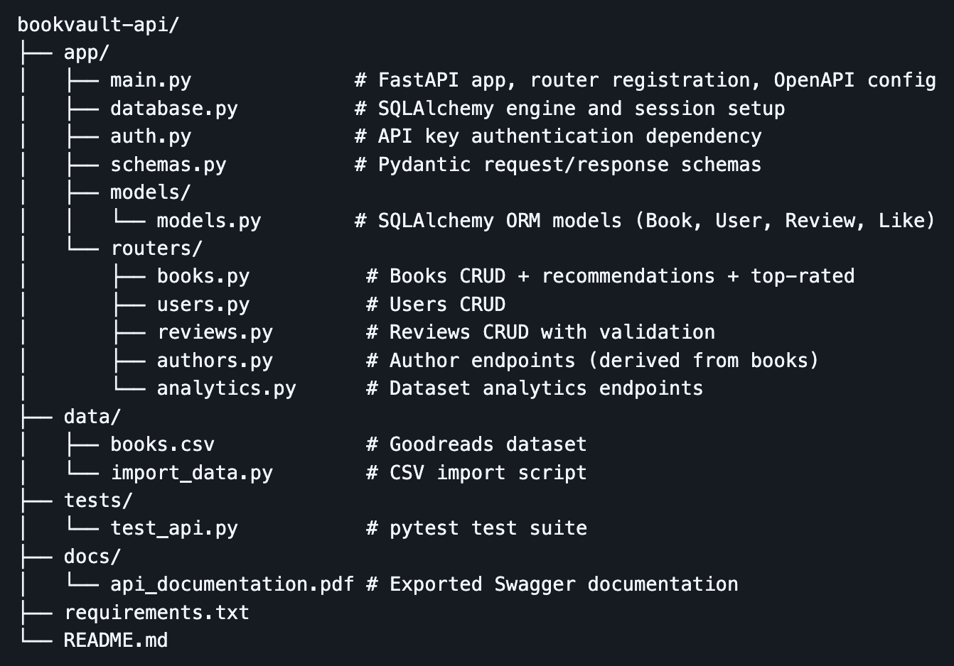
Architecture
The API uses a modular router-based architecture meaning that each resource has its own router file (stored in the routers folder) to separate endpoint logic for more manageable development.
Other components of the architecture such as authentication and database management are isolated into their own modules.
The main application file’s sole purpose is to initialize the app and register routes.

Slide 5
Demo
POST /users - create a user, authentication, 201 response
GET /books/ - browse books with filters, pagination, search params
POST /reviews – user-book relationship, validation
GET /users/1/reviews – retrieve and filter reviews, query params, JSON response shape
GET /reviews?book_id=1
GET /analytics/ - rating dist, top publishers, trends
https://bookvault-api-wth1.onrender.com/

Slide 6

Version Control
Throughout the project I used Git to incrementally commit changes, usually after every feature or fix. This way, each commit represents a unit of work, and it is easy to roll back to a previous working version to find a bug if the app stops working.
A git ignore file is used to remove any files that should not be committed such as .env files and .db files.
Database files are not committed for the purpose of keeping the repository lightweight. Since it is already easy to set up the app, it does not add much complexity to generate the database from the dataset on set up.
To imitate team environments, branches were used for distinct features.
One limitation would be that code reviews were not performed before each push or merge, which is a common practice in team-based development.

Slide 7

GenAI usage
Anthropic’s Claude AI was used all throughout this project in an assistive role and as a generative agent.
Firstly, Claude was used as a high-level planner and decision maker. It provided the pros and cons of each choice as well as a suggestion for the architecture and tech stack of the application.
It was used to generate file templates to make each feature easier to implement and iteratively develop. When bugs were discovered that were difficult to diagnose, Claude was used to identify the problems and solve them.
The test suite was also made with the help of Claude. The generated tests revealed some hidden errors in the database that had not been flagged yet.

Slide 8
Reflection
Challenges
Dataset swap mid-build - Original dataset lacked user rating metadata. Required refactoring multiple files and restructuring the project.
Tricky data bugs - Whitespace in CSV header and DB representation issues — simple fixes but hard to diagnose.
Lessons Learned
Understand data first - Exploring the dataset before designing endpoints avoids costly rework.
Modular design pays off - Router-based separation made debugging and iteration much faster.
Future Work
In the future, I would add a recommendation endpoint that, given a book by ID, returns similar reads.

